Slide 1
LC: Can I find out about the Jewish festival of Purim?
This will include looking at:
- Who celebrates this?
- How is it celebrated?
- Why is it celebrated?
- Any key individuals
This year the festival of Purim begins on Thursday 25th February and ends on Friday 26th February.
This week you will use an information powerpoint and a video to learn more about the Jewish festival of Purim.
Then we would like you to create a mind map of what you have found out.
What are the key facts?
Use an LC and a date.

Slide 2
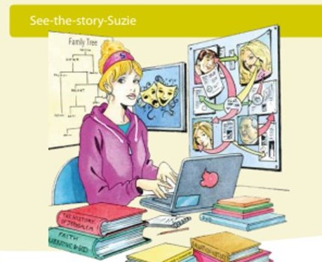
Today we will be See- the- story-Suzie.
Remember, she looks at stories to see how religions are shaped and why a religion chooses to do certain things.

Slide 3

Purim is a Jewish festival
This year it starts on 25th February and ends on the 26th February (today!).
It is always one month before Passover.
It commemorates the time when the Jewish people living in Persia were saved by a young, courageous woman named Esther.

Slide 4
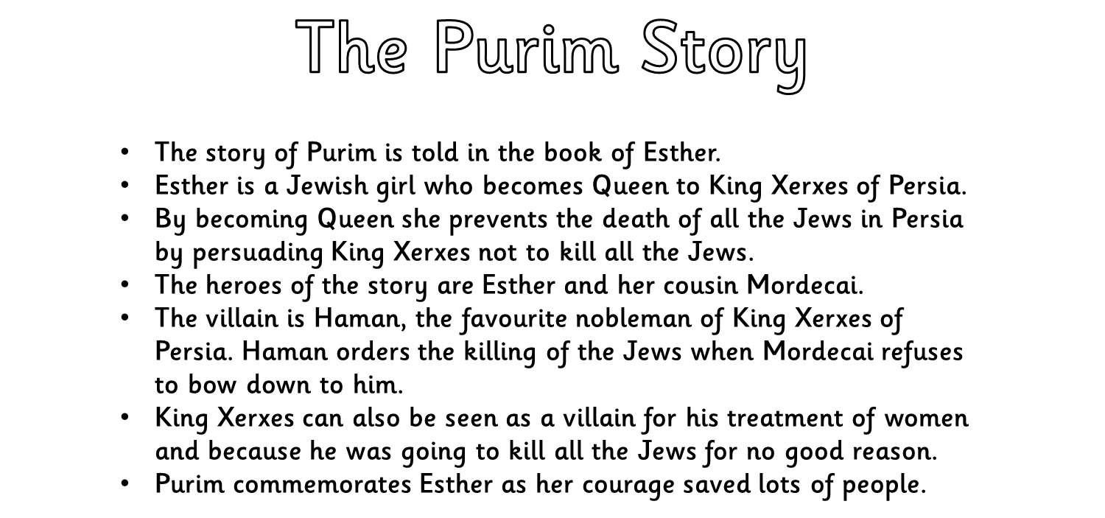
Please also use the additional PowerPoint called:
The story of Esther

Slide 5

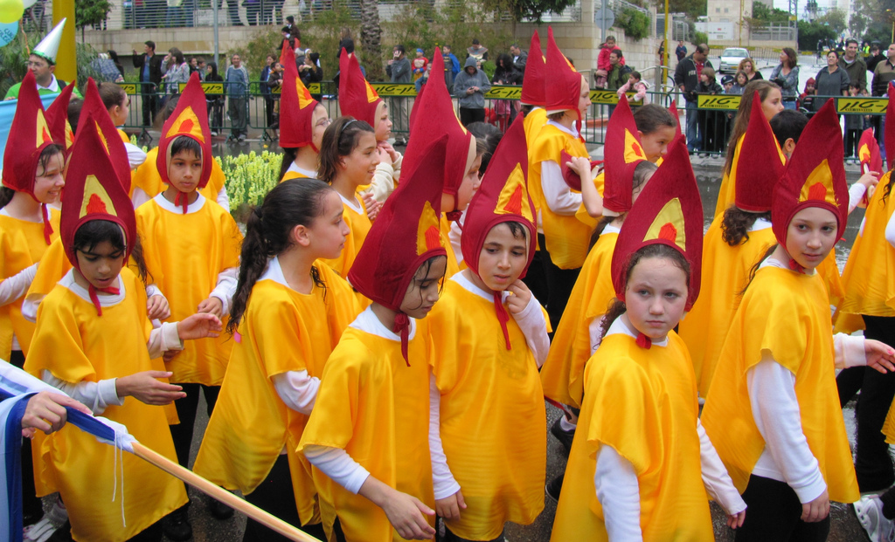
Photo courtesy of Lilachd (@flickr.com) - granted under creative commons licence - attribution

Slide 6
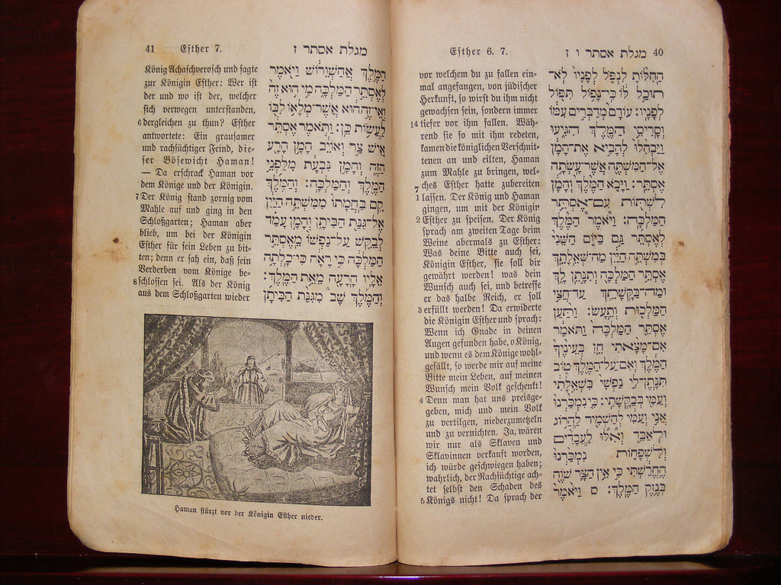
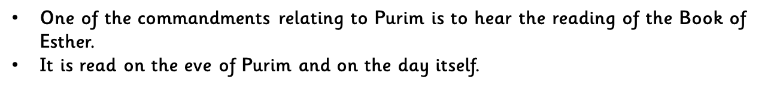
Photo courtesy of gruven_rueven(@flickr.com) - granted under creative commons licence - attribution

Slide 7
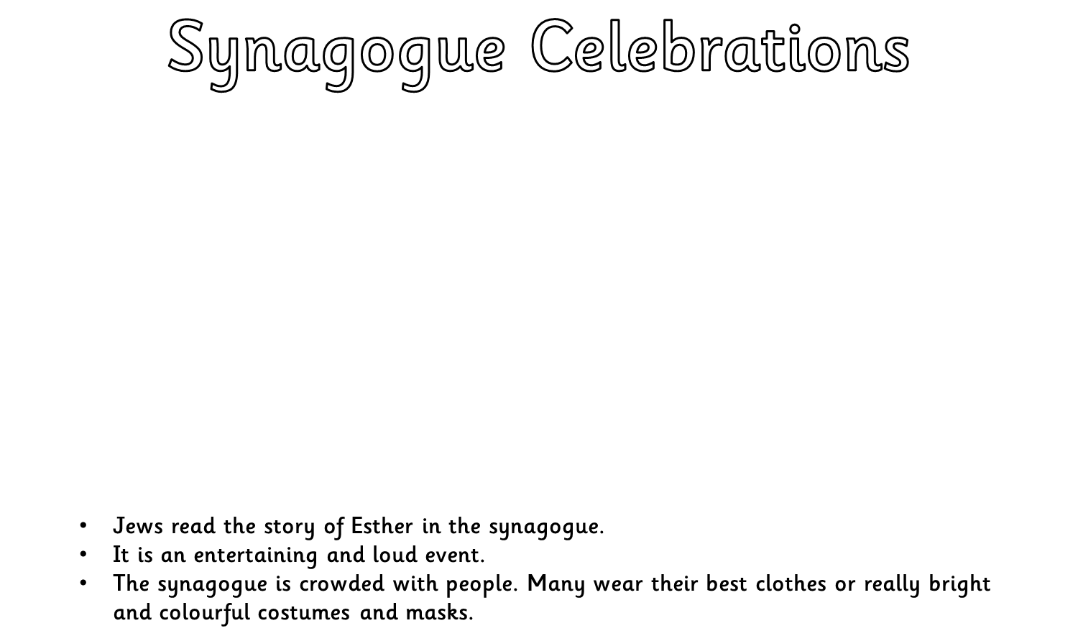
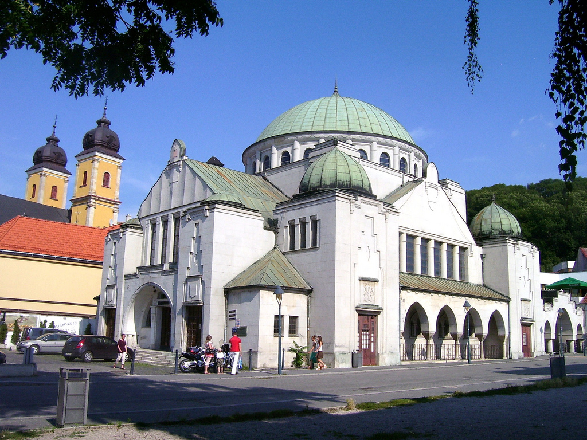
Photo courtesy of Lilachd (@flickr.com) - granted under creative commons licence - attribution

Slide 8
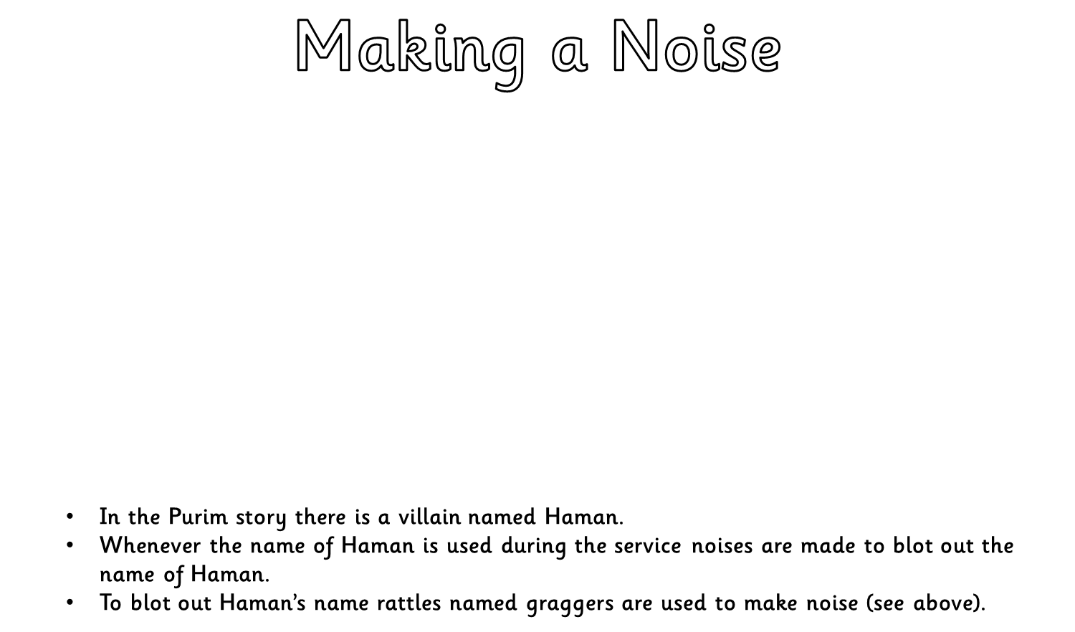
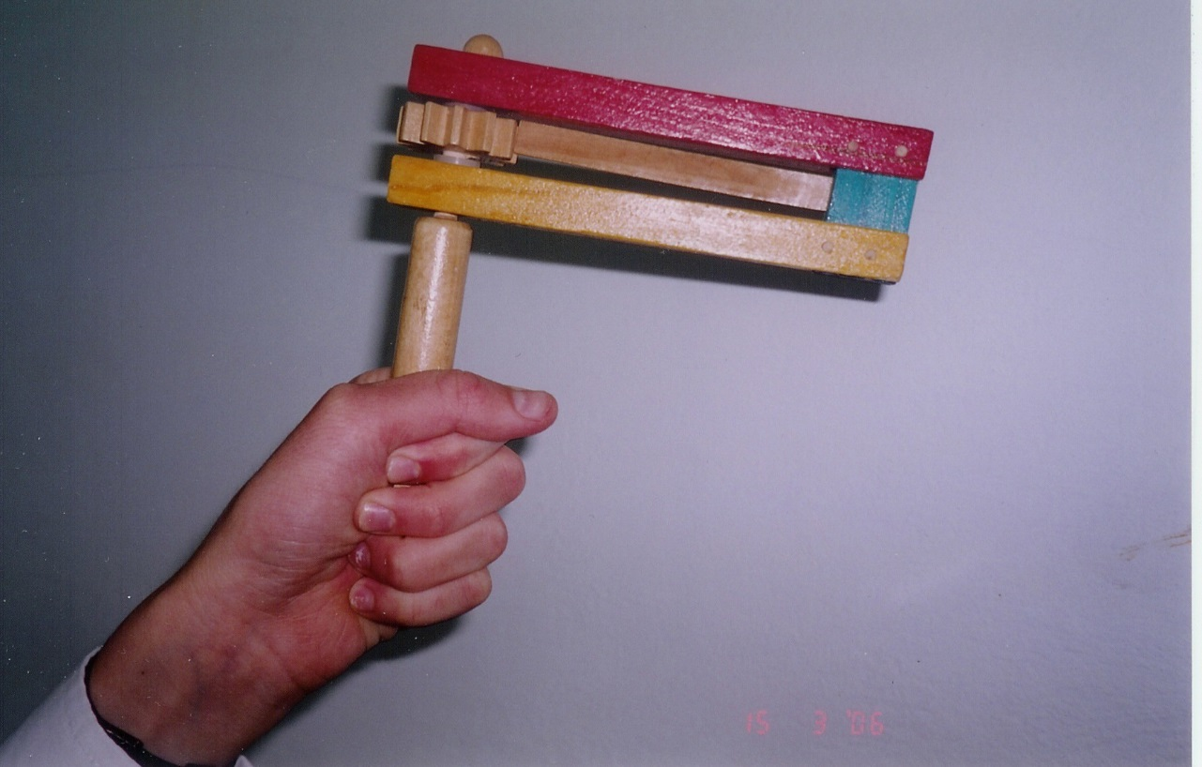
Photo courtesy of Yoninah (@Wikimedia Commons) - granted under creative commons licence - attribution

Slide 9
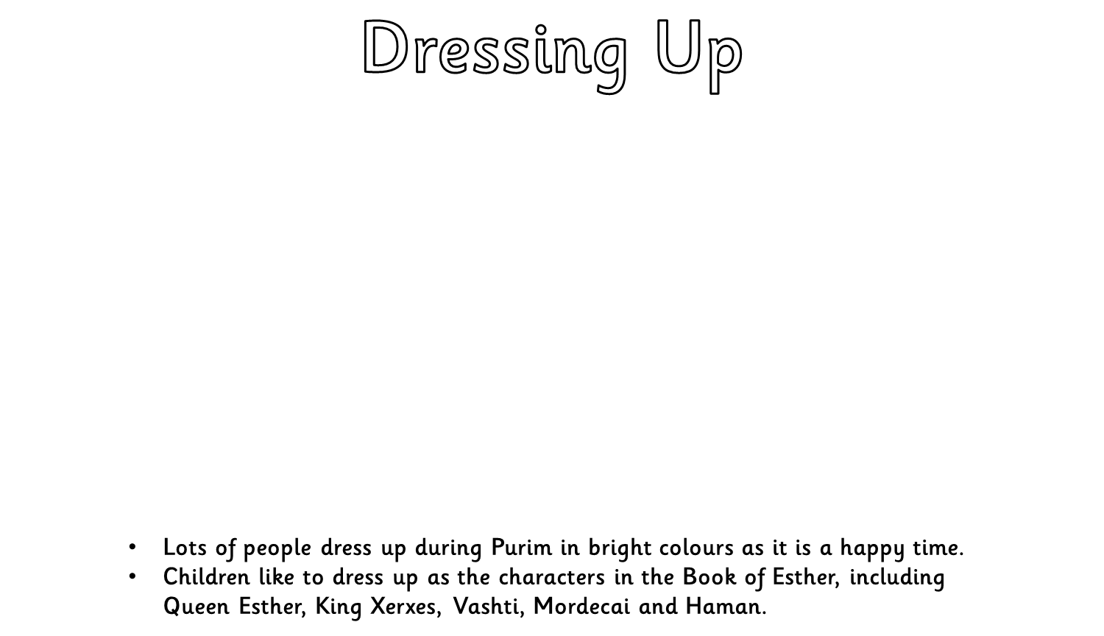
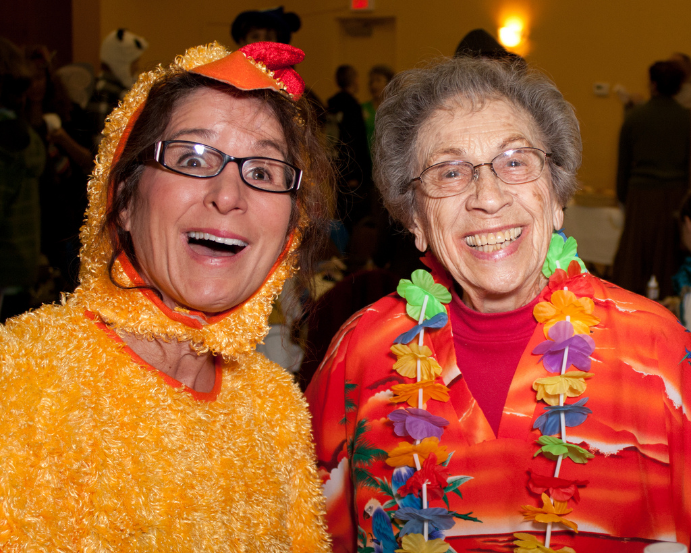
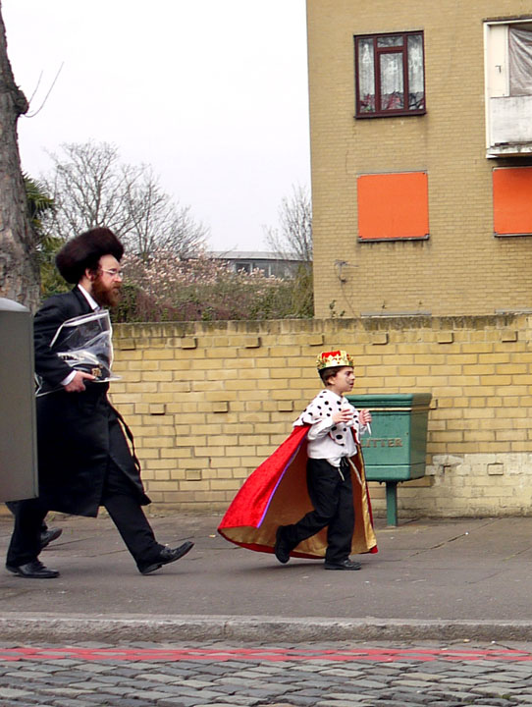
Photo courtesy of **RCB** , Alan Denney - granted under creative commons licence - attribution

Slide 10
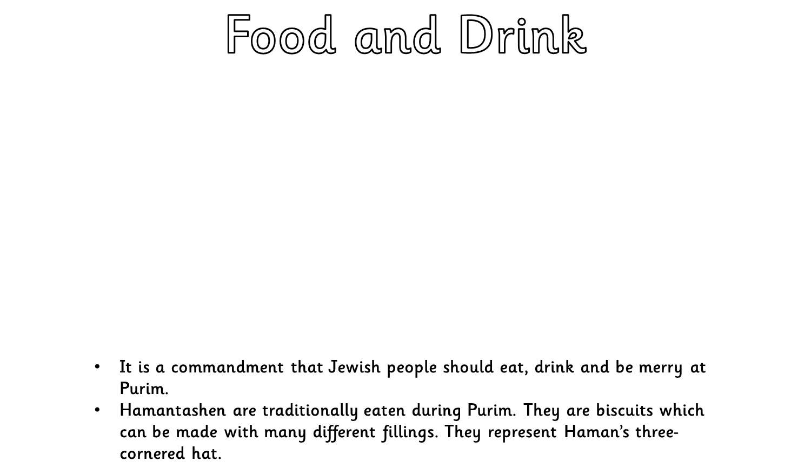
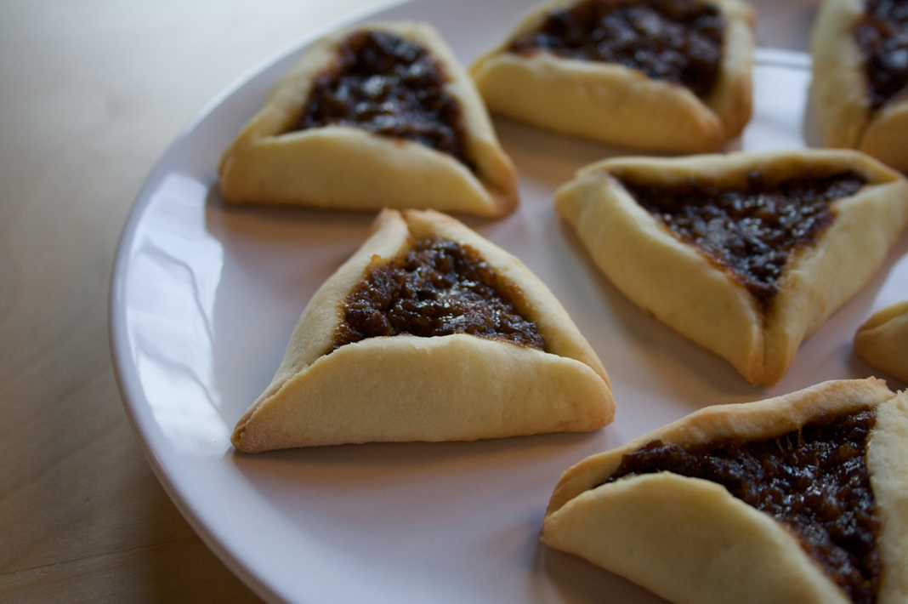
Photo courtesy of nate steiner - granted under creative commons licence - attribution

Slide 11
There are some videos on this link.
Here you will watch as two children prepare for and celebrate the festival of Purim.
You can also watch a cartoon of the story of Queen Esther.
https://www.bbc.co.uk/cbeebies/watch/lets-celebrate-purim

Slide 12
Task
Use the information from the two PowerPoints and videos to create a mind map, or information poster about the festival of Purim.

