Slide 1

Warm Up – Can you spot the mistakes?
Witch was the right way home?
Cleverly the king was disguised.
Silently Nyasha crept through the jungle.
The two sisters where very different.

Slide 2
LC: Can I punctuate speech correctly?
Yesterday, you wrote a conversation between Nyasha and Nyoka using speech bubbles.
Today you are going to write your ideas up as a conversation using inverted commas.

Slide 3
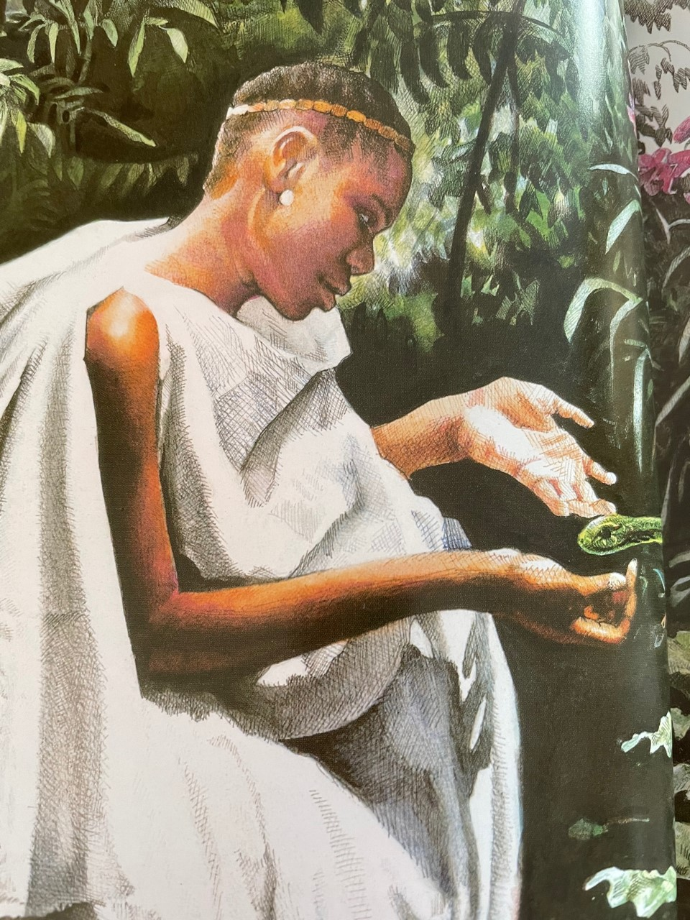
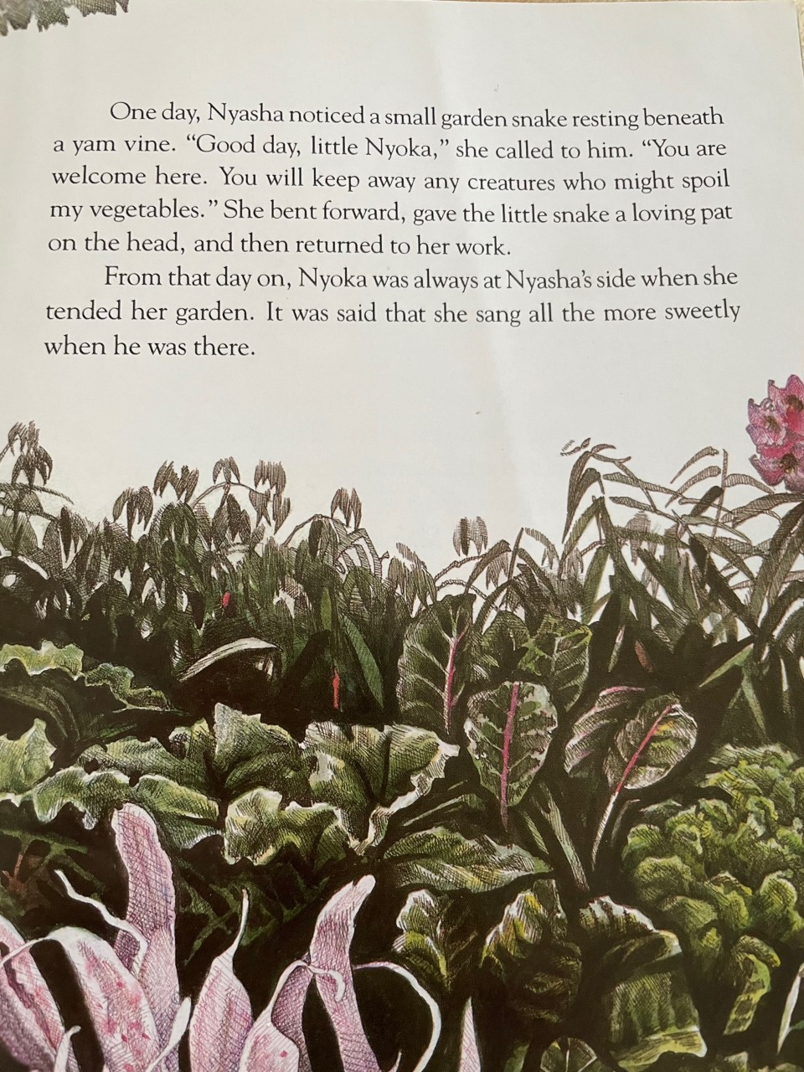
Your speech bubbles showed an imaginary conversation bewteen Nyoka and Nyasha.

Slide 4
How do we move from speech bubbles to punctuating speech correctly?
You are so precious to me and a very kind pet.
Nyasha
I really love to see you.
You are so lovely and kind.
Nyoka

Slide 5
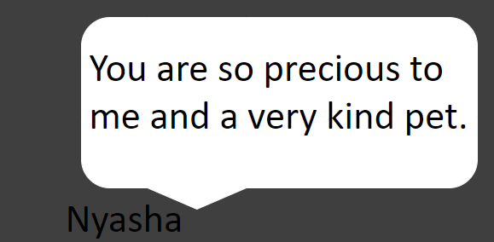
LC: Can I punctuate speech correctly?
Toolkit:
Put inverted commas around what has been said and include punctuation before you close the inverted commas.
" You are so precious to me and a very kind pet," said Nyasha

Slide 6
LC: Can I punctuate speech correctly?
Toolkit:
Start a new line for each speaker
" You are so precious to me and a very kind pet," said Nyasha.
" I really love to see you. You are so lovely and kind," said Nyoka.

Slide 7
LC: Can I punctuate speech correctly?
Toolkit:
Remember to say who is speaking. This can go at the beginning or the end. You can also use synonyms for 'said'.
" You are so precious to me and a very
kind pet," whispered Nyasha.
Nyoka replied gently, " I really love to see you. You are so lovely and kind,".

Slide 8
LC: Can I punctuate speech correctly?
Today you need to write up your conversation, punctuating correctly.
Don't forget the toolkit we discussed.

