Slide 1

Warm Up – Can you spot the mistakes?
Angrily Manyara pushed her sister.
When will I reach the palace
It wos such a long journey
She should of taken the right route.

Slide 2
LC: Can I write a monologue?
Today, you will be writing a monologue.
You will practice using inverted commas for speech.

Slide 3
LC: Can I write a monologue?
Toolkit:
Inverted Commas
First person
Include feelings and emotions.

Slide 4
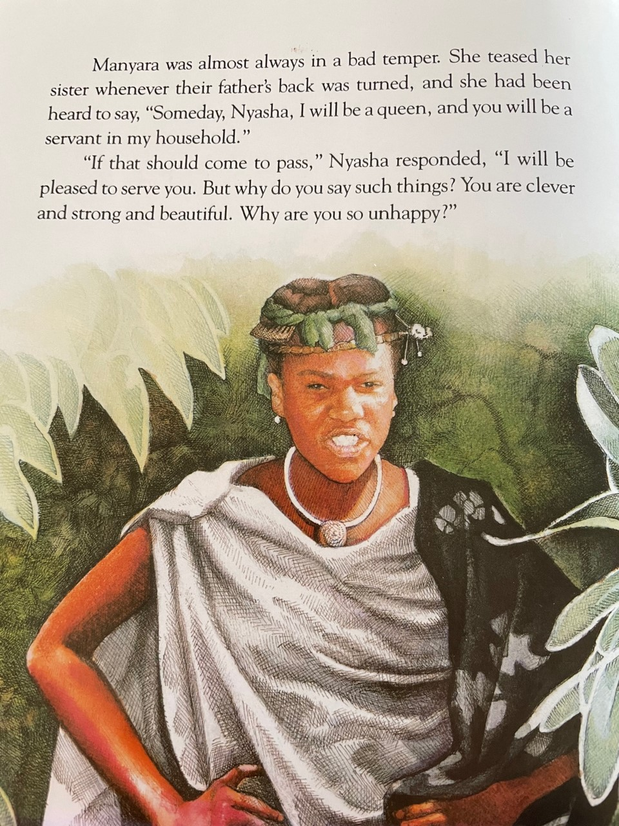
Let’s take a look at pages 3 and 4 again.

Slide 5
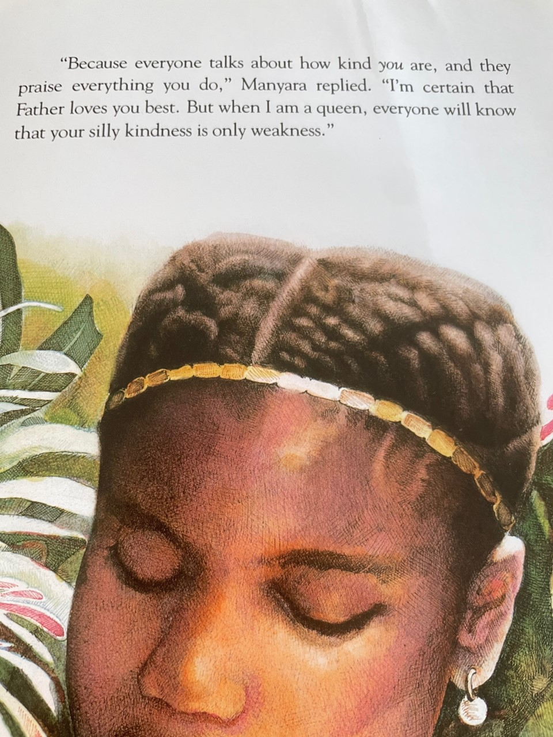
Let’s take a look at pages 3 and 4 again.

Slide 6
How do you think Nyasha is feeling?
What do you think she wants to say to her sister?
Note down some ideas in chat.

Slide 7
Idea Bank:
Sad that my sister is always unkind to me.
Confused as I am always kind to my sister.
Angry that our father doesn’t notice.
Lonely as I’d like to have fun with my sister.

Slide 8
LC: Can I write a monologue?
Write a monologue to say how she is feeling. Remember that it does not need to be long.
You can use the idea bank if you are stuck.

Slide 9
What might it look like in my book?
Here are a couple of sentences you may want to magpie to get you started:
“ I am so sad and upset today. I just cannot understand her! Why doesn’t she like me and want to be a kind sister!”

Slide 10

Extension:
Create a conversation between Nyasha and her sister Manyara.
Use inverted commas to show dialogue and remembe
Use

