Slide 1
LC: Can I recognise fractions with equivalence of ½ and 2?
4
Today we are looking at different fractions which have the same value.
What does equivalent mean? What symbol do we use?

Slide 2

Fold your strip of paper in half.
Now fold in half again. Can you tell me which fraction is the same as one half?
1
2
2
4
=

Slide 3
Finding ½ and 2 of an amount
4
Work this out using a set of objects or you can draw dots to represent objects.
Find ½ and 2 of:
4
4
12
8
What do you notice?

Slide 4
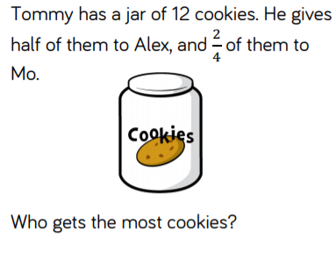
2
1 is the same as
2 4
Now answer:

Slide 5
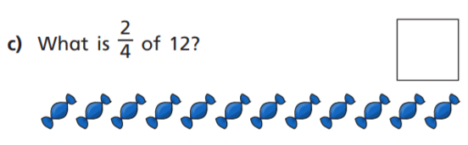
How can we solve this?
What if it was ¾?

