Slide 1
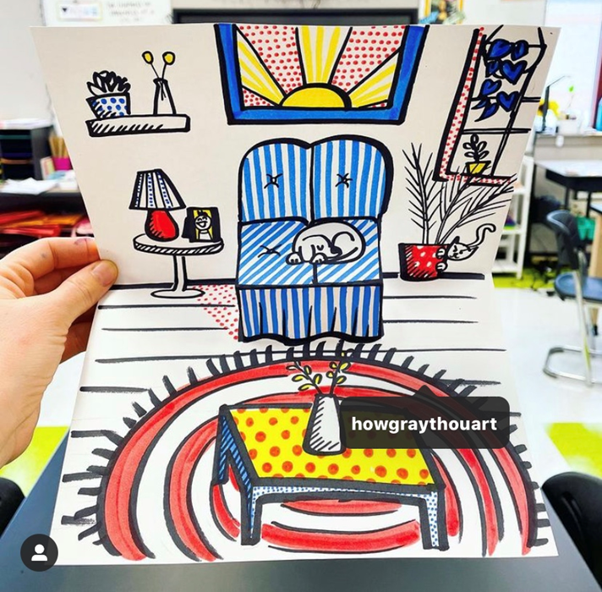
Pop-up room
art

Slide 2
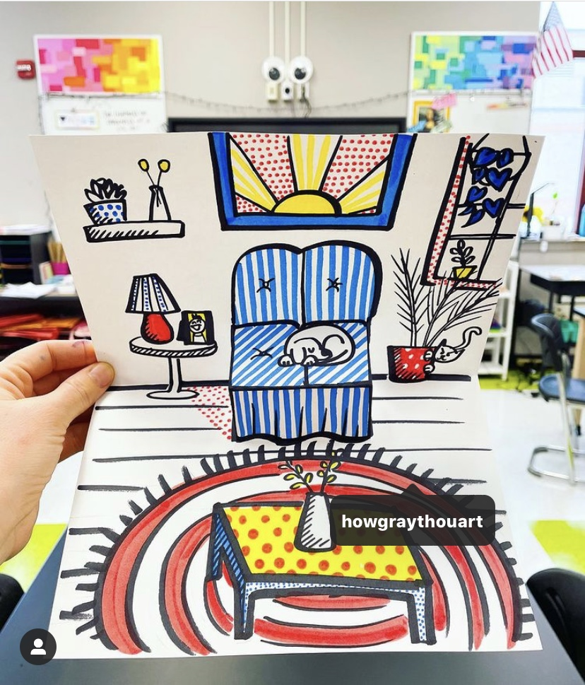
Pop-Up Room Art
We have been spending a lot more time in our homes and bedrooms recently due to lockdown. Perhaps you’ve been daydreaming about how you’d like your room to look… Today we are going to do an activity where we get to design our own room with a fun pop-up element. You can design your dream bedroom or whatever room you like. Follow the instructions and pictures below. I can’t wait to see what you make! ☺

Slide 3
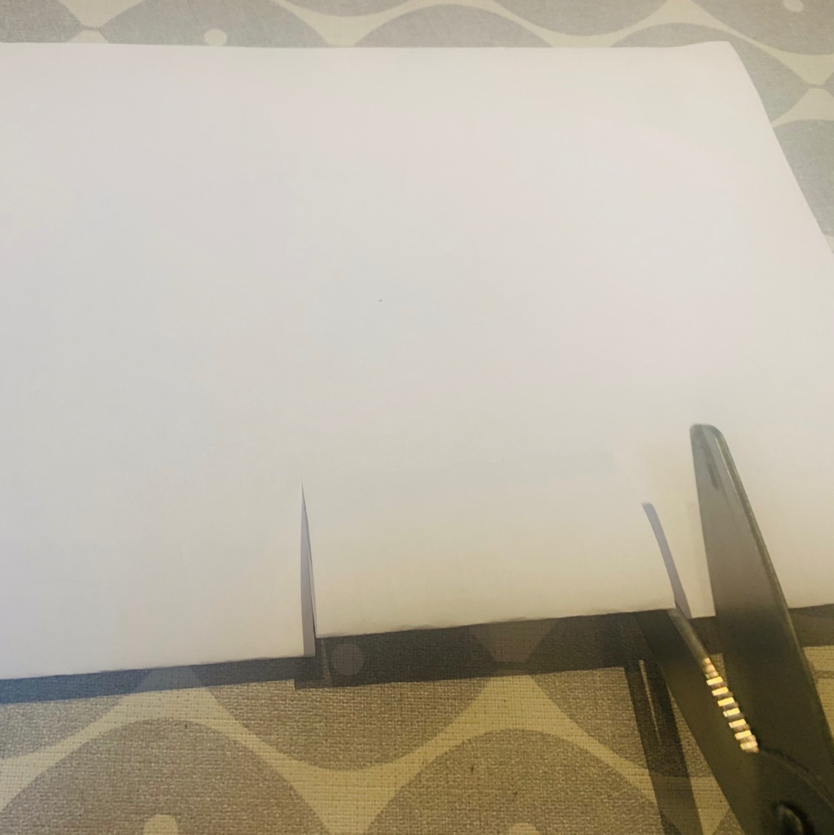
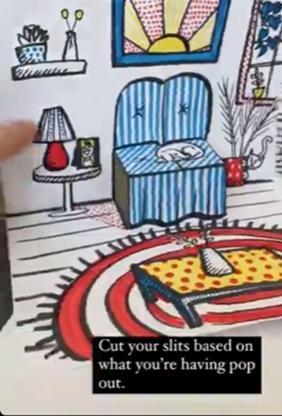
1. Fold paper in half (A4 works well) and make two cuts as shown. This will form your pop-up element (a sofa, table, bed etc.)

Slide 4
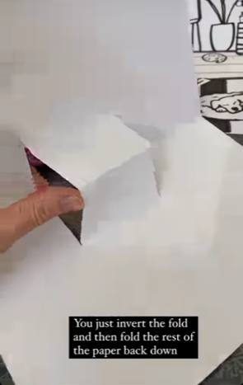
2. Open paper out and invert cut piece (this is the hardest part).

Slide 5
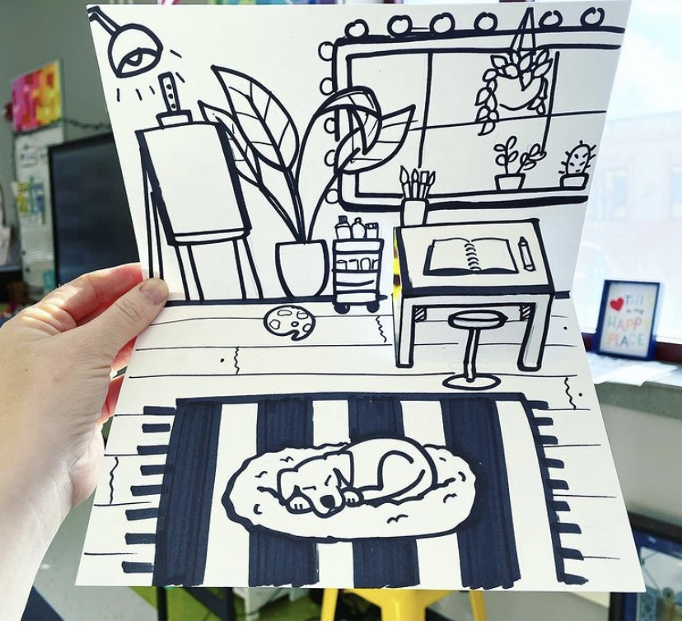
3. Draw your room. This one has been in black pen so you can see the drawings but you can draw your design in pencil. Think about what you would like in your room and how each item would look based on where it is. Will you include your pet or a dream pet? Make it as exciting and creative as you like and then colour it in in whatever medium you like. Most importantly, have fun!

Slide 7
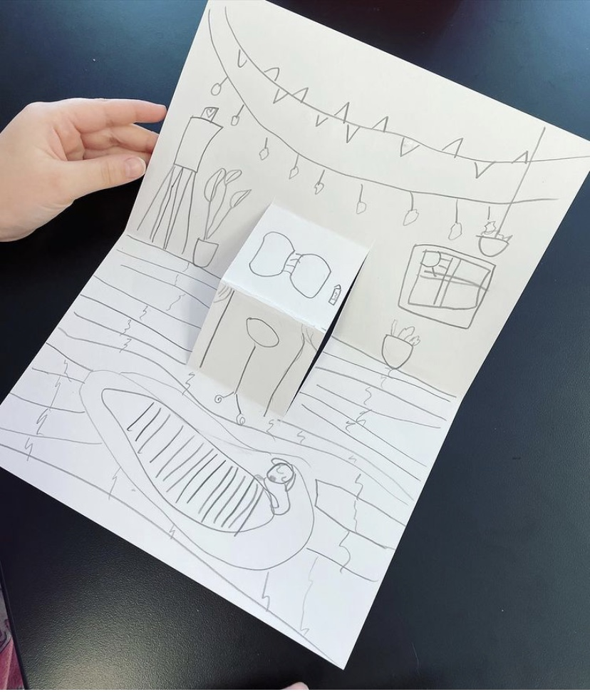
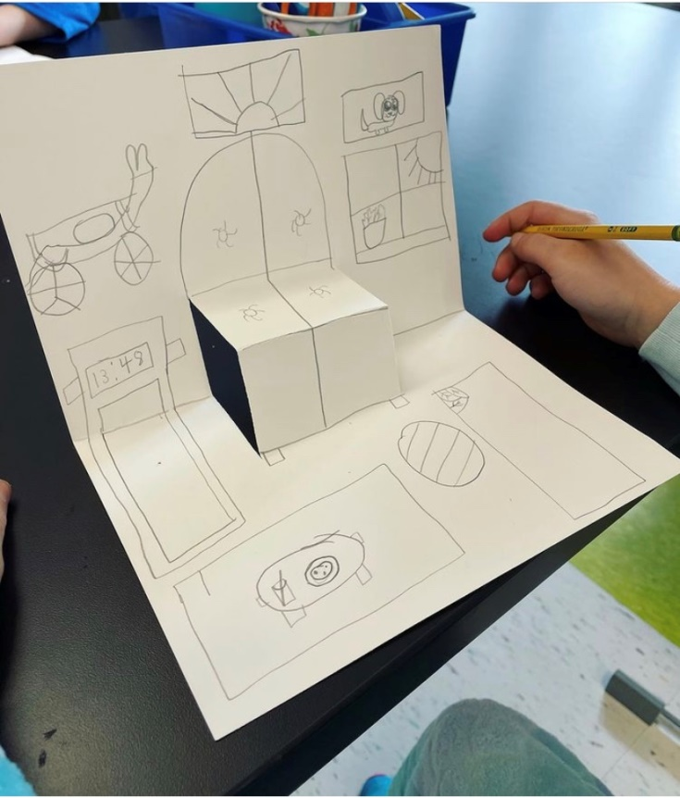
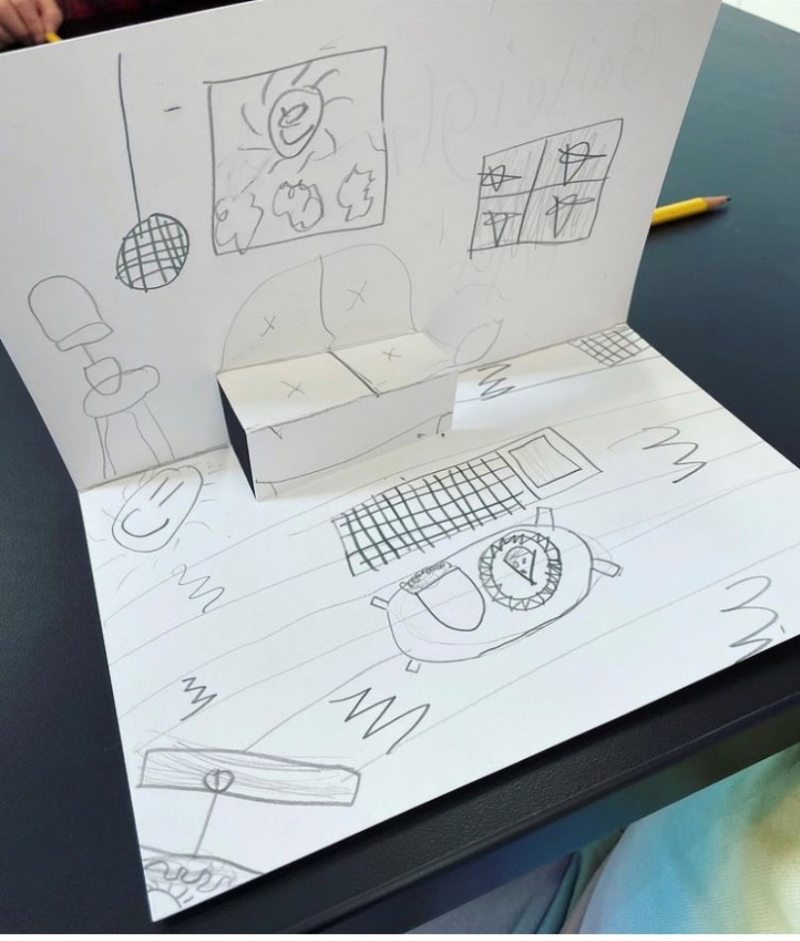
Here are some rooms designed by other children…

