Slide 1

ENGLISH

Slide 2
Lesson 3
Text Research
Today, we are going to continue our research about whales.
This time, we will be finding our information from a range of texts.

Slide 3


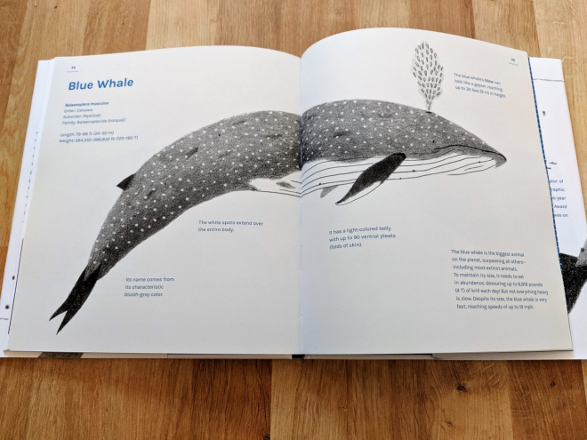
Lesson 3
Where Do I Begin with a text?
When you first open a book, especially for a complex subject,
it can be a little overwhelming.
The idea that you have to look
at all this information and pick
out the important parts can be
very overwhelming.
  Where do I start?
  How do I know which
  information is important?
  How can I shorten the sentences?

Slide 4
Lesson 3
Scan for Key Words
Think of the important words that
link to what you want to find out.
Quickly scan the text for these words.
Only read the parts of the text
that contain your key words.

Slide 5
Lesson 3
Skim for Important Facts
Once you have found the correct section,
you do not have to read every single word.
Skim over each sentence,
taking in the important facts.

Slide 6
Write down Only the Key Information
Lesson 3
Decide what is most important
and write that down.
Only write down key words and phrases;
you do not need to write in full sentences.

Slide 7
Lesson 3
Today's task:
Continue to add notes to your chosen methods (concept map, post its etc.)
There are some texts in the folder. On these texts, use a highlighter pen, felt pen or pencil crayon to underline or highlight key pieces of information.
If you have your own books – great! Just don't underline or write in these.
Don't have your own books? Don't worry! There's a couple of links on the next slide that may help too.
Challenge: You might even be able to develop a key and underline different categories of information in different colours.
There are a range of texts provided. YOU DO NOT NEED TO READ ALL OF THEM.
This week's Thursday Reading directs you to BUG CLUB but no additional comprehension has been set so you can use some of tomorrow's reading time on this activity too.

Slide 8





https://www.youtube.com/watch?v=fN82J3KEqfI
https://www.youtube.com/watch?v=6eFnKn-zROU
https://www.youtube.com/watch?v=GsgkvClnbXc
https://www.youtube.com/watch?v=lG9iVNhZV4c
https://www.youtube.com/watch?v=cGJtipHplps

Slide 9
ENGLISH

