Slide 1
Year 2 Maths Revision
LC: Can you add two 2 - digit numbers (not crossing 10)?

Slide 2
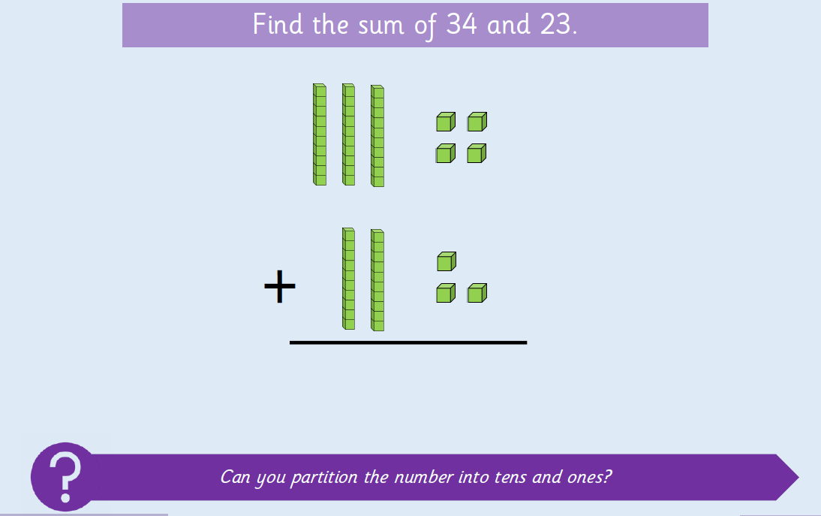
Remember, add the ones then add the tens.

Slide 3
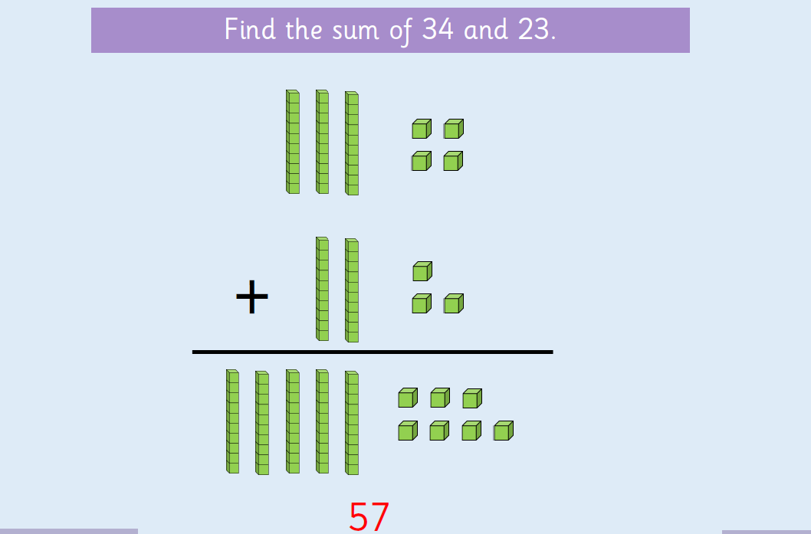

Slide 4
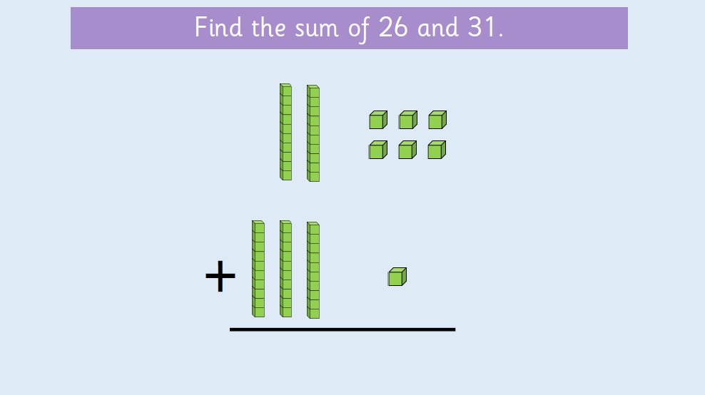
Remember, add the ones then add the tens.

Slide 5
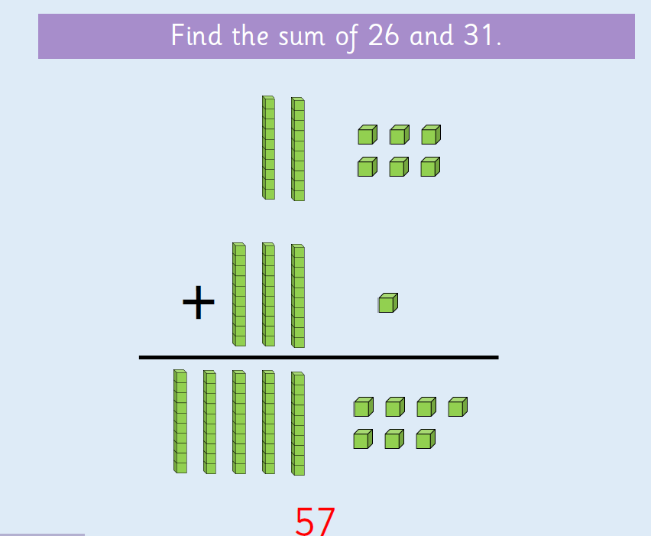

Slide 6
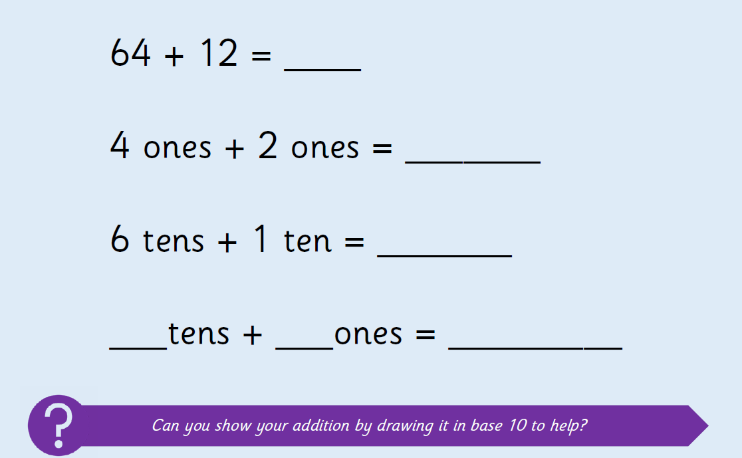
Remember, draw sticks for tens and dots for ones.

Slide 7
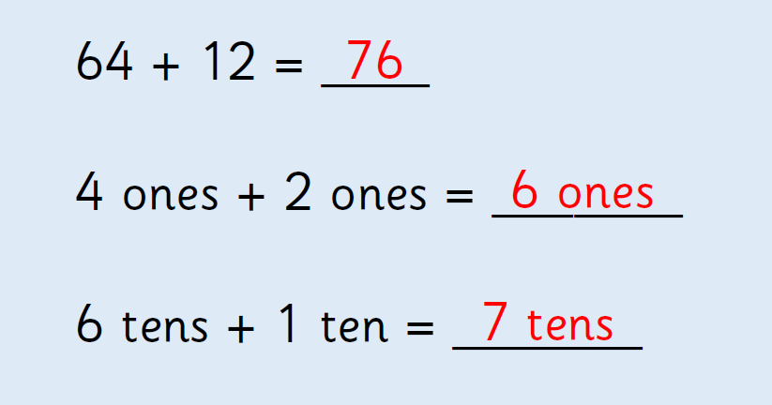

Slide 8
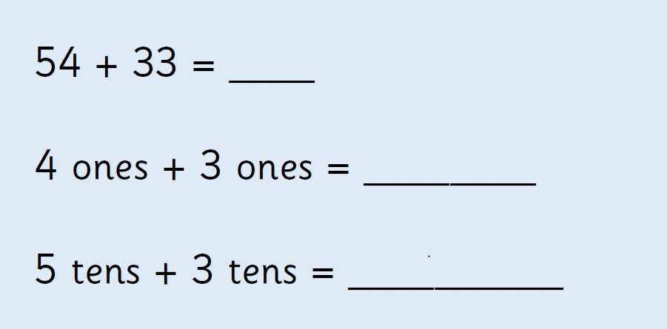
Remember, draw sticks for tens and dots for ones.

Slide 9
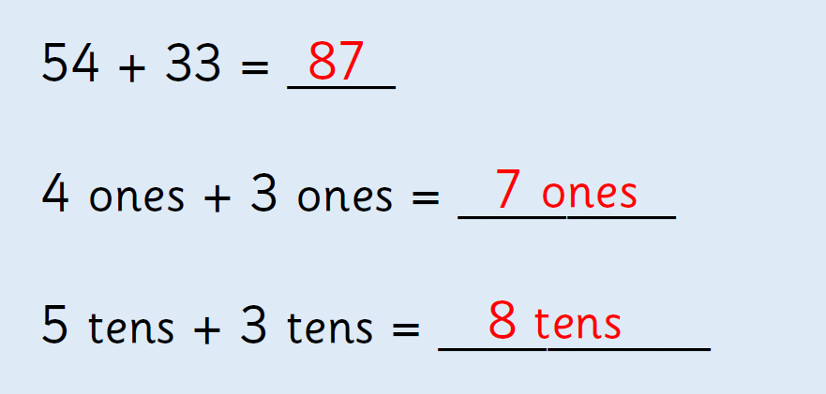

Slide 10
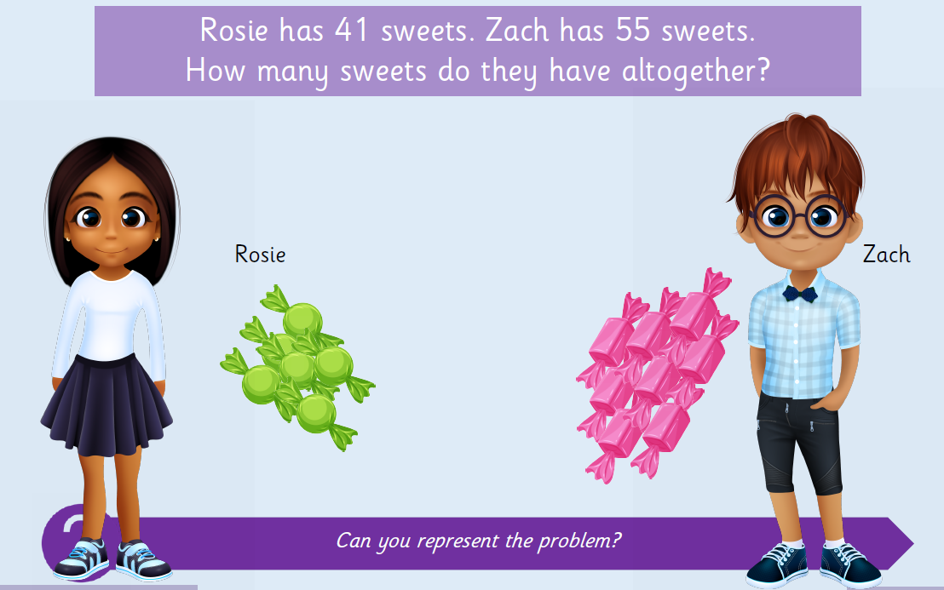
Have a go on paper or a whiteboard.
Remember, draw sticks for tens and dots for ones.

Slide 11
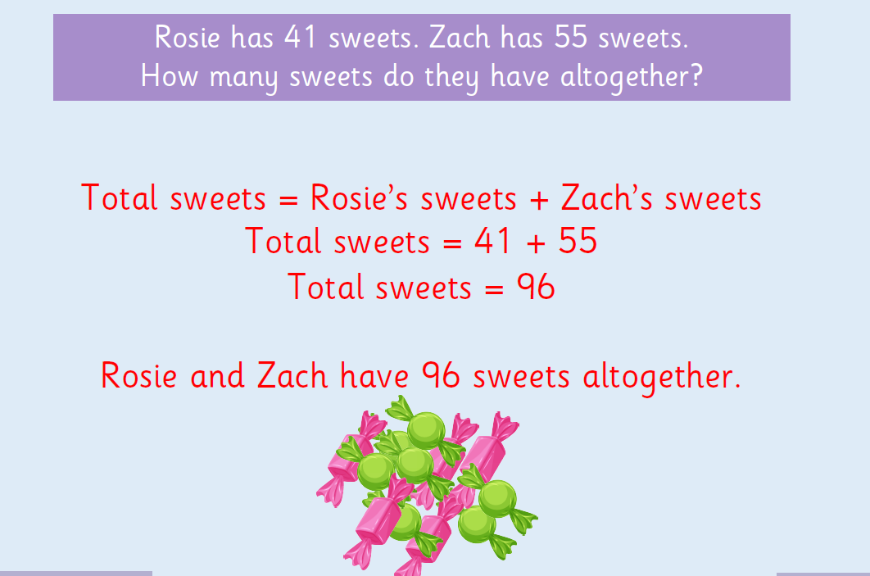

Slide 12
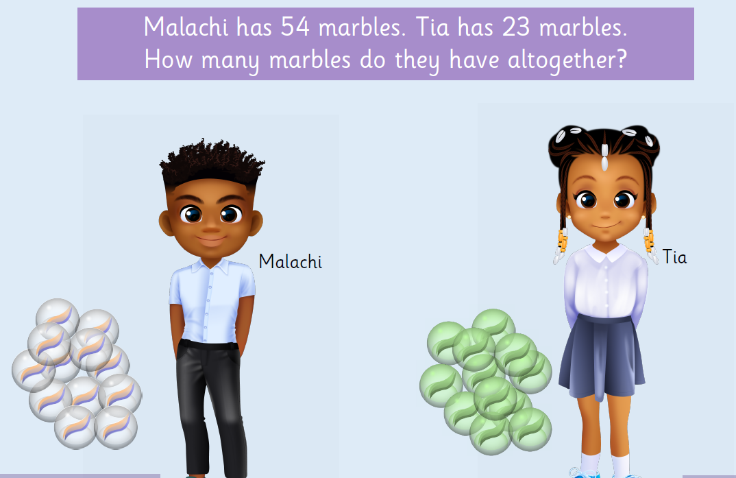
Have a go on paper or a whiteboard.
Remember, draw sticks for tens and dots for ones.

Slide 13
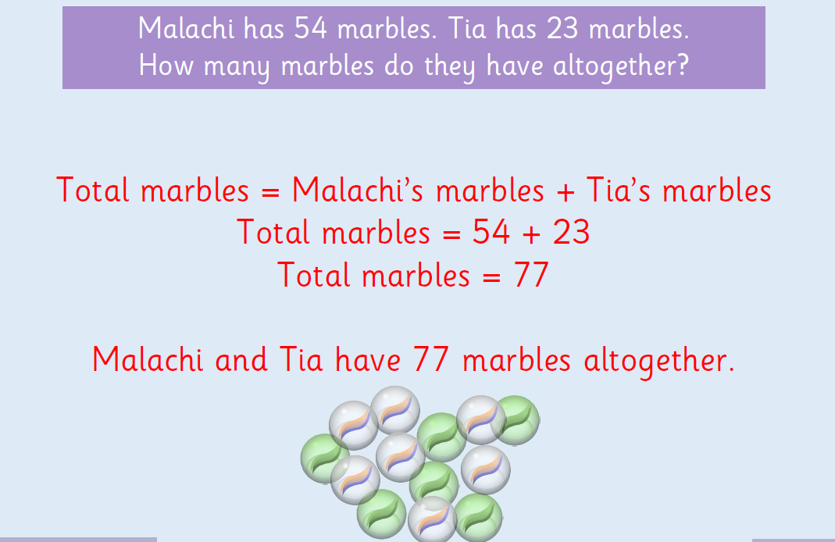

Slide 14
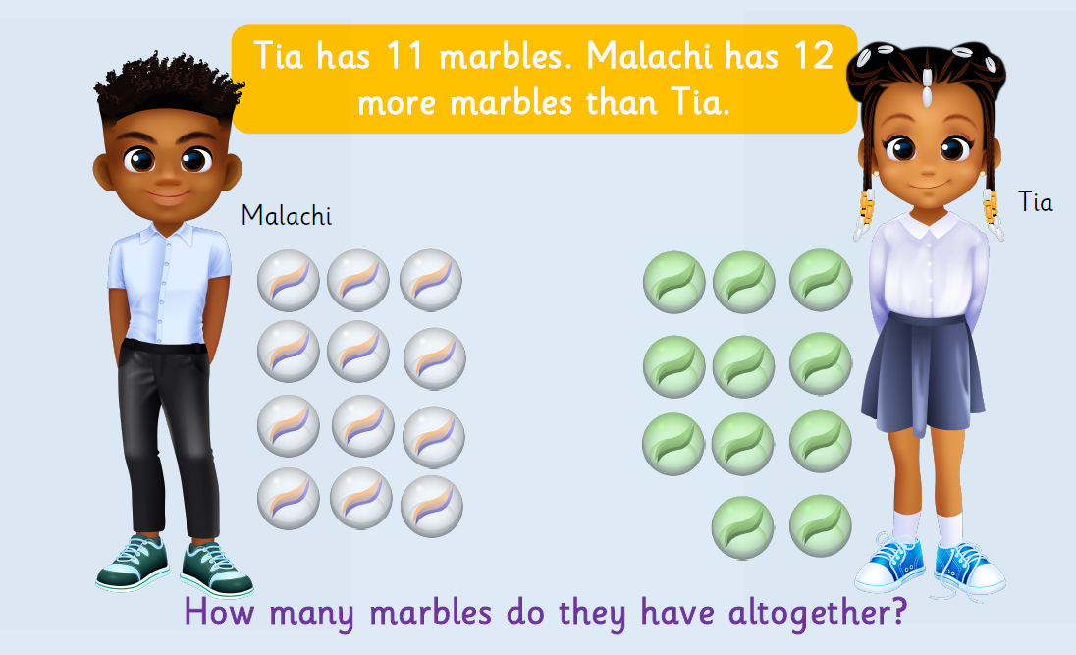
Have a go on paper or a whiteboard.
Remember, draw sticks for tens and dots for ones.

Slide 15
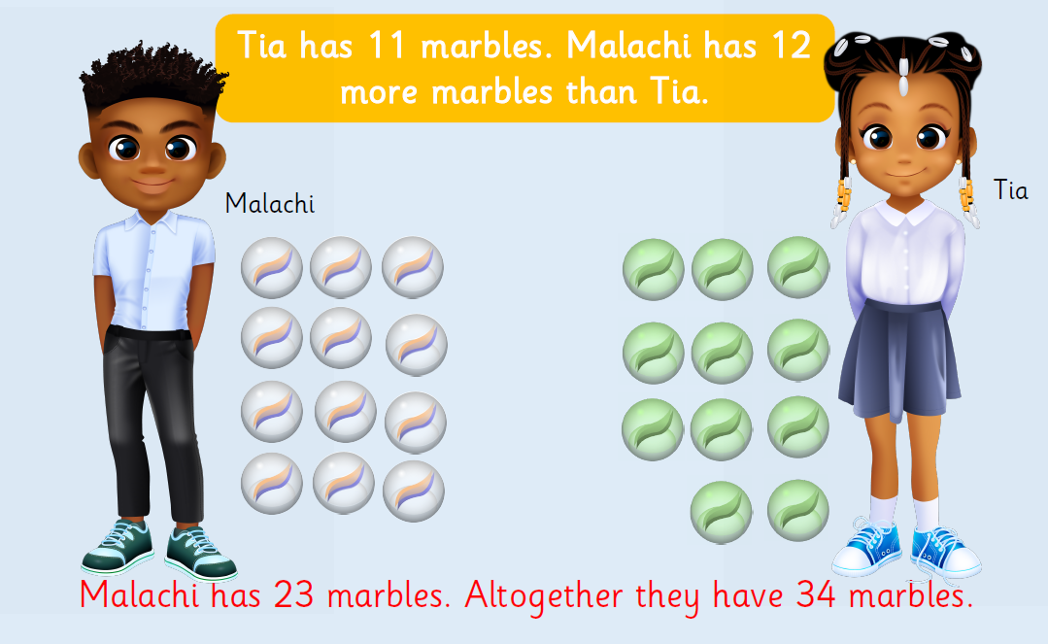

Slide 16
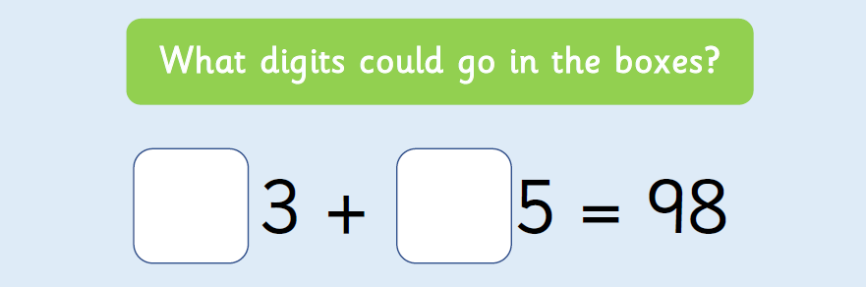
How many pairs of numbers can you find?

Slide 17


