Slide 1
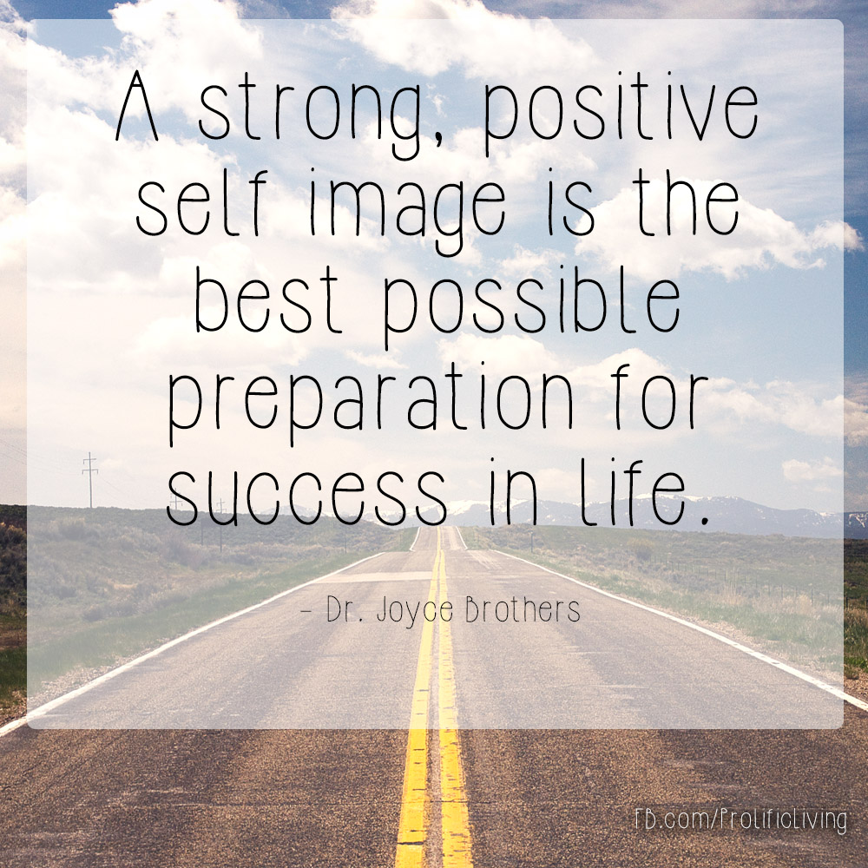
E- Safety Warm Up
Our theme for this half term is our self-image.
Does anyone use:
Snap chat
Instagram
Tik Tok?

Slide 2
E- Safety Warm Up
While these platforms may be fun to use, remember that sometimes they may put pressure on people to behave or to look a certain way.
We will be looking at this more when we are back in school.
Do you ever feel pressure to look or behave a certain way after looking at media sites online?
Who might you talk to if you do feel under pressure?

Slide 3
What do you think a positive self image is?
Are you aware that a lot of images we see online are not 'real' but manipulated to look 'better'?
Can you name 3 fabulous things about yourself.

Slide 4

This half term, we are moving back to coding.......
There will be plenty of different games and activities, which you will be able to practise at home.

Slide 5
Recap on coding vocabulary
Can you remember what these coding words/phrases mean and why we use them?
Algorithm
Tinkering
Debugging
Decomposition
Using repeat blocks
Conditional statements

Slide 6
Recap on coding vocabulary
Algorithm – a set of instructions to complete a task
Tinkering – investigating, trying things out, finding out what works and what doesn't
Debugging – finding a mistake in a programming sequence and correcting it
Decomposition - breaking a problem down into smaller pieces
Using repeat blocks – instead of writing a lot of lines of code, we can just write something once and put it in a repeat block
Conditional statements – using the 'if' and 'else' blocks so that something can only be done if certain conditions are met

Slide 7
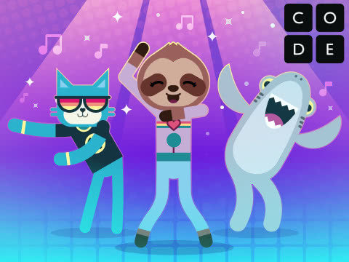
We all have lots of different ways to be creative. What might these normally include?
- drawing
- building
- painting
- dancing
- gymnastics
Today we're going to see how we can combine coding with dancing in a creative way.

Slide 8
Recap – key coding vocabulary in this activity.
code - (v) to write code, or to write instructions for a computer.
Event - An action that causes something to happen.
Program - An algorithm that has been coded into something that can be run by a machine.

Slide 9
Let's watch this video which tells us about Dance Party.
Code.org - Dance Party (2019)

Slide 10
Now it's over to you. You have the time to plan your own Dance Party.
Code.org - Dance Party (2019)

