Slide 1
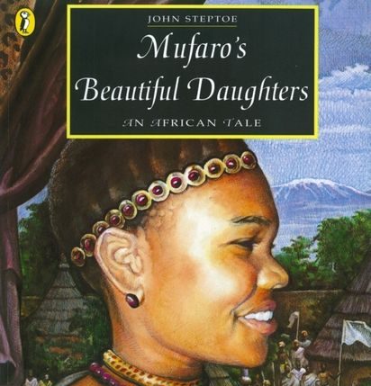
Warm Up
In the chat, can you write down at least one detail about the story?
Chilli Challenge: Can you think of a quick summary for the story to share with the class?

Slide 2
LC: Can I look at 2 characters from a story?
Today, you will be doing an English activity called 'Role on the Wall'.
It will help you to look at the 2 sisters in the story and write about them.
The role on the wall is to be submitted via Teams.

Slide 3
LC: Can I look at 2 characters from a story?
First, let's recap the key main characters and how they link to one another.

Slide 4
Key characters
Father – 2 daughters. One kind, one unkind
King – looking for marriage.
Does the story remind you of a similar traditional story?

Slide 5
Role on the wall.
In your books, you are going to carefully draw an outline of 2 people.
Label one character Manyara and the other one Nyasha.

Slide 6
Role on the wall.
On the outside, write:
How they look.
What other people think about them.
How they behave to other people.

Slide 7
Role on the wall.
On the inside, write:
What they think of themselves.
Their personality
Any secrets they may have.

Slide 8
You can listen to the story again if you need to remind yourself of the details.
Mufaro's Beautiful Daughters - Read Aloud - YouTube

Slide 9

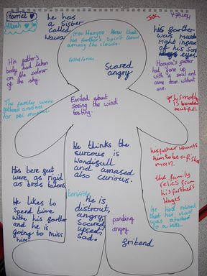
Role on the Wall.
What does it look like?
This is an example of another primary school child's work based on a different book. It gives you a good idea of how your two characters should look in your book.

