Slide 1


Slide 2
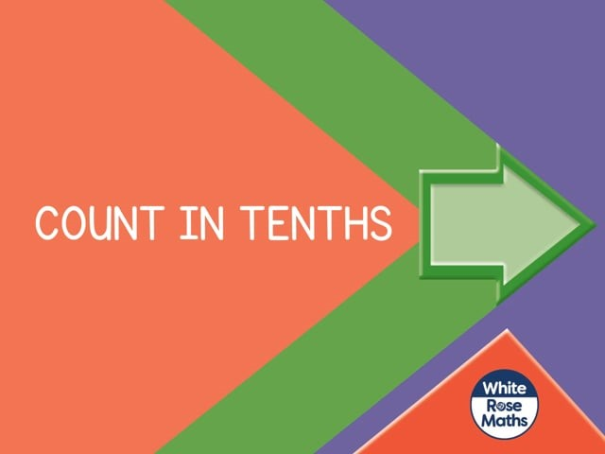

Slide 4



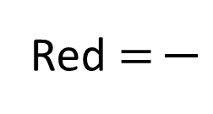
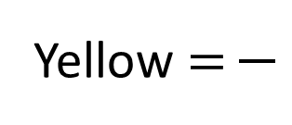
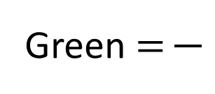
What fractions of the cubes are each colour?
Which of the fractions above are unit fractions?
Which of the fractions above are non-unit fractions?
Yellow $=$
Red $=$
Green $=$

Slide 5
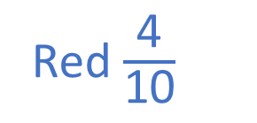


What fractions of the cubes are each colour?
Which of the fractions above are unit fractions?
Which of the fractions above are non-unit fractions?
5
4
1
Yellow $=$
Red $=$
Green $=$
10
10
10
Green $\frac{\text{1}}{\text{10}}$
Yellow $\frac{\text{5}}{\text{10}}$
Red $\frac{\text{4}}{\text{10}}$

Slide 7
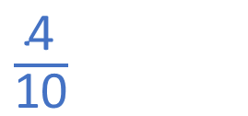
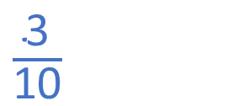
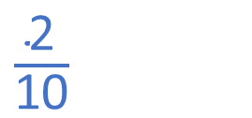
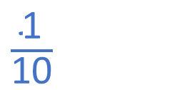
What fraction are yellow?
$\frac{\text{1}}{\text{10}}$
0
$\frac{\text{2}}{\text{10}}$
$\frac{\text{3}}{\text{10}}$
$\frac{\text{4}}{\text{10}}$

Slide 8
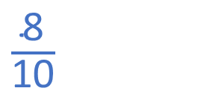
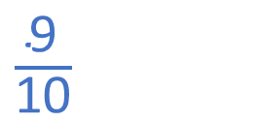
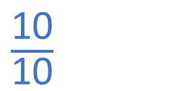
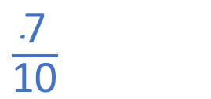
What fraction are yellow?
$\frac{\text{1}\text{0}}{\text{10}}$
or 1
$\frac{\text{9}}{\text{10}}$
$\frac{\text{8}}{\text{10}}$
$\frac{\text{7}}{\text{10}}$

Slide 9
Have a go at questions
1 – 3 on the worksheet

Slide 10
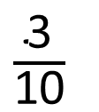
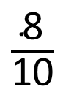
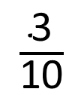
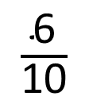
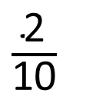
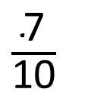
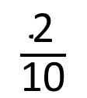
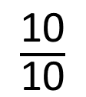
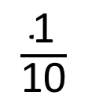
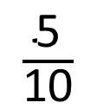
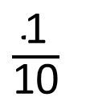
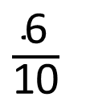
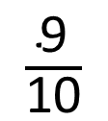
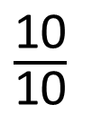
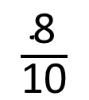
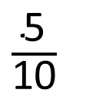
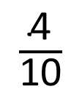
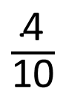
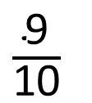
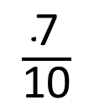
0
$\frac{\text{1}}{\text{10}}$
$\frac{\text{2}}{\text{10}}$
$\frac{\text{3}}{\text{10}}$
$\frac{\text{4}}{\text{10}}$
$\frac{\text{5}}{\text{10}}$
$\frac{\text{6}}{\text{10}}$
$\frac{\text{7}}{\text{10}}$
$\frac{\text{8}}{\text{10}}$
$\frac{\text{9}}{\text{10}}$
$\frac{\text{10}}{\text{10}}$
or 1
0
1
$\frac{\text{1}}{\text{10}}$
$\frac{\text{2}}{\text{10}}$
$\frac{\text{3}}{\text{10}}$
$\frac{\text{4}}{\text{10}}$
$\frac{\text{5}}{\text{10}}$
$\frac{\text{6}}{\text{10}}$
$\frac{\text{7}}{\text{10}}$
$\frac{\text{8}}{\text{10}}$
$\frac{\text{9}}{\text{10}}$
$\frac{\text{10}}{\text{10}}$

Slide 11
Have a go at question
4 on the worksheet

Slide 12
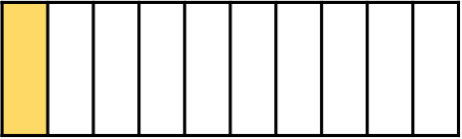
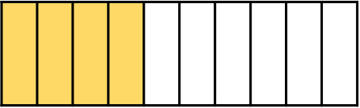
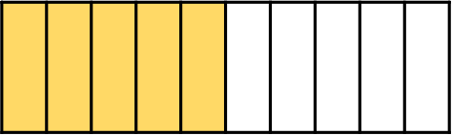
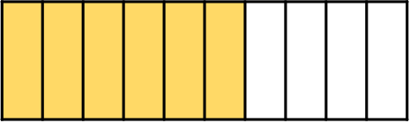
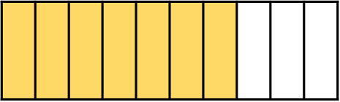
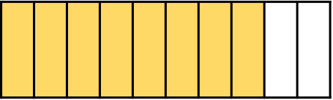
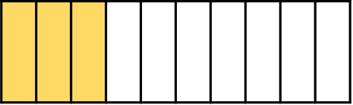
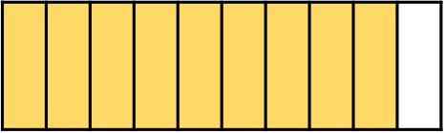
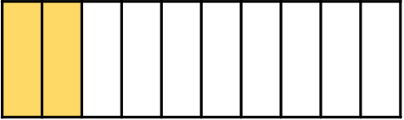
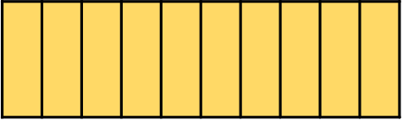
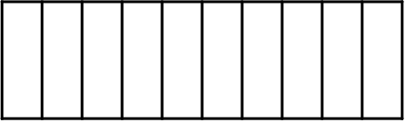
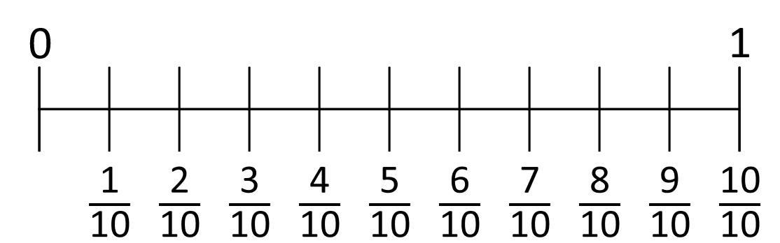










2
$\frac{\text{1}\text{1}}{\text{10}}$
$\frac{\text{12}}{\text{10}}$
$\frac{\text{13}}{\text{10}}$
$\frac{\text{14}}{\text{10}}$
$\frac{\text{15}}{\text{10}}$
$\frac{\text{16}}{\text{10}}$
$\frac{\text{17}}{\text{10}}$
$\frac{\text{18}}{\text{10}}$
$\frac{\text{19}}{\text{10}}$
$\frac{\text{20}}{\text{10}}$

Slide 13
Have a go at the rest of the worksheet

