Slide 1
Y2 Phonics
‘wr’ digraph
What words can we remember from yesterday?

Slide 2


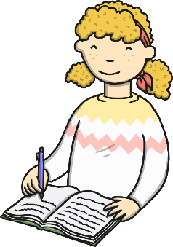

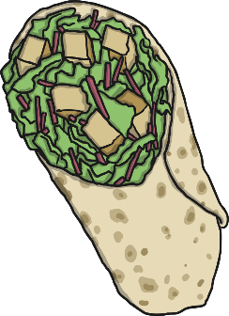
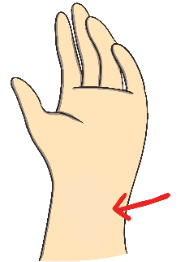
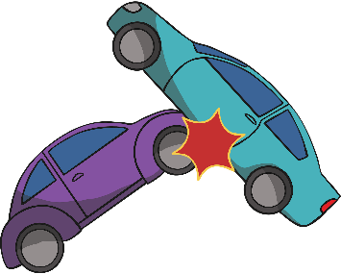
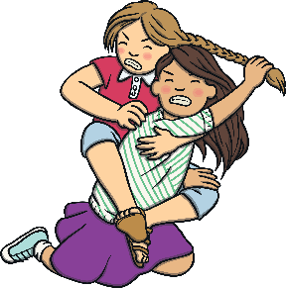



/r/ Spelt ‘wr'
Words that start with the phoneme /r/ are
sometimes spelt with the digraph ‘wr’.
write
written
wrote
wrong
wrap
hunt
hunt
wrist
wreck
wrestle
wriggle
wren

Slide 3
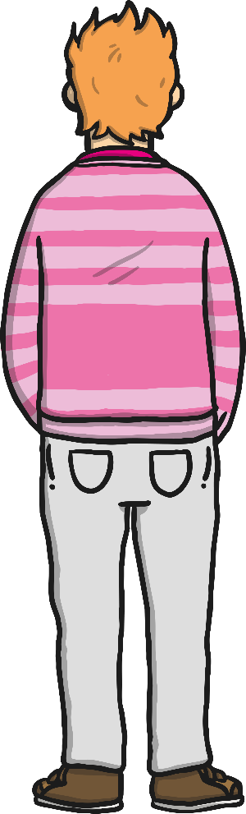

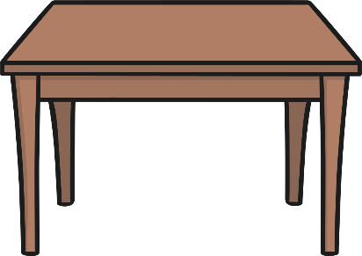



/r/ Spelt ‘wr'
Words that start with the phoneme /r/ are
sometimes spelt with the digraph ‘wr’.
Can you air write a ‘wr’ with your finger?
Can you write a ‘wr’
on your table or
the carpet?
Can you write either a ‘wr’ or an ‘r’ on a
partner’s back?
Can they tell what letters you have written?

Slide 4
Practise writing these words in cursive writing. Please join your letters.
write
written
wrote
wrong
wrap
wrist
wreck
wrestle
wriggle
wren

Slide 5
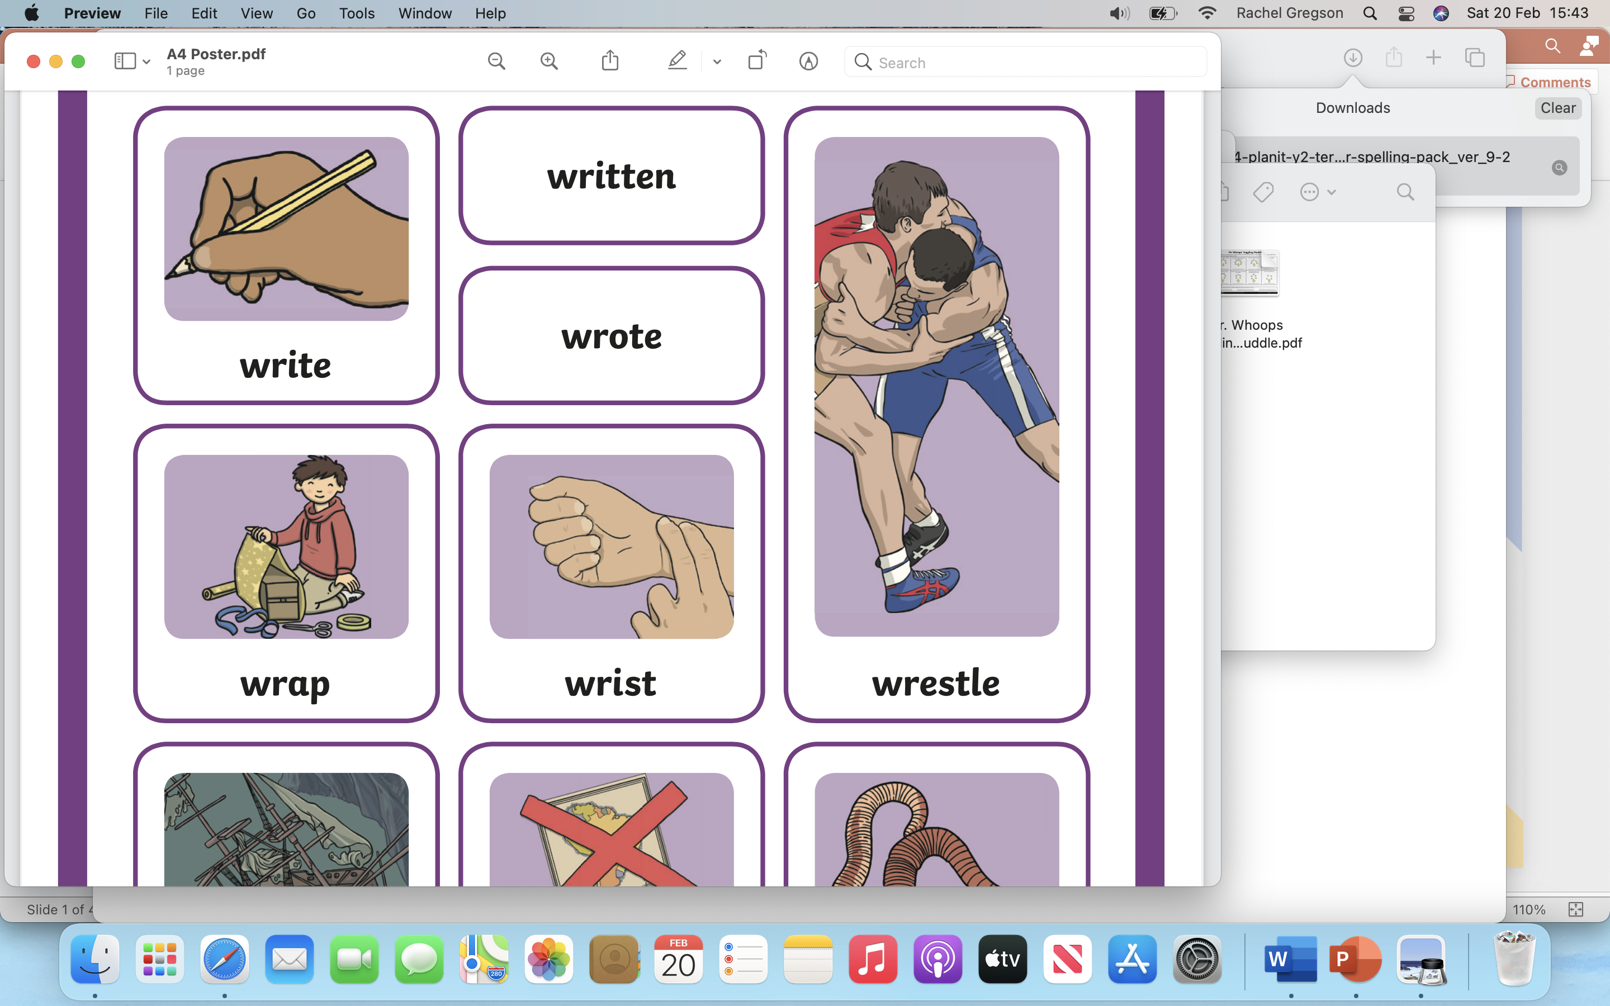
Pronounce the ‘wr’ words

Slide 6
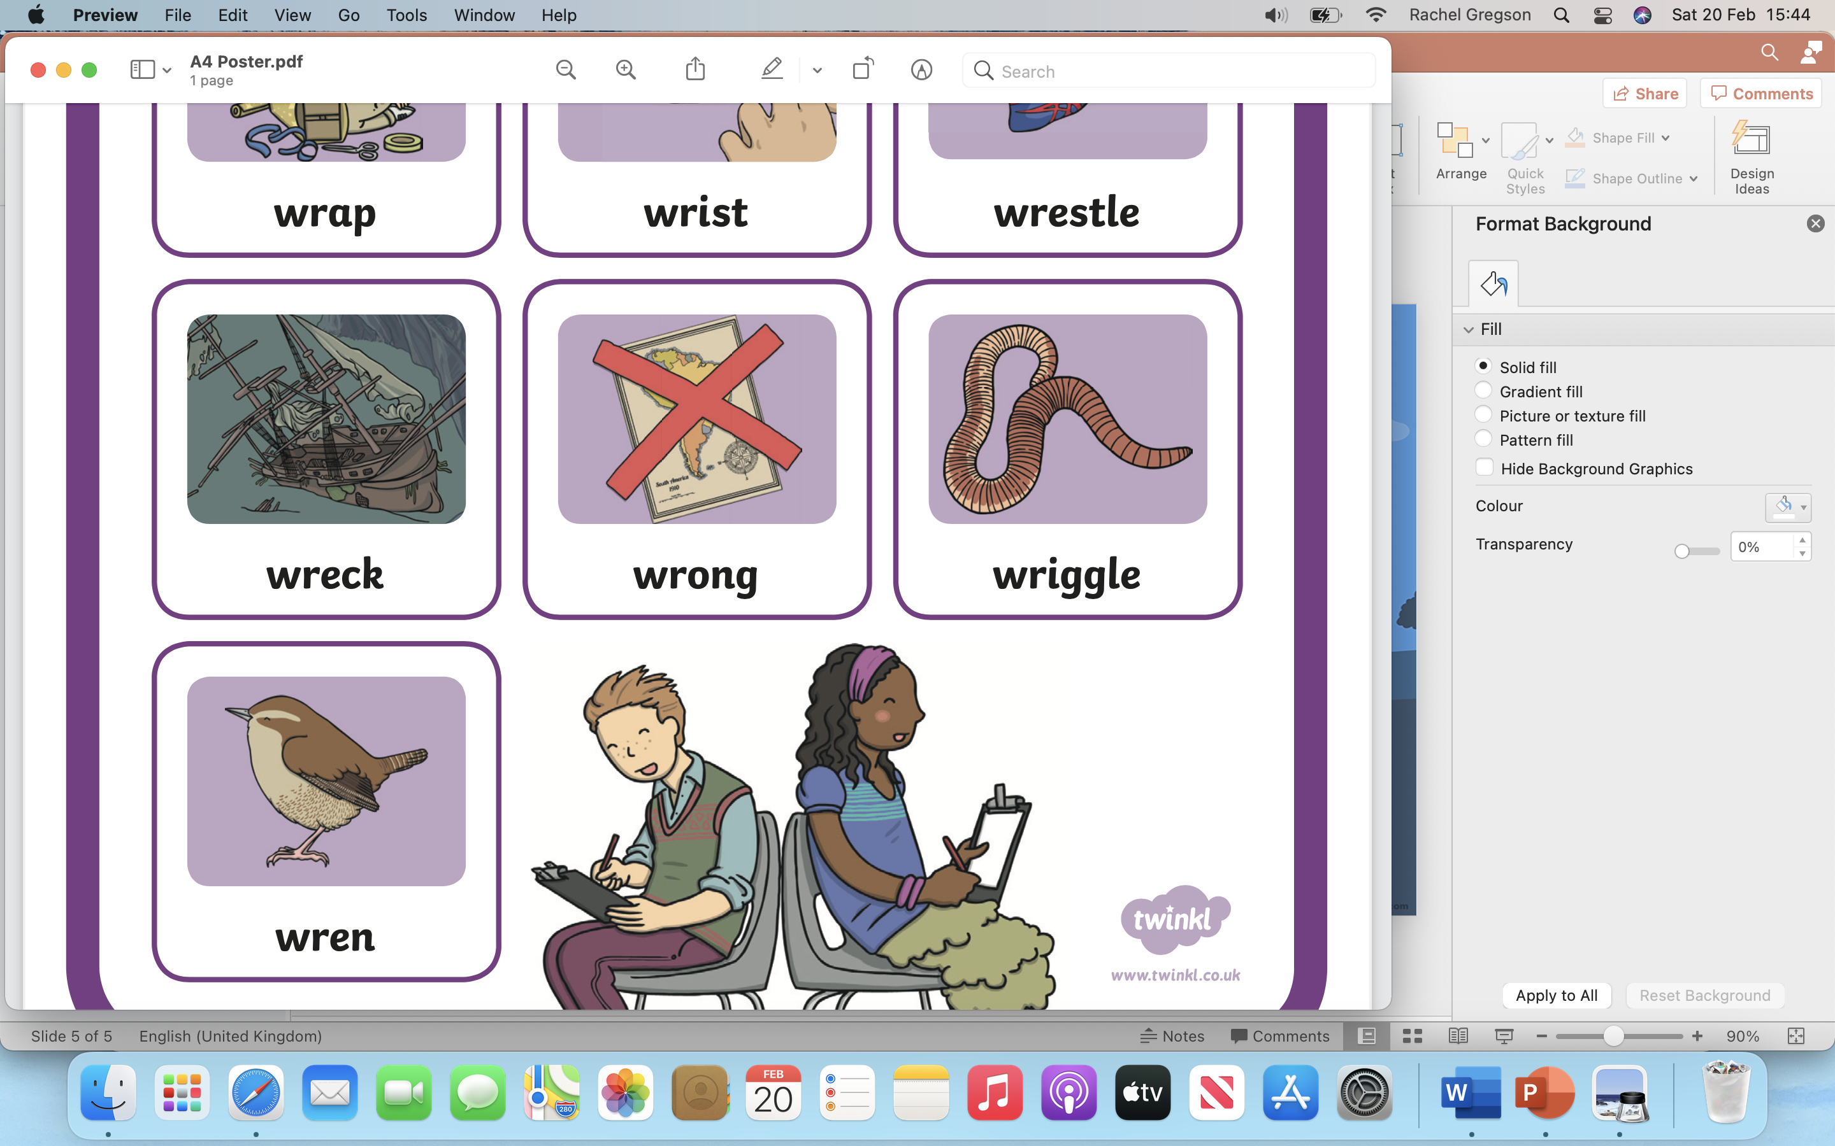

Slide 7
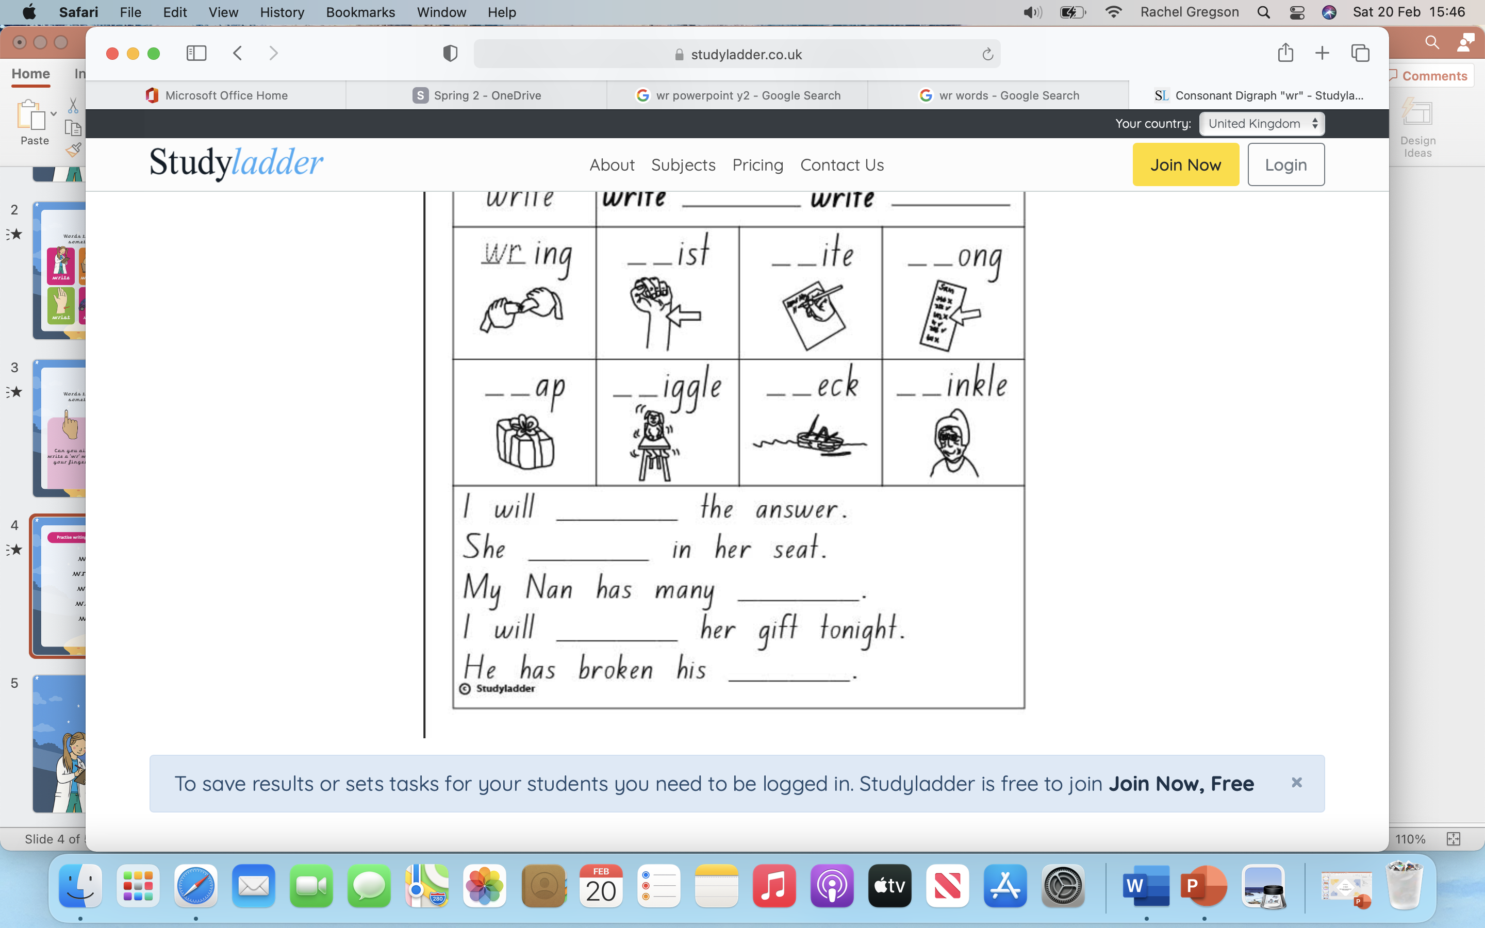
Missing ‘wr’ digraph. Which words will complete the sentences?

Slide 8
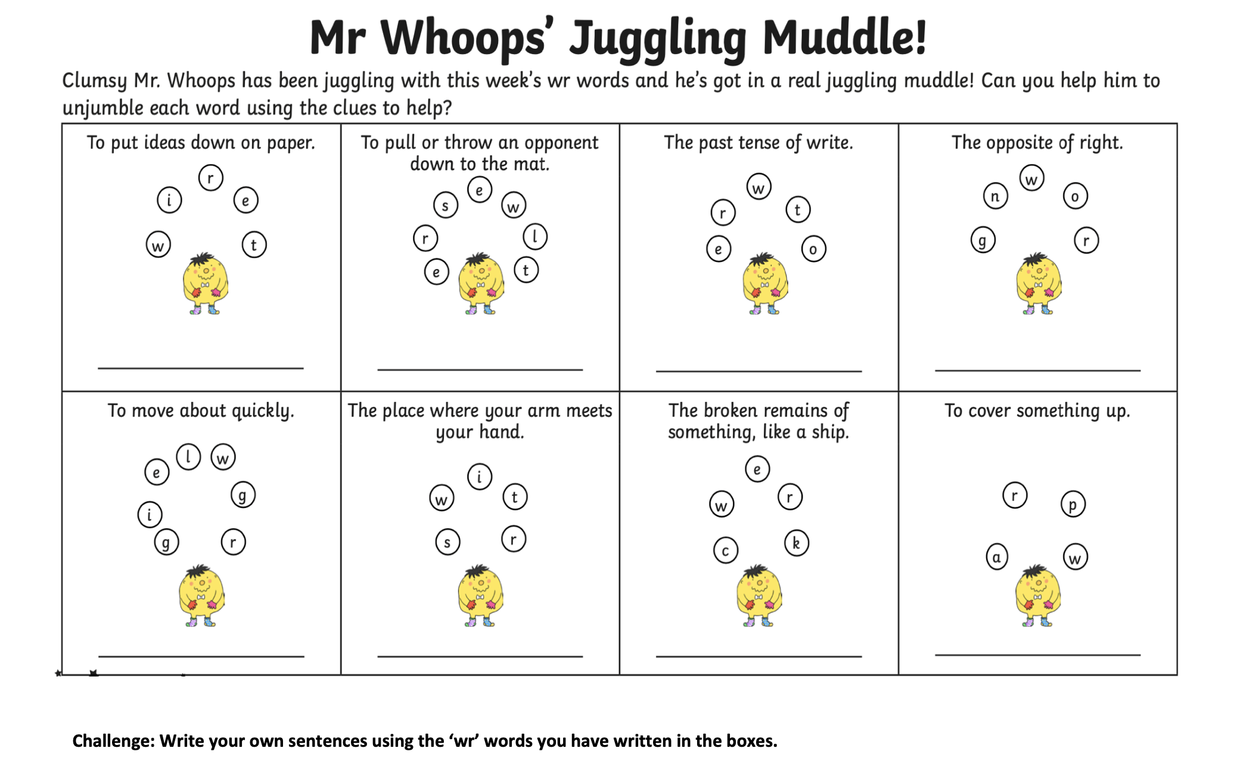
Activity 1

Slide 9
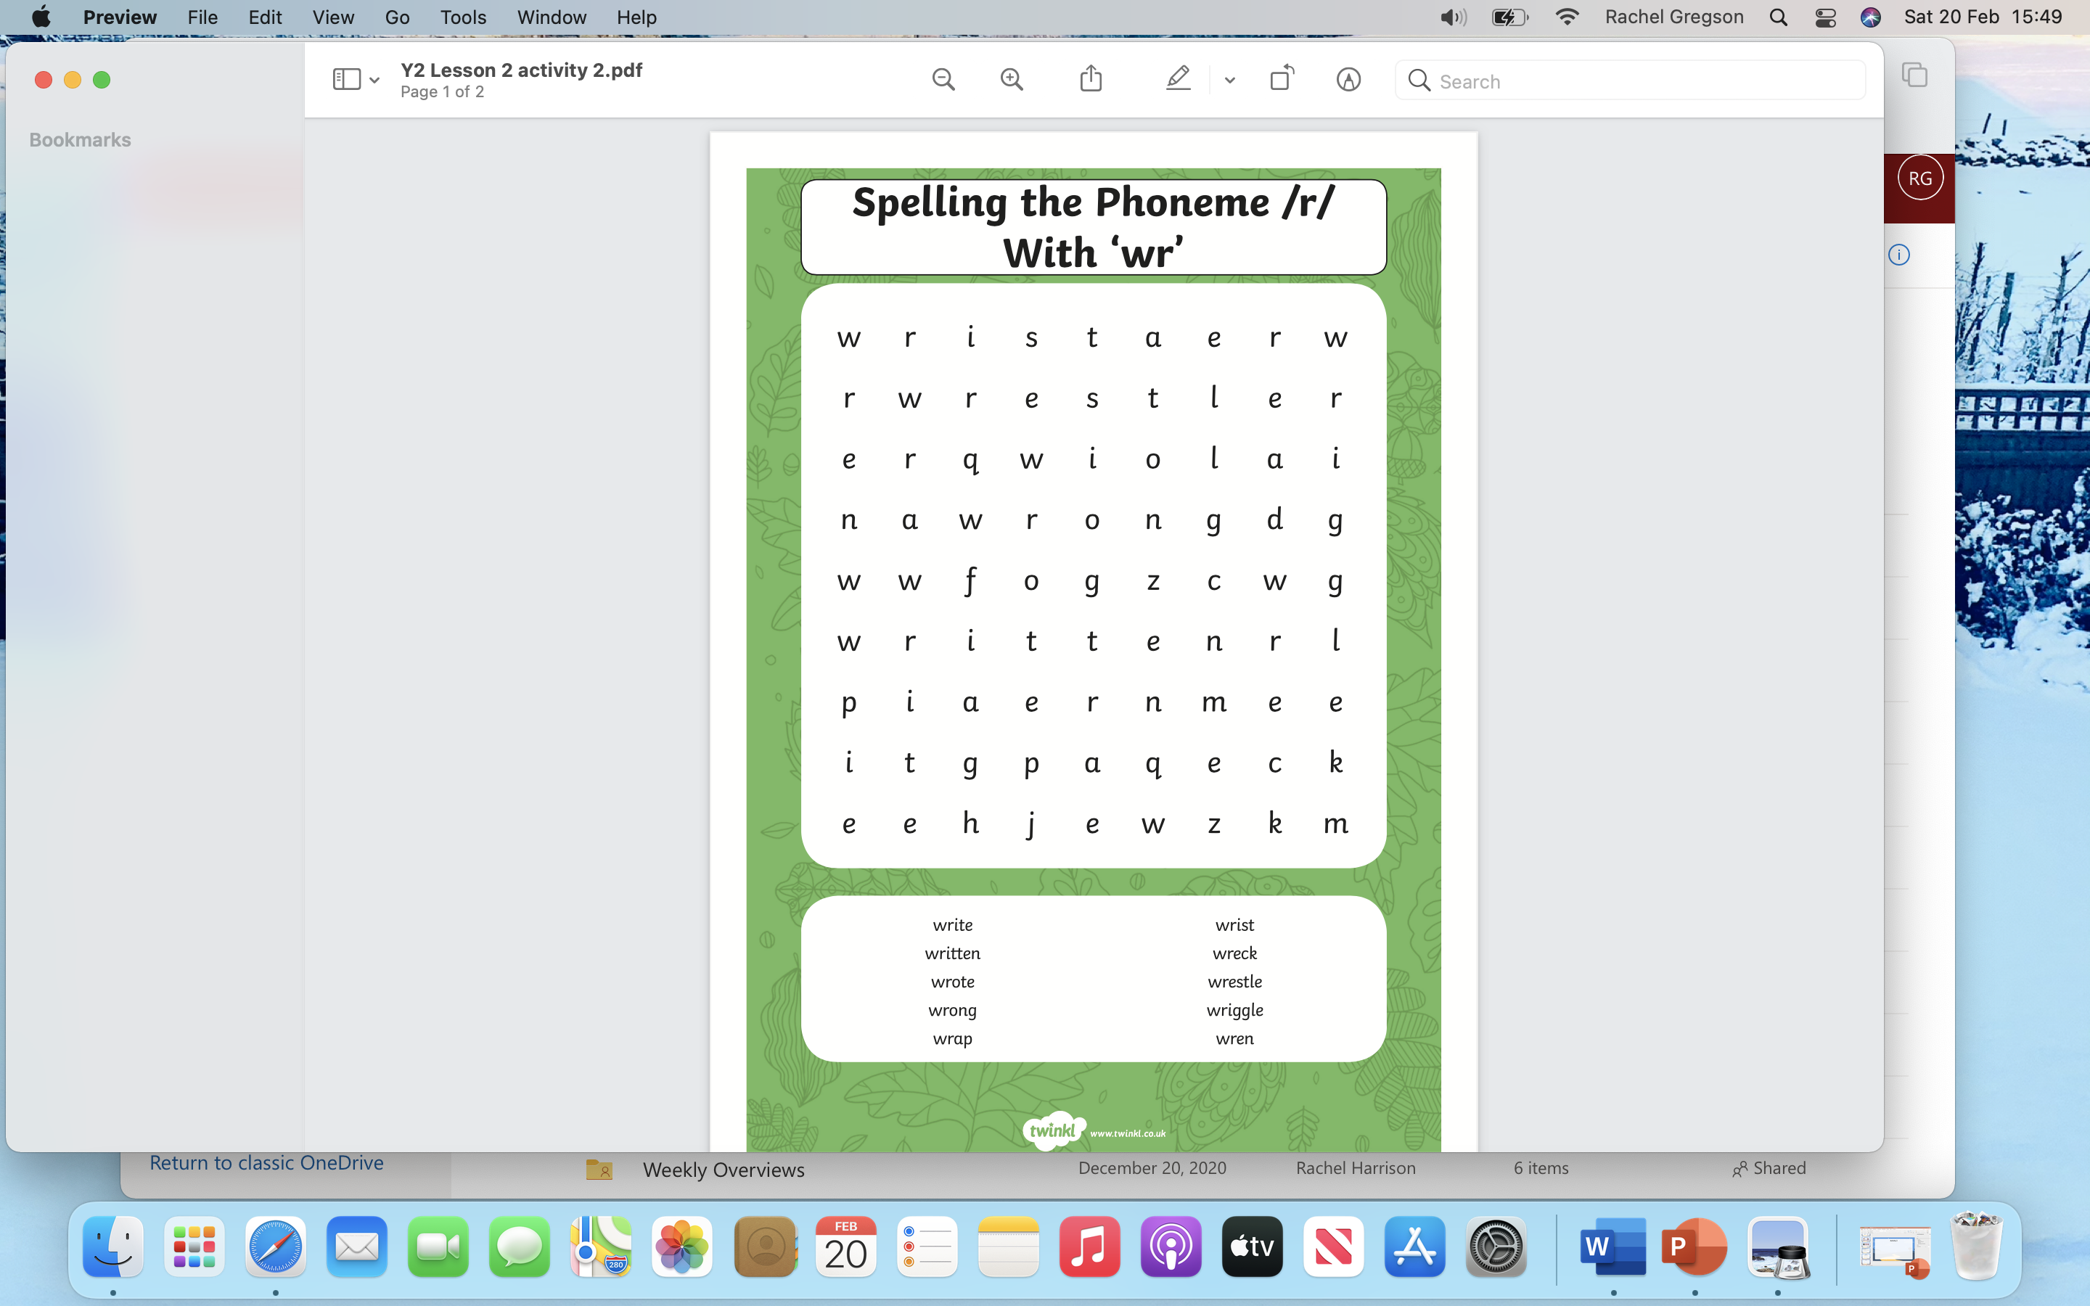
Activity 2

