Slide 1
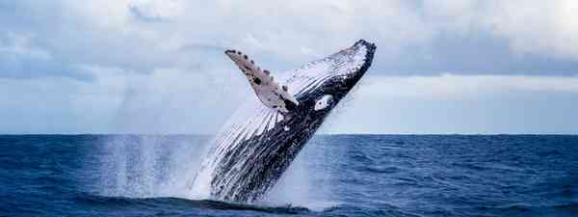
ENGLISH

Slide 2
Lesson 2
Today, we are going to continue our work on
note-taking in preparation for writing a report
Yesterday, we practised taking notes about a familiar topic – yourself!
Today, we are going to start taking notes about our focus topic 'Whales'.

Slide 3
Lesson 2
All about Whales

Slide 4
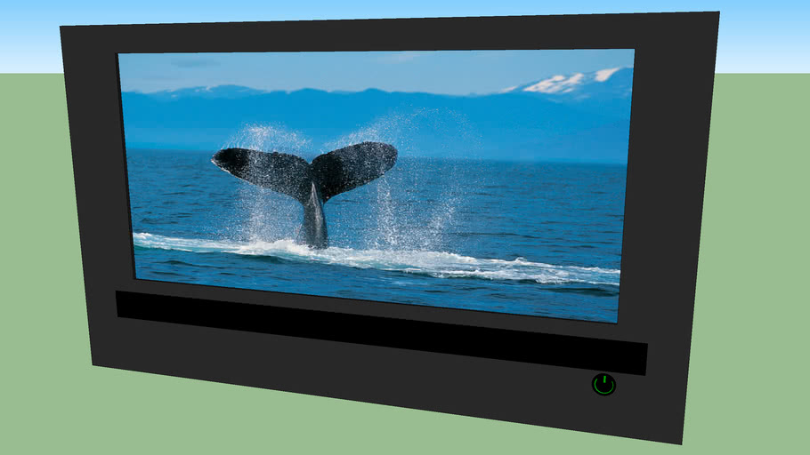
Lesson 2
Video Research
Today, our source of information is going to be short films and information videos.
Remember, because each video is talking about the same topic, some of the information might be repeated. If this is the case, you don't need to write it down a second time.

Slide 5
Use Abbreviations
Lesson 2
When taking notes whilst watching something on TV or interviewing someone, it is often important to be speedy. You could record an interview and make the notes later and you can keep pausing the television. Although, being able to write quickly is a big help so on these occasions, abbreviations might help.
Abbreviations are shortened words:
‘e.g.’ for ‘for example’, ‘info.’ instead of ‘information’. If you shorten a word, put a full stop at the end of it to show it is an abbreviation.
Symbols: &, +, =, @.
As long as you understand them,
you can make up your own symbols.

Slide 6
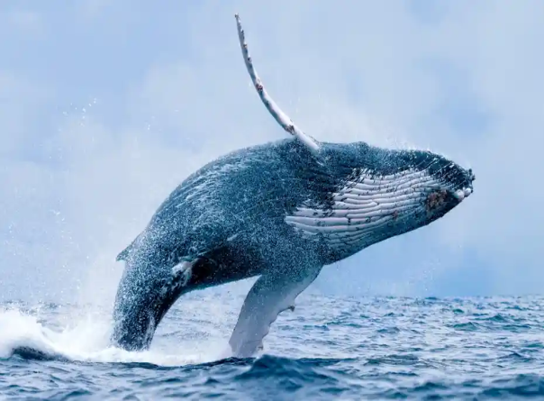
https://www.youtube.com/watch?v=kFMh8roaipU
Lesson 2
Note taking and video research
Here are a few videos we have selected that you can use to find out information about whales although you may want to watch other videos and programmes on television to support your research.
https://kids.britannica.com/kids/article/whale/353922#:~:text=Toothed%20whales%20have%20sharp%20teeth,also%20belong%20to%20this%20group.
https://www.youtube.com/watch?v=I9qlhNU1ATE
https://www.youtube.com/watch?v=CQcytKiiTM0
https://www.youtube.com/watch?v=HCCTIbDQorI

Slide 7
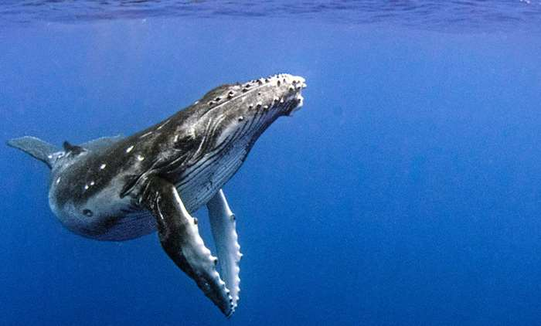
Lesson 2
Today's task:
Watch some of the film clips (or your own) and make notes about whales using your chosen method of note-taking.

Slide 8
ENGLISH

