Slide 1
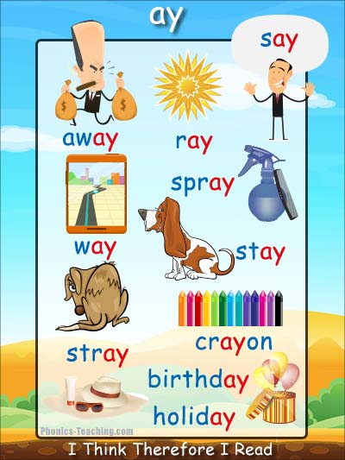
Today we will be looking at the digraph 'ay'

Slide 2
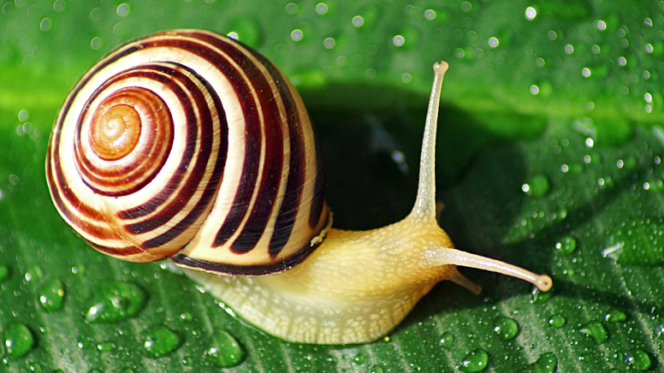
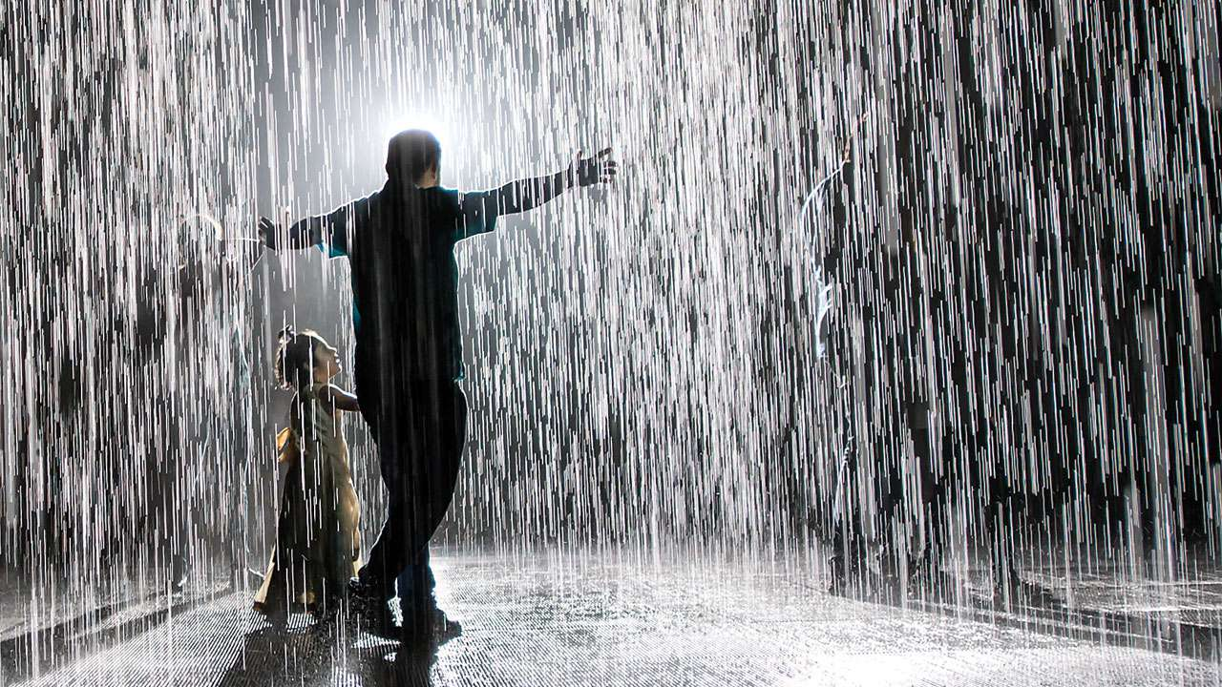
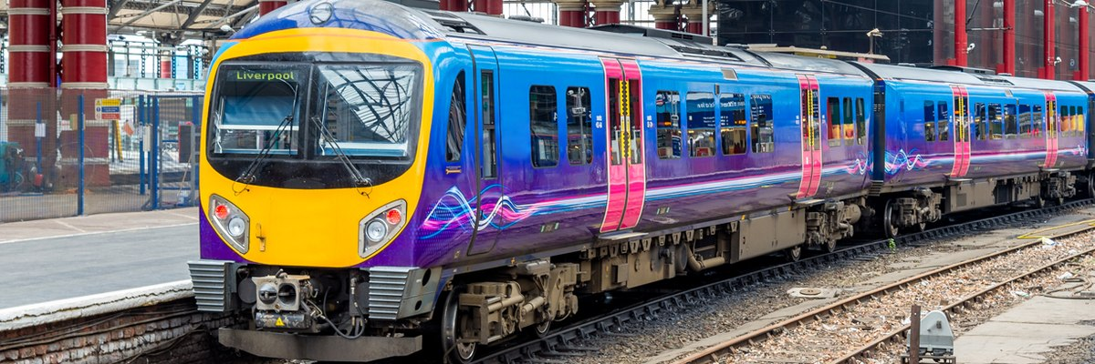
We have already learnt about the 'ai' digraph which makes the same sound.
snail
rain
train

Slide 3
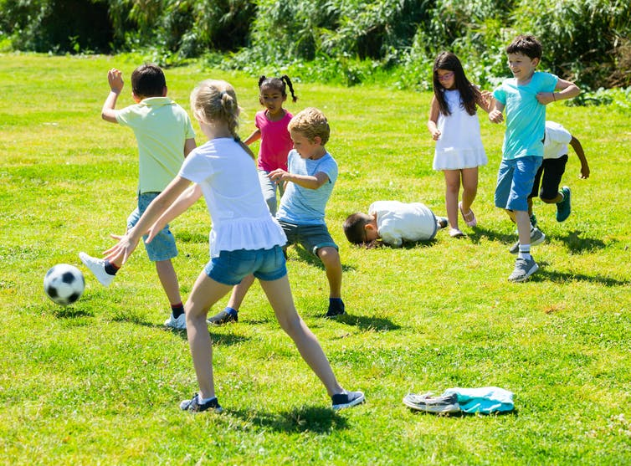
Today we are focussing on:
‘ay' ​
stay & play
Start today’s learning by watching this teaching video:
https://www.youtube.com/watch?v=WpvquS6c5vk

Slide 4
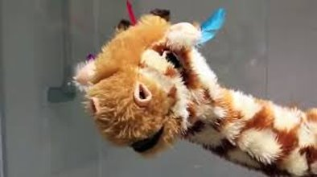
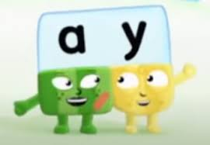
Here are some other fun videos you may enjoy to help you to learn the ‘ay' sound
Geraldine Giraffe:
https://www.youtube.com/watch?app=desktop&v=MTCP8i4Nwgc
Alphablocks:
https://www.youtube.com/watch?v=ROKNNvuGpEo

Slide 5

ai and ay comparison
https://www.youtube.com/watch?v=BGrIyCT7nK0
MOST of the time the ‘ai’ appears in the middle of a word and the ‘ay’ is at the end of a word although there are some exceptions e.g. crayon

Slide 6
Have a go at reading these ‘ay’ words.
Can you identify where the different sounds are to help you to sound out?
ay
The different colours on the next slides help to show the different sounds (and where you would put sound buttons).

Slide 7
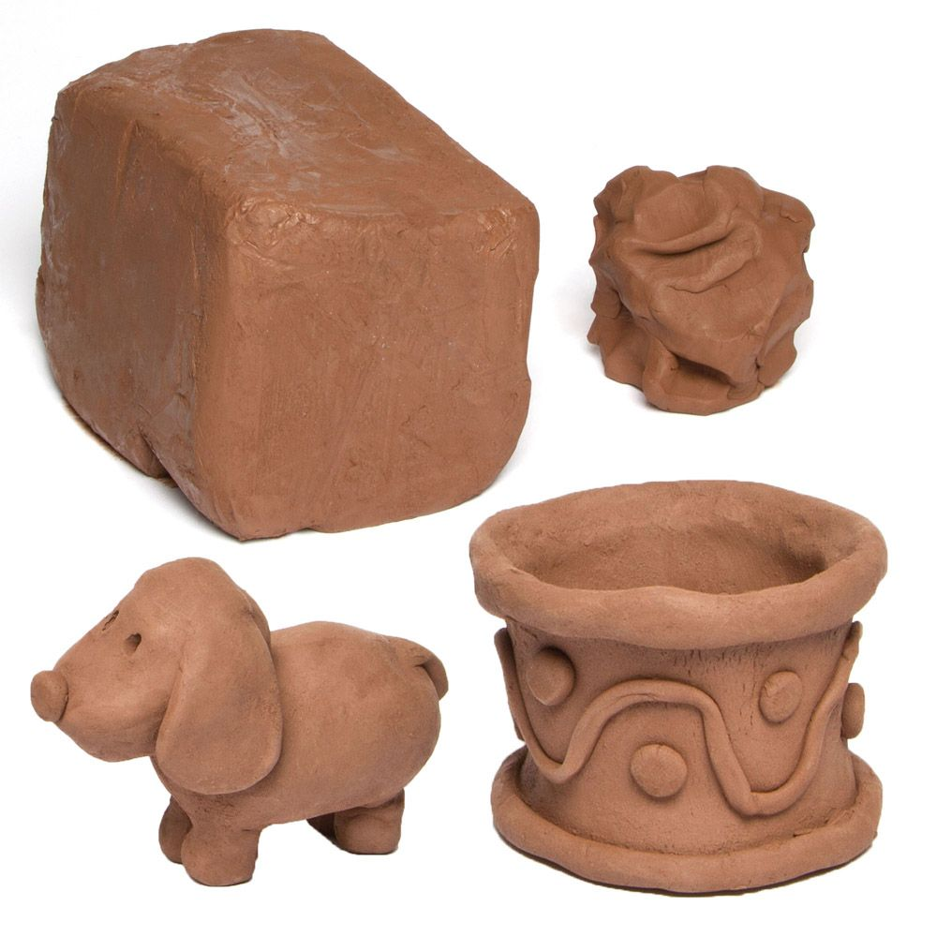
clay

Slide 8
clay

Slide 9
play

Slide 10
play

Slide 11
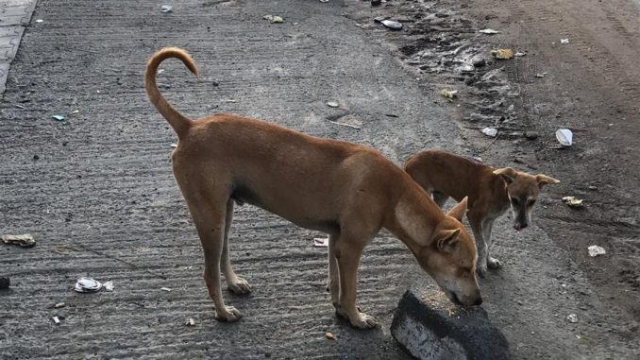
stray

Slide 12
stray

Slide 13
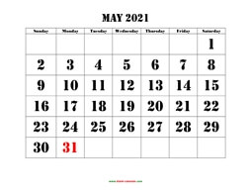

May

Slide 14
Watch Out:
May – for the month of May needs to start with a capital letter.
If it was someone's name or the start of a sentence, it would also require a capital 'M'.
However, in a sentence: 'I may go home soon.' It would not require a capital.
May

Slide 15
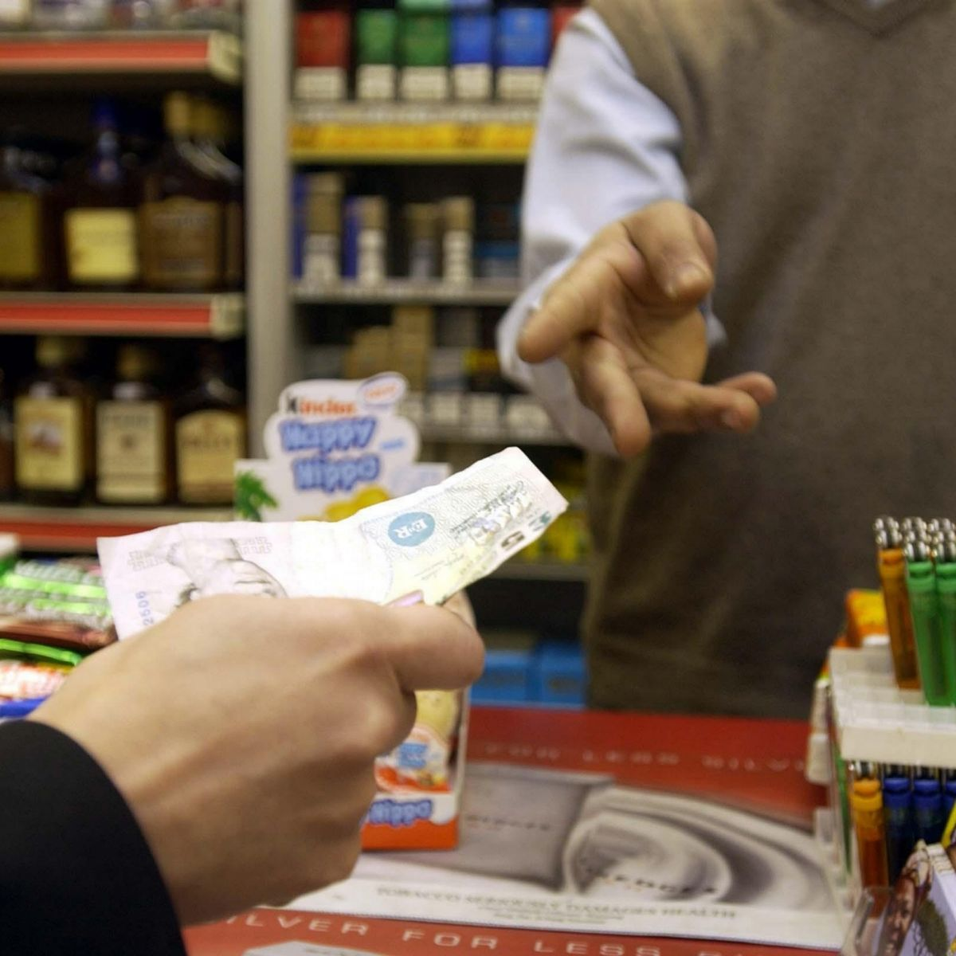
pay

Slide 16
pay

Slide 17

holiday

Slide 18
holiday

Slide 19
Now have a go at spelling these words.
Remember to really ‘sound out’ each sound.
Remember cursive letter formations.
Think about your pencil grip.
Have a try at joining the digraph ‘ay’.

Slide 20
Can you spell this word?

Slide 21
clay

Slide 22
Can you spell this word?

Slide 23
play

Slide 24
Can you spell this word?

Slide 25
stray

Slide 26
Can you spell this word?

Slide 27
pay

Slide 28
Can you spell this word?

Slide 29
holiday

Slide 30
Tasks...
Select from:
Practise writing the words using neat, cursive writing. Have you joined the digraph ‘ay'?
Can you apply these words in a sentences?
Can you add sound buttons to the words?
Have you completed the activities in the folder? There's a lot to choose from – you don't have to do them all!
Can you find items around your house that match the sound just like Geraldine Giraffe does?

