Slide 1


All about Plants
LC: What are plants?

Slide 2
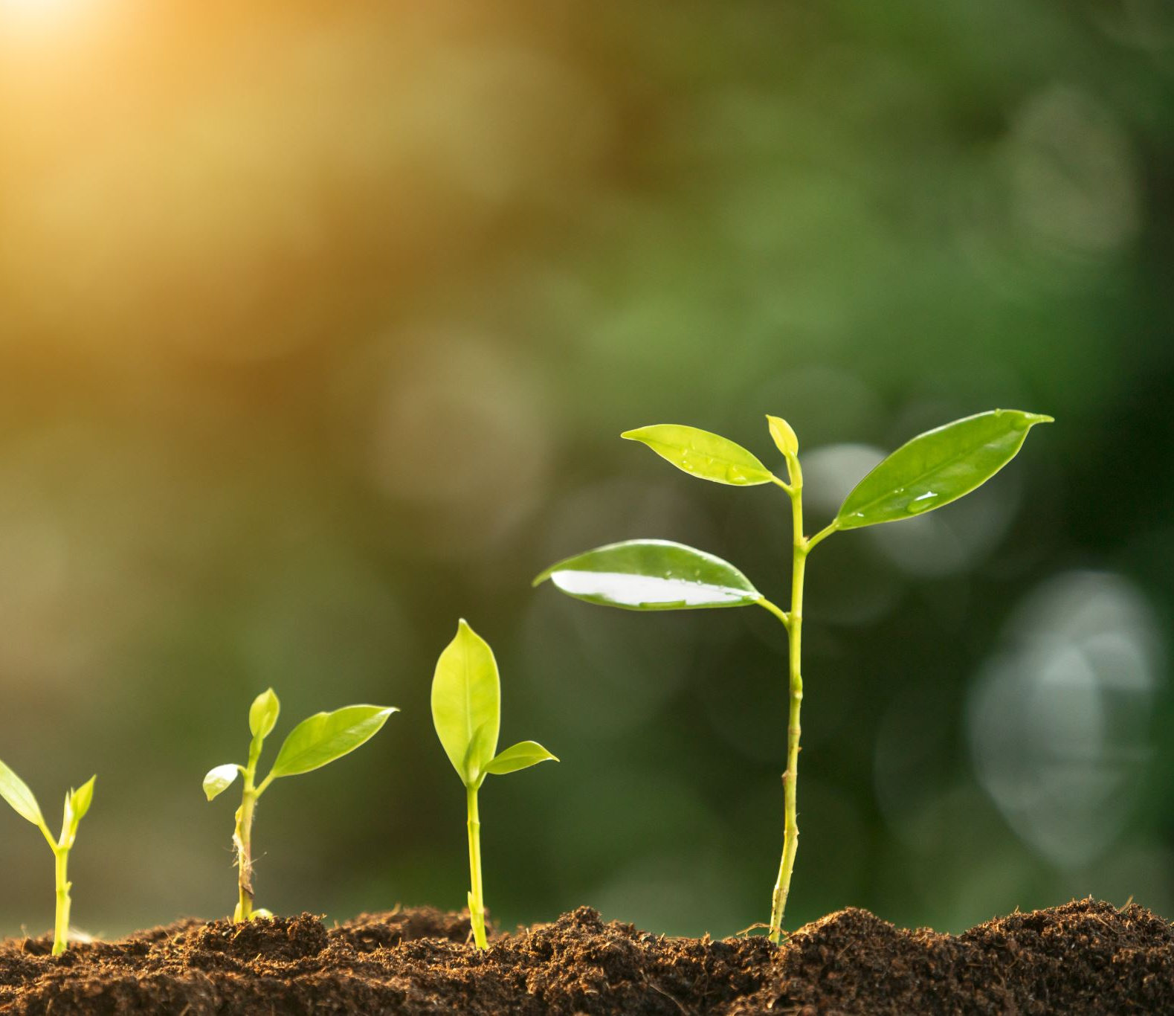
Today we are starting our new topic in science: All about Plants.

Slide 3
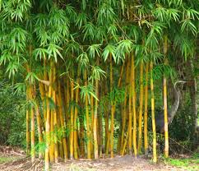
Plants are living things.
Plants are alive.
Just like humans and animals, plants do certain things;
They grow.
They eat.
They move.
And reproduce (create new plants).
https://www.bbc.co.uk/bitesize/clips/zyvs34j

Slide 4
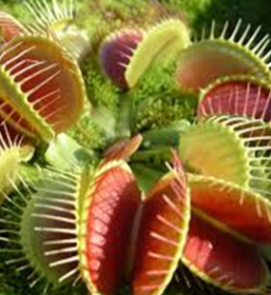
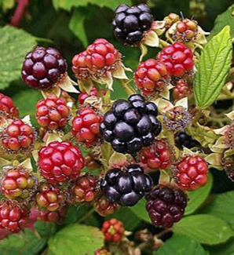
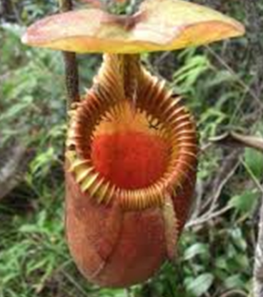
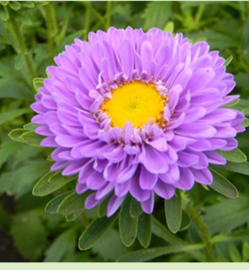
What are plants?
Plants can be found all over the world.
They can be different sizes, different colours and different shapes.
Do you recognize any plants in this clip?
https://www.bbc.co.uk/bitesize/clips/zthxpv4

Slide 5
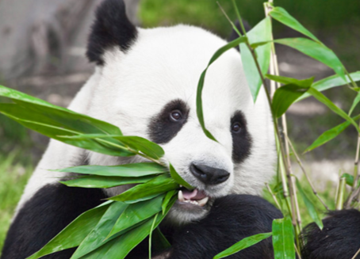
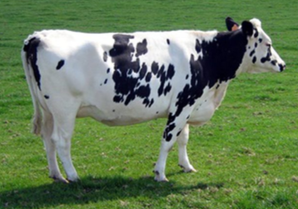
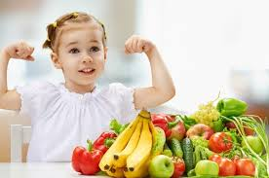
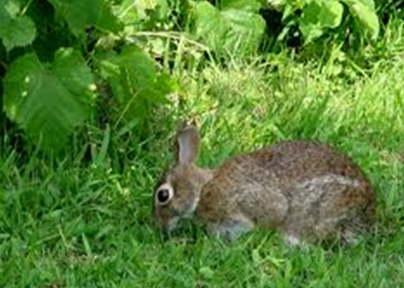
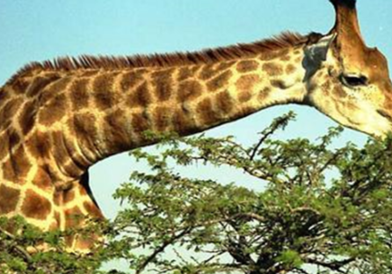
Plants provide food for other living things.
Including you and me!

Slide 6
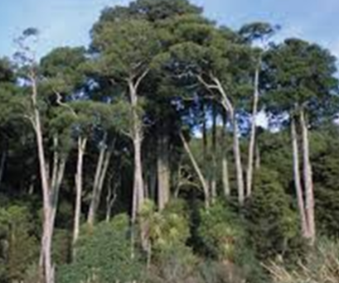
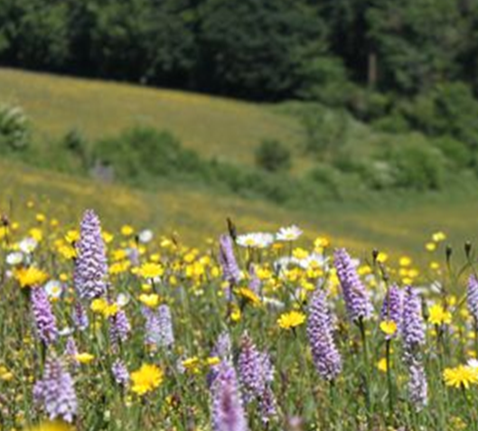
Plants provide habitats (places to live) for other living things.
They also produce oxygen which keeps us alive.

Slide 7
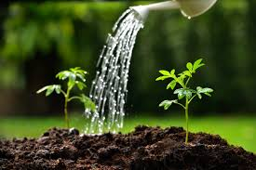
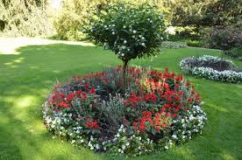
What do plants have in common?
Plants need certain things to grow:
Water
Sunshine
Air
Plants are not able to move around.

Slide 8
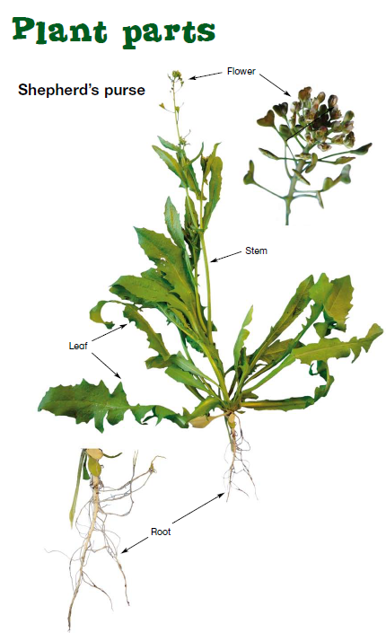
What do plants have in common?
The structure of all plants is the same:
Leaf
Stem
Roots
Some will also produce flowers and fruits which help them to reproduce.

Slide 9
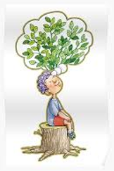
Activity 1: Create a poster to show what plants are. Remember:
Plants are living things.
Plants provide food for other living things.
Plants can be all sizes, shapes and colours.
Plants provide habitats for animals.

Slide 10
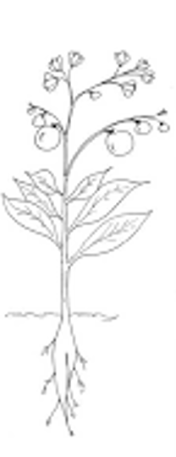
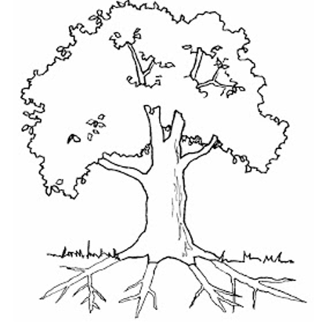
Activity 2: Can you draw and label the parts of a plant and a tree?
Leaf
Stem
Trunk
Roots
Flower
Branch

