Slide 1
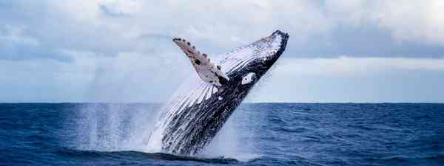
ENGLISH

Slide 2
This week our focus will be on non-fiction
Lesson 1
We are going to be writing a report.
Before we write our report, we are going to be gathering information and learning
about note-taking.

Slide 3
Did you know that it was World Whale Day 2021 on Saturday (20th Feb)?
Lesson 1
World Whale Day is observed annually on the third Saturday in February.
It is a wonderful opportunity to celebrate these magnificent aquatic mammals.
Unfortunately, there are some threats to the wellbeing of whales. Ship collisions are one of the leading causes of serious injuries and non-natural death for these cetaceans. Commercial whaling, entanglement in fishing gear, pollution, climate change, global warming, oil and gas development, toxic contamination, and habitat degradation are the main threats faced by whales.
World Whale Day provides an opportunity to voice concerns regarding the wellbeing of these marine mammals.

Slide 4
All about Whales
Lesson 1
This week, we are going to be learning

Slide 5
-a short report all about whales
-a short report all about a specific type of whale
-a non-chronological report, with subheadings and paragraphs, about a variety of whales or key features about a specific whale e.g habitat, diet.
Lesson 1
At the end of this week, you are going to write an information report about whales (non-fiction).
You might write:

Slide 6

Why do we read and write reports?
Lesson 1
Reports organise and store information.
We read them to find out information.
We write them to give information to others.
A non-chronological reports means that information does not need to be organised in a special order.

Slide 7

Why do I need to plan my report before I write it?
Lesson 1
To help me plan and organise my ideas and information I have researched or collected.
To organise the information into subject areas using sub-headings so that it is easier for the reader to follow.
To organise what I will include in each section to help make my writing clearer.

Slide 8

Where do we get our facts from?
Lesson 1
Before we can complete any factual, information writing we need to know lots about the topic or subject.
What is a source of information?
What sources of information might we use in our research about whales?

Slide 9
Sources of information could include:
Lesson 1
Books (inc bought, library,)
Wildlife magazines
TV programmes and videos
Interviewing people who know more
Visiting places – trips, real/wild, museum
Looking at photographs (especially those with captions)
Some facts about topics appear in a fiction text.
Internet
News/newspapers

Slide 10
Note taking
Lesson 1
Note taking isn’t writing full sentences but jotting down key words.
You might choose to use some bullet points
Or you might create a grid of key information to look for when watching the videos e.g habitat, size, diet, age, different types
Instead, you might find a concept map (also known as a mind map or spider diagram) a good way to record your notes – see next slides.
Another idea is to use small cut up pieces of paper / post-it notes to jot down each different idea and then arrange them into groups of similar facts at the end.

Slide 11
Why Take Notes?
Lesson 1
Throughout the next few lessons, we are going to take some notes.
To gather information about a specific topic.
To use within a piece of writing at a later date.
To analyse a text.
To revise for a test.
Notes might be taken from a text e.g. A book or newspaper, but they can also be taken whilst interviewing someone or whilst watching a TV programme or listening to the radio.

Slide 12
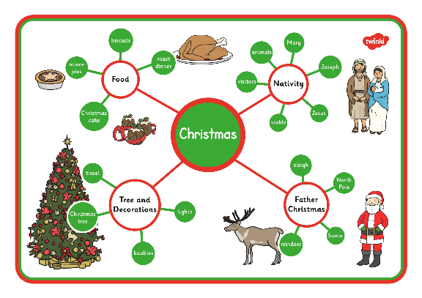
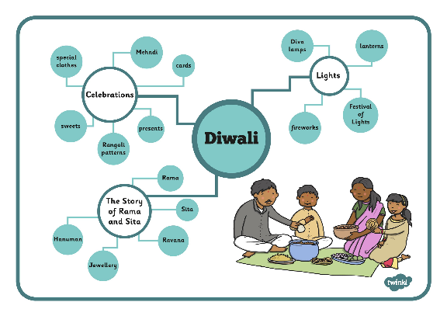
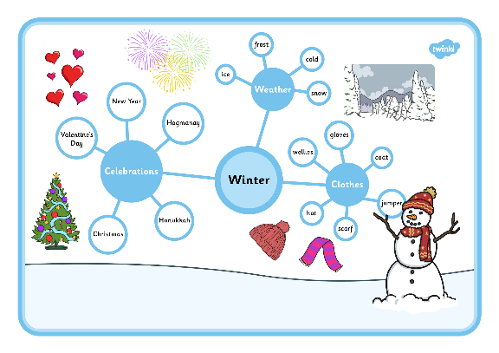
Use Concept Maps
Also known as mind maps and spider diagrams
Lesson 1
With a concept map, you are creating a visual
setup that helps to explain the relationships
between concepts and the main topic.

Slide 13
The next few slides show a step-by- step guide to using a concept map.
Lesson 1
Today, you are going to have a go at using the concept map to make notes about a topic you know lots about – ‘yourself’.
Then, over the next few days, you will apply this same method when learning about whales.

Slide 14

Step 1
Lesson 1
Decide what the title of your report is going to be and write this in the centre of your plan.
So today this is likely to be your own name. Tomorrow this might be ‘All about whales’
Your name

Slide 15
Step 2
Lesson 1
Next, organise the information you would like to include by deciding on the main key areas you think the reader will find interesting.
Add a sub-heading for each of these to your plan. Remember to include an introduction so it is clear what your report is about.
Introduction
Your name
What you look like
Friends
Where you live
Family & pets
Hobbies and interests

Slide 16
Step 3
Lesson 1
Now it’s time to plan what you will write in each section.
Remember to include key facts about each sub-heading, you don’t need to write in full sentences at this stage, more detail and description can be added when you write the actual report.
Football
Computer gaming
Hobbies and interests
Art and Crafts
Walking in the country and camping

Slide 17
Step 4
Lesson 1
Check through your plan and add any important words or technical vocabulary to each section which you think the reader will find interesting.
Hobbies and interests

Slide 18
Step 5
Lesson 1
When you are happy with your plan, it’s time to write your actual report. Use the checklist below to edit your finished report.
Non-chronological report checklist:
I have chosen interesting information to put into my writing.
I have organised my writing with sub-headings.
I have thought carefully about who might read my writing.
I have started my writing with a title and a clear explanation of what I am writing about.
I have used technical words.
I have used some describing words to help me explain clearly.
I have written in the present tense.
I have remembered capital letters and full stops.
I have re-read it to make sure it gives information clearly to the reader.

Slide 19
Today’s task:
Lesson 1
Today you are having a little practise at writing some notes about a very familiar topic – yourself!
You might choose to use a concept map like the example in the slides before.
You might write lots of different facts and information about yourself on small pieces of paper / post-it notes and then arrange them into categories.
You might write information next to bullets on a sheet of paper. Maybe then you could colour code different information that goes together?
Remember – you are just practising note taking and not writing full sentences and a complete report.

Slide 20
ENGLISH

