Slide 1
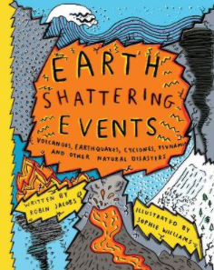
LC: Can I answer questions about vocabulary in a text?

Slide 2
What do you think the book might be about?​​
​​
What genre do you think the book is?​​
​​
What key information might you find in this book?​

Slide 3
Let’s read the blurb:
We humans take our domination of the planet for granted, but sometimes nature reminds us that this is an illusion. Tectonics rip open the earth, vast waves sweep away coastal towns, magma spews from volcanoes and hurricanes lay waste to entire countries. This book explores nature at its most destructive. Clear, coherent explanations break down the science behind phenomena including hurricanes, tornadoes, avalanches, earthquakes, tsunamis and volcanoes, alongside fascinating facts about the biggest and the worst.

Slide 4
Vocabulary
domination – the exercise of power or influence over someone or something
ruptures – cause to break or burst suddenly
ramshackle - appearing ready to collapse

Slide 5
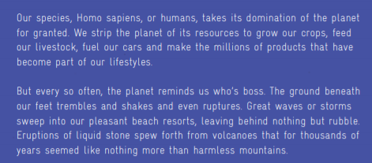
Please read the ‘Introduction’ extract today.
Today our questions are focused on the vocabulary used by the author in the extract. The author uses powerful adjectives and verbs to show how disastrous natural disasters can be! Let’s read this extract together and spot a few.

Slide 6
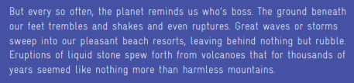
Question:
Find and copy another word for nice.

Slide 7
Answer:
Pleasant.

Slide 8
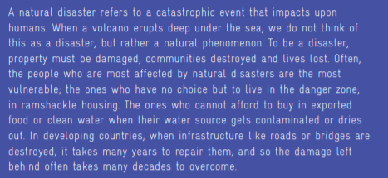
Question:
Find and copy a phrase which shows that it can take a long time to recover from a natural disaster.

Slide 9
Answer:
the damage left behind often takes many decades to overcome

Slide 10

Use your highlighter to pinpoint any vocabulary
you are unsure of the meaning of.
Can you find out the meaning?
Your highlighter will also be useful for pinpointing
answers today.

Slide 11
Questions:
Find and copy the phrase which shows that we take too much from our planet.
What does ‘the planet shows us who’s boss’ mean?
What is a natural disaster?
What is the difference between a natural phenomenon and a disaster?
Choose two verbs which show that natural disaster cause damage.
Chilli Challenge:
Which kind of natural disaster do you think would be the most damaging? Why?
Why must we respect and look after the planet?

Slide 12
Answers:
We strip the planet of its resources.
Even though we take what we want for the planet and have control over it, there are some things that we cannot control in nature.
It is a catastrophic event that impacts on humans.
A disaster has an impact on humans and involves damage where as a phenomenon is just a natural event.
Scorched, harmed, destroyed, contaminated

