Slide 1
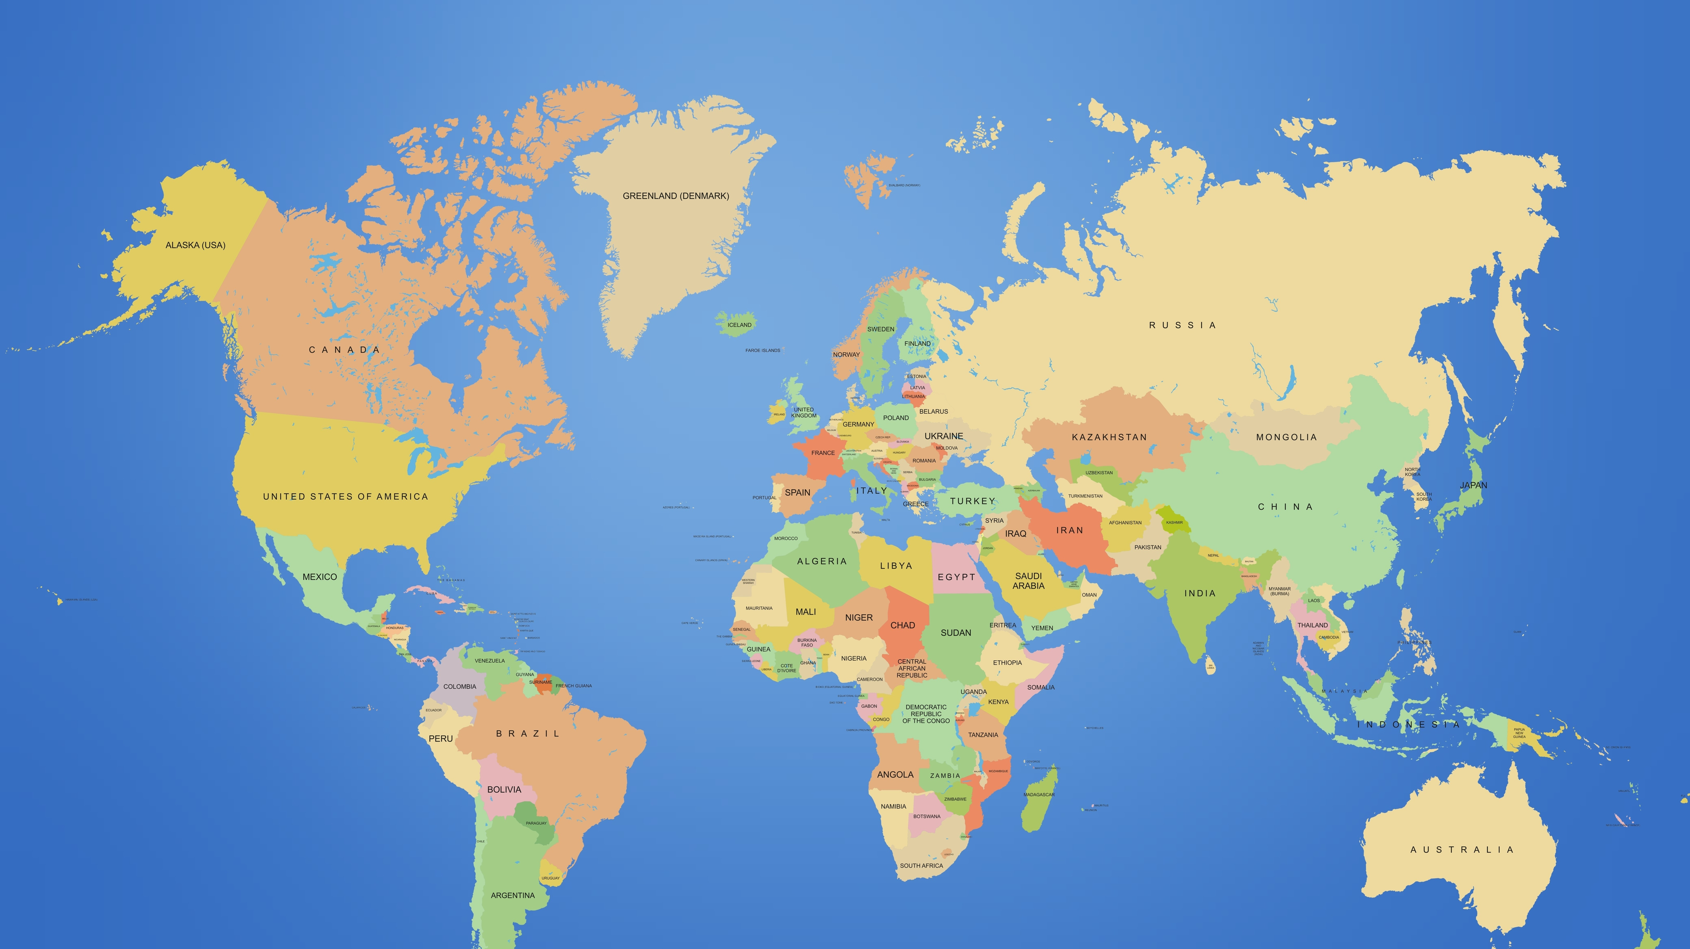
What other countries have you visited and what have you learnt about their cultures?

Slide 2
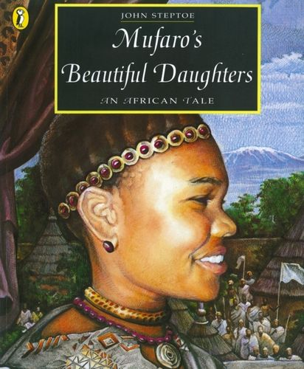
Monday: Stories from other cultures
This half term, we are looking at some traditional stories from other cultures.
The first story is called: Mufaro's Beautiful Daughters.

Slide 3
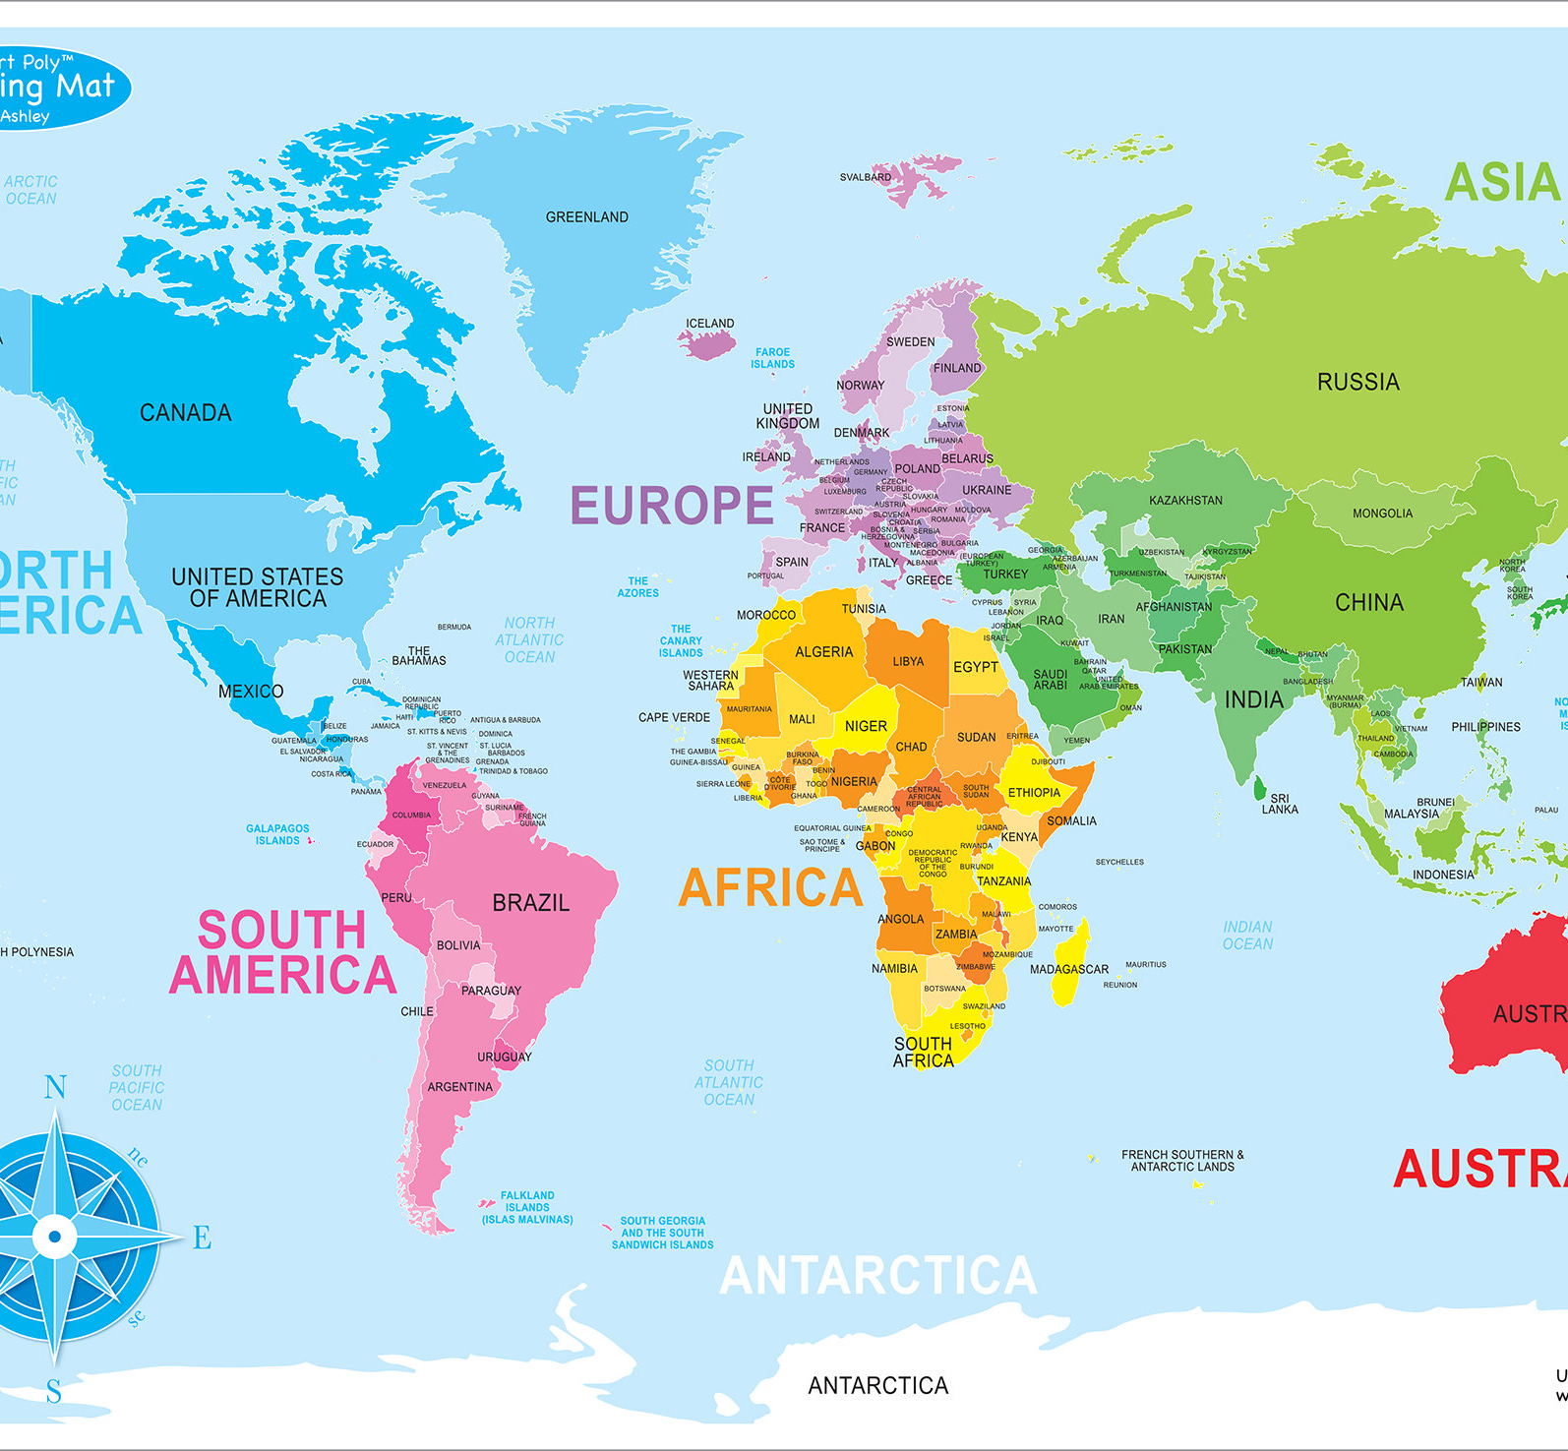
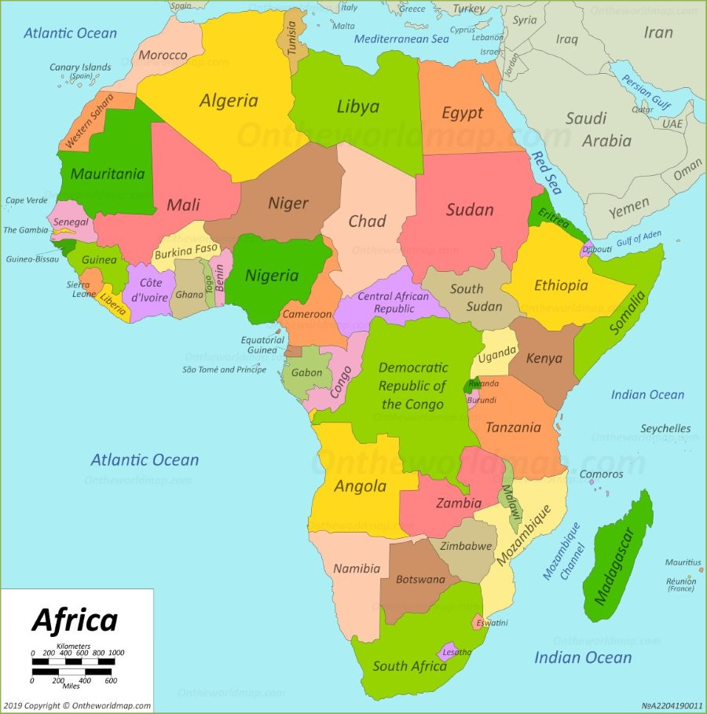
The story is thought to be set in Zimbabwe in Africa.

Slide 4
It is thought the story is based on an ancient walled city called Great Zimbabwe. It was a main trading centre of the Shona people in the 1400s.

Slide 5
The names in the story come from the Shona language. Let's practise these pronounciations together.
Mufaro – moo-FAR-oh
Nyasha – nee-AH-sha
Manyara – mahn-YAR-ah
Nyoka –nee-YO-kah

Slide 6
First Impressions
What do you think the book might be about?
The title says 2 daughters so why do you think only one is on the front cover?
What do you think the author means by 'beautiful'?

Slide 7
Today we'd like you to listen to the story
Mufaro's Beautiful Daughters - Read Aloud - YouTube

Slide 8
As you are listening consider:
Any vocabulary you may need to look up.
Characters – Who is good and who is bad?
Similarities and differences with other stories you know.
Mufaro's Beautiful Daughters - Read Aloud - YouTube

