Slide 1


Slide 2


Slide 4





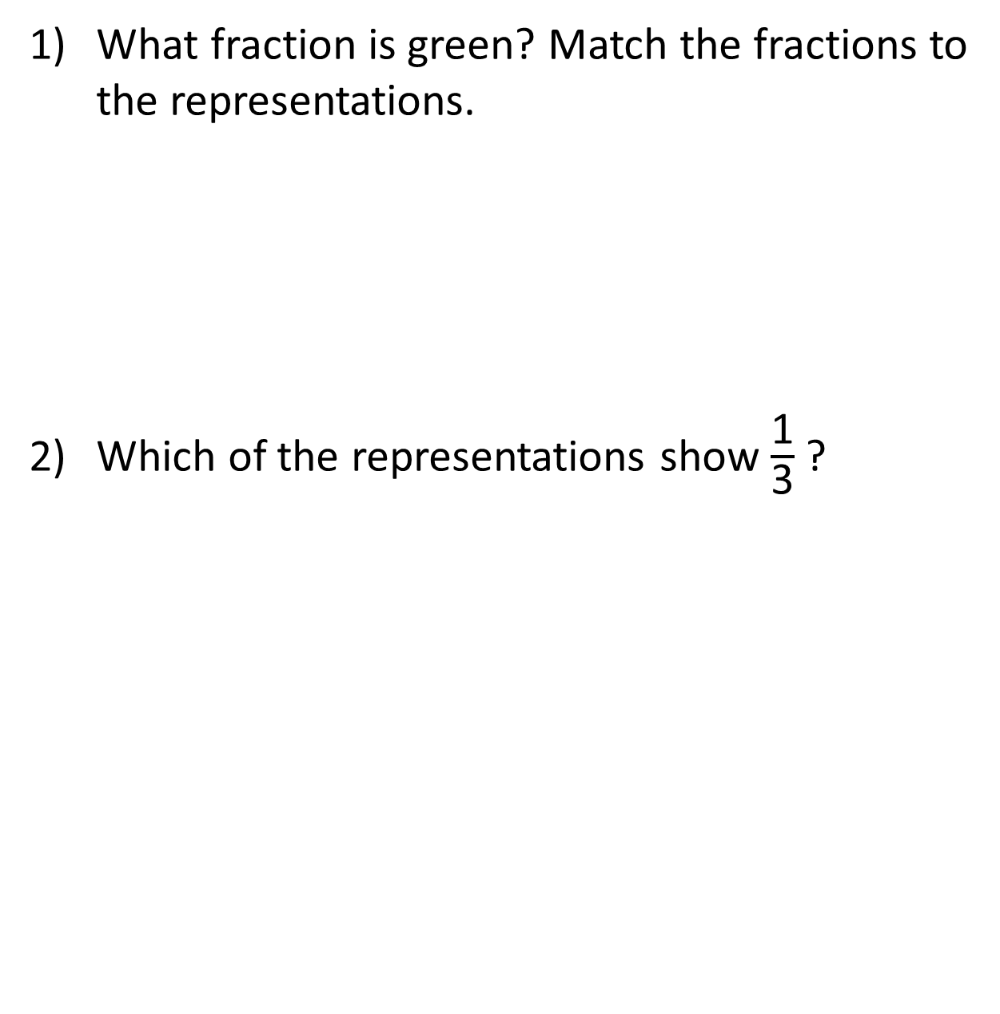
What fraction is green? Match the fractions to the representations.
Which of the representations show $\frac{\text{1}}{\text{3}}$ ?
$\frac{\text{3}}{\text{5}}$
$\frac{\text{1}}{\text{4}}$
$\frac{\text{3}}{\text{4}}$

Slide 5

What fraction is green? Match the fractions to the representations.
Which of the representations show $\frac{\text{1}}{\text{3}}$ ?
$\frac{\text{3}}{\text{5}}$
$\frac{\text{1}}{\text{4}}$
$\frac{\text{3}}{\text{4}}$

Slide 7





Have a think
$\frac{\text{7}}{\text{10}}$
What fraction of the flowers are blue?
What fraction of the flowers are orange?
10
There are flowers altogether.
out of flowers are blue.
of the flowers are blue.
This is a fraction.
3
10
$\frac{\text{3}}{\text{10}}$
non-unit

Slide 8

Tenths
$\frac{\text{1}}{\text{10}}$

Slide 9


Have a think
Which of these representations shows $\frac{\text{1}}{\text{10}}$? Why?

Slide 10




Have a think
Tenths
$\frac{\text{1}}{\text{10}}$
$\frac{\text{4}}{\text{10}}$
$\frac{\text{9}}{\text{10}}$
$\frac{\text{1}}{\text{10}}$
$\frac{\text{6}}{\text{10}}$
What fraction is not shaded?

Slide 11







What fraction of the cubes are red?
What fraction are yellow?
$\frac{\text{3}}{\text{10}}$
$\frac{\text{7}}{\text{10}}$
1
$\frac{\text{10}}{\text{10}}$
$\frac{\text{3}}{\text{10}}$
$\frac{\text{7}}{\text{10}}$

Slide 12









Have a think
What fraction of the cubes are red?
What fraction are blue?
What fraction are yellow?
$\frac{\text{2}}{\text{10}}$
$\frac{\text{5}}{\text{10}}$
$\frac{\text{3}}{\text{10}}$
$\frac{\text{10}}{\text{10}}$
$\frac{\text{2}}{\text{10}}$
$\frac{\text{5}}{\text{10}}$
$\frac{\text{3}}{\text{10}}$

Slide 13
Have a go at questions
1 – 4 on the worksheet

Slide 14



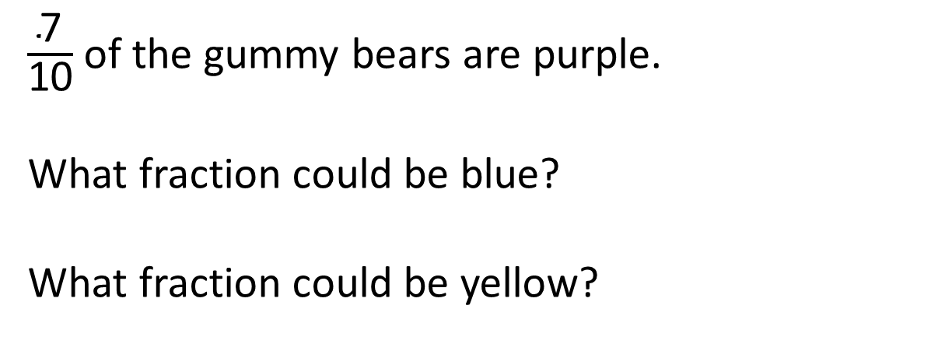







$\frac{\text{7}}{\text{10}}$ of the gummy bears are purple.
What fraction could be blue?
What fraction could be yellow?
$\frac{\text{3}}{\text{10}}$
$\frac{\text{2}}{\text{10}}$
$\frac{\text{1}}{\text{10}}$
0
0
$\frac{\text{0}}{\text{10}}$
$\frac{\text{1}}{\text{10}}$
$\frac{\text{2}}{\text{10}}$
$\frac{\text{3}}{\text{10}}$
Have a think

Slide 15
Have a go at the rest of the worksheet

