Slide 1
Year 2 Maths Properties of 3D shapes
LC: What are vertices on 3D shapes?

Slide 2
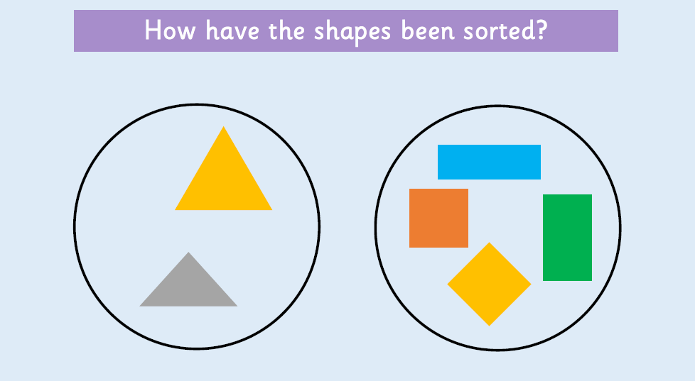
Warm up

Slide 3
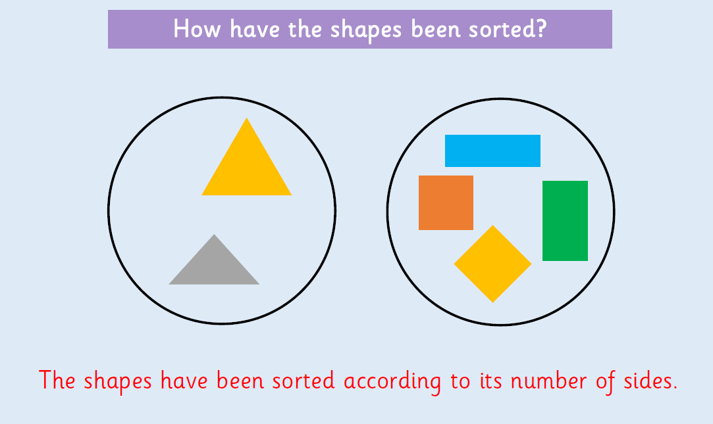

Slide 4
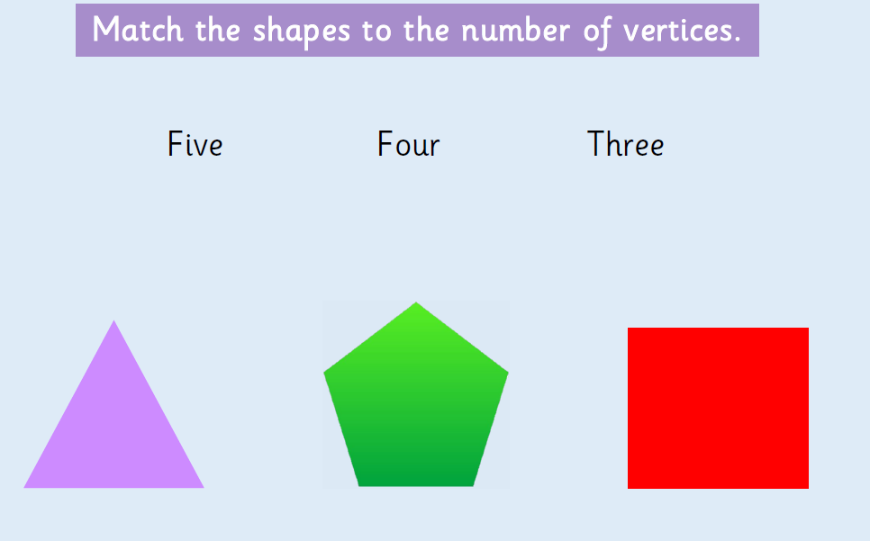
What are vertices?
A vertex is a corner where edges meet.
The plural is vertices.

Slide 5
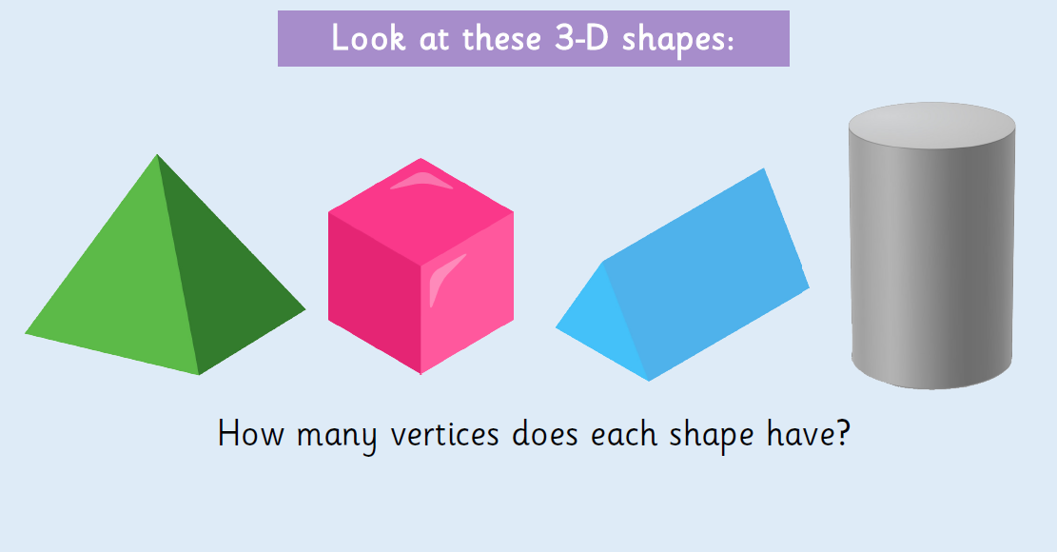

Slide 6
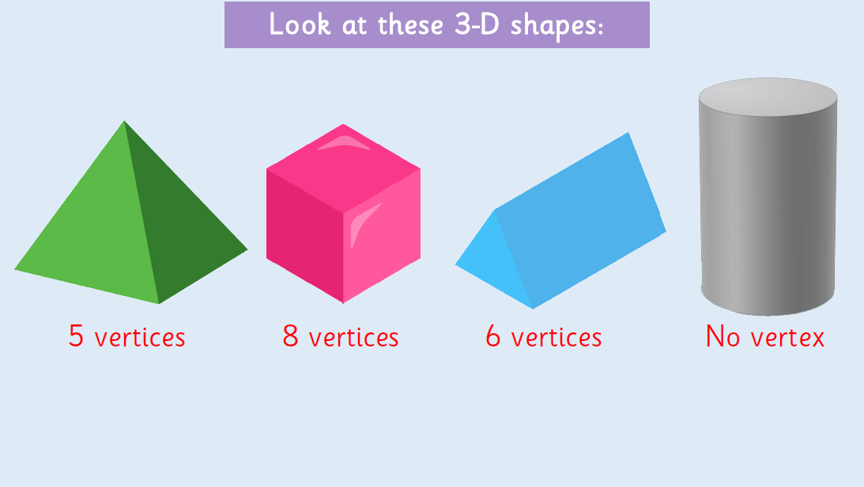

Slide 7
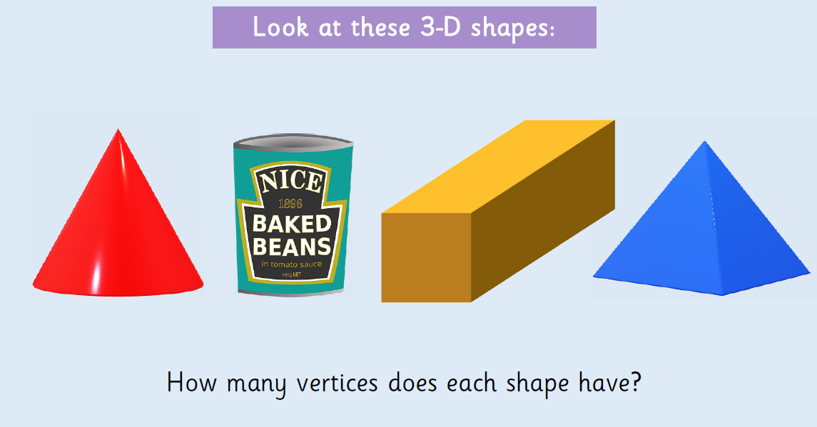

Slide 8
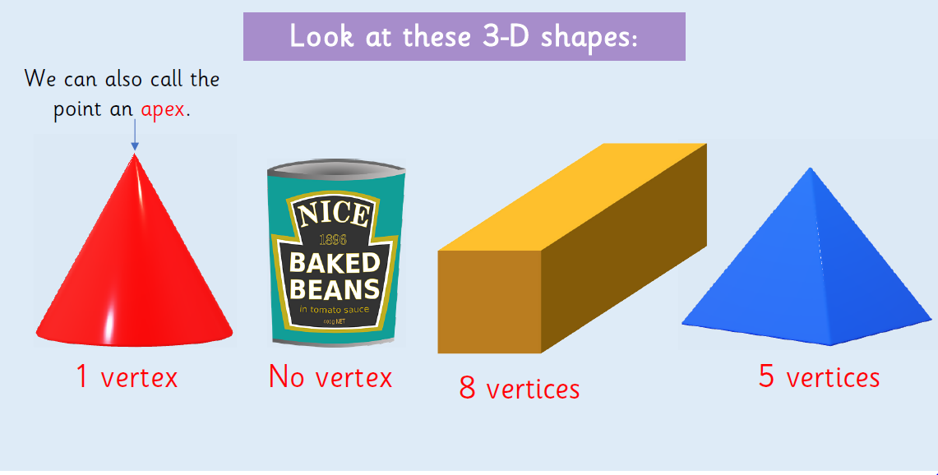

Slide 9
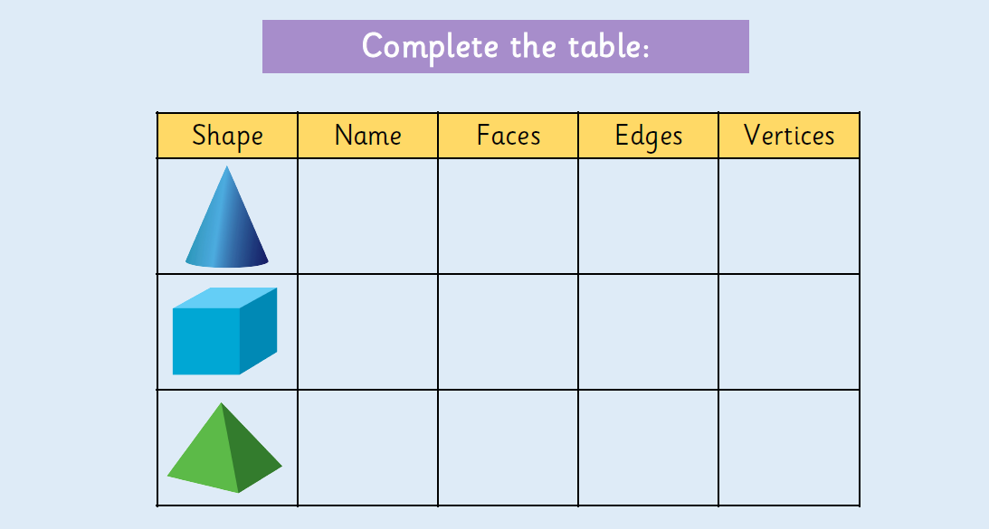

Slide 10
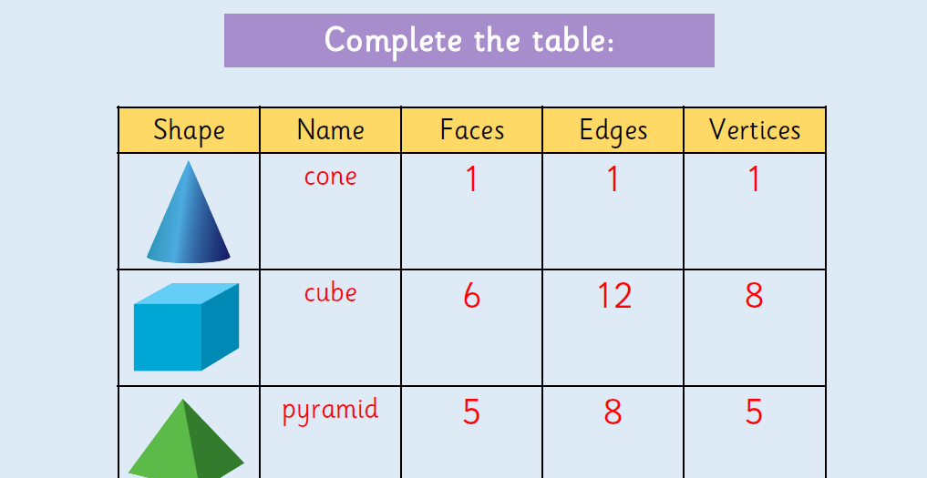

Slide 11
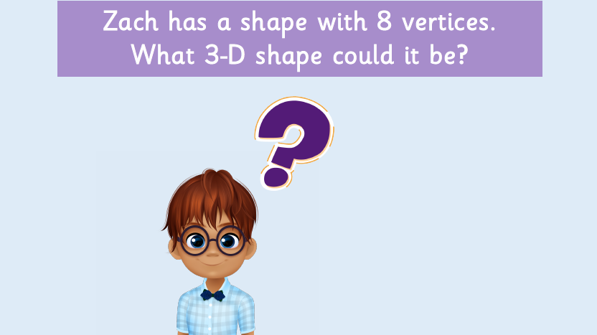

Slide 12
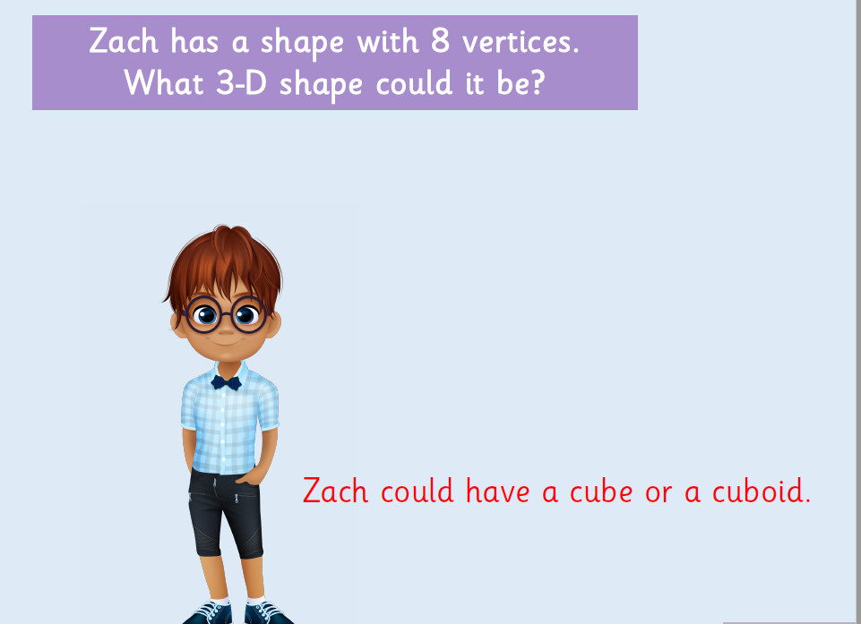

Slide 13
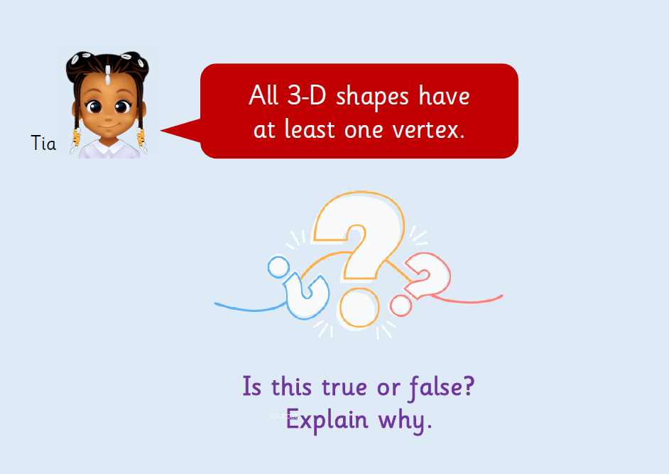

Slide 14
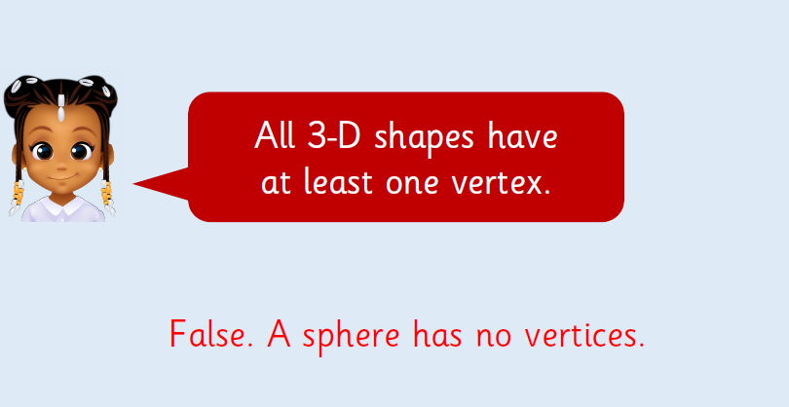

Slide 15
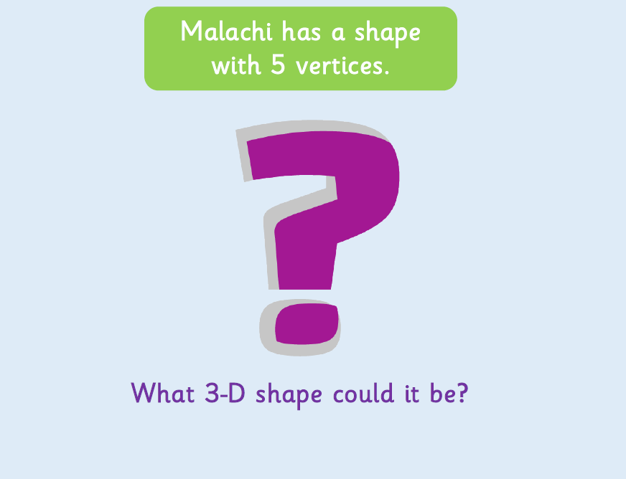

Slide 16
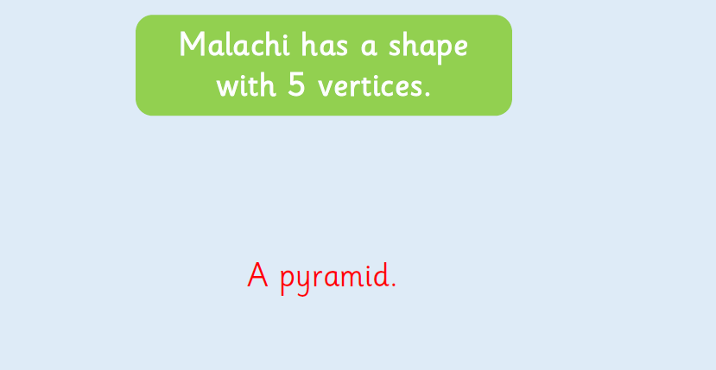

Slide 17
Watch the following BBC Bitesize clip about Properties of 3D shapes. https://www.bbc.co.uk/bitesize/topics/zjv39j6/articles/zgqpk2p
CPG Book p. 60 & 61

