Slide 1

Can you use a capital letter for the names of places

Slide 2
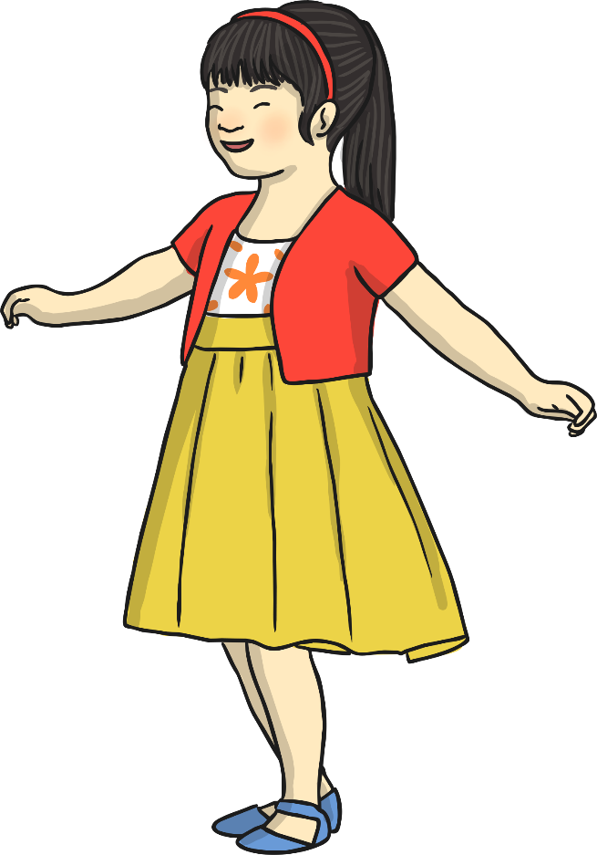
Last week we looked at
Capital Letters for Names
First names and surnames both need a capital letter.
Tom Smith
Holly Thompson
Jack Hill

Slide 3
This included using a capital letter for titles
Mrs Flower
Mrs Colbourn
Miss Gregson
Miss Harrison
Mr Bradley

Slide 4
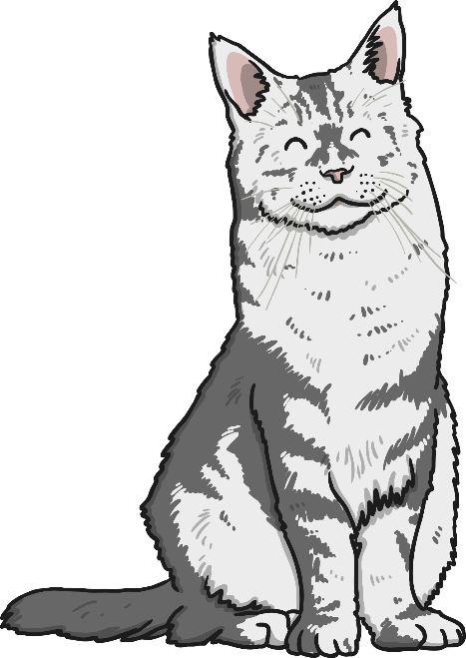
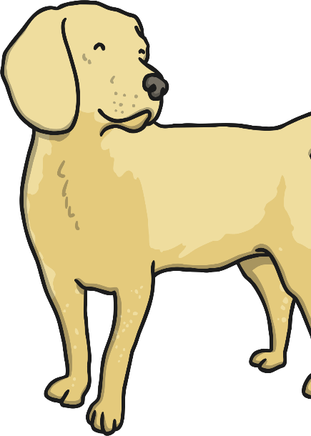
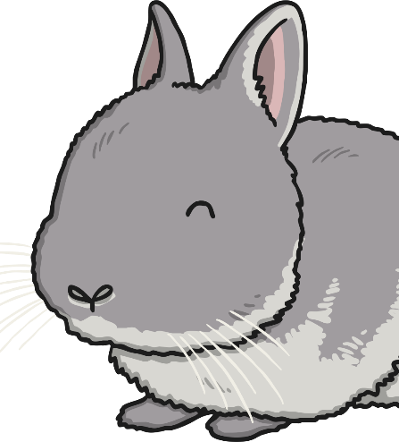
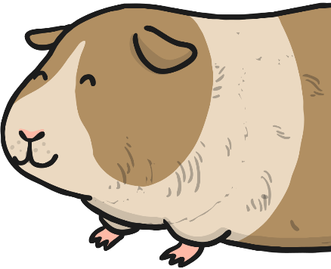
It also included capital letters at the start of the names of our pets.
Tom
Jessie
Fluffy
Twinkles

Slide 5
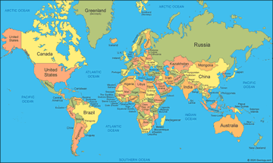
Today our focus is capital letters for place names

Slide 6
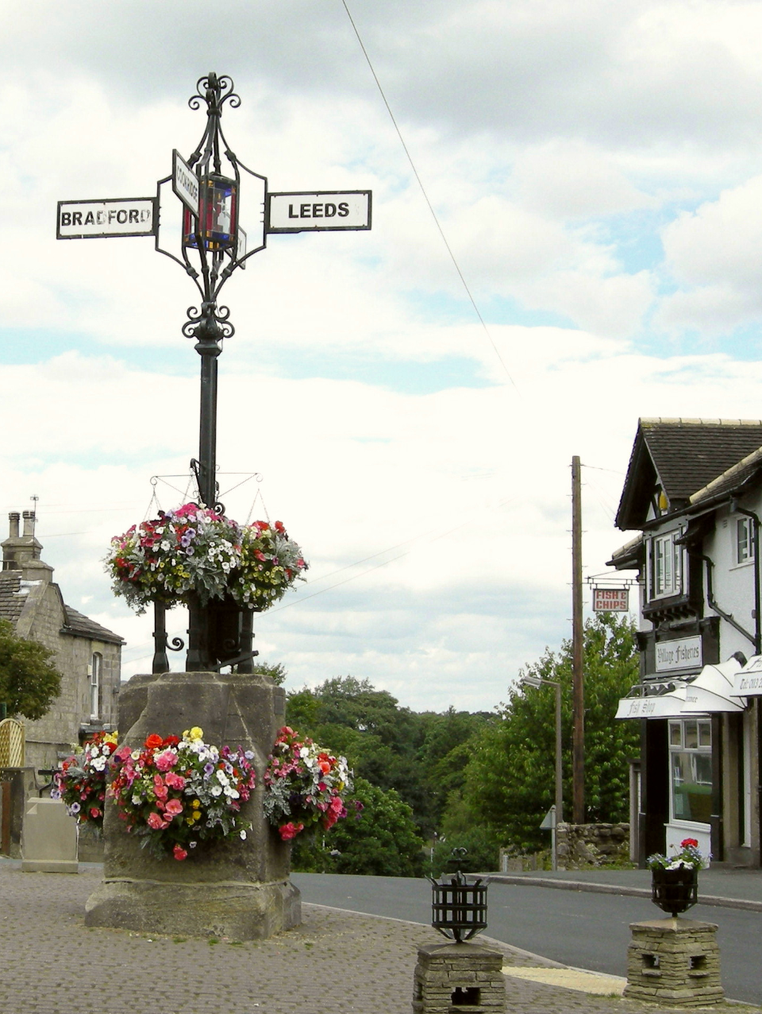
This could be a village, town or city
Bramhope
Leeds
Otley
Adel
Cookridge

Slide 7
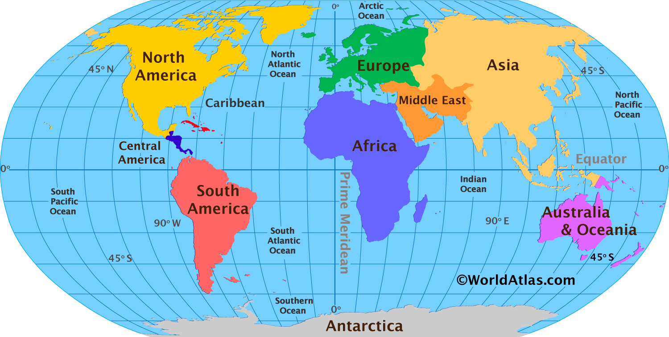
It might be a country or even a continent

Slide 8
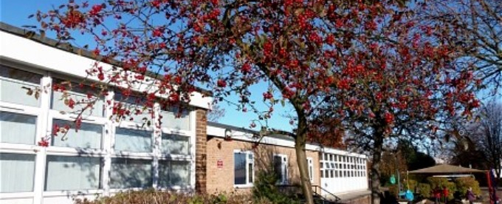
Capital letters are also used at the name of buildings and venues
Bramhope Primary School

Slide 9
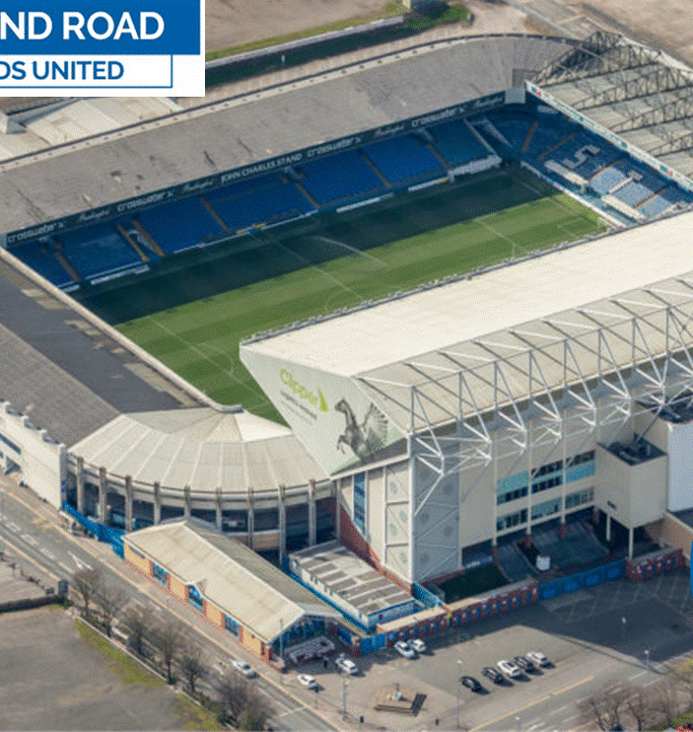
Elland Road Stadium

Slide 10
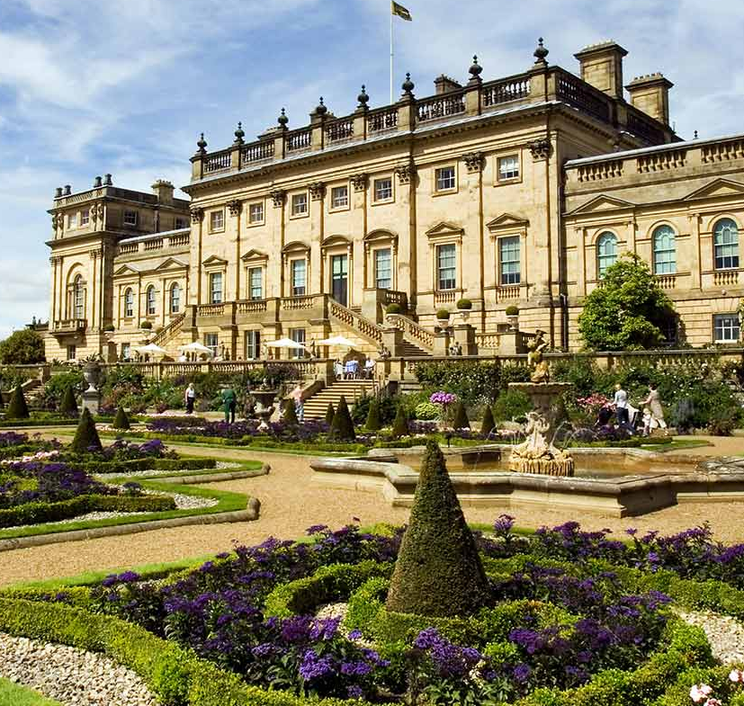
Harewood House

Slide 11
Tasks:
Write down some places.
-Start with some villages, towns and cities – this could include where you live or places you have visited recently e.g. Bramhope, Leeds. You may even include your street e.g Breary Rise, Leeds Road
-Now think about the names of different countries – think about places you have either visited or would like to visit. Our recent work in Geography may also help here.
-Finally, consider the name of specific buildings or venues you have visited. These places also require a capital letter e.g. Bramhope Primary School, Buckingham Palace, Wembley Stadium, Leeds General Infirmary, Alton Towers. Maybe the house you live in has a name as well as a number?
-Now write some sentences using these ‘names of places’.
Don’t forget to remember to use all the things we have learnt so far about good sentence writing.

