Slide 1
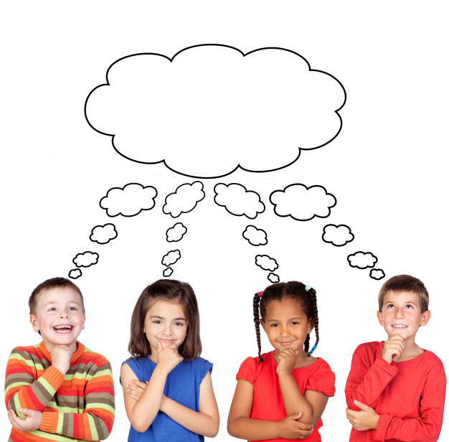
LC Can I write my own
prayer or reflection?

Slide 2
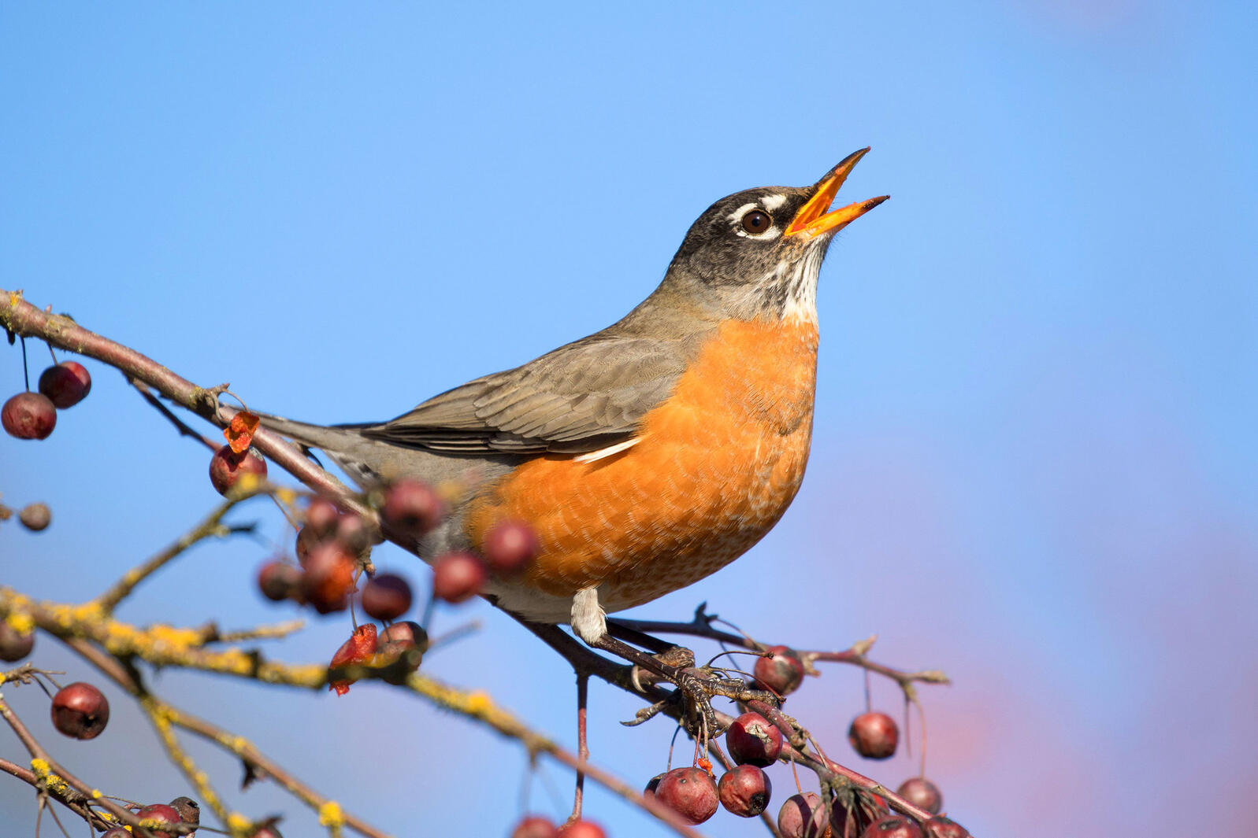
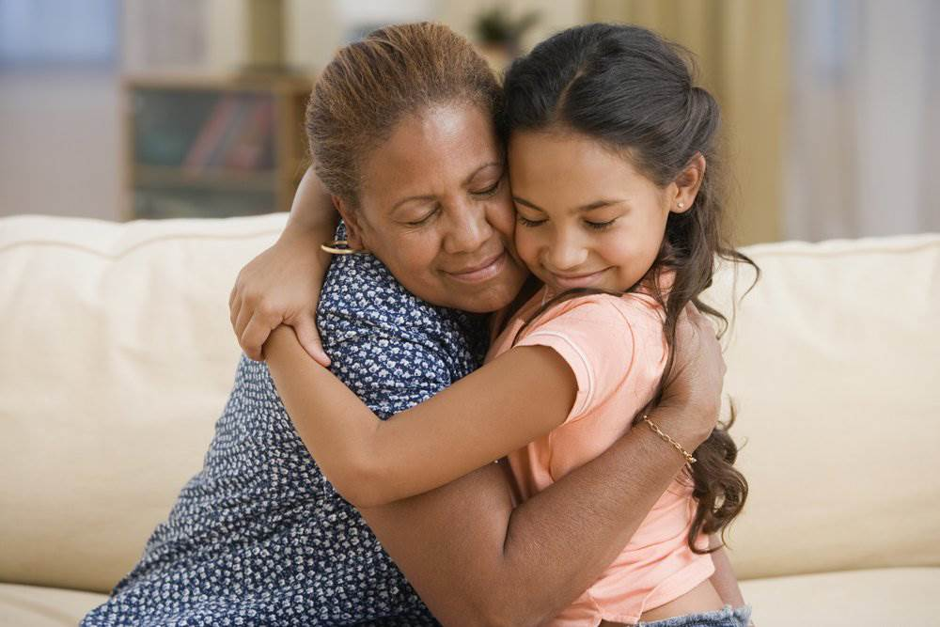
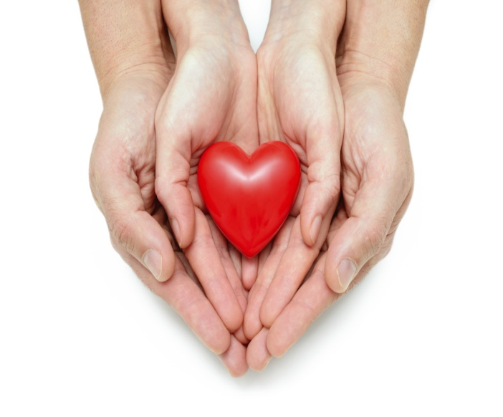
Take some time to think about all the things that are special to you.
Consider all the things around you that you are thankful for.
Try not to think too much about materialistic items but things that are particularly meaningful.

Slide 3
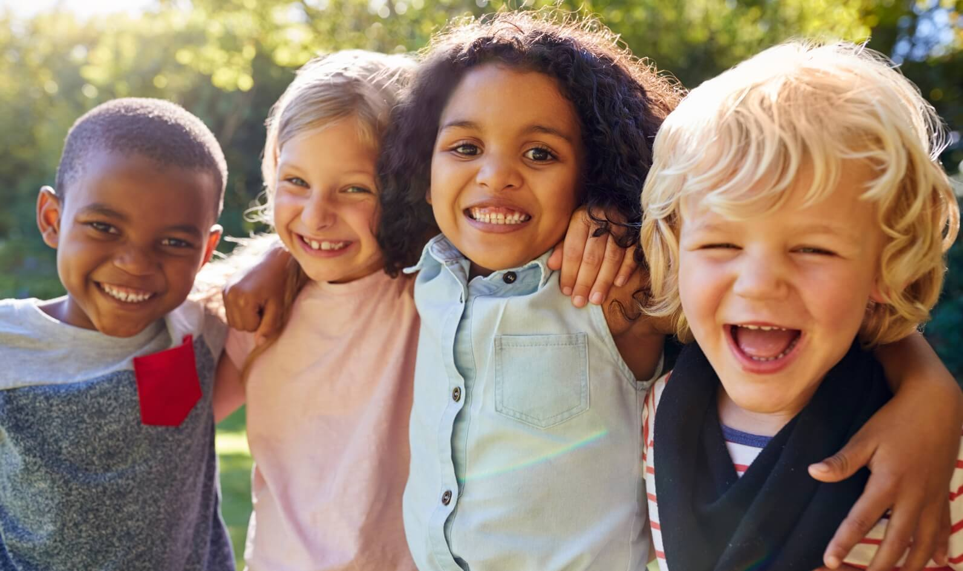
Lockdown is a time to really reflect on things that we maybe took for granted previously, but we are now really missing.
Or it may possibly be something we previously took for granted but we are really grateful for right now.

Slide 4
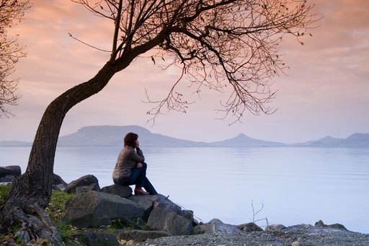
It might be a special place that you like to visit.
This special place may have many special memories of fun and good times.
It might be somewhere that you spent time with someone special. Maybe you don't get to see this person very often anymore. Or maybe not at all.

Slide 5
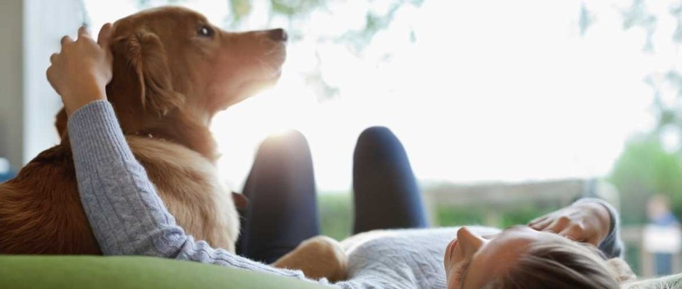
You might want to think about special friendships.
Or it could be family members.
Maybe you have some pets that are special to you.
Or it could be a photograph, souvenir or trinket.

Slide 6
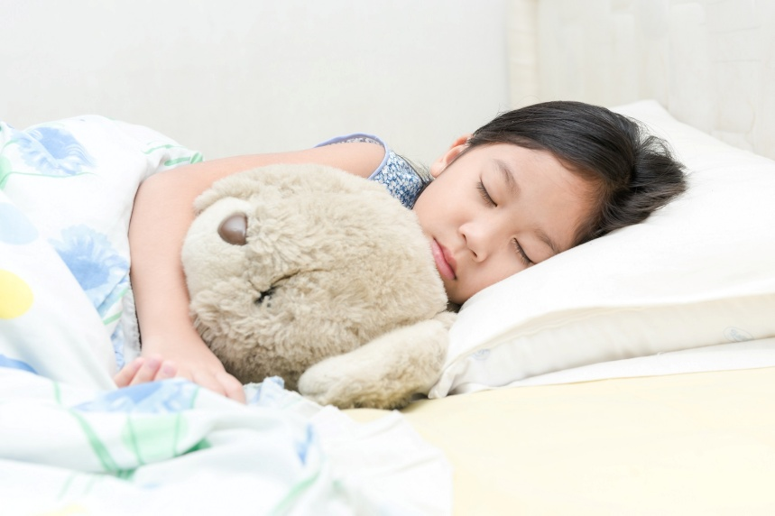
Maybe you have a special doll or teddy.
Maybe it is special because it helps you to get to sleep every night or a cuddly toy you have had since the day you were born.

Slide 7
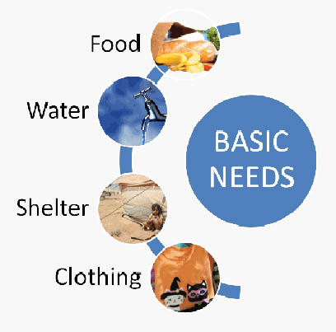
Consider
'wants' v 'needs'
We have lots of things in life that we 'want' and we say thank you for e.g. computer games, lots of toys, holidays.
But have you taken time to really consider the things that you have that we sometimes take for granted but need e.g enough food to eat, a shelter/home, love.

Slide 8
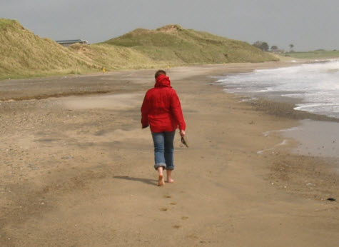
It might be that you are thankful for walks in the fresh air e.g the countryside or along a beach.
You may notice the naturally occurring environment – the cool breeze, the tweeting birds, the wildlife, the crashing waves, the trickling water.

Slide 9
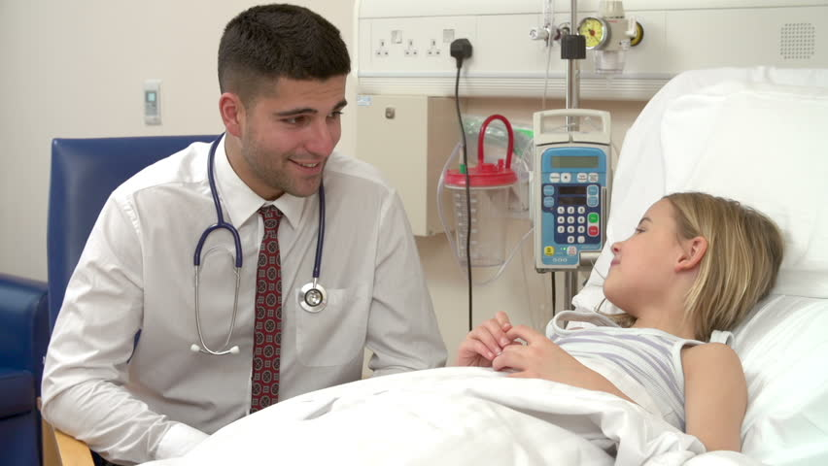
Maybe you are thankful for your health and that of a family member.
Or possibly you know someone who is not very well at the moment and you want to show that you are thinking about them and hoping they get better soon.

Slide 10
Task:
Today we are going to write our own prayer or reflection.
It is a little bit like a poem.
Sometimes we write and read/recite the same prayer or words of reflection.
At other times we speak from the heart and reflect in the moment.

Slide 11
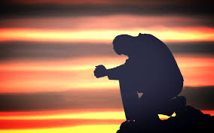
The following slides provide some examples and starting lines to support you.

Slide 12
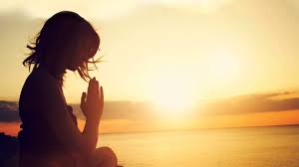
Caring
I care about the trees,
I care about the flowers,
I care about my friends,
I care about . . .

Slide 13
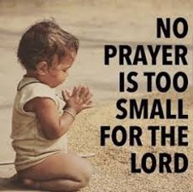
Take care
Dear Lord please . . .
Take care of the world around us
Take care of the animals
Take care of the fields
Take care of . . .

