Slide 1
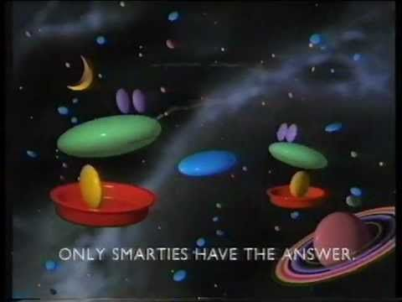
Yesterday, we considered the name and slogan for our product.
Let’s have a quick reminder

Slide 2
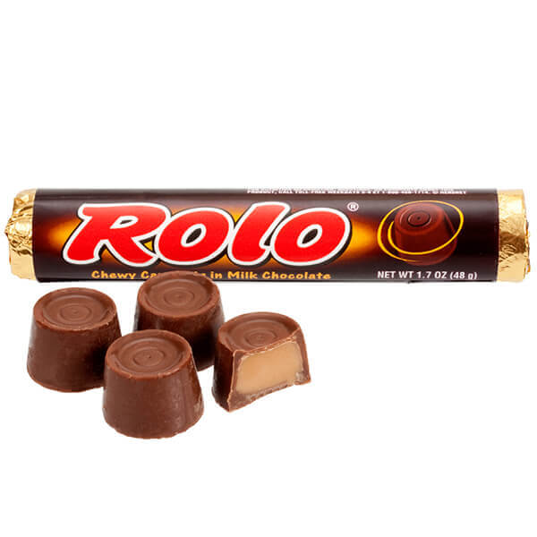
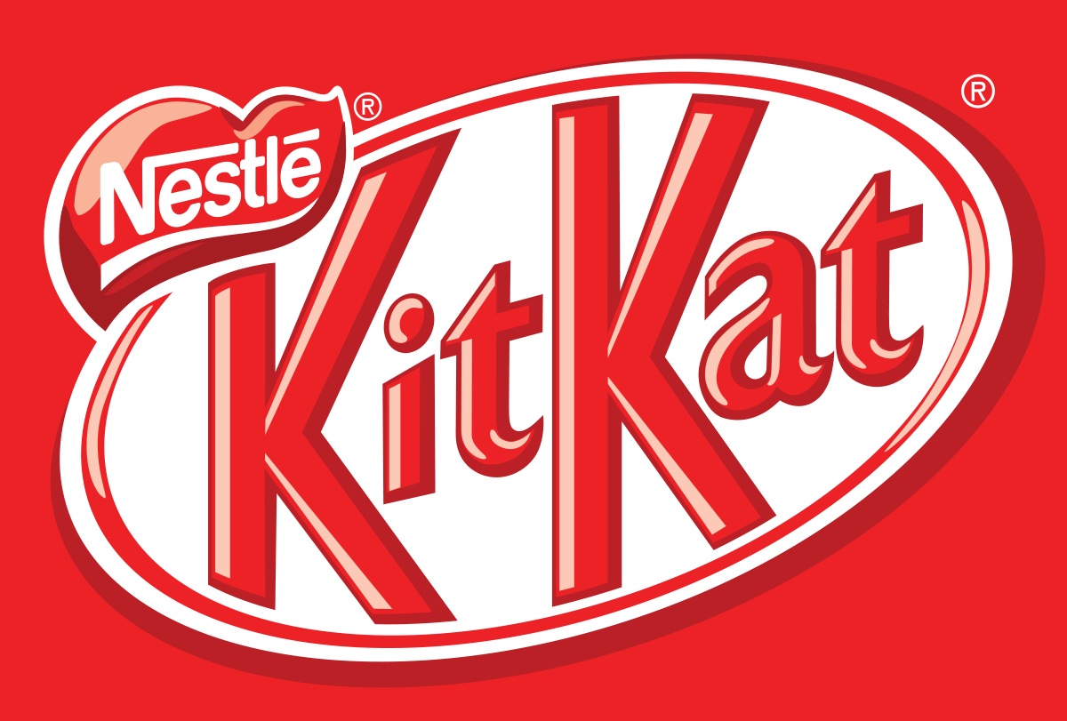
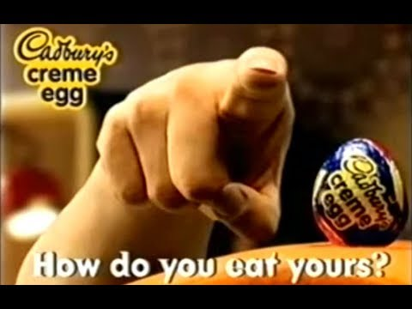

Do you love anyone enough to give them your last Rolo?
Have a break,
have a KitKat

Slide 3
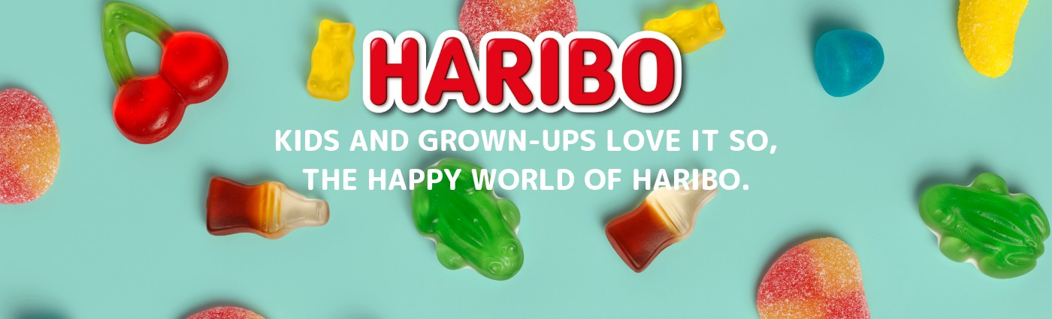
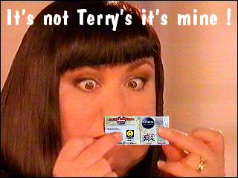
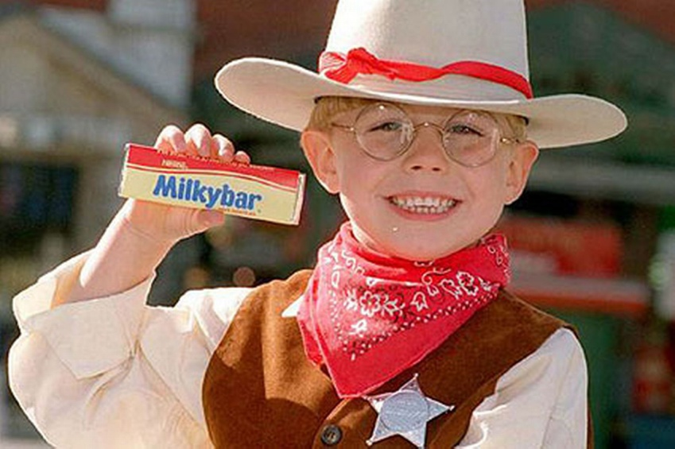
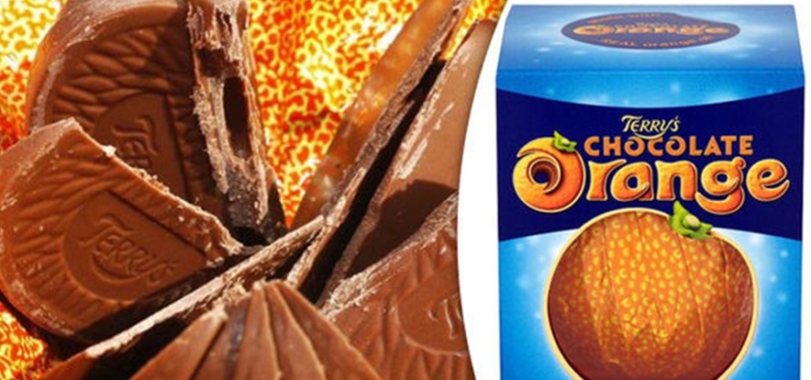
The Milky Bars are on me !

Slide 4
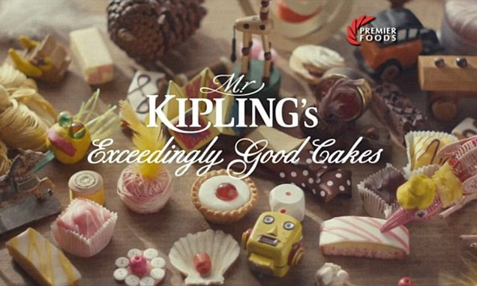

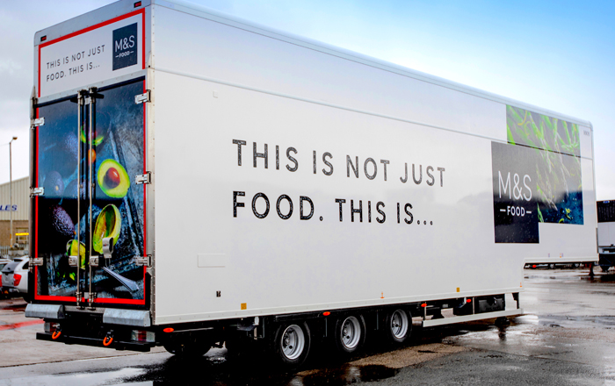
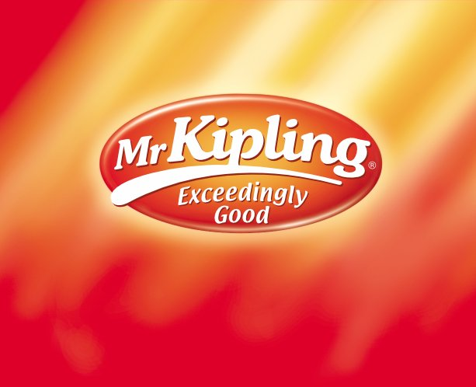

Slide 5

These slogans are often used on the packaging but also in adverts e.g. TV adverts, posters etc
Watch the adverts on the following slides and identify where the slogan is used in the adverts.

Slide 6
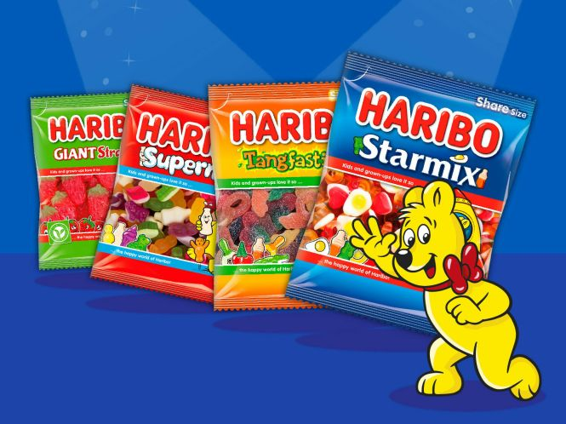
https://www.youtube.com/watch?v=29tCGFh43Tg
https://www.youtube.com/watch?v=78_vOtgdBzk

Slide 7
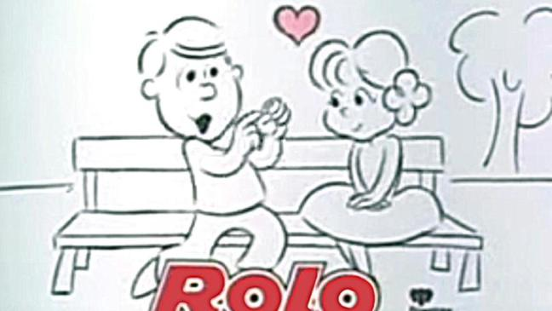
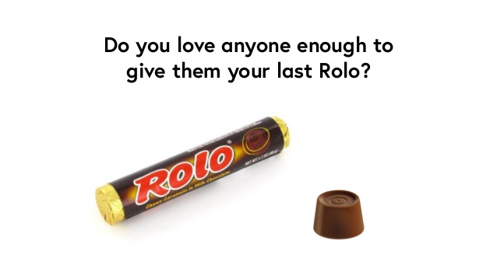
https://www.youtube.com/watch?app=desktop&v=_14WbDd3Zng
https://www.youtube.com/watch?v=ONPKr5s4Deo

Slide 8
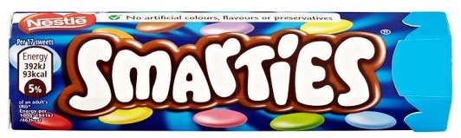
https://www.youtube.com/watch?v=DLb-mFTOD08
https://www.youtube.com/watch?v=pno6aYn3Eyo
Only Smarties have the answer!

Slide 9
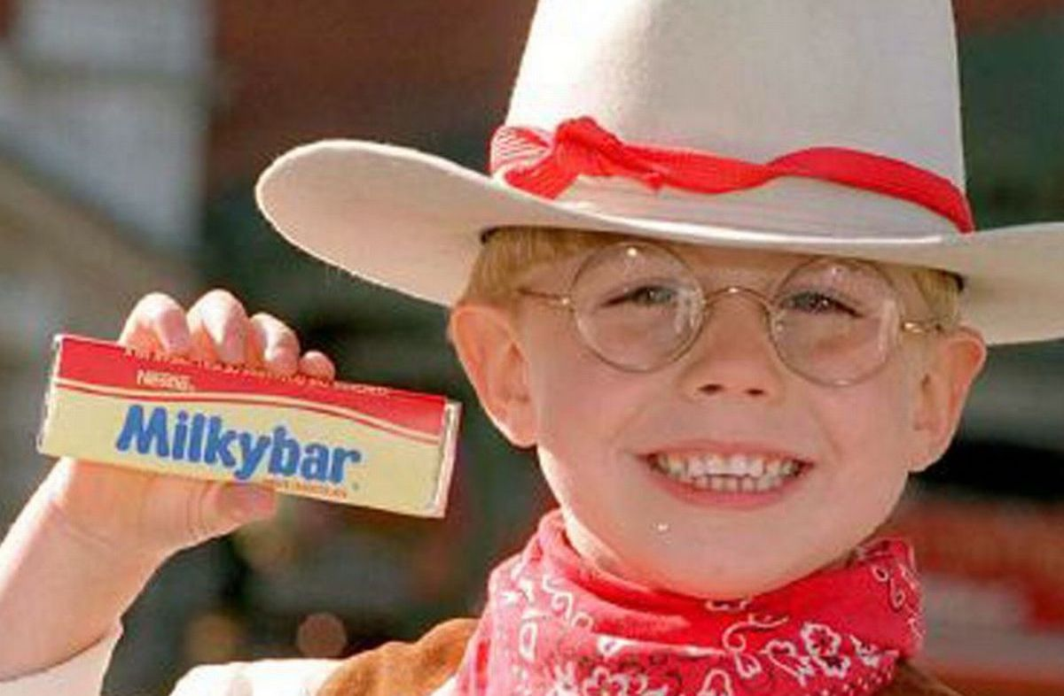
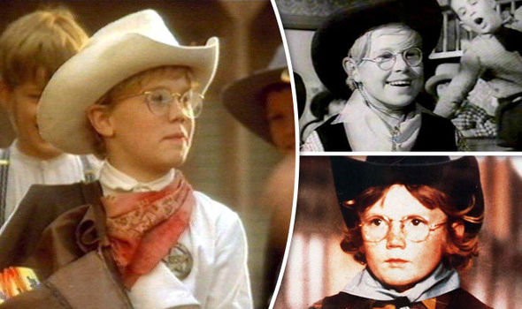
Can you design a character to go with your new invention?
This is The Milky Bar Kid
https://www.youtube.com/watch?v=x4ZFkU5GQAE
https://www.youtube.com/watch?v=WOovjhwG9X4
‘The Milky Bars are on me!’

Slide 10
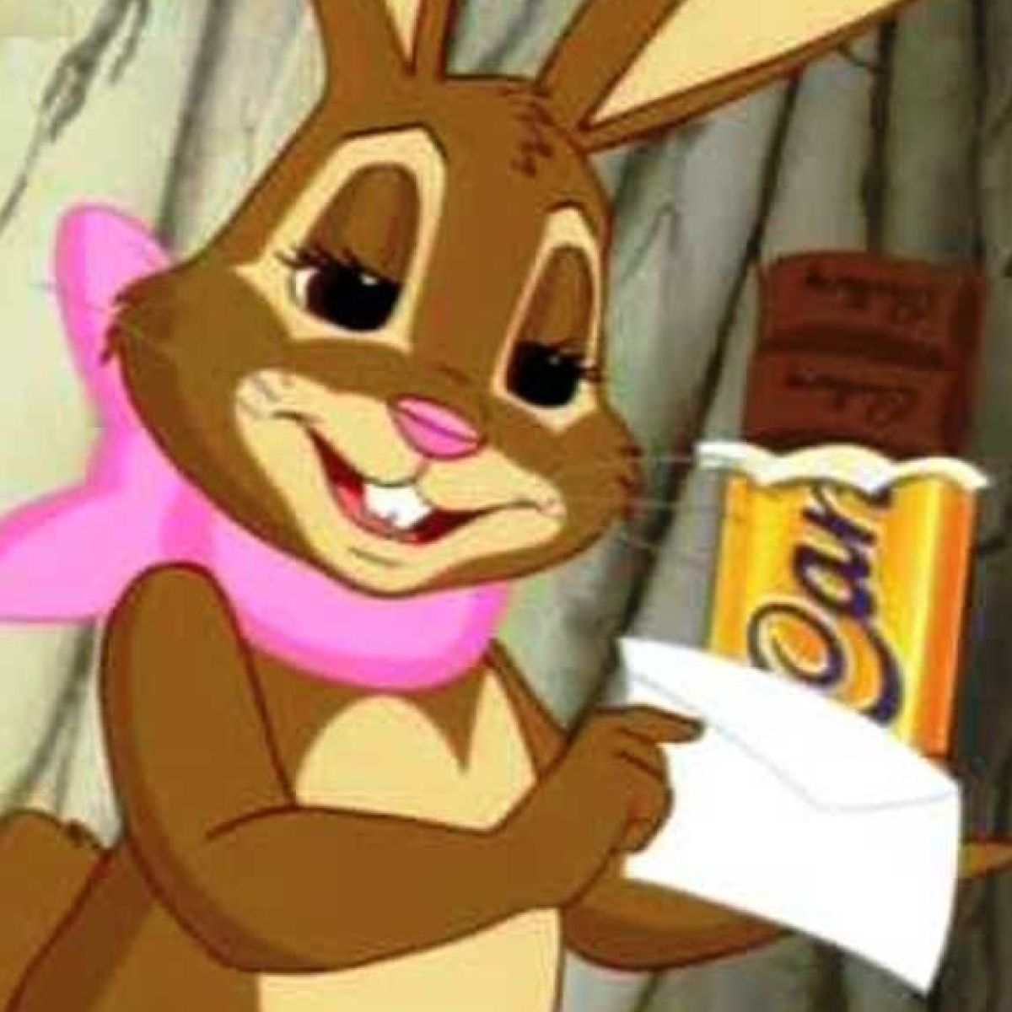
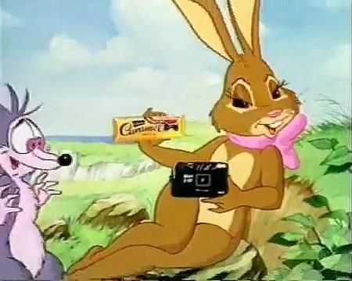
‘Take it easy with Cadbury’s Caramel’
https://www.youtube.com/watch?v=dvkexGUF79A
As well as a slogan, some chocolate bars have a character associated with them like the Cadbury’s Caramel Bunny.

Slide 11
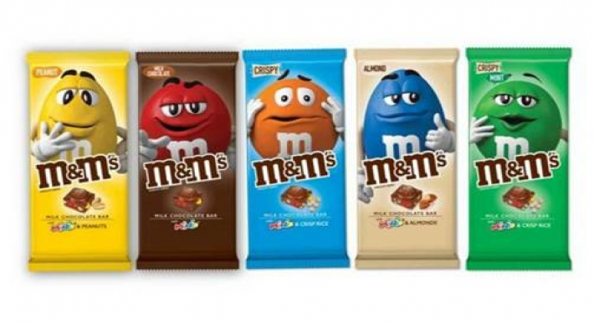
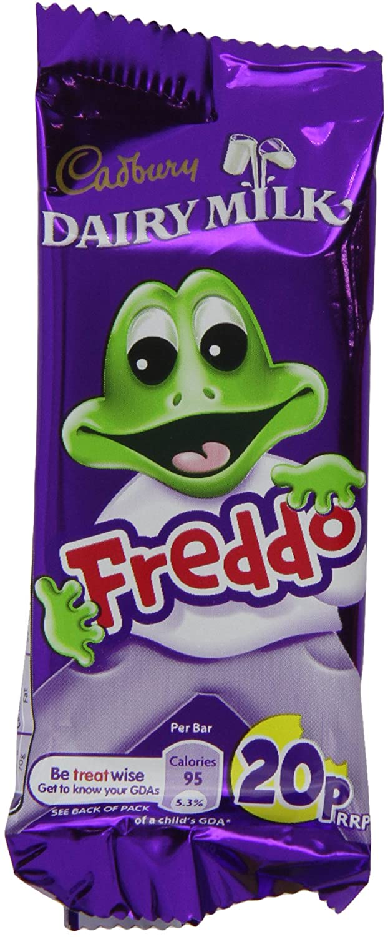


Slide 12
Extension work:
You might have noticed, whilst watching some of the adverts, that some had a song which included the slogan.
This is called a jingle.
The jingle might always be the same or sometimes, adverts alter some of the words but follow the same tune and contain the same slogan.
Jingle: a short slogan, verse, or tune designed to be easily remembered, especially as used in advertising.

Slide 13
Take a look back through some of the adverts shared already – can you spot a jingle?
Take a look at the following adverts where a longer jingle/song has been used.
Can you create a tune to go with your slogan to turn it into a jingle OR challenge yourself further and write as little song. You could use the tune of an existing nursery rhyme e.g. ‘Twinkle Twinkle Little Star’ to help you with this task.
Have fun with this Jingle Quiz! If you don’t know them – many of your parents will!
https://www.youtube.com/watch?v=vov5OHmSIqc

Slide 14
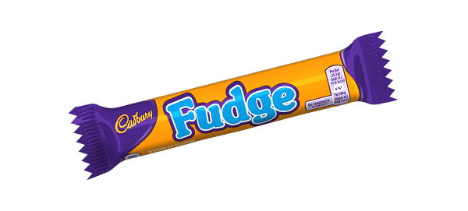
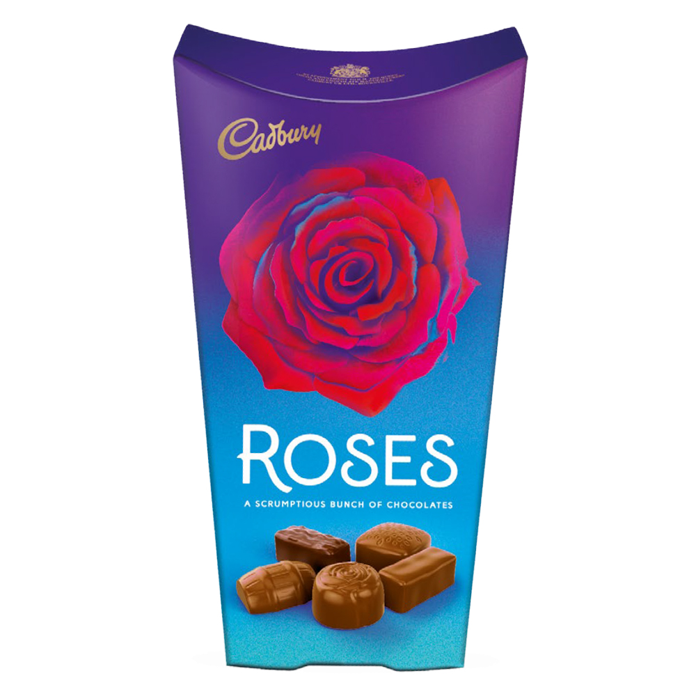
More inspiration:
https://www.youtube.com/watch?v=ZdITFVpAJvM
https://www.youtube.com/watch?v=nC9BBLSZZdQ
Thank You Very Much...
https://www.youtube.com/watch?v=VtP4VBsQQXw
https://www.youtube.com/watch?v=cslbOjFyHBU
https://www.youtube.com/watch?v=L33Yn-xqmPQ
More Jingle inspiration:
https://www.youtube.com/watch?v=UB2HC0zKCT0

