Slide 1
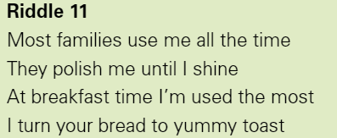
Warm Up - Riddles

Slide 2
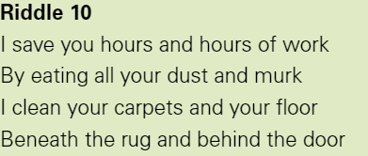
Warm Up - Riddles

Slide 3
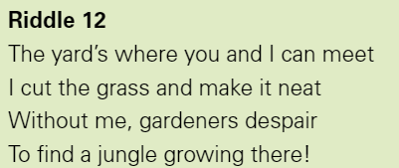
Warm Up - Riddles

Slide 4
Nikola Tesla
Questions?
Where was he born?
What is the name of the electrical system he invented?
How many inventions does he have to his name?

Slide 5
Nikola Tesla
Answers
Croatia
AC or alternating current
700

Slide 6

LC: Can you find out about Thomas Edison?
By the end of the lesson, you should:
Be able to explain who Thomas Edison was
Explain what he is known for
Be able to give some key facts about his life

Slide 7
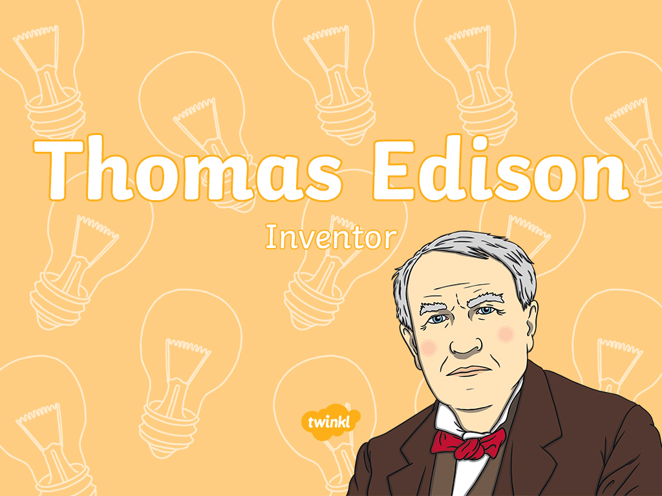

Slide 8
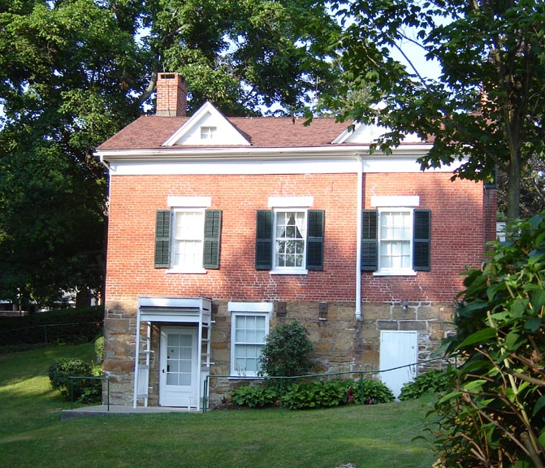
His Childhood
Thomas Alva Edison was born in Ohio, America. He was the seventh child of Samuel and Nancy Edison.
As a child, he had hearing problems from the illness scarlet fever.
His mother was a teacher, so he did not go to school but was
taught at home.
User: (WT-shared) 2old at wts wikivoyage [CC BY-SA 4.0-3.0-2.5-2.0-1.0 (http://creativecommons.org/licenses/by-sa/4.0-3.0-2.5-2.0-1.0)], via Wikimedia Commons

Slide 9
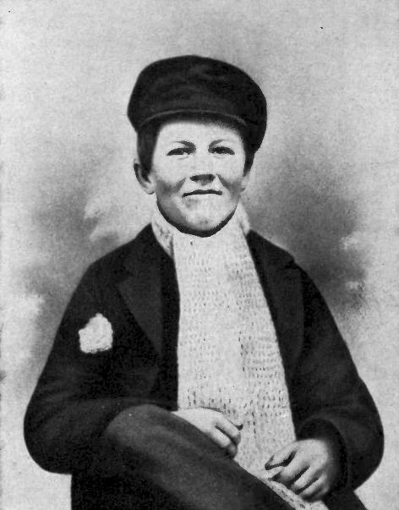
Teenage Years
As a teenager, Edison sold candy and newspapers on trains. Quickly, he became quite a good businessman and, with four assistants, started selling newspapers on the streets.
Did you know…?
Because he didn’t have access
to books from a school, Thomas got himself a library card for
the local library and it is said that he read all the books in there!

Slide 10
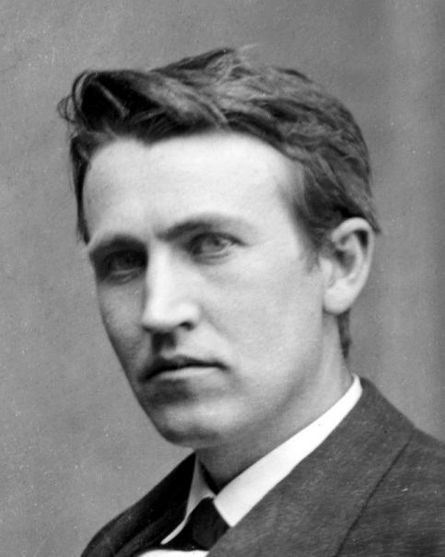
Edison First Job
Thomas Edison got his first job by accident when he saved a 3
year-old boy from being hit by a train. The boy’s father was so
grateful that he gave Thomas a job as a telegraph operator!
What is it?
A telegraph operator is a person who operates a telephone switchboard.

Slide 11
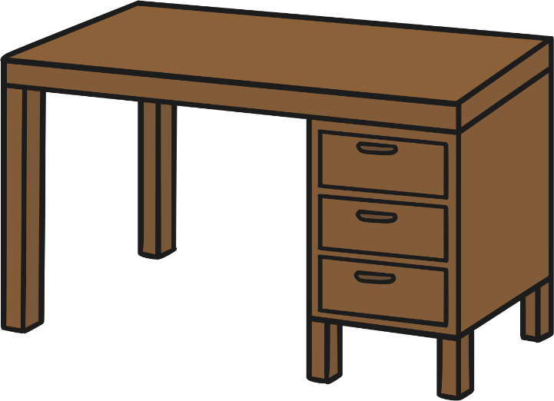
Losing His Job
At 19 years of age, Thomas moved to Kentucky to start a new job. He chose to work at night so that he could carry on with his experiments in the daytime.
Unfortunately, he spilt sulfuric acid on the floor and it dripped through the wooden floor boards onto the desk of his boss below.
Thomas Edison was fired!

Slide 12
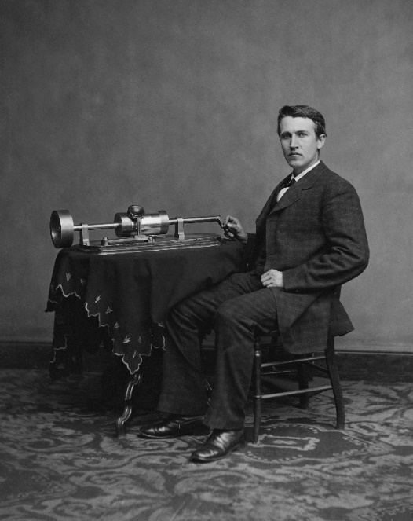
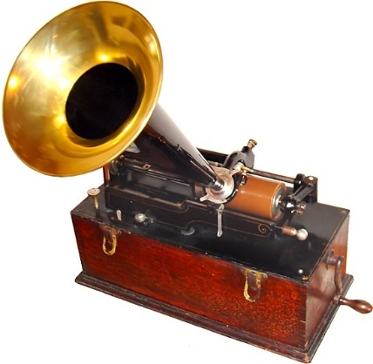
His First Invention
Thomas Edison’s first invention was completed in 1877 – the phonograph. This was a machine that could record and replay sound. The sound was played through a large horn.
Edison recorded himself saying the nursery rhyme ‘Mary Had a Little Lamb’ and was amazed when his invention played it back to him.
Edison’s phonograph was based on his work on
the telephone and the earlier invention of the
phonautograph, the earliest known sound
recorder, which was invented
by Édouard-Léon Scott de
Martinville in 1857.
By Terren (Edison Light Bulb) [CC BY 2.0 (http://creativecommons.org/licenses/by/2.0)], via Wikimedia Commons

Slide 13
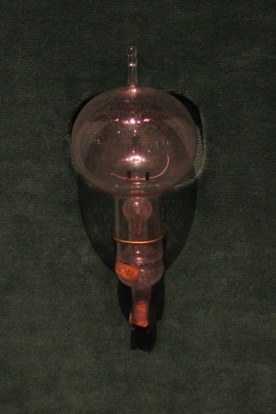
The First Electric Lightbulb
Thomas began to try to invent a light that did not need oils or gas to
be lit. Edison created a lightbulb that would stay lit using electricity
for 13 ½ hours!
In 1879, he demonstrated his amazing invention to a group of people
in Menlo Park. Because of this, he became known as the ‘Wizard of Menlo Park’.
Did you know…?
The first light bulb needed a tiny piece of bamboo to work properly.
By Terren (Edison Light Bulb) [CC BY 2.0 (http://creativecommons.org/licenses/by/2.0)], via Wikimedia Commons

Slide 14
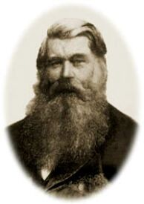
The First Electric Lightbulb
There has been some debate over whether Thomas Edison was the first person to invent the electric lightbulb.
Other inventors had made early versions of electric lamps, including Henry Woodward and Mathew Evans, who later sold their idea to Edison.
In 1850, Joseph Swan, a British inventor, began working on his own version of a lightbulb. In 1879, Swan was able to publically show a working lamp, the same year that Edison’s lightbulb was patented.
In order to avoid competing, Edison and Swan joined companies in 1883 to form Edison and Swan Electric Light Company.
Did You Know…?
Joseph Swan’s house in Gateshead, ‘Underhill’, was the first house to have working lightbulbs installed.

Slide 15
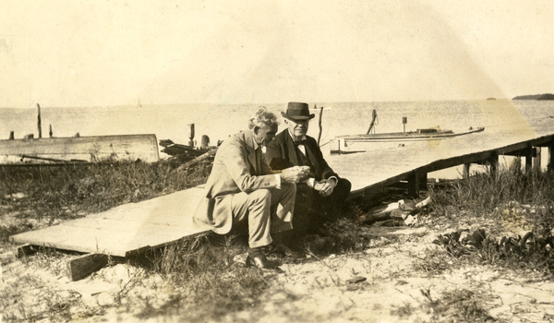
Making Friends
Soon, the car maker Henry Ford asked Thomas Edison to design a battery for a car to start itself. Edison did this, and Ford and Edison became great friends.

Slide 16
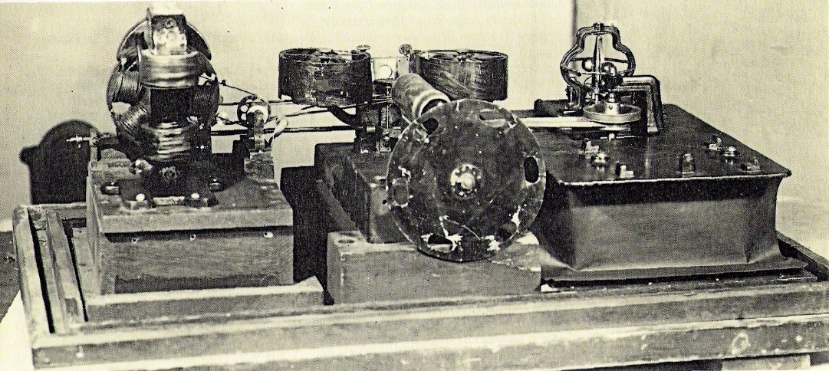
Other Inventions
Edison invented a machine called a kinetograph that could crush
rocks that had been brought up from the mines.
He also developed the carbon transmitter that improved the sound heard down a telephone line.

Slide 17
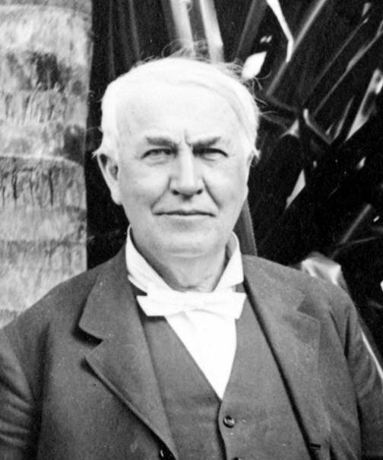
A Super Inventor
Thomas Edison was a very careful worker, who is now known as
one of the most important inventors in history.
He managed to encourage very important people to support his inventions and put money into them, so that he had the time to
work on them properly.

Slide 18

The End of an Inventor
Thomas Edison died in 1931 from problems with diabetes. He was 84 years-old.
Almost everyone in the world has used at least one of his inventions: the electric lightbulb. We are still using them today, over 100 years later!

Slide 19
LC: Can you find out about Thomas Edison?
By the end of the lesson, you should:
Be able to explain who Thomas Edison was
Explain what he is known for
Be able to give some key facts about his life
Task
Choose how to present your research.
Tips:
Use the PowerPoint to help you.
Complete on plain paper or in your book.
Make sure you have clearly shown who he is, what he did and some other key facts.
There is a fact sheet for you to use as well.

