Slide 1

LC: Can I identify and use determiners?

Slide 2
Aim
I can identify and use determiners.
Success Criteria
I can explain what a determiner is.
I can identify determiners.
I can explain where a determiner belongs in a sentence.
I can explain that there are different types of determiners.
I can include determiners in my own writing.

Slide 3

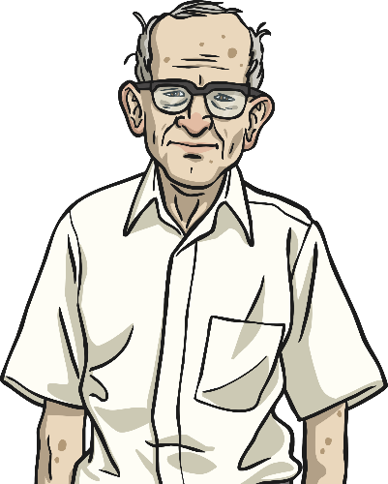
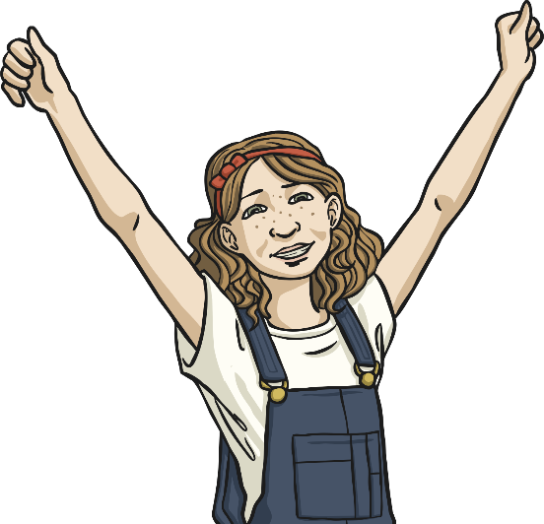
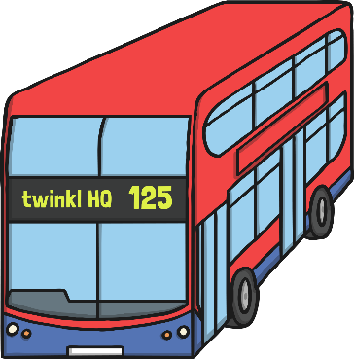

Understanding Determiners
Nouns
Nouns are often known as ‘naming words’ because they name people, places, objects and ideas.
Person:
Grandpa
Idea:
excitement
Object:
football
Place:
London

Slide 4
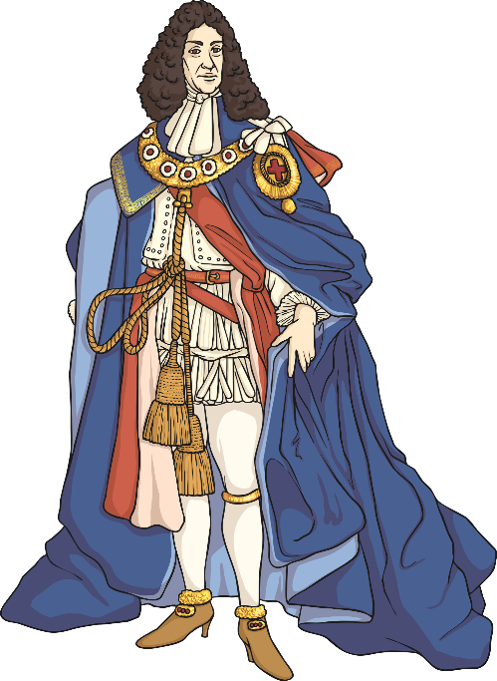
Understanding Determiners
What is a Determiner?
Determiners are words that come before a noun.
Determiners come before any modifiers such as adjectives.
They introduce the noun and give the reader important information about it.
the
my
king
Determiners
a

Slide 5
Understanding Determiners
Specific Determiners
These refer to a specific noun. Use specific determiners when the reader knows exactly what noun you are referring to.
The definite article
Demonstrative determiners
her
his
the
this
those
our
my
whose
these
which
that
their
your
what
Possessive determiners
Interrogative determiners

Slide 6
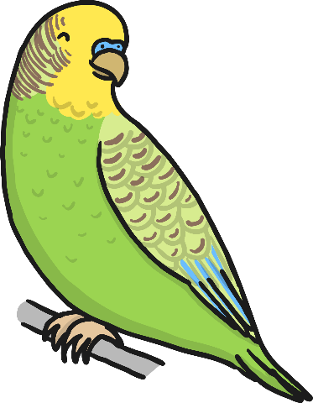

Understanding Determiners
Specific Determiners in Action
Use specific determiners when the reader knows exactly what noun you are referring to.
Which film did you go and see?
Your pet budgie is smiling at me.
Try completing this sentence using a specific determiner:
___________ Dad’s car broke down on the way home last night.

Slide 7
Understanding Determiners
General Determiners
These refer to general nouns or nouns that the reader does not know.
General determiners can also tell the reader how many nouns you are talking about, these are called quantifiers.
more
any
a
Indefinite article
less
some
few
an
many
some
five
Quantifiers

Slide 8


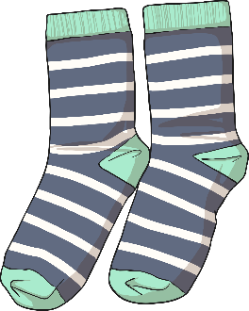
Understanding Determiners
Can you identify the determiner in this sentence?
Any computers must be turned off.
Now try these trickier sentences which have two determiners.
The river is just beyond those trees.
Five seagulls landed on the beach.
Whose socks are these stripy ones?

Slide 9
Understanding Determiners
Did you identify it correctly?
Any computers must be turned off.
Did you spot both the determiners in each sentence?
The river is just beyond those trees.
Five seagulls landed on the beach.
Whose socks are these stripy ones?

Slide 10

Determiner Detectives
Have a go at the worksheet to see if you can find the determiners.
There are two sheets for each year group.
You can complete one or both.
Extension – If you want some more practice there is an extra sheet.

