Slide 1
60s to think of synonyms better than:
‘sad’

Slide 2
gloomy, sorrowful, crestfallen, unhappy, melancholy.

Slide 3
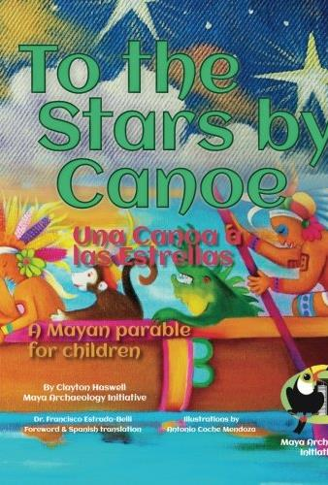
Thursday: LC: Can I bring my myth to life?
We have completed our writing on Maya myths so today you are going to bring your story to life. Home-learners, you have the choice of 2 tasks:
Task 1
For task 1, we’d like you to pick your favourite part of your story and you are going to to create a ’freeze-frame’ of the scene.
Task 2 (Home-learners option)
Create a miniature world showing your story.

Slide 4
What is a freeze -frame?
https://www.youtube.com/watch?v=7N_cT-bjSqI

Slide 5
What is a freeze -frame?
What part of the story will you pick?
What will your ‘thoughts’ be?
Do you need to involve your family in your freeze-frame?

Slide 6
Task 2 – home-learners.
Which part of your quest will you bring to life?
What are the key features of your setting which you want to show?
What materials do you already have that you can use?
E.g. cereal boxes, figurines, arts and crafts.

Slide 7


