Slide 1
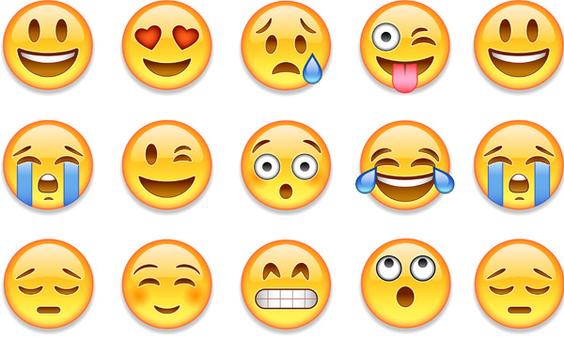
The Importance of Mental Health & Wellbeing.
Expressing Yourself

Slide 2
Warm up task –
Using a piece of paper, can you write the alphabet in the margin.
Can you think of an emotion / feeling for each letter of the alphabet. I have given you a few to get you started.
A-
B-
C-
D-
E- Excited
F-
G-
H-
I- Irritated
J- Joy
K-
L-
M-
N-
O-
P-
Q-
R-
S-
T- Terrified
U-
V-
W-
X-
Y-
Z-

Slide 3
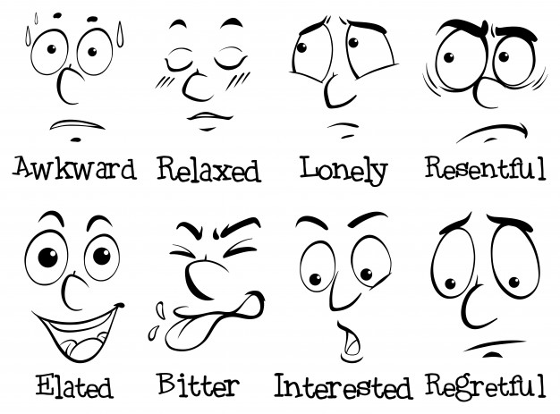
What does it mean to express yourself?
When you use expressions you are making your thoughts and feelings known.
Some people find it really easy to express themselves and find it easy to talk to people about how they are feeling.
Some people find it tricky to express themselves and do not like to or want to talk about how they might be feeling.
Talking about your feelings can be a tricky thing to do.

Slide 4
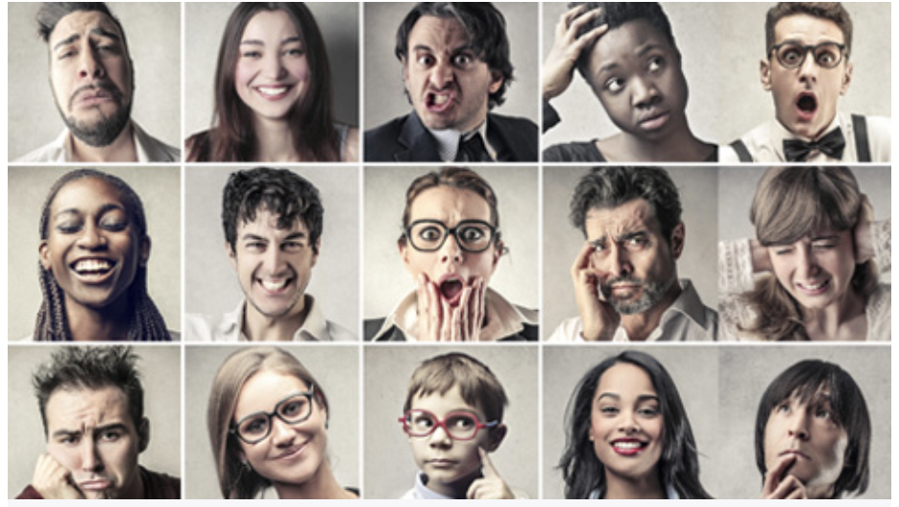
When might we use expression or use the word expression?
You might hear your teaching asking you to use expression when you read, this is about using expression in your voice to show how a character might be feeling or thinking.
You might also hear people talking about facial expressions.
Just by looking at the faces below, can you work out how they are feeling?
Task
Try to pull as many different facial expressions as you can.
You could show a sibling or your parents and see if they can guess what feeling or expression you are trying to do.
If you don’t have some one to try this on you could try pulling as many different faces as you can in a mirror.

Slide 5
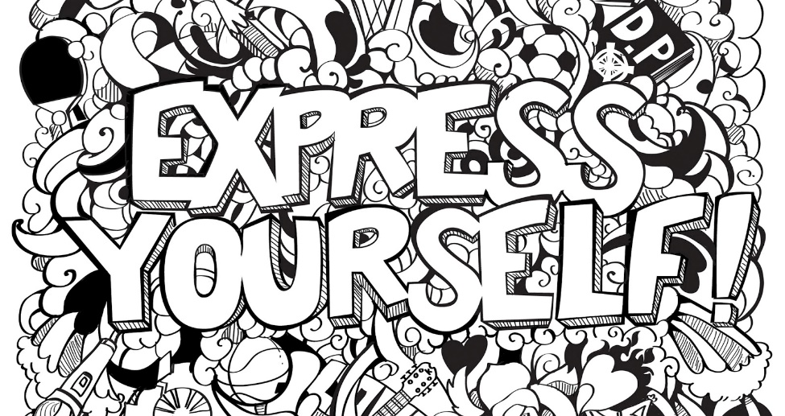
There are hundreds of ways…
There are lots of different ways that help you to express yourself and there are hundreds of different things that might effect your emotions.
There has been a lot of change in the past year. We have had to cope with lots of changes, this might make you feel lots of different emotions, your emotions now might be different to how you felt a year a go. It is ok to have different emotions and it is ok for your emotions to change.
That is the same for expression. The way that you express yourself can change and sometimes we have to try different things to see if they help us to process our emotions.

Slide 6
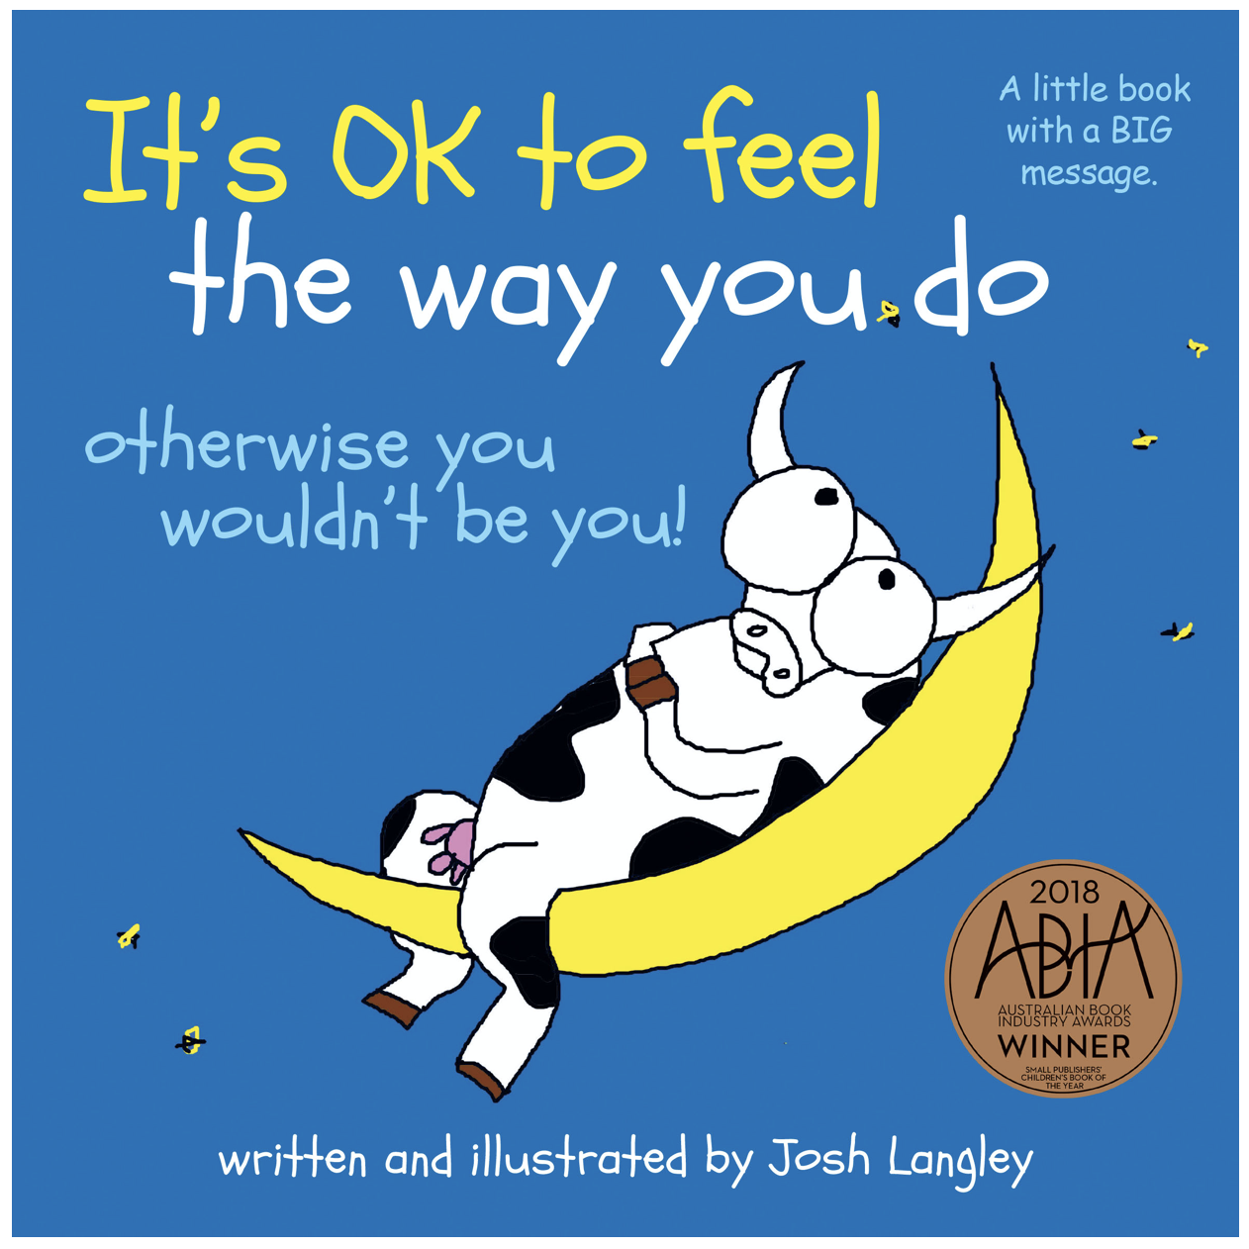
Look on the next few slides for some great ideas for Josh Langley, an Australian author who writes about some of the ideas we’ve been talking about.

Slide 7
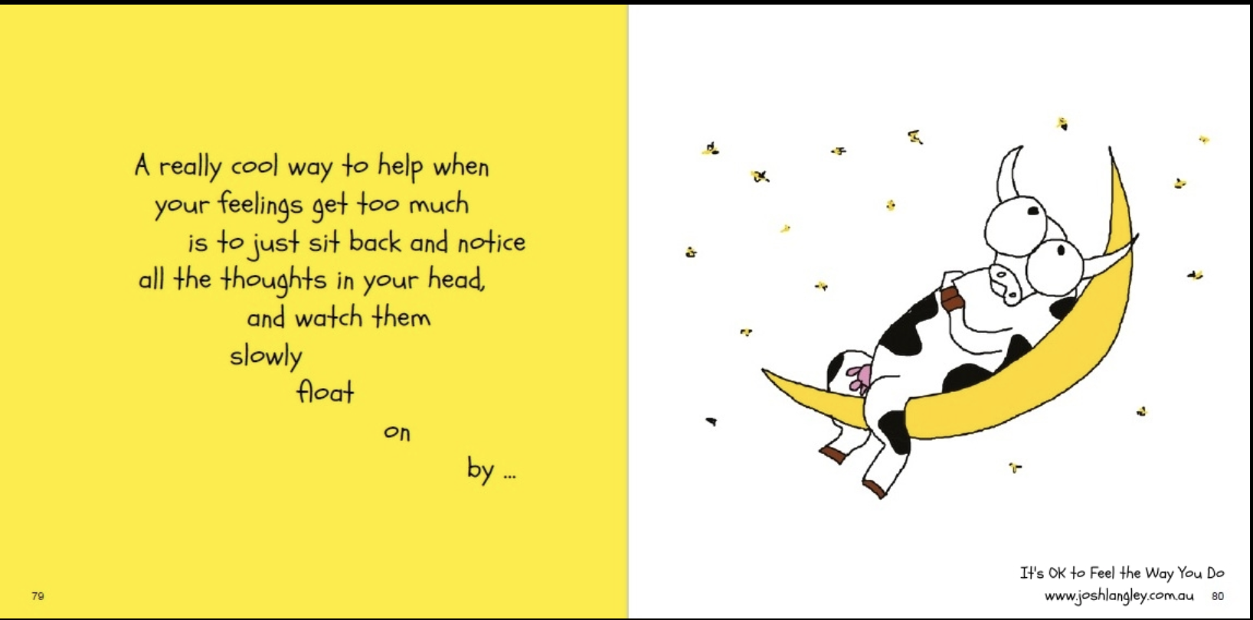

Slide 8
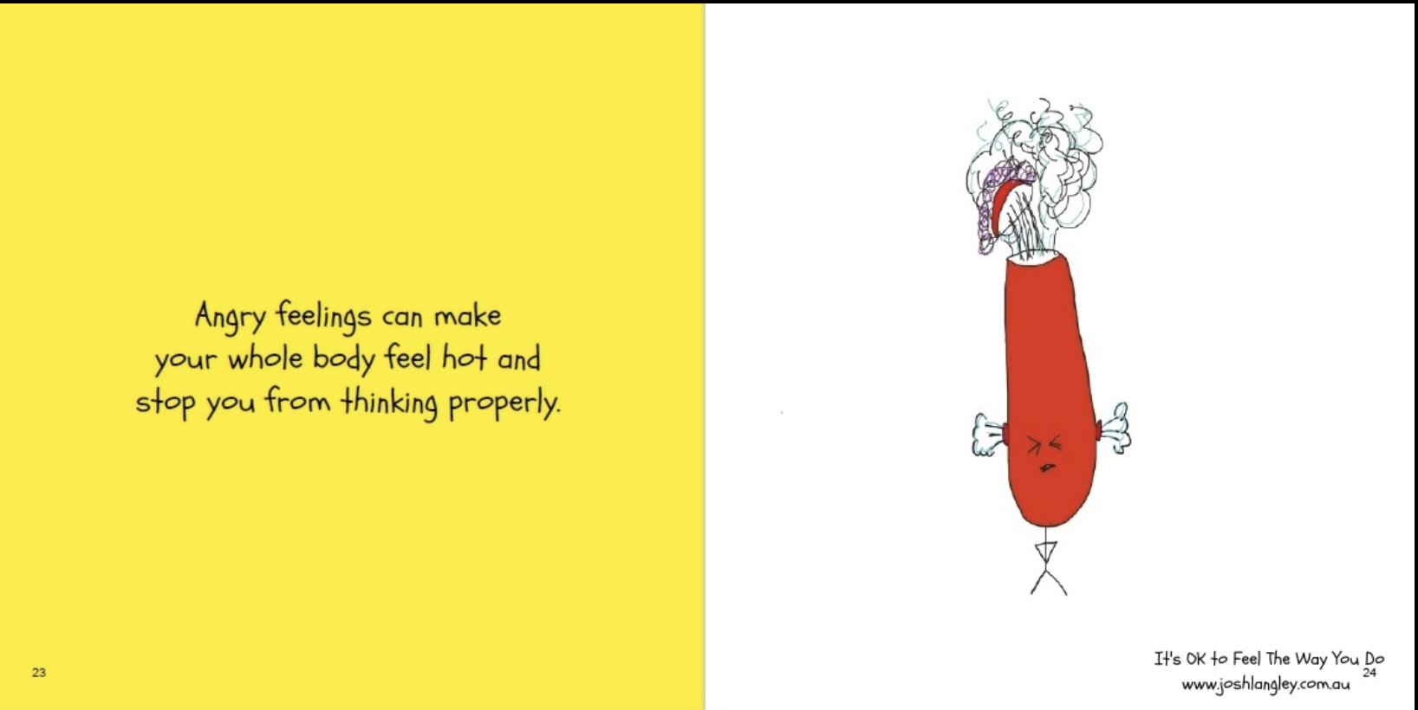

Slide 9
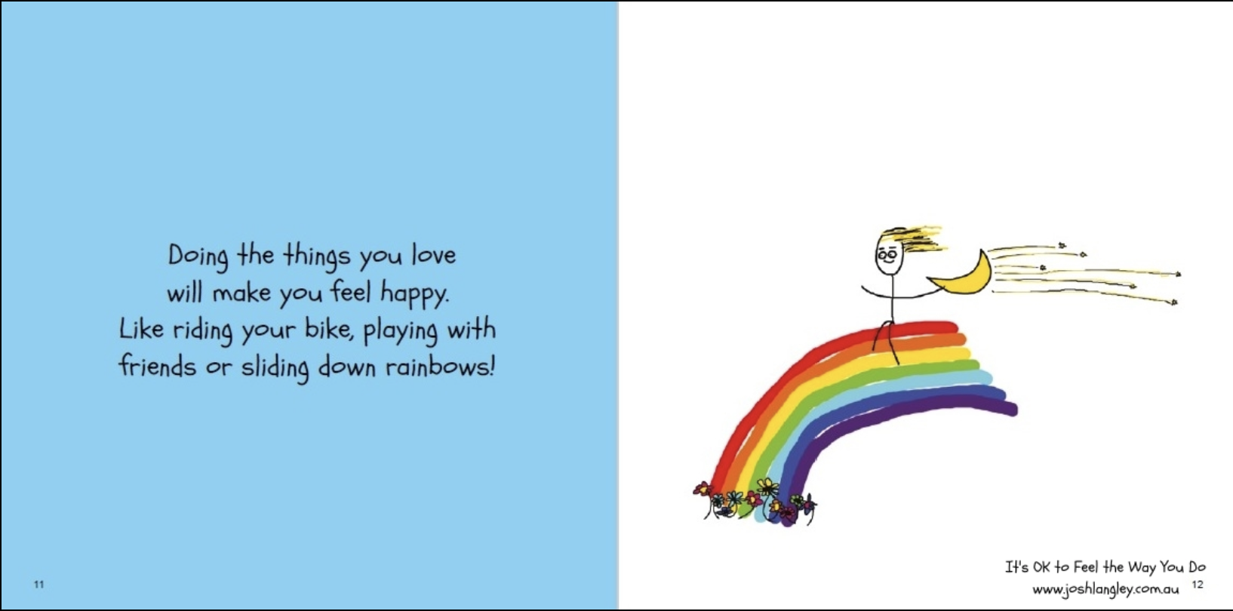

Slide 10
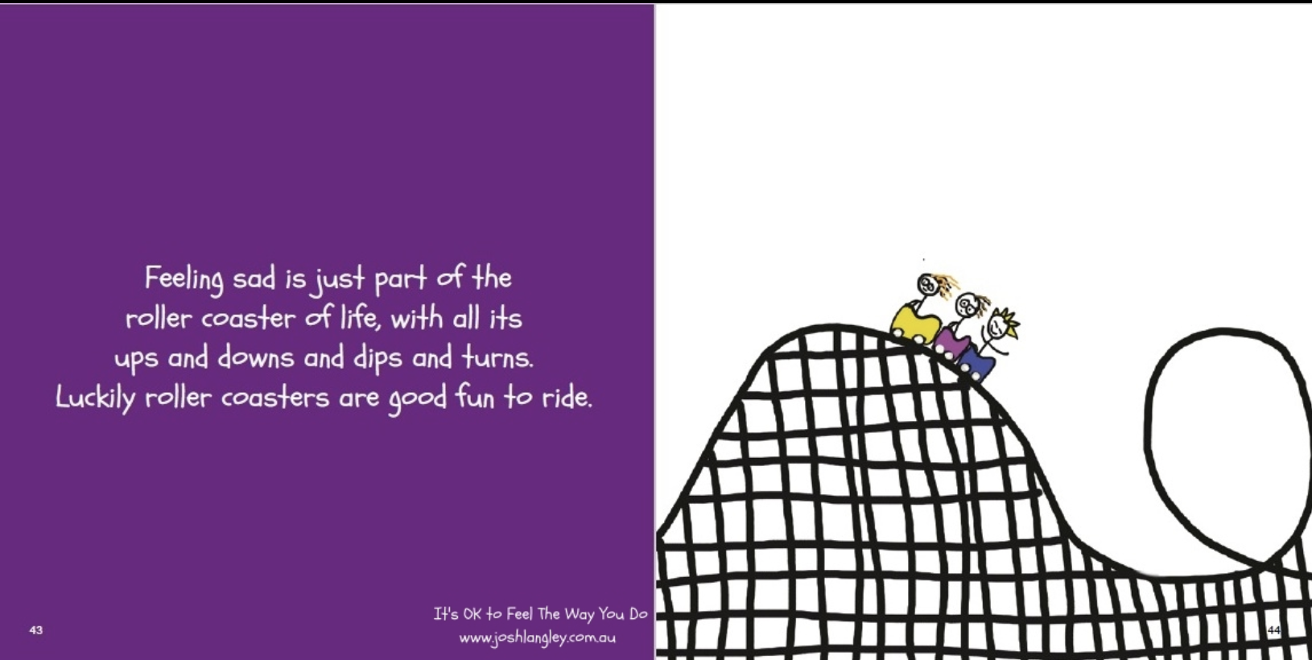

Slide 11
This is a great book to help you to see that feelings and emotions are a normal part of life.
It is really important that we learn how to direct our emotions into ways of expression.

Slide 12
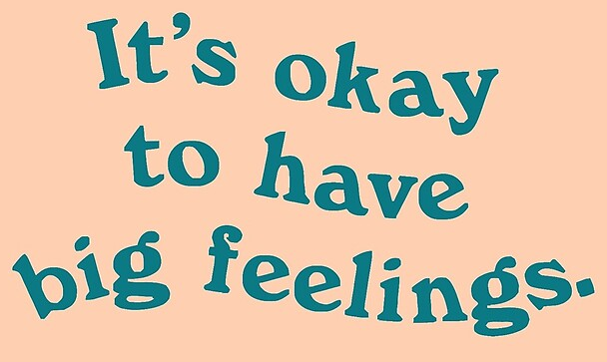
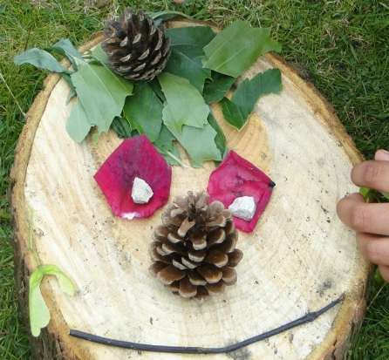
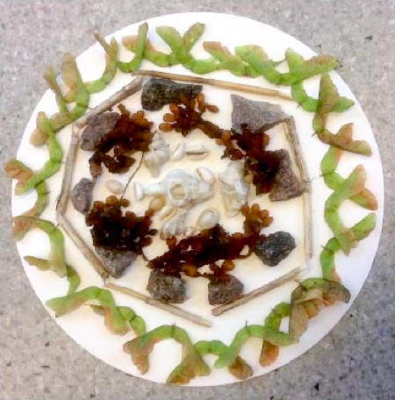
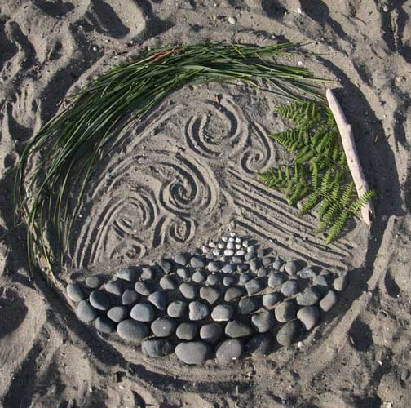
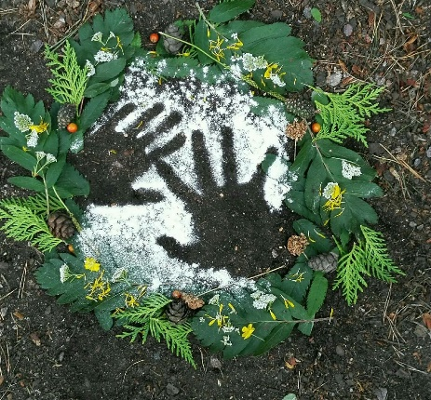
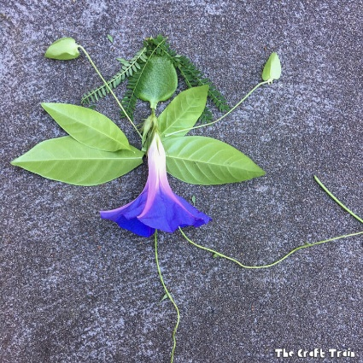
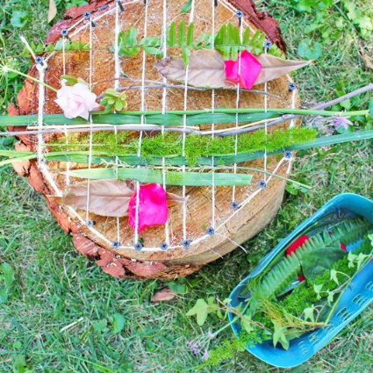
Task 1
Think about your biggest feeling this week.
That feeling might be happiness, frustration, excitement, sadness, anger, silliness. You might have felt all of these but I really want you to think about your biggest feeling from the week.
I would like you to use natural art to express this feeling.
You could go out into the garden and collect some natural objects, sticks, stones
Or you could use things around the home, your recycling, lego, crafts.
Can you create a piece of art that shows your big emotion. There is no right or wrong. It can be made just of shapes and lines or you can try and create a specific image. This is to show your feelings so it is individual to you.

Slide 13

When you have finished your emotive art. Could you take a photo of it or have a go at drawing it and then write a couple of sentences to describe what your art work represents.
Why have you chosen the materials that you have?
Have you chosen to use specific colours? Why have you chosen them?
Have you used any specific shapes? Why have you chosen those shapes?

Slide 14
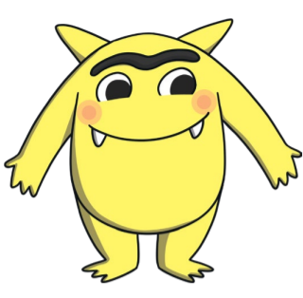
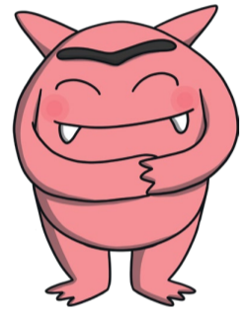
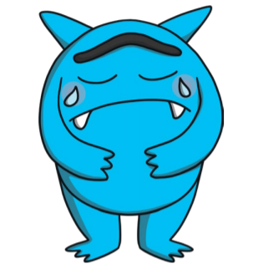
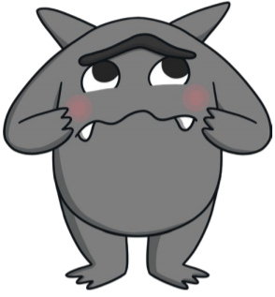
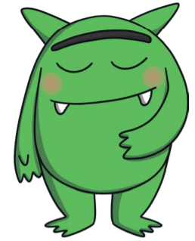
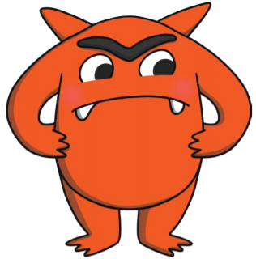
Task
Here are some different feeling monsters. Today, I would like you to pick 3 different feelings, they can be the same as the ones here or 3 different feelings.
You are going to create your own feelings monsters.
Each monster will be filled with the top 3 things that make you feel that particular feeling.
Example – If you choose to complete a happy monster. Inside your monster can you write 3 things that make you feel happy.
If you choose the calm monster, can you write 3 things that help you to feel calm.
If you want to add more than 3 things you can.
On the outside of your monster, you should write 3 things that would help you deal with you when you are feeling that way.
Example - if you were feeling scared, it might help you to cuddle your pet or cuddle a teddy.
Happy
Love
Sad
Scared
Angry
See my example on the next slide.
Calm

Slide 15
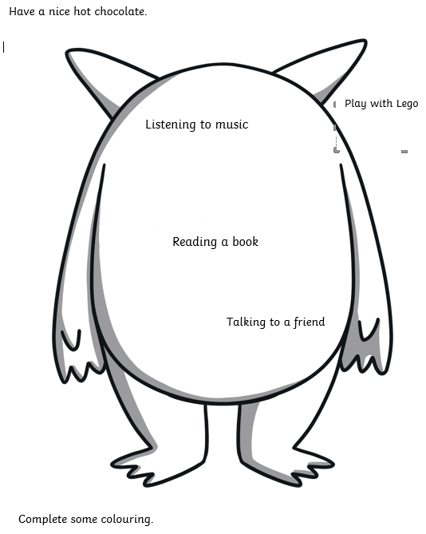
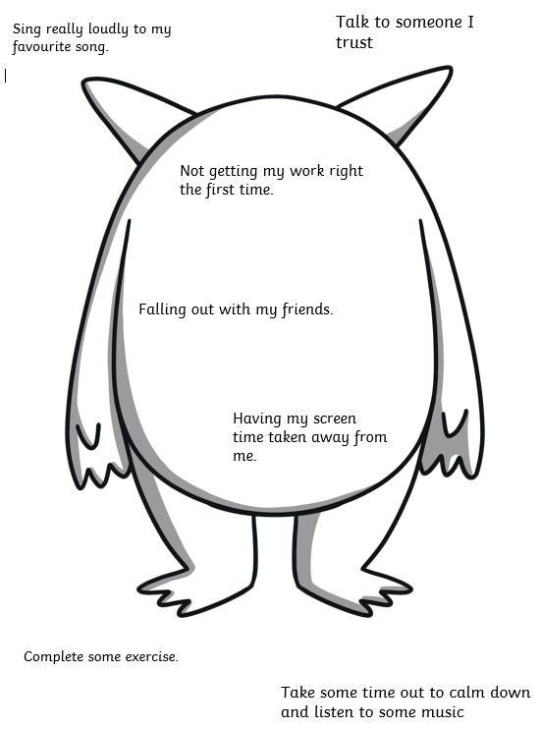
My Calm Monster
My Angry Monster
You can use the template provided or you can draw your own monster. You can also colour in your monster so that it is bright and eye catching. When you have completed this, you could put these in a drawer or in your room and when you have the feelings you have written about, you can look at them and think about what will help you.

