Slide 1
PSHE Day
Afternoon Session

Slide 2
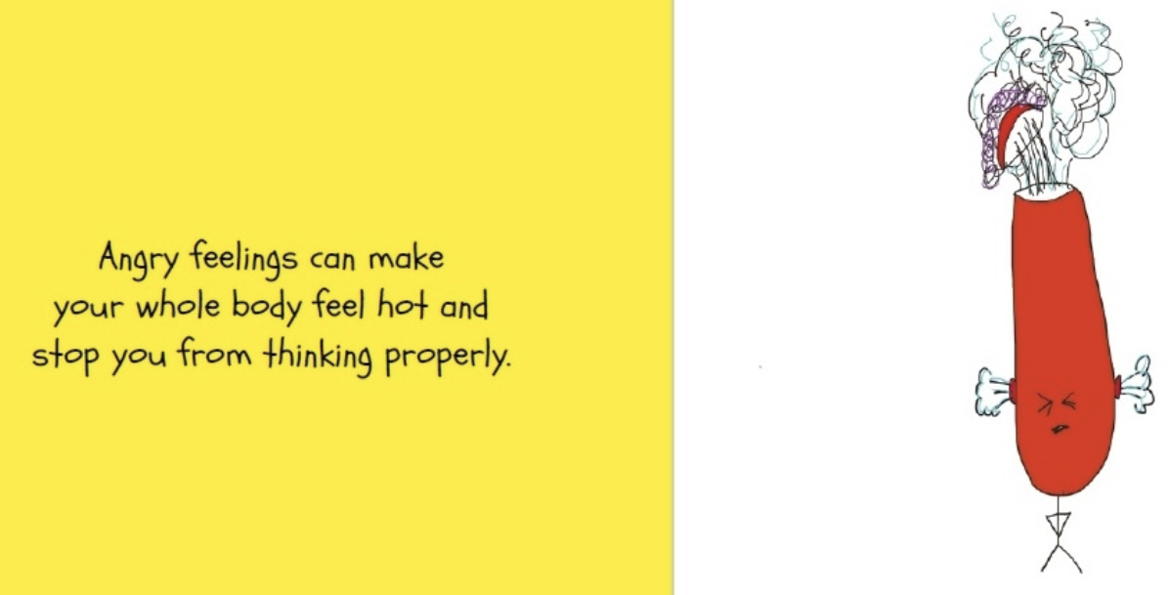
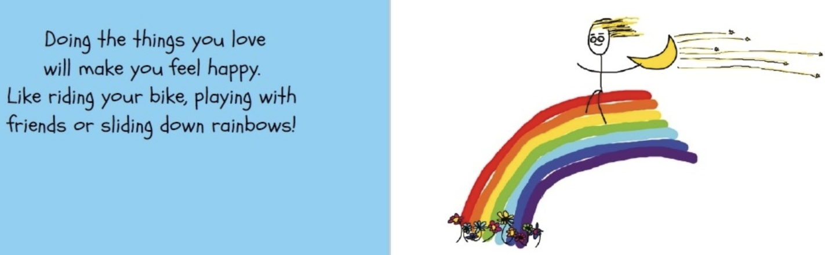
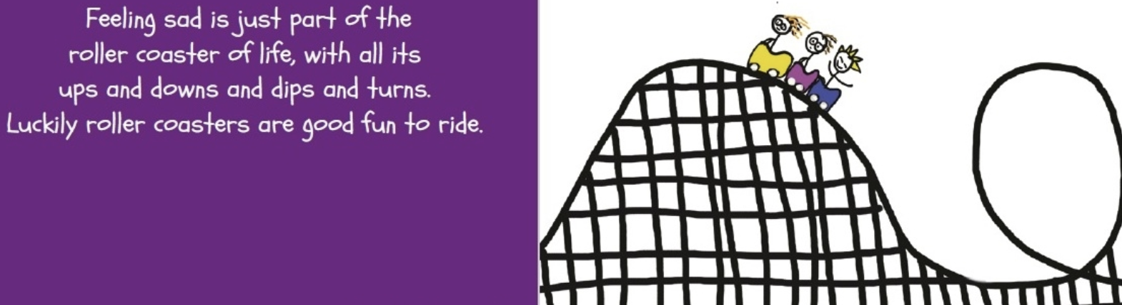
Lets look back at some of the things we read this morning from the It’s ok to feel the way you do.
Different feelings can make us make different choices and can affect how we get through our day.
If we feel happy, we get excited, we feel like we have more energy, we can be more productive and we feel good about ourselves.
If we feel sad, we can find it difficult to get motivated, we can feel down and tired. It can make us less productive and it can also make us think negative thoughts about ourselves and our abilities.
When we feel angry, we can say and do things that we don’t mean. Feeling angry and frustrated can lead to feeling sad because it can be difficult to manage anger and frustration in a positive way.
It is very very normal to feel all of these emotions, what we need to do is to be able to recognize when we are feeling certain ways and learn about how to deal with those feels, especially the feelings that don’t make us feel very good about outselves.

Slide 3
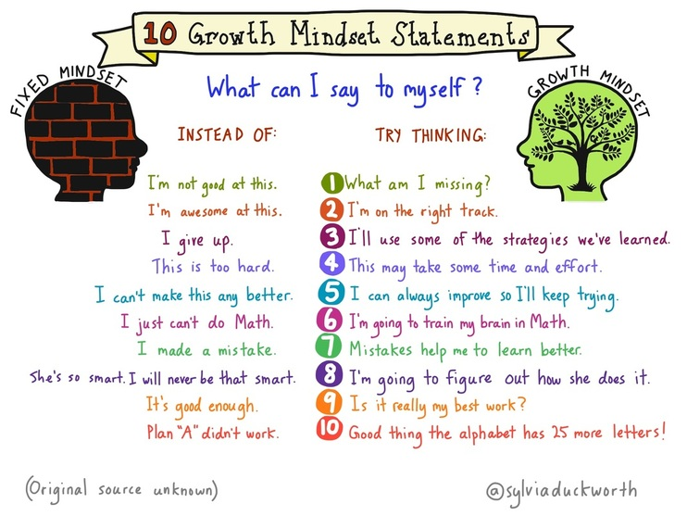
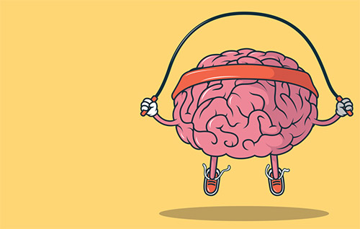
We spoke about this a lot in September when we returned to school but it is really important that we remember to be kind to ourselves.
To speak to ourselves positively about ourselves, just because we find something tricky now, doesn’t mean that we will always find it tricky.
Can you remember the GROWTH MINDSET?

Slide 4
I can’t do it!
How many times have you said that to your parents during your home learning at home?
The truth is, you might not be able to do some of the learning that we have been sending home. You might find some of the work really tricky. You cannot be a master of everything as soon as you start, somethings take work and some things take more work than others.
What you do need to be saying is……
I can’t do it yet!
When you learn something new, your brain has to tell your body what to do.
When you learn something new, your brain has to create a pathway.
The first time you create a pathway it can feel quite hard. But the more you practice and take time to learn, then the easier that pathway becomes and the stronger it becomes.

Slide 5
Task.
Can you write about or draw a picture of the first time you learnt something tricky?
It could be learning to ride a bike or learning and learning to swim.
Can you answer the following questions in your work? If you are creating a picture, you could split your page into the different stages of your learning.
Could you do these things when you first tried?
How did it feel when you couldn’t do it at first or you found it tricky. Did you get frustrated or upset? Did it make you want to give up or where you more determined to keep going?
When you had another go how did it feel? Were you still finding it tricky?
How did it feel when you achieved it for the first time?

Slide 6
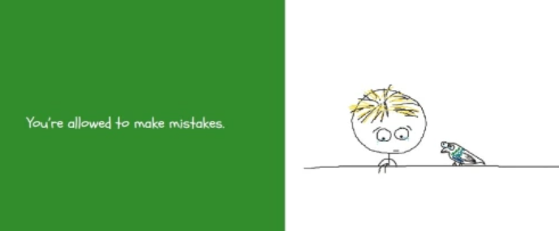

If we don’t make mistakes, we cannot learn to be better. Even the greatest sports person, the greatest teacher or famous actors and actresses will make mistakes. It is what makes us human, it is how we grow and how we get better.
Even if we do make mistakes along the way or you find something really really hard to master. This doesn’t mean you shouldn’t follow your dreams. Being determined and resilient will help you to achieve your dreams.

Slide 7
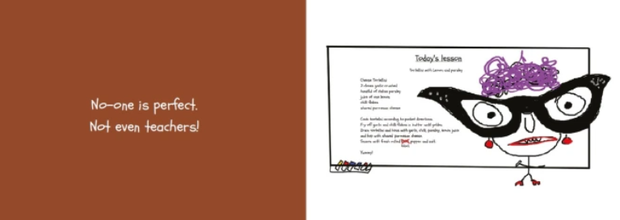
No one is perfect. We all make mistakes but it is how we bounce back and learn from them that helps us achieve.

Slide 8



Feelings imagery
Thinking of images can help us describe strong or intense feelings.
What feelings do these images make you think of?

Slide 9



Writing about feelings
Write a sentence to match each picture and describe the feeling you think it best represents.
For example: Like a little cat, outside and lost in a snowstorm, she felt lonely and afraid.

Slide 10
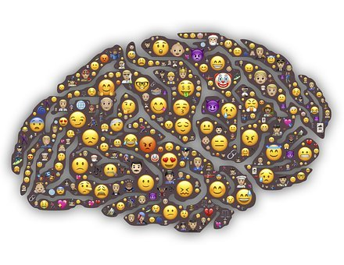
Why is it important to express feelings?
Expressing our different feelings helps us to recognise and manage them.
Expressing feelings can help stop strong or intense feelings from taking over our minds and bodies.
It helps us recognise when we might need help with our feelings.
Sometimes it is good for others to know how we are feeling — it helps them to help us.

Slide 11







Ways to express feelings
What are some of the different ways people can express their feelings?
art – drawing, painting, collage
talking to others
writing – diaries, poems, stories, blogs
face and body
music
acting, dancing and singing

Slide 12
Remember!
Expressing our feelings is important — it helps our minds stay well. There are many ways you can do this but talking to an adult you trust is one of the best ways.
Produce a piece of artwork (a painting or collage) or descriptive writing (a poem or the beginning of a story) about feelings.

