Slide 1
Year 2 Shape Properties
LC: What are edges when looking at properties of 3D shapes?

Slide 2
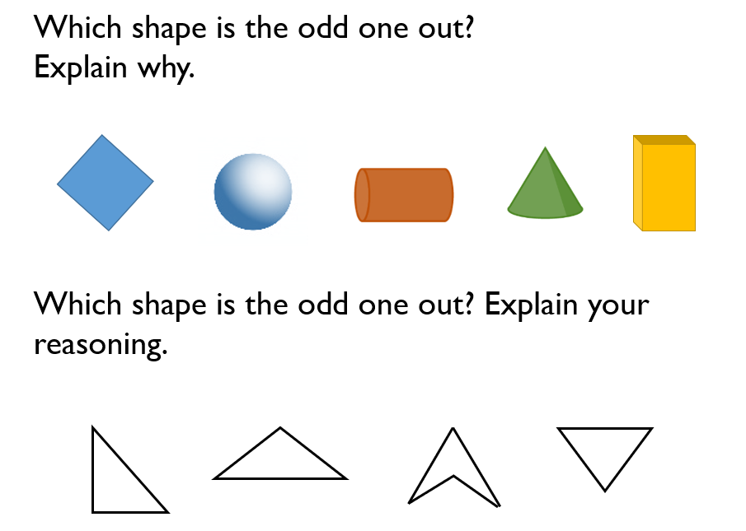
Warm up

Slide 3
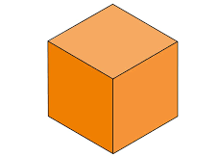
What are edges on 3D shapes?
An edge is where two faces meet.
For example, a cube has 12 edges.

Slide 4
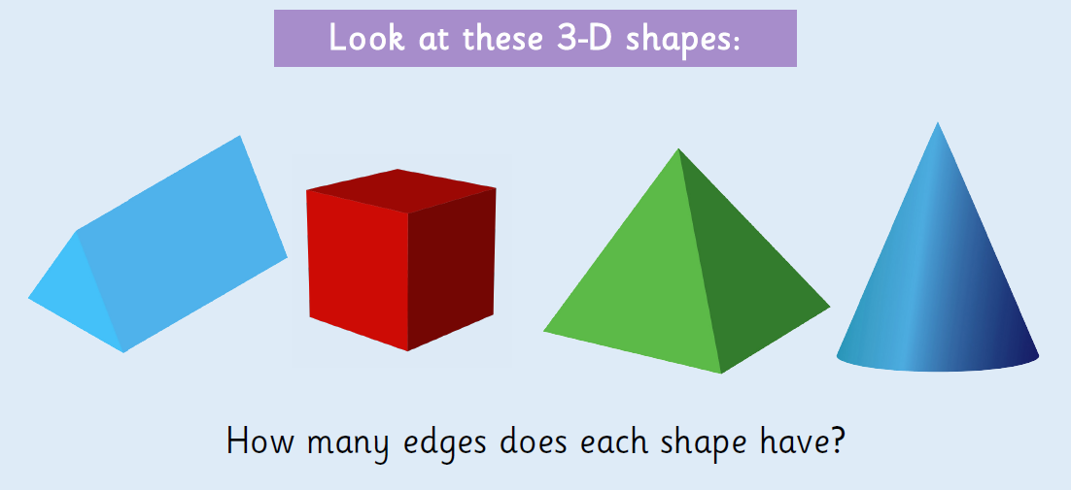

Slide 5
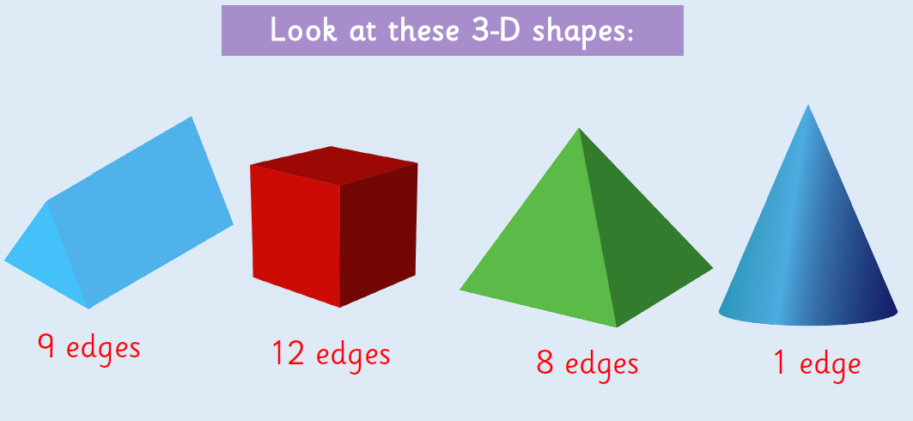

Slide 6
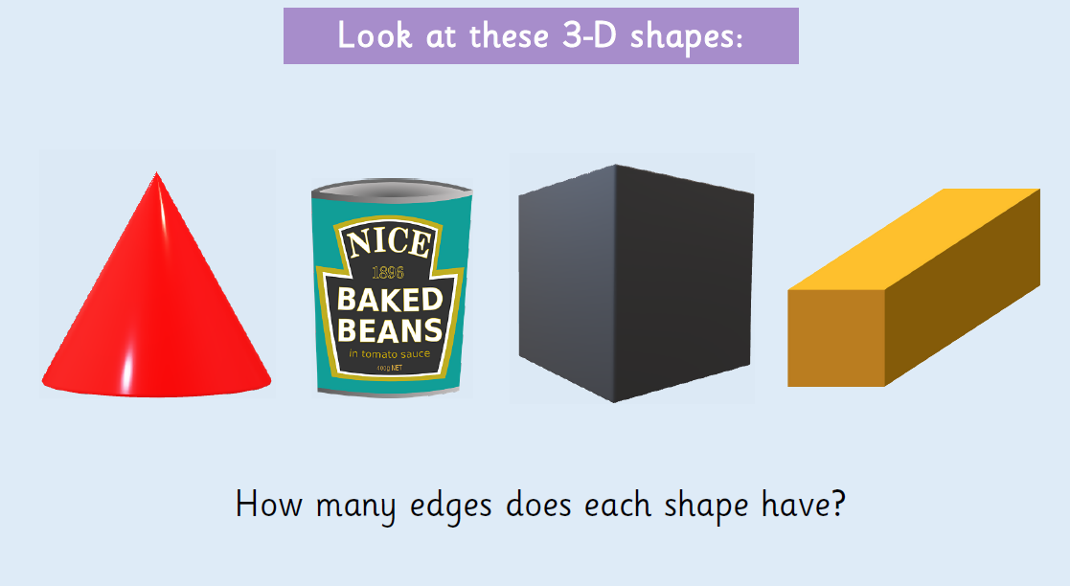

Slide 7
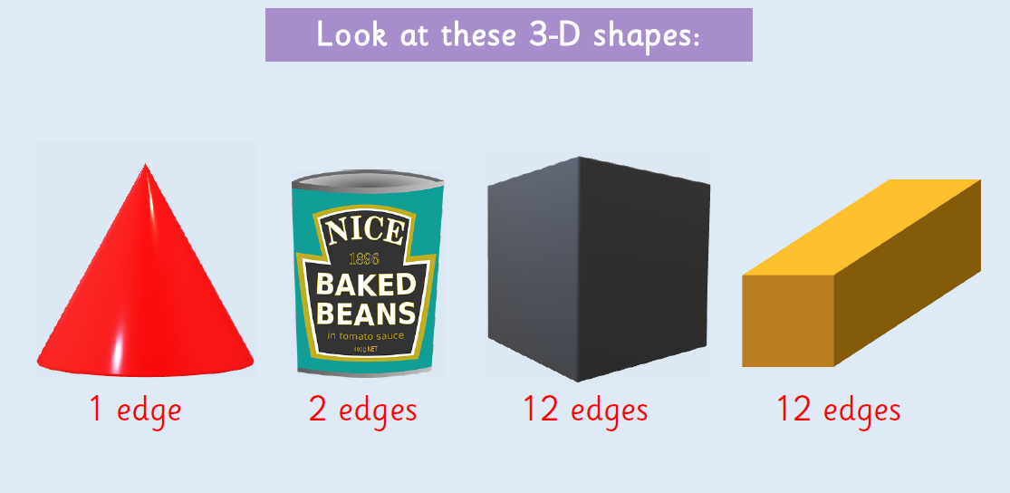

Slide 8
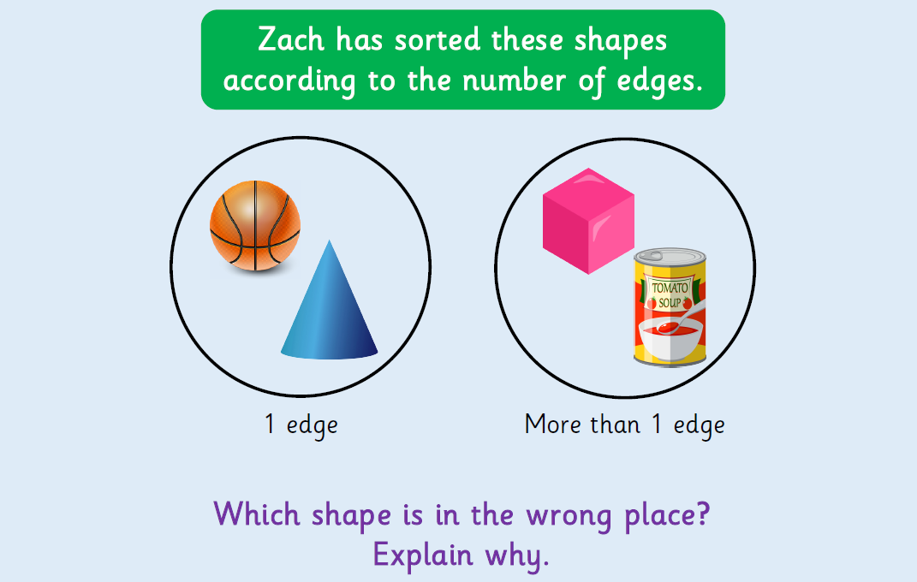
Count edges on 3D shapes

Slide 9
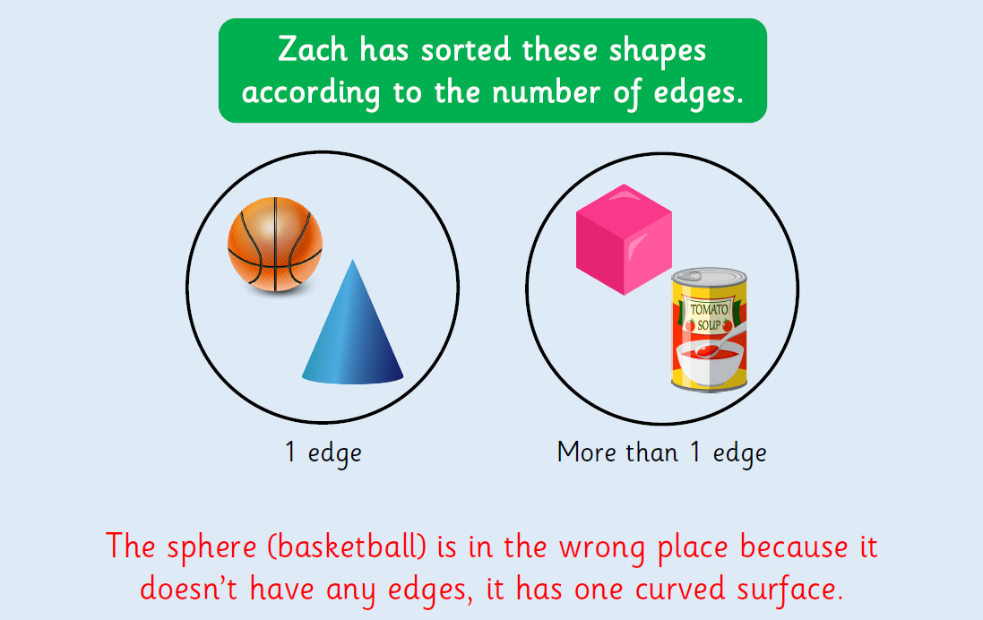

Slide 10
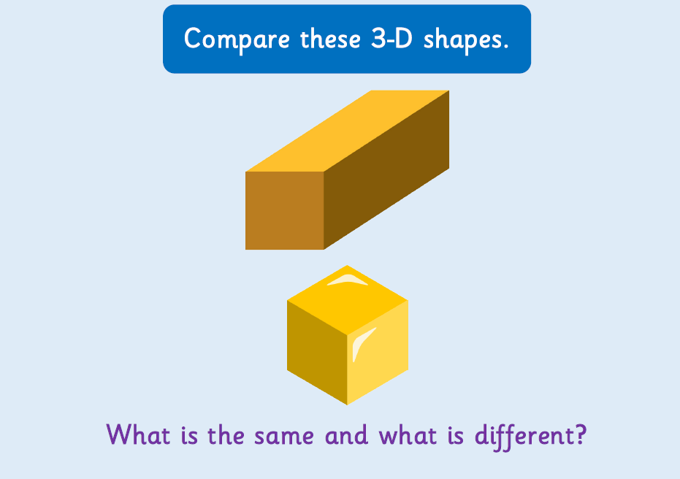

Slide 11


