Slide 1

The Race to the Pole

Slide 2
Terra Nova Expedition
Robert Falcon Scott & team
V
Amundsen Expedition
Roald Amundsen & team

Slide 3

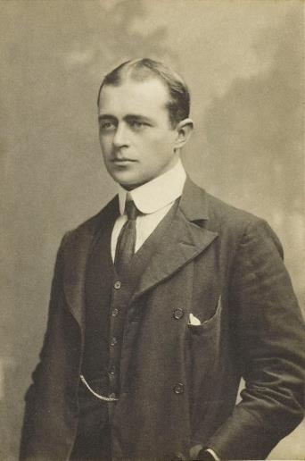
Terra Nova Expedition
In 1910, Robert Falcon Scott set off on another expedition to reach the South Pole.
On the way to Antarctica, the ship encountered several problems.
Another explorer, Amundsen, had sent Scott a telegram. In it, he explained that he was also going to the South Pole!
The ship was struck by a storm. The crew had to use buckets to stop water from flooding in and sinking the ship.
The ship then ran into ice that it couldn’t sail through. They were delayed by
20 days.
Scott

Slide 4
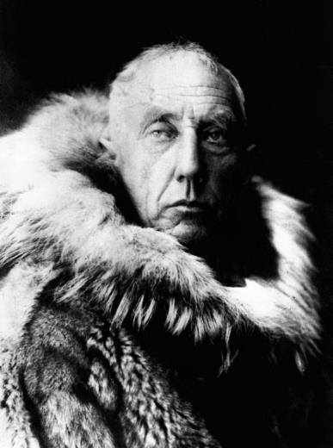
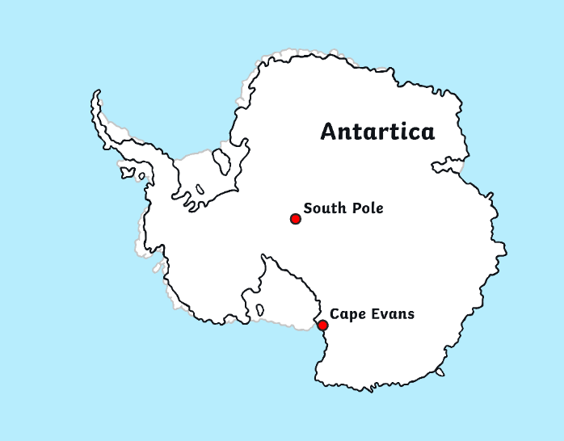
Terra Nova Expedition
In 1911, the Terra Nova team set up a hut on Antarctica in a place that they named Cape Evans.
Amundsen
It was while doing scientific research that the team found out that the rival explorer, Amundsen, was camped on Antarctica too!

Slide 5
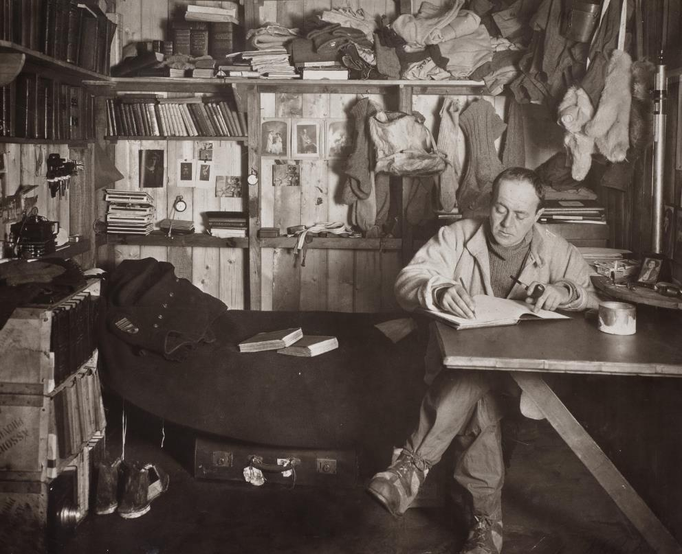
Terra Nova Expedition
There was now a clear race to reach the South Pole.
Scott wrote in his diary that he was going to carry on as usual, ignoring Amundsen and
his team.

Slide 6
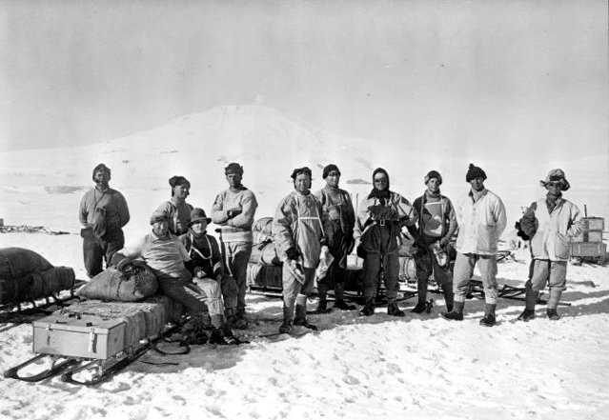
Terra Nova Expedition
In September, Scott set out to reach the South Pole.
He initially set out with a group of 12 men.
Along the way, some of the crew returned to base.
Eventually, it was a final team of five that completed the whole mission:
Scott, Wilson, Oates, Bowers and Evans

Slide 7
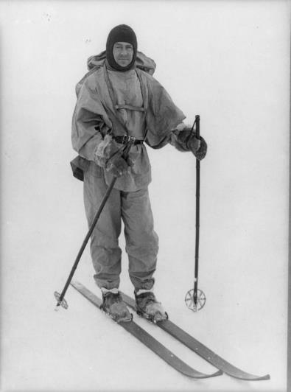
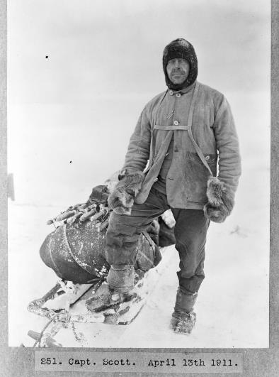
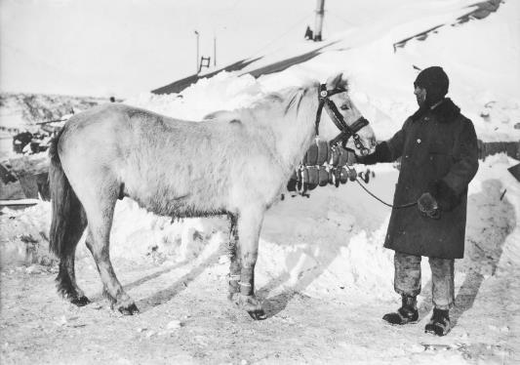
Terra Nova Expedition
The Terra Nova team travelled over the ice and snow on foot, on skis, on motor sledges and on sledges pulled by both dogs and horses.

Slide 8
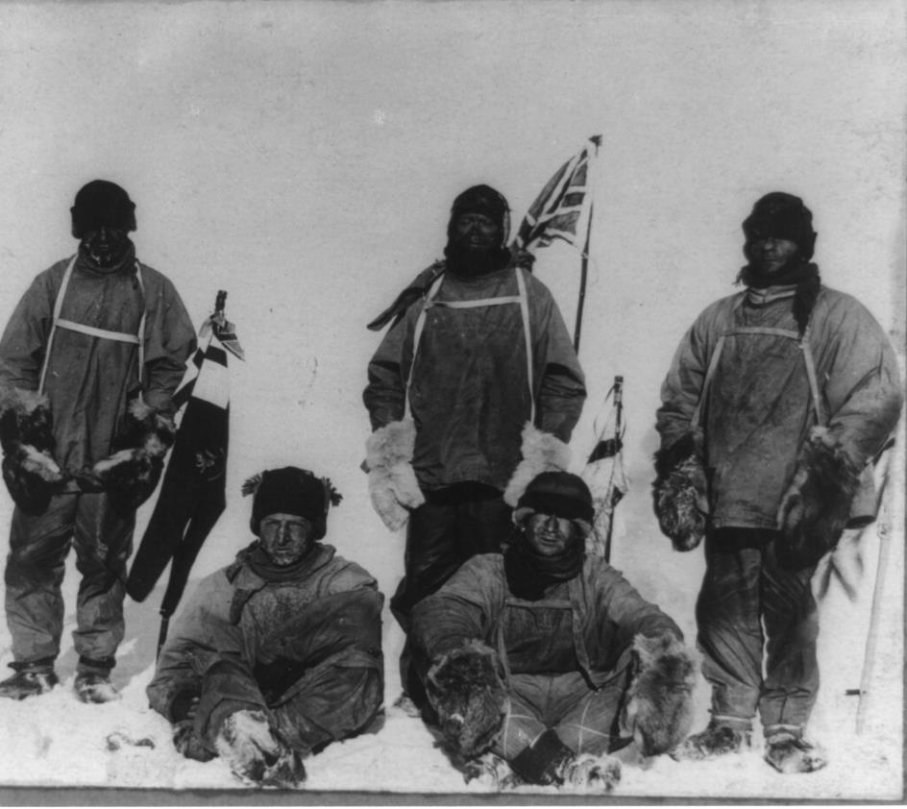
Terra Nova Expedition
In 1912, the team finally achieved
their incredible goal!
The team of five men reached the South Pole and planted their British flag.
There was just one problem…

Slide 9
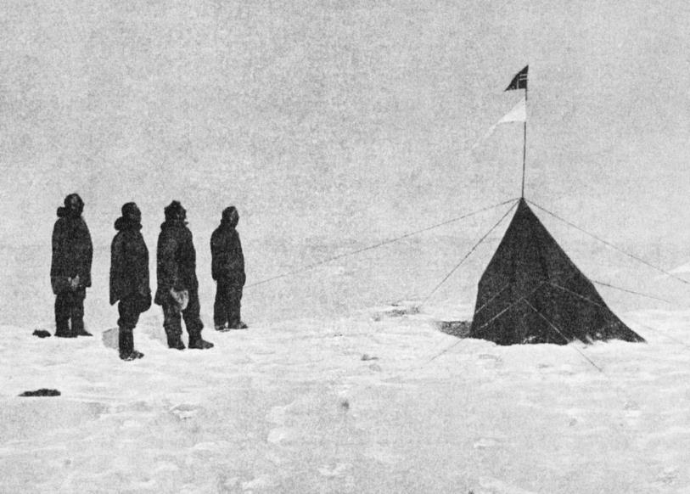

Amundsen Expedition
The Amundsen Expedition had already reached the South Pole!
Roald Amundsen, Helmer Hanseen, Sverre Hassel and Oscar Wisting were the first people to ever reach the South Pole.
They had arrived on 14th December, 1911, and planted the Norwegian flag.
They had discovered a new route to the South Pole that took them only 57 days.

Slide 10
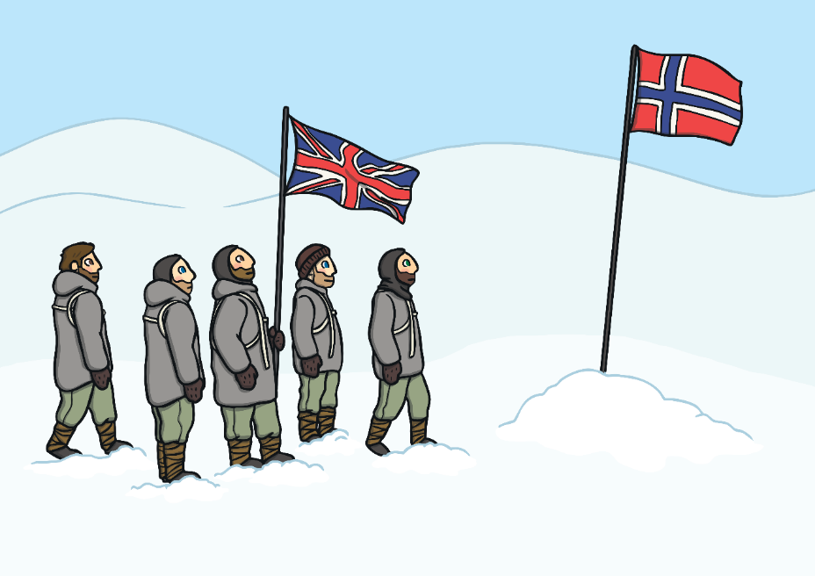
Scott’s Disappointment
It was over a month later, on 17 January, 1912, that Scott and his team reached the South Pole and discovered that the Norwegians had beaten them to it.
They were extremely disappointed.
After planting their flag, Scott’s team headed for home.

Slide 11
Watch these video about Scott and Amundsen to help explain the Race to the Pole a little more clearly.
https://www.youtube.com/watch?v=HosGqMXSeWk
https://www.youtube.com/watch?v=Ts3LIirgDbU
https://www.youtube.com/watch?v=LI3zaVoHerg

Slide 12
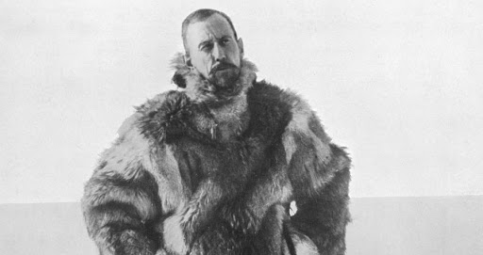
Let’s find out a little more about the explorer
Roald Amundsen

Slide 13
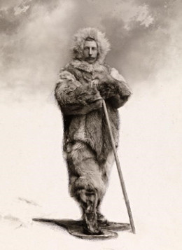
Roald Amundsen was one of the most important explorers to have ever lived.
The Norwegian explorer was the first ever to reach the South Pole in 1911, much to the disappointment of Ernest Shackleton and Robert Scott.
In 1926, Amundsen successfully reached the North Pole as well - making him the first man in history to reach both poles.
In 1928, on a rescue mission in the Arctic, Amundsen and his crew of five all disappeared.

Slide 14
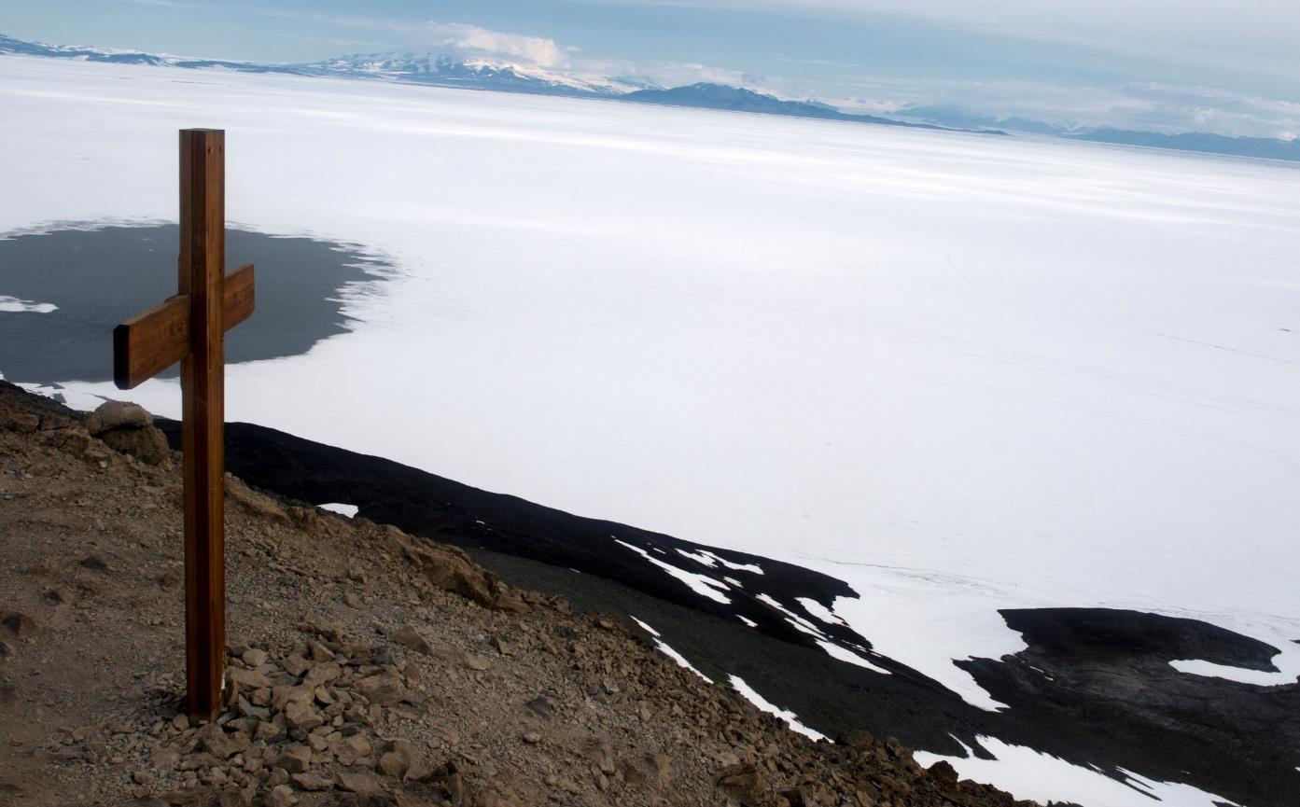
A Dangerous Mission
Scott’s Terra Nova expedition ended in tragedy. No one survived the return journey.
Later that year, a search party set out to find Scott and the Terra Nova team. They put up a cross that now acts as a memorial to these brave explorers.

Slide 15
Task:
Like last week, we are giving you a choice of tasks. We would like you to complete at least one (you are welcome to do more).
- Produce a short recount about 'The Race To The Pole'.
- Imagine you are organising or joining in a similar mission. Write a list / Draw and label the items you would take with you. Extension: Add a sentence to each to explain your choice of items. Don't choose this option if you did it last week as last would be very similar.
- Write a short diary entry as if you were Scott and include your disappointment at achieving the goal of reaching the South Pole, but discovering you aren't the first OR be Roald Amundsen and write about your elation at being the first to reach the Pole.
- Complete the fact file in the folder.
- Create a comic strip/storyboard to show the sequence of events.
- Draw a picture of Scott and his team, maybe along with some of his equipment, and the UK flag (but also showing the Norwegian flag/ note left by Amundsen and his team).
- Be creative and come up with your own ides to share the facts you learnt!

