Slide 1
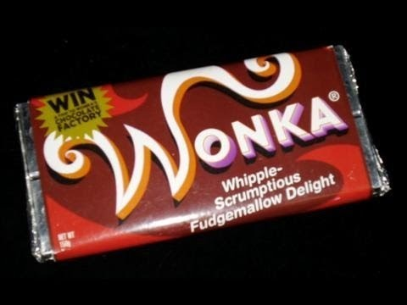
An inventive product like yours deserves some exciting packaging!
The name you gave your product yesterday
needs to be really clear too.
You might want to consider the lettering
so that it matches the product name.

Slide 2
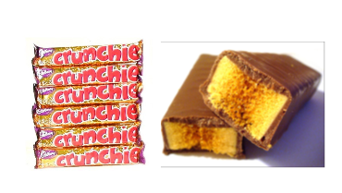
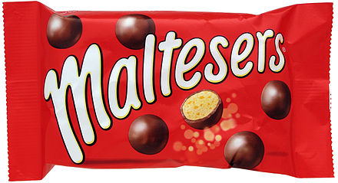
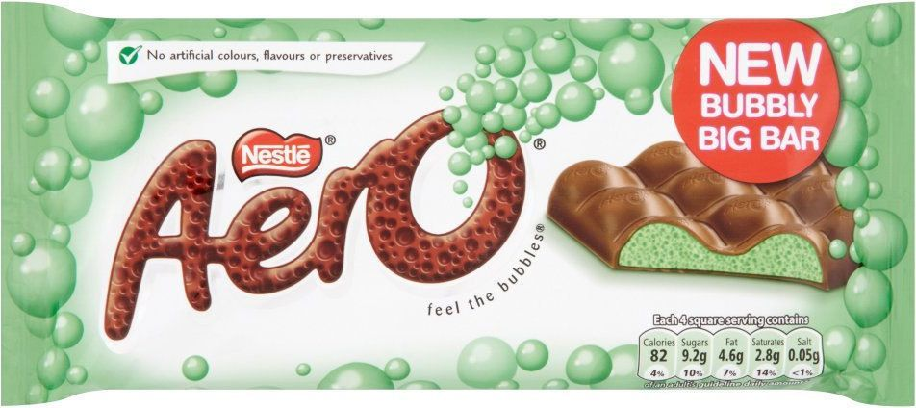
Let’s look at a few familiar examples:

Slide 3
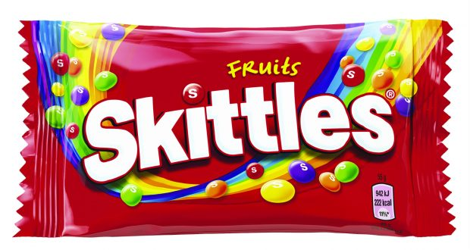
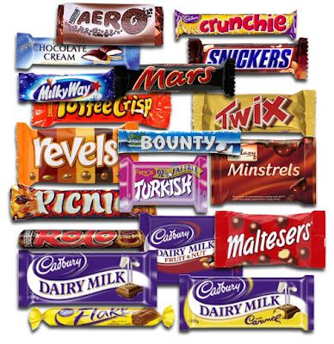
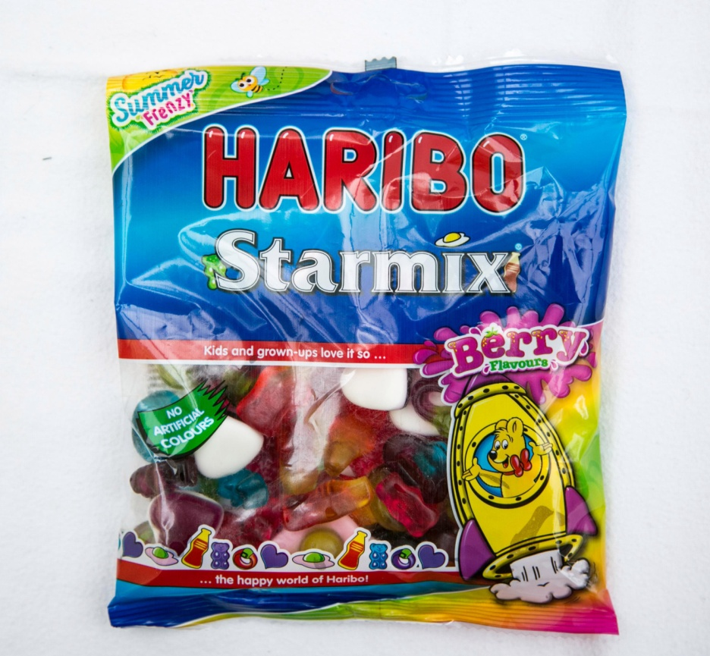

Slide 4
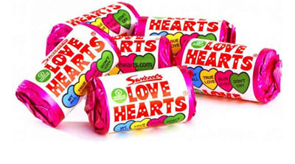
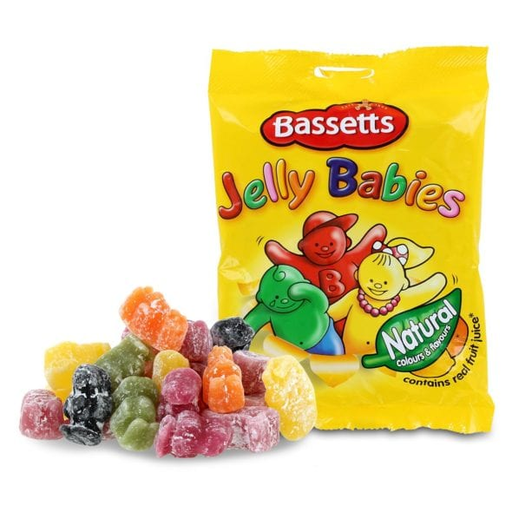
Consider your choice of:
Lettering
Colours
Images
See-through
or solid (opaque)
packaging
Box or bag

Slide 5
Many products often have a slogan to help to promote and sell their products.
SLOGAN: a short and striking or memorable phrase used in advertising.

Slide 6
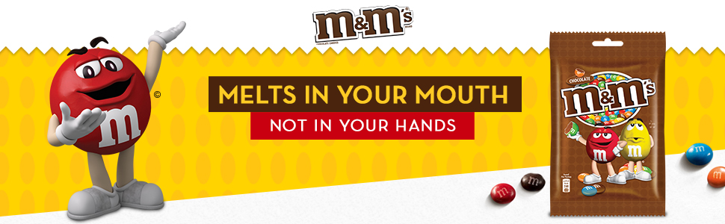
Have a go at this fun slogan quiz with your family...

Slide 7
Have a break, have a ________.

Slide 8
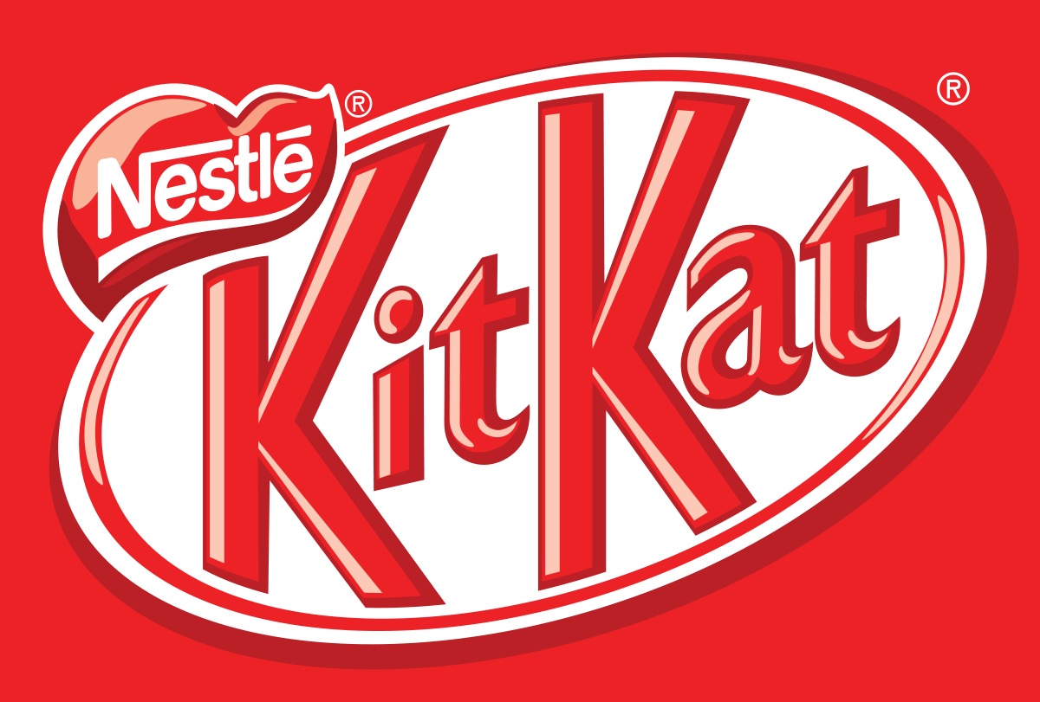
Have a break, have a KitKat.

Slide 9
Everyone’s a ___________ case.

Slide 10
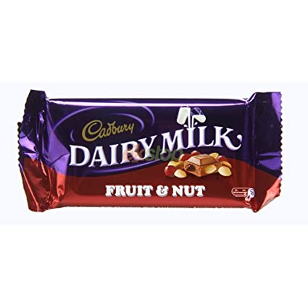
Everyone’s a Fruit & Nut case.

Slide 11
A finger of _________is just enough to give your kids a treat.

Slide 12
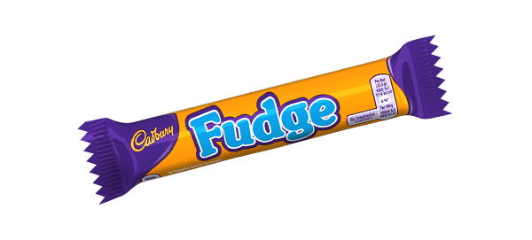
A finger of Fudge is just enough to give your kids a treat.

Slide 13
A__________a day helps you work, rest and play.

Slide 14
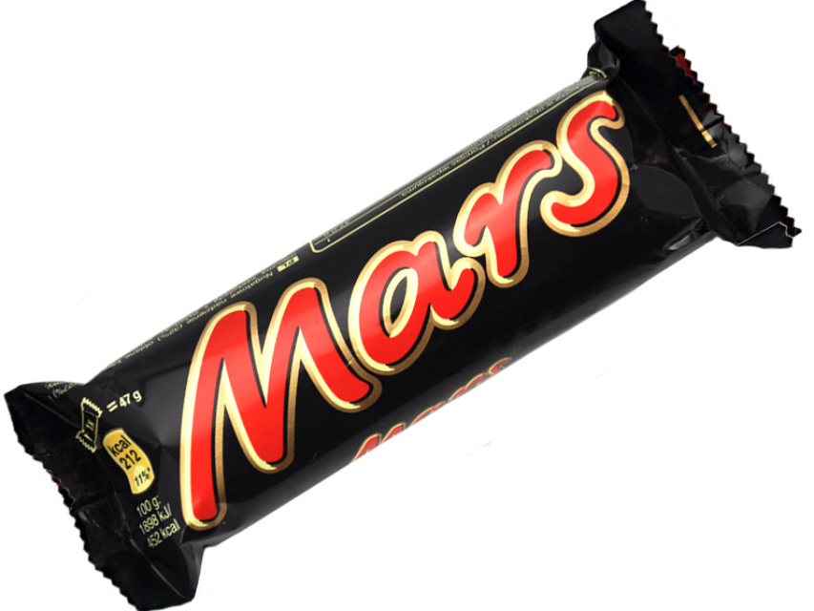
A Mars a day helps you work, rest and play.

Slide 15
Only____ have the answer.

Slide 16
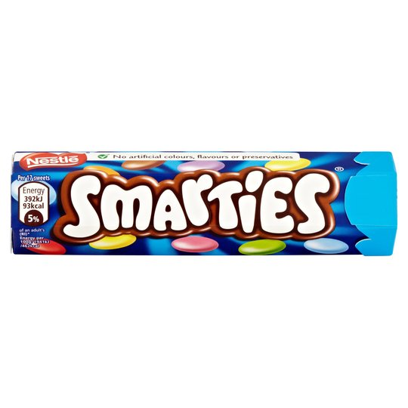
Only Smarties have the answer.

Slide 17
If you like a lot of chocolate on your biscuit join our _______.

Slide 18
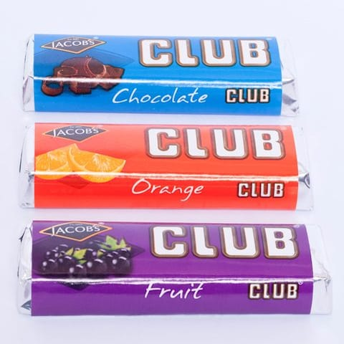
If you like a lot of chocolate on your biscuit join our Club.

Slide 19
Do you love anyone enough to give them your last ______?

Slide 20
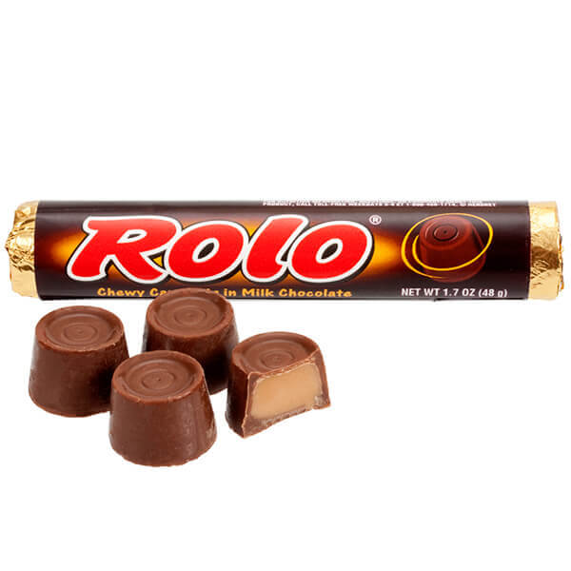
Do you love anyone enough to give them your last Rolo?

Slide 21
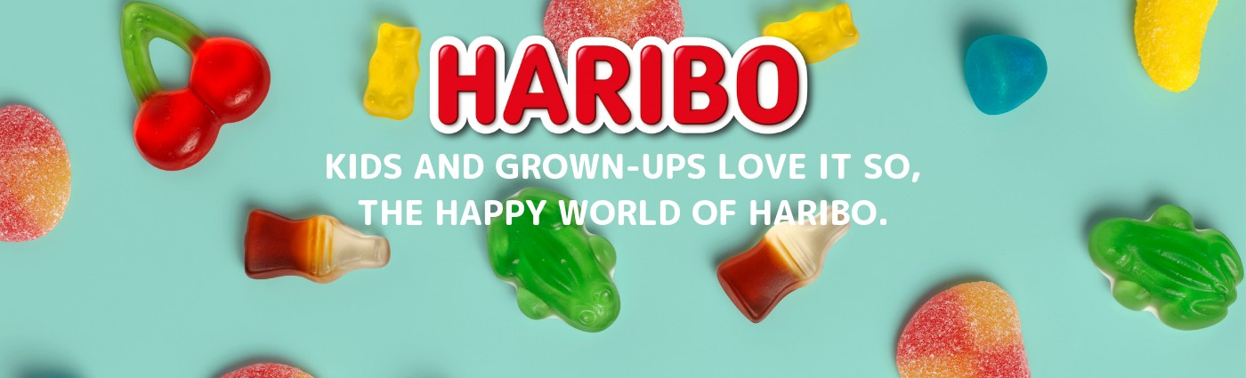
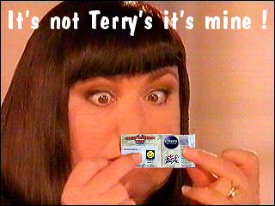
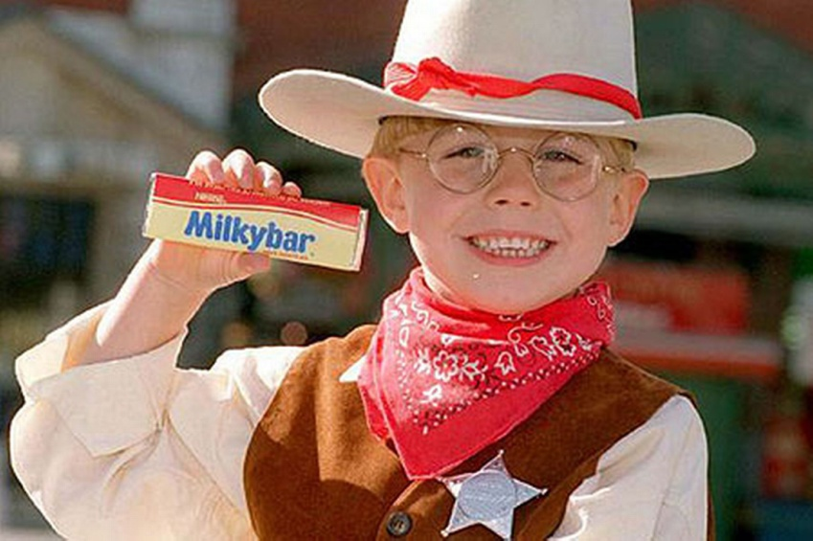
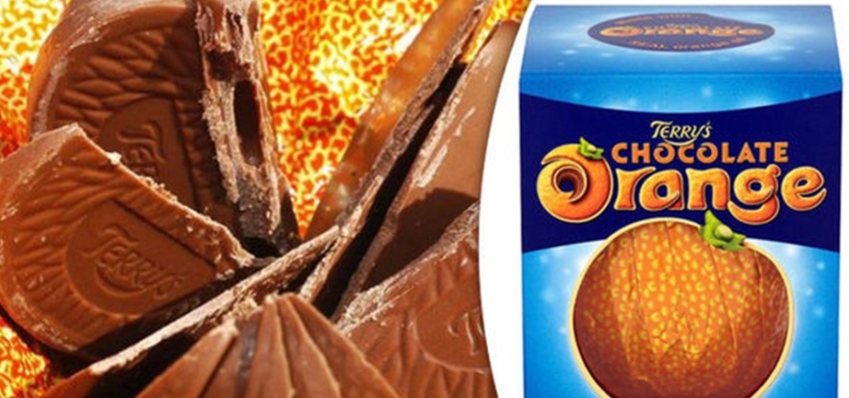
Can you think of anymore?
The Milky Bars are on me !

Slide 22
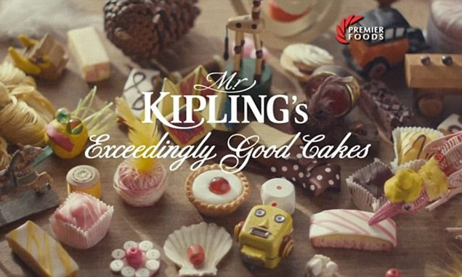

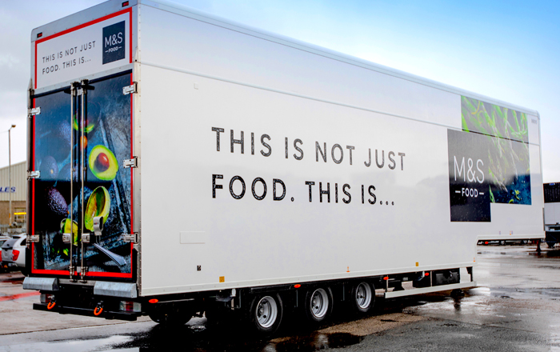

Can you think of a slogan to match your product?

Slide 23

Task: To design the packaging and slogan for your invention.

