Slide 1
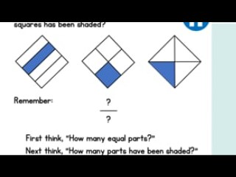

Slide 2
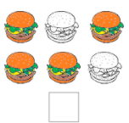
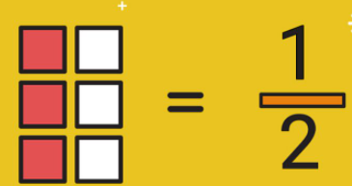
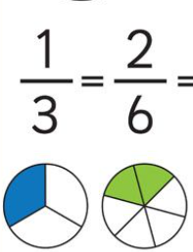
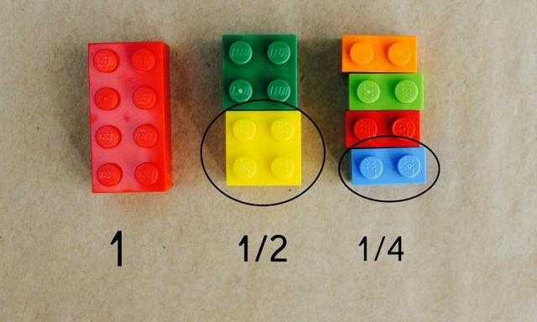
A fraction is part of a whole. This can be an equal part of a shape, a set of objects or a number.
4
6

Slide 3
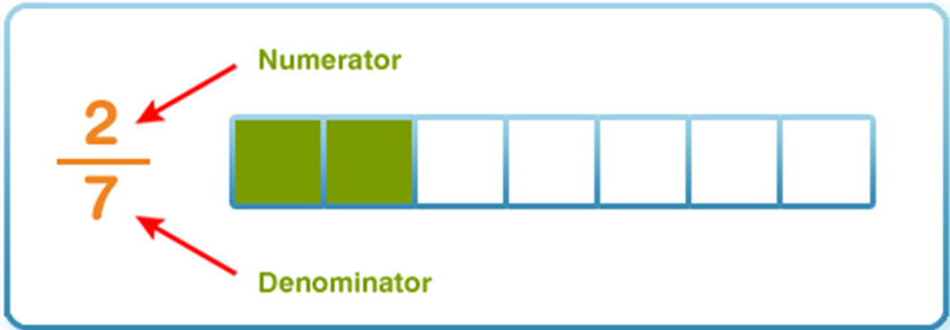
A fraction is part of a whole. There are two parts to a fraction:

Slide 4

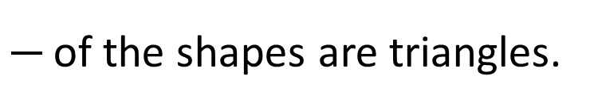
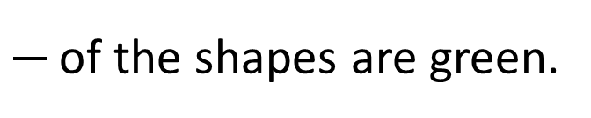
Numerator
1
How many parts we are looking at?
of the shapes are triangles.
4
Denominator
How many equal parts are there?
Have a think
1
of the shapes are green.
5

Slide 5
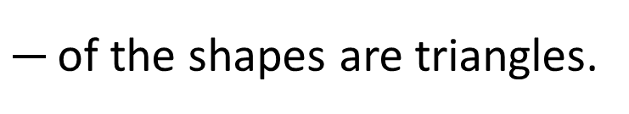
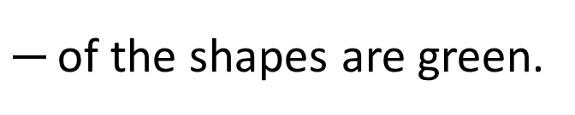
1
of the shapes are triangles.
4
1
of the shapes are green.
5
What’s the same? What’s different?
These are called unit fractions.
Unit fractions have a numerator of 1
Have a think

Slide 6
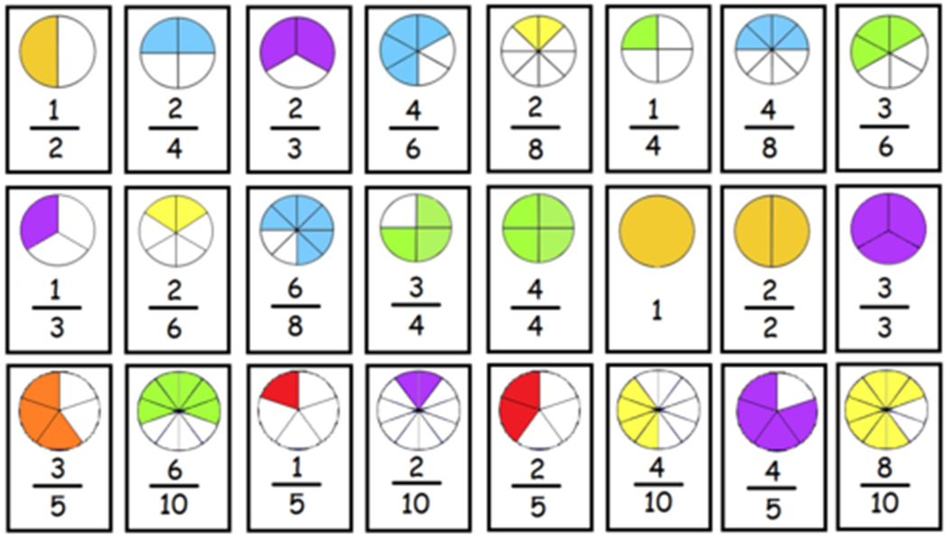
Let’s practice reading these fractions and saying them aloud.

Slide 7
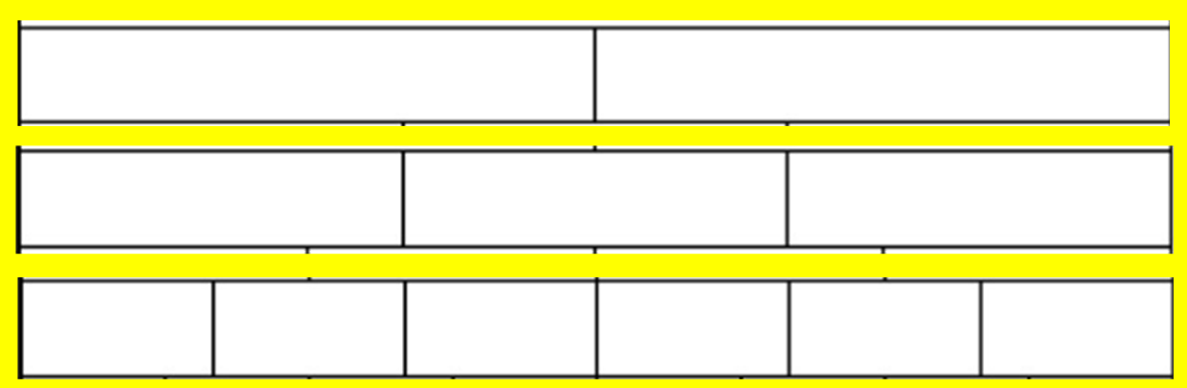
What fractions are being shown here? Think of how many equal parts.

Slide 8
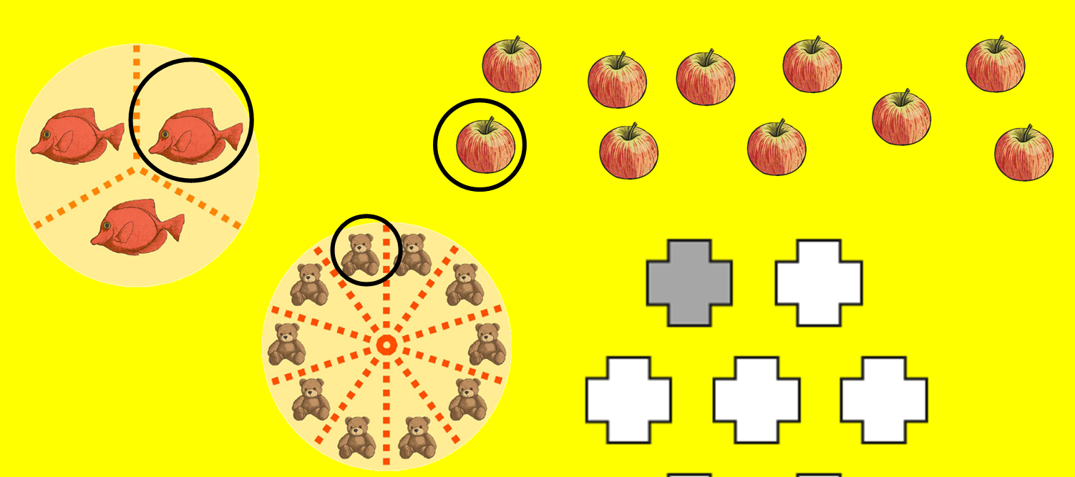
What fractions are being shown here?

Slide 9
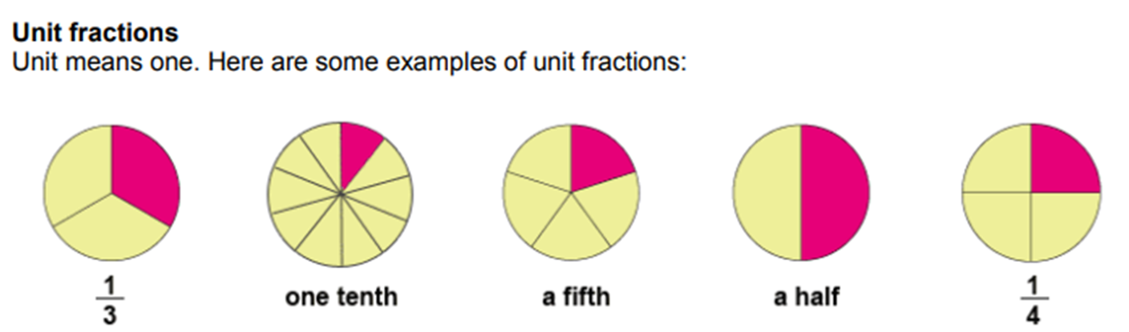
A unit fraction is where the numerator is one. Can you think of any other unit fractions?

