Slide 1
The Maya
LC: Can I find out about the decline of the Maya civilisation?

Slide 2

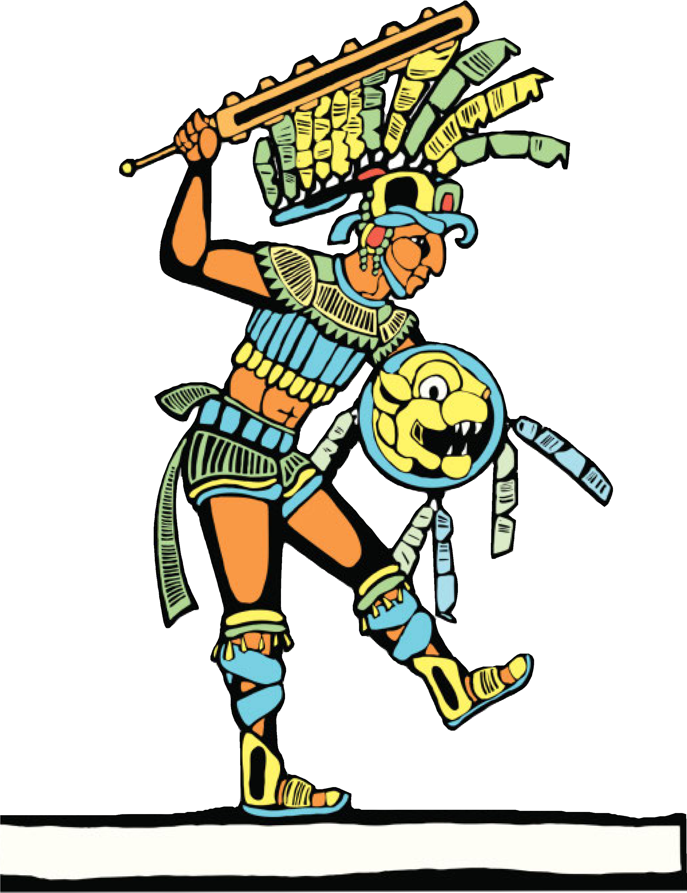


Until quite recently, historians believed the Maya to be a peaceful people. However, they now know that there were many battles between city states. These battles were to try and gain captives for sacrifice, to gain control of trade routes or to gain power. Warriors were expected to be brave. It was considered an honour to be killed in battle.

Slide 3
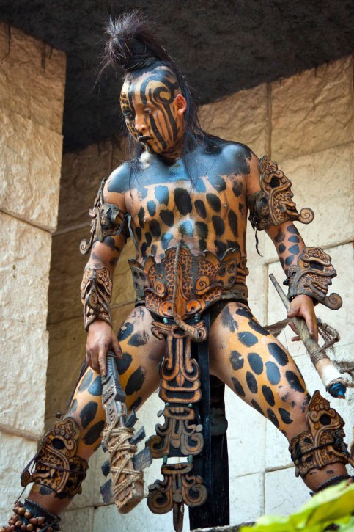
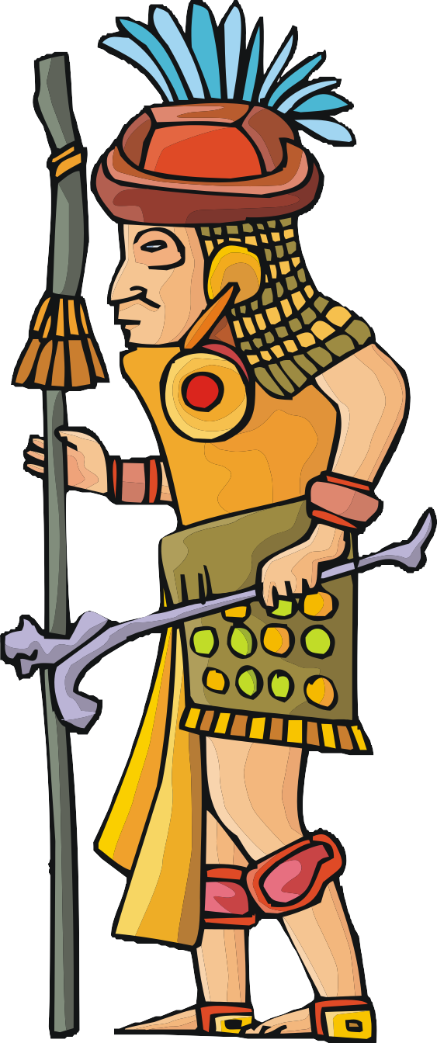

Maya warriors wore tunics, loincloths or fur costumes and often painted their faces or bodies. They used stone and wood to make spears, shields and other weapons.
This Maya man is dressed as a warrior would have dressed in the first century. What can you see?

Slide 4
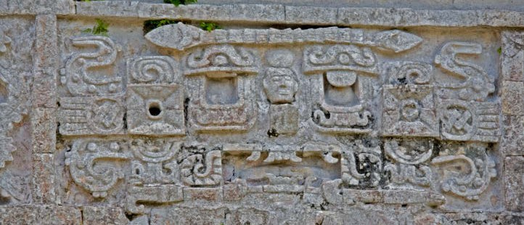
The details of the battles between the city states were written on stone stelae in the cities, like this one. They told of great warriors and great battles, giving details of victories and defeats.
BACK
NEXT
www.planbee.com

Slide 5

However, around the year 900 AD the records disappeared and the some of the Maya cities vanished from history. Maya cities in Guatemala were abandoned, not to be discovered again until the Spanish conquistadors arrived in the sixteenth century.
What do you think might have happened?
Why do you think a thriving civilisation might suddenly cease to exist?

Slide 6
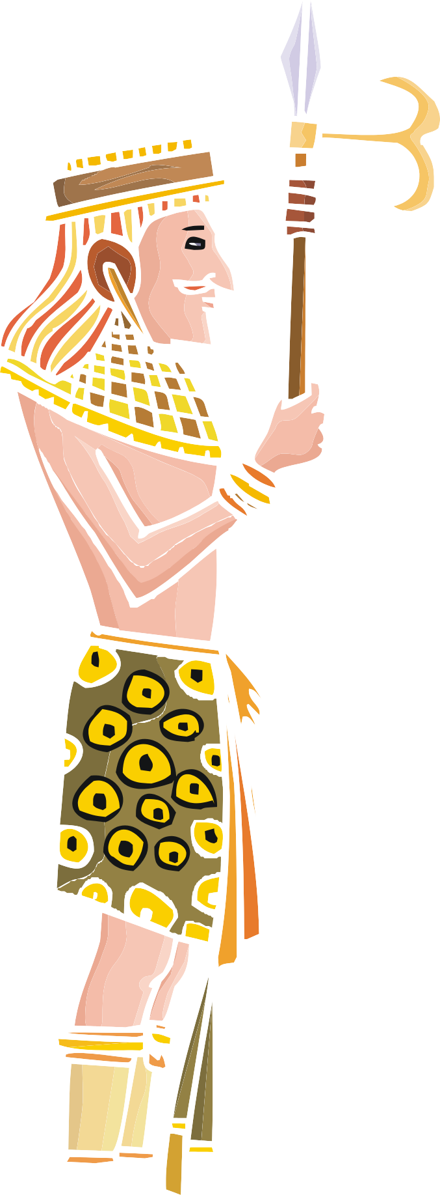



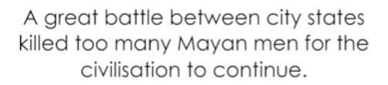


No one knows exactly why the great Maya cities fell into decline.
Which of these explanations do you think is most likely? Why?

Slide 7
No one really knows for sure but it is likely that the Maya left because the city states could no longer support them.
By AD900, some city states had huge populations, but they didn't have enough food or land for so many people. Food shortages were probably made worse by the Maya farming methods, which damaged the land.
These problems probably led to conflict as communities began to fight over food and good farmland.

Slide 8
After some cities were abandoned, the Maya settled to the north in the Yucatan Peninsula and built great cities such as Chichen Itza.
600 years later, in 1502, the Spanish arrived in Maya territory and fought with them for decades. By 1540, they had taken over most of the Maya region. The Spanish claimed by best land and forced some Maya to work for them as slaves. They also forced the Maya to give up their religion and become Christians.

Slide 9
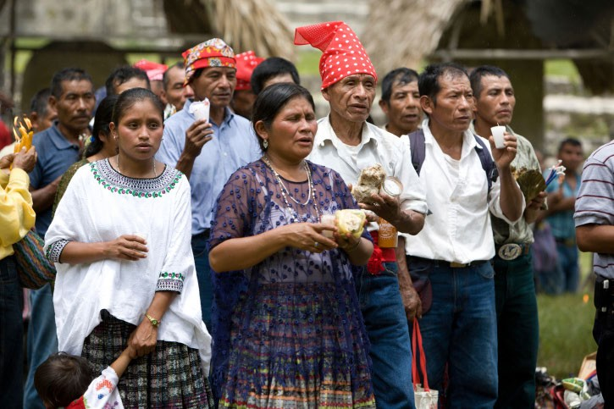
The Maya civilisation didn’t end completely however. Small groups of Maya continued to live in the rainforests and volcanic mountains of Mesoamerica but the great cities were no more. These people kept the Maya culture and traditions going and the Maya still live in the region today.

Slide 10
Activity
Imagine you are a Maya farmer in AD900.
You are speaking to one of the skilled craftsmen who is going to carve your story on a Stelae before you leave with your family.
What would you tell him about your reasons to leave?

Slide 11
End of Unit Quiz

