Slide 1
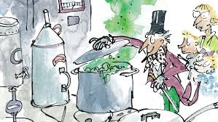
The Inventing Room

Slide 2
Chapter 19 – The Inventing Room
Charlie Bucket stared around the gigantic room in which he now found himself. The place was like a witch’s kitchen! All about him black metal pots were boiling and bubbling on huge stoves, and kettles were hissing and pans were sizzling, and strange iron machines were clanking and spluttering, and there were pipes running all over the ceiling and walls, and the whole place was filled with smoke and steam and delicious rich smells.
Mr Wonka himself had suddenly become even more excited than usual, and anyone could see that this was the room he loved best of all. He was hopping about among the saucepans and the machines like a child among his Christmas presents, not knowing which thing to look at first. He lifted the lid from a huge pot and took a sniff; then he rushed over and dipped a finger into a barrel of sticky yellow stuff and had a taste; then he skipped across to one of the machines and turned half a dozen knobs this way and that; then he peered anxiously through the glass door of a gigantic oven, rubbing his hands and cackling with delight at what he saw inside. Then he ran over to another machine, a small shiny affair that kept going phut-phut- phut-phut-phut, and every time it went phut, a large green marble dropped out of it into a basket on the floor.

Slide 3
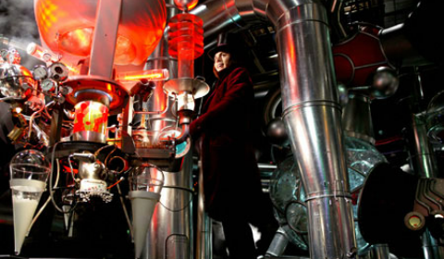
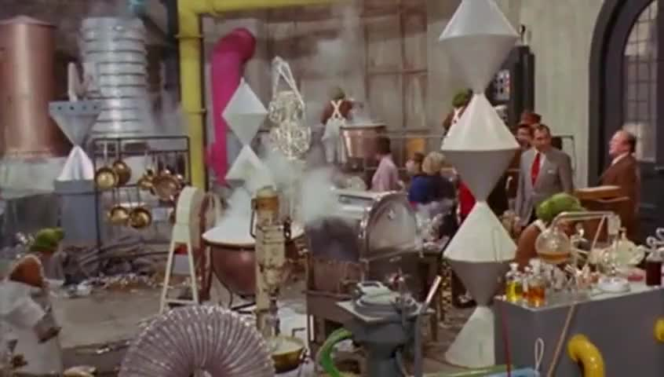
The inventing room
https://www.youtube.com/watch?v=AbaJJq6Wfxs

Slide 4
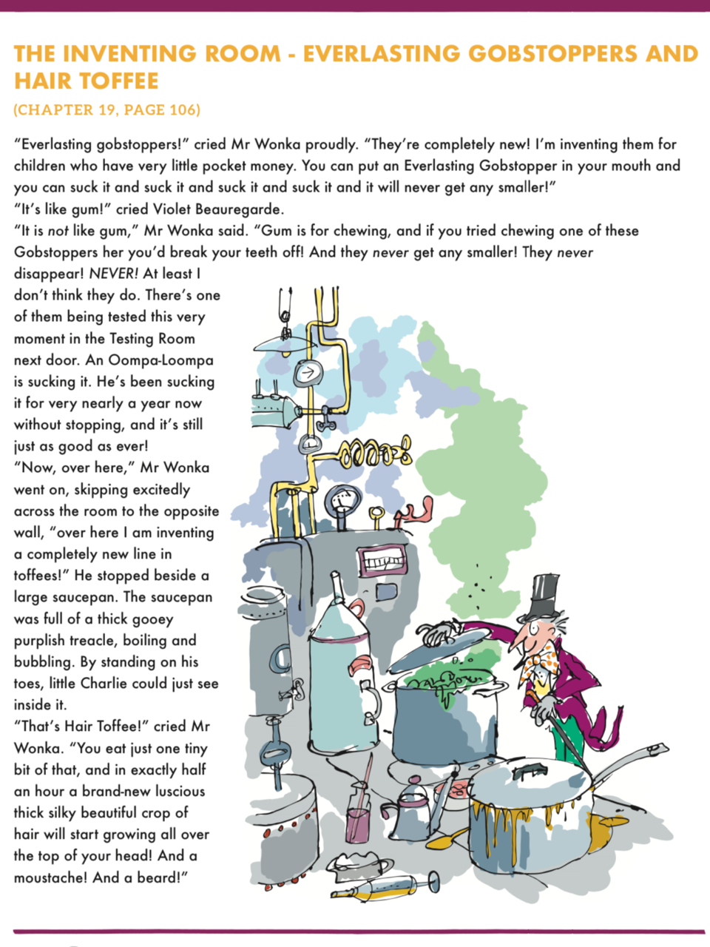

Slide 5
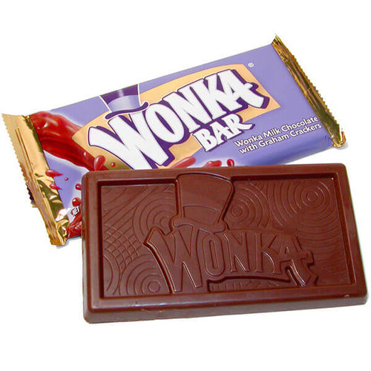
Chapter 22: Along the corridor...
During Chapter 22, Willy Wonka and the remaining characters rush past many rooms:
Eatable (Edible) Marshmallow Pillows;
Lickable Wallpaper for Nurseries;
Hot Ice Creams for Cold Days;
Cows That Give Chocolate Milk.

Slide 6
Earlier in the book, extract from Chapter 2...
Mr Willy Wonka can make marshmallows that taste of violets, and rich caramels that change colour every ten seconds as you suck them, and little feathery sweets that melt away deliciously the moment you put them between your lips. He can make chewing-gum that never loses its taste, and sugar balloons that you can blow up to enormous sizes before you pop them with a pin and gobble them up. And, by a most secret method, he can make lovely blue birds’ eggs with black spots on them, and when you put one of these in your mouth, it gradually gets smaller and smaller until suddenly there is nothing left except a tiny little pink sugary baby bird sitting on the tip of your tongue.

Slide 7

Your mission today is to invent your very own chocolate bar or sweet creation.
You can be as creative and inventive and ‘Wonka like’ as you like
Or
Keep your invention very realistic with everyday confectionary ingredients.

Slide 8
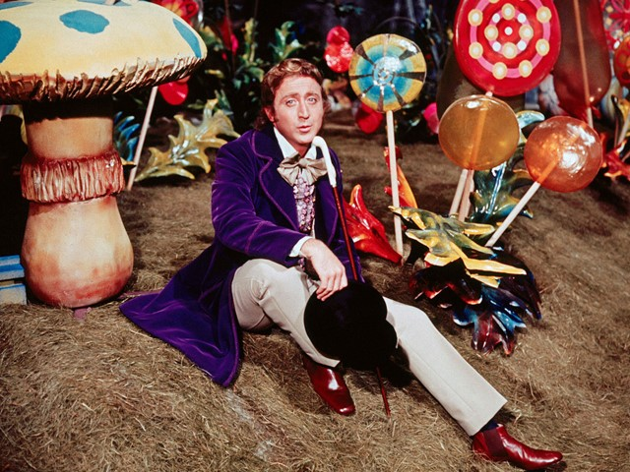

Slide 9
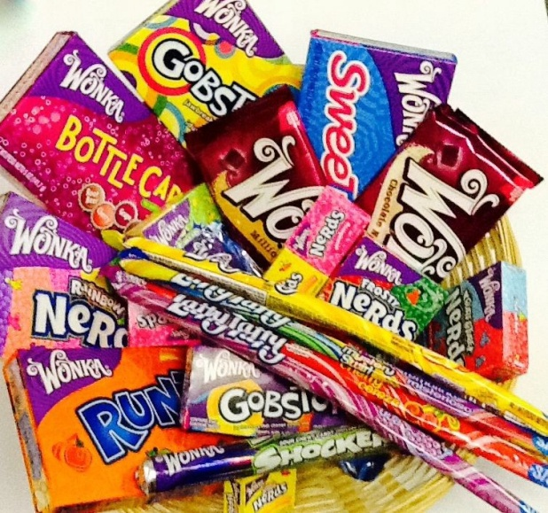
Today you are thinking about:
The look of the bar / sweet
(NOT the packaging – that’s tomorrow’s task!)
The ingredients contained in your creation
(These can be fun and crazy Wonka-style ideas or realistic, everyday baking ingredients)
Does your creation remain the same or does it alter with each lick, chew or bite?
What shape is your sweet or bar? Does this stay the same of change?
As you ‘invent’ your new taste sensation, consider what you think would be a suitable name for your product – make it fun and catchy!
Task: LC Can you invent your own chocolate bar / sweet?
Use the design sheet in the folder or create your own.

Slide 10
Naming your Product
A good product needs a catchy name!
Think about the
ingredients, tastes and flavours
of your product.
Also think about the function it may perform.
Which words might help to convey your message.
Lively- Lickster
Taste-Twister-Toffee
Bubbleblowster
Fizzblaster
Glitterwhizzer
Jumbo Juicy Gems

Slide 11
Extension: Can you write a recipe for your product?
We have worked on instructions and recipes earlier in the year.
Have a go at applying your knowledge to writing a recipe for your invention.
Again, your methods and equipment can be as realistic ‘everyday’ or as creative and ‘Wonka-tastic’ as you like.
As a reminder, a Recipe Success Criteria might include:
Correct layout/structure (inc. title, ingredients, equipment, numbered and chronological instructions)
Imperative verbs (bossy words)
Adverbs
Time words

