Slide 1
Wheels or no wheels

Slide 2
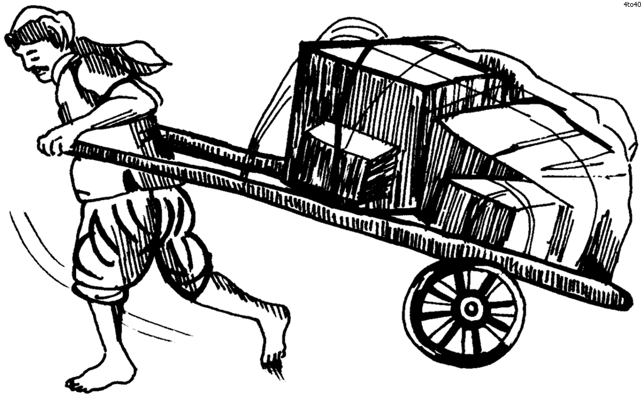
The first carts were pulled by people.
pull!

Slide 3
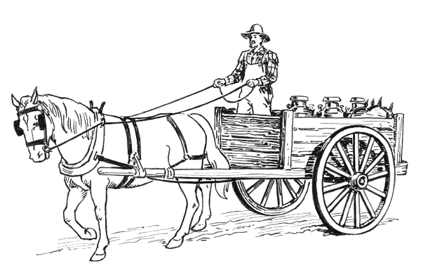
Much later, horses were used to pull carts.
horse and cart

Slide 4
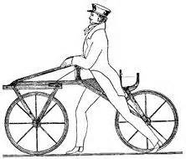
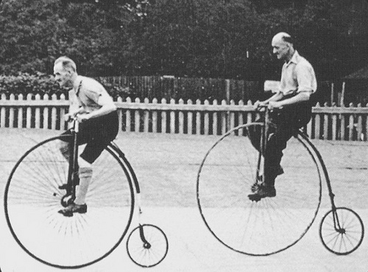
These bicycles were called penny farthings.
Look how high they are!
The first bicycles were called bone shakers –
can you think why?
What were missing on these bicycles?
bicycles

Slide 5
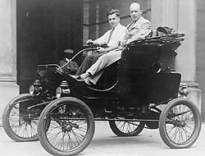
The first motor car
When engines were invented, the engine turned the wheels and horses were not used anymore.

Slide 6
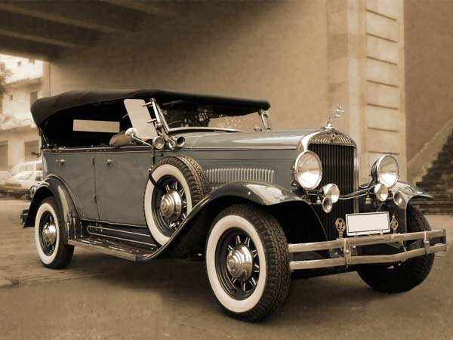
old car
Motor cars became very popular and lots of new roads had to be built.
This one is from a museum of old cars and it still works!

Slide 7
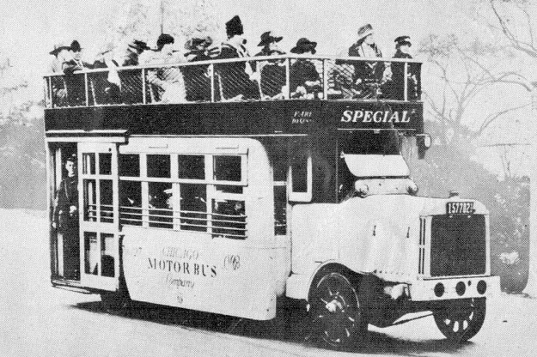
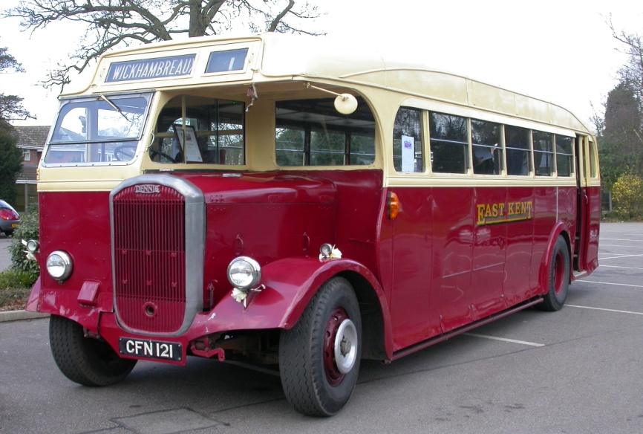
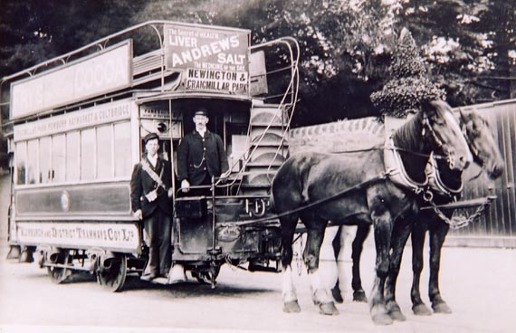
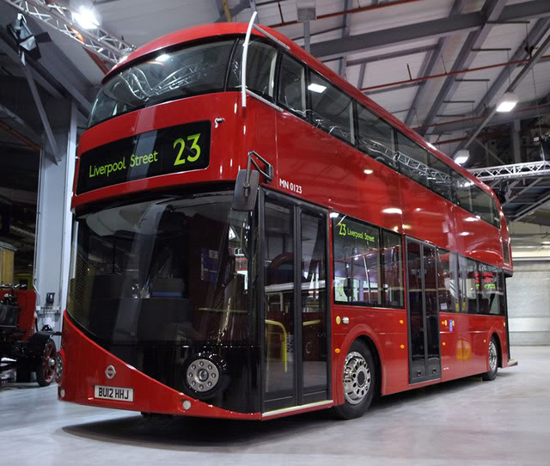
buses
Can you order these buses from oldest to newest?

Slide 8

old
new
Were you correct?

Slide 9
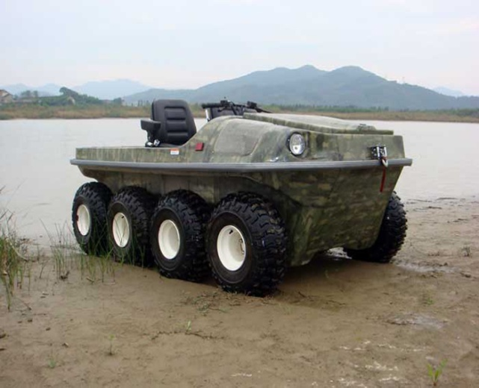
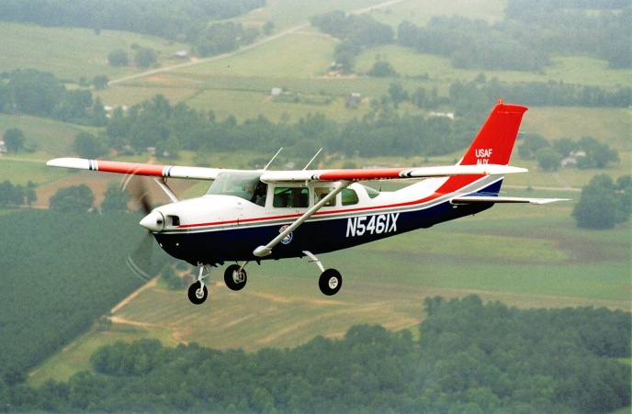
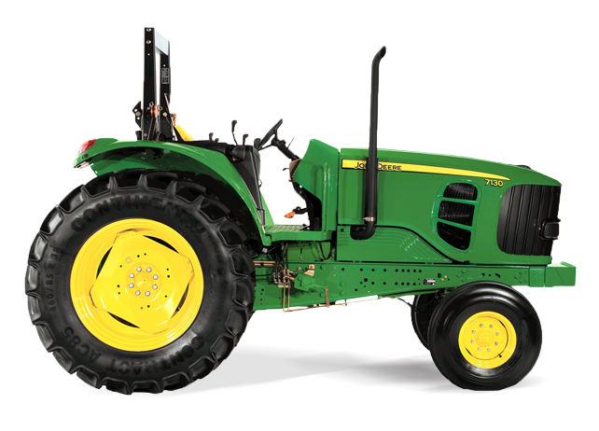
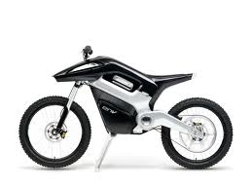
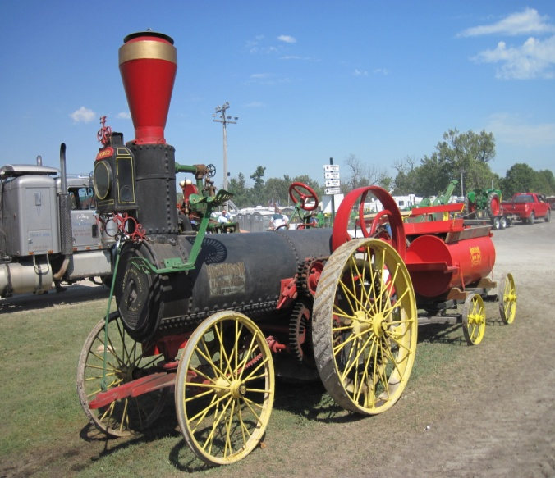
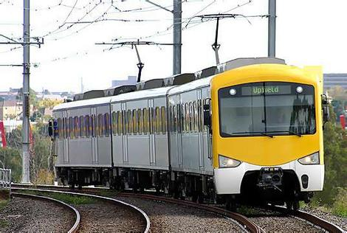
Here are some other vehicles that have wheels:
Can you think of more?

Slide 10
Activity:
To cut and sort the pictures into the correct boxes: wheels or no wheels.
OR
Draw some pictures in your book of objects with wheels or no objects with no wheels.

