Slide 1


Slide 2
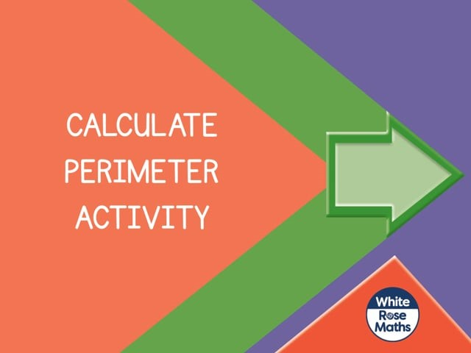

Slide 4
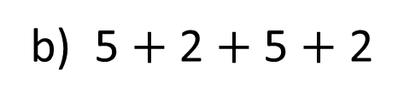
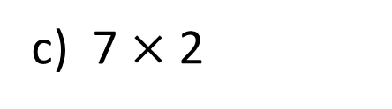
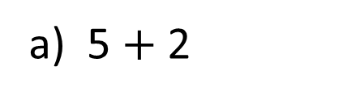
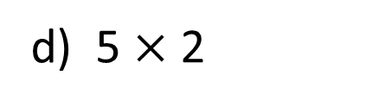
Which calculations will calculate the perimeter of this rectangle?
5 cm
5 cm
2 cm
2 cm
a) 5 $+$ 2
b) 5 $+$ 2 $+$ 5 $+$ 2
c) 7 $×$ 2
d) 5 $×$ 2

Slide 5
Which calculations will calculate the perimeter of this rectangle?
5 cm
5 cm
2 cm
2 cm
a) 5 $+$ 2
b) 5 $+$ 2 $+$ 5 $+$ 2
c) 7 $×$ 2
d) 5 $×$ 2

Slide 7





What is the perimeter of the rectangle?
I think it’s 52 cm
I think it’s 104 cm
50 mm
5 cm
2 cm
You are both wrong. It is 7 cm
You’re all wrong. It is 14 cm
Who is correct?
Can you see what the others were thinking?
Jack is correct. The perimeter is 14 cm.

Slide 8

Here is a rectangle with a perimeter of 16 cm
1 cm
1 cm
1 | 2 | 3 | 4 | 5 | 6
7 | 8 | 9 | 10 | 11 | 12
I wonder if every rectangle with a perimeter of 16 cm has 12 squares inside.
Have a think

Slide 9
I wonder if every rectangle with a perimeter of 16 cm has 12 squares inside.
1 cm
1 cm
1 | 2 | 3 | 4 | 5 | 6 | 7
1 | 2 | 3 | 4 | 5
6 | 7 | 8 | 9 | 10
11 | 12 | 13 | 14 | 15
1 | 2 | 3 | 4
5 | 6 | 7 | 8
9 | 10 | 11 | 12
13 | 14 | 15 | 16

Slide 10
Have a think
How many different rectangles can you draw with a perimeter of 18 cm?
Which rectangle has the smallest number of squares inside?
Which has the greatest number?
What do you notice?

Slide 11

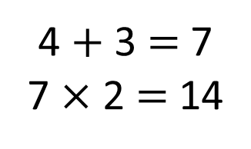
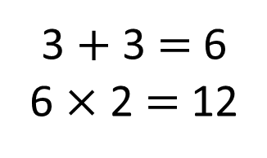
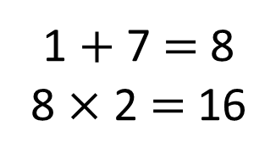
You can’t draw a rectangle with an odd perimeter.
1 cm
3 cm
4 cm
7 cm
3 cm
3 cm
4 $+$ 3 $=$ 7
7 $×$ 2 $=$ 14
3 $+$ 3 $=$ 6
6 $×$ 2 $=$ 12
1 $+$ 7 $=$ 8
8 $×$ 2 $=$ 16
Is Tiny correct?
Can you explain why?
Have a think

Slide 12

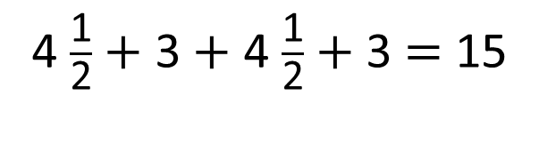
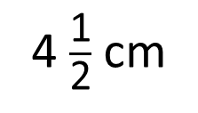
You can’t draw a rectangle with an odd perimeter.
4 $\frac{\text{1}}{\text{2}}$ cm
3 cm
4 $\frac{\text{1}}{\text{2}}$ $+$ 3 $+$ 4 $\frac{\text{1}}{\text{2}}$ $+$ 3 $=$ 15
I think I have found a way!

