Slide 1


Slide 2
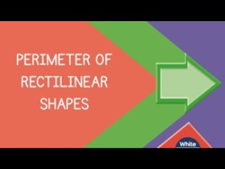

Slide 4
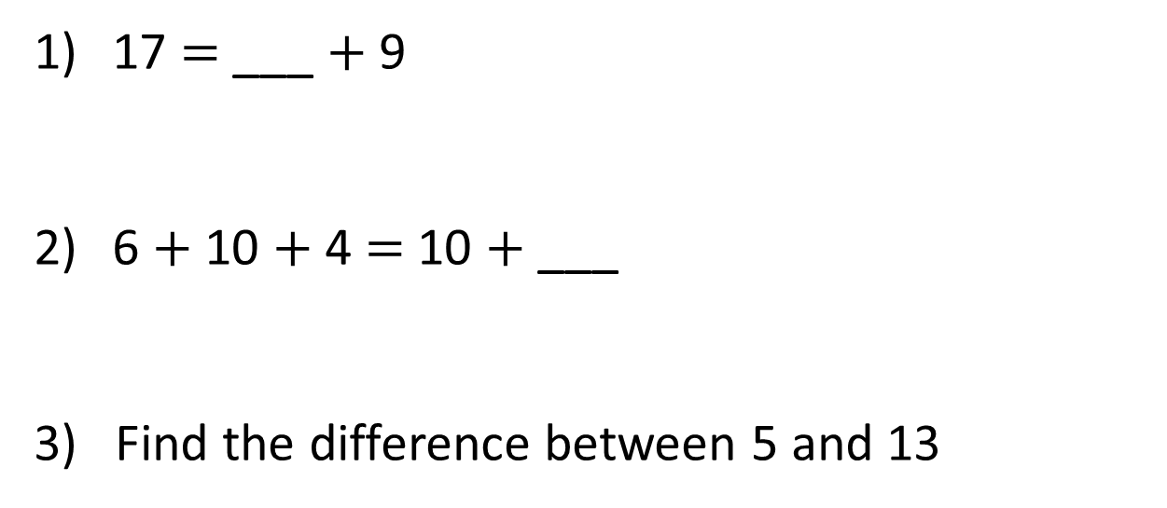
17 $=$ ___ $+$ 9
6 $+$ 10 $+$ 4 $=$ 10 $+$ ___
3) Find the difference between 5 and 13

Slide 5
17 $=$ ___ $+$ 9
6 $+$ 10 $+$ 4 $=$ 10 $+$ ___
3) Find the difference between 5 and 13
8
10
8

Slide 7
Find the perimeter of the rectilinear shape.
1 cm
A rectilinear
shape is a
shape where all the sides meet at right angles.
1 cm
2 cm
3 cm
5 cm
3 cm
2 cm
5 cm
2 cm
+ 3 cm
+ 3 cm
+ 2 cm
+ 5 cm
+ 5 cm
= 20 cm

Slide 8
Have a go at questions 1 and 2 on the worksheet

Slide 9
6 cm
4 cm
4 cm
7 cm
? cm
5 cm
3 cm
3 cm
1 cm
= 26 cm
7 cm $+$ 6 cm $+$ 4 cm $+$ 5 cm$+$3 cm $+$ 1 cm

Slide 10
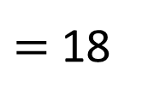
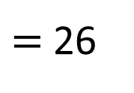
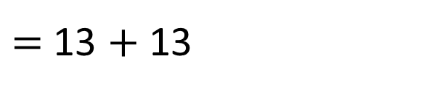
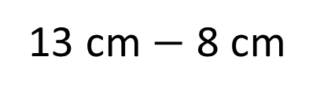
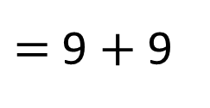
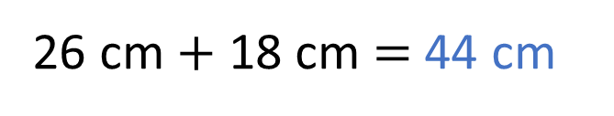
13 cm
13 cm
3 cm
8 cm
8 cm
9 cm
6 cm
13 cm $−$ 8 cm
= 5 cm
$=$ 13 + 13
13 + 5 + 8
$=$ 26
5 cm
3 + 6 + 9
$=$ 9 + 9
$=$ 18
26 cm + 18 cm $=$ 44 cm

Slide 11
Have a go at questions 3 and 4 on the worksheet

Slide 12
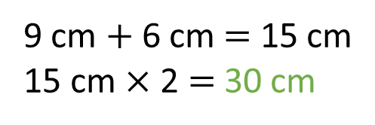
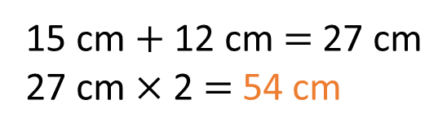
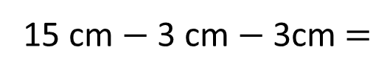
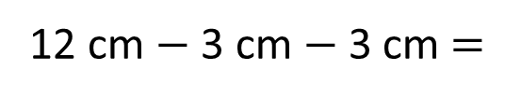
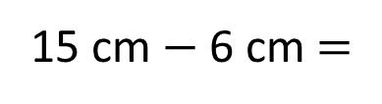
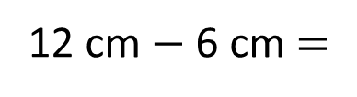
A photo frame is 15 cm long and 12 cm high.
The frame around the photo window is 3 cm wide.
15 cm
3 cm
9 cm
6 cm
12 cm
3 cm
3 cm
3 cm
12 cm $−$ 3 cm $−$ 3 cm $=$
12 cm $−$ 6 cm $=$
6 cm
15 cm $+$ 12 cm $=$ 27 cm
27 cm $×$ 2 $=$ 54 cm
9 cm $+$ 6 cm $=$ 15 cm
15 cm $×$ 2 $=$ 30 cm
15 cm $−$ 3 cm $−$ 3cm $=$
15 cm $−$ 6 cm $=$
9 cm

Slide 13
Have a go at the rest of the worksheet

