Slide 1
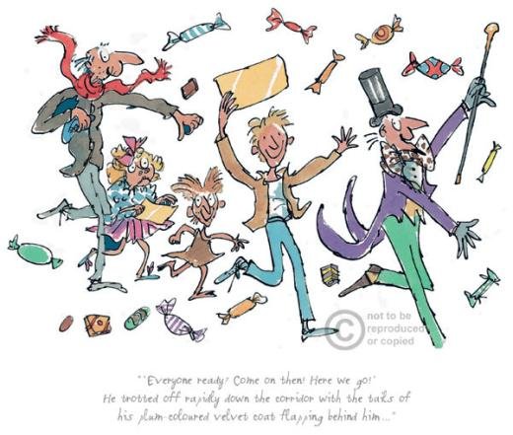

Charlie and the Chocolate Factory
Character descriptions continued

Slide 2
LC Can you write a character description?

Slide 3

Using a gingerbread for a character profile plan
Yesterday we looked at....
Inside the gingerbread we write vocabulary linked to:
Personality
Behaviour
On the outside of the gingerbread we write vocabulary linked to:
Physical Looks
&
Appearance

Slide 4
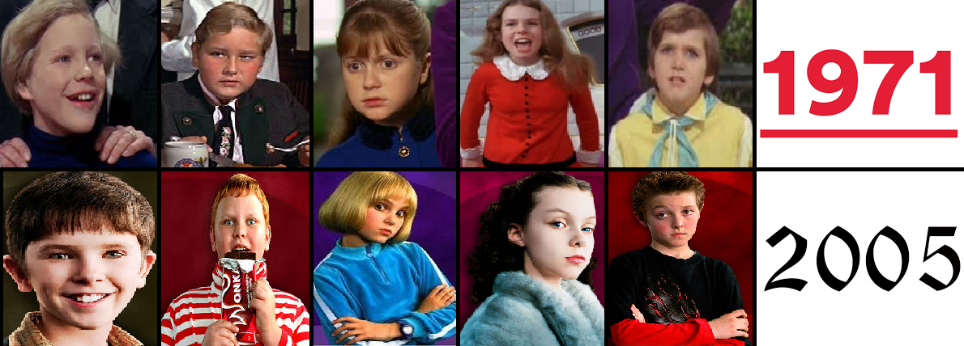
Today, your task is to write a character description of one of your chosen characters.
This may be one of the children from the story book, Willy Wonka or your own
6th Golden Ticket winner!

Slide 5
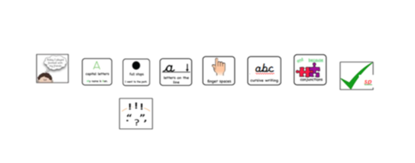
Task: LC: Can write a character description?
Success Criteria:
Writer's Toolkit
-Adjectives (personality and appearance)
-Commas in a list (between a list of describing adjectives)
- Similes (to support your description)
Verbs & adverbs (if these help to describe actions of your character)

