Slide 1
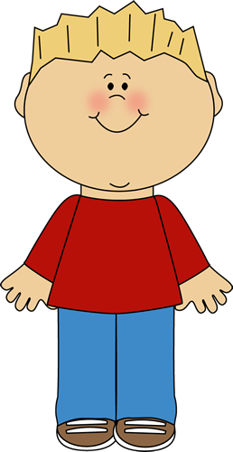
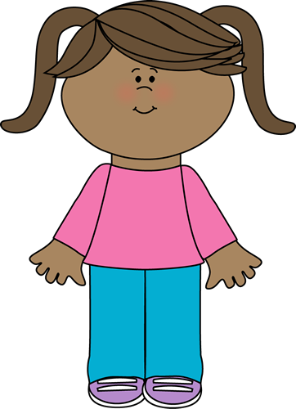
Making Choices:
Right or Wrong?
?

Slide 2
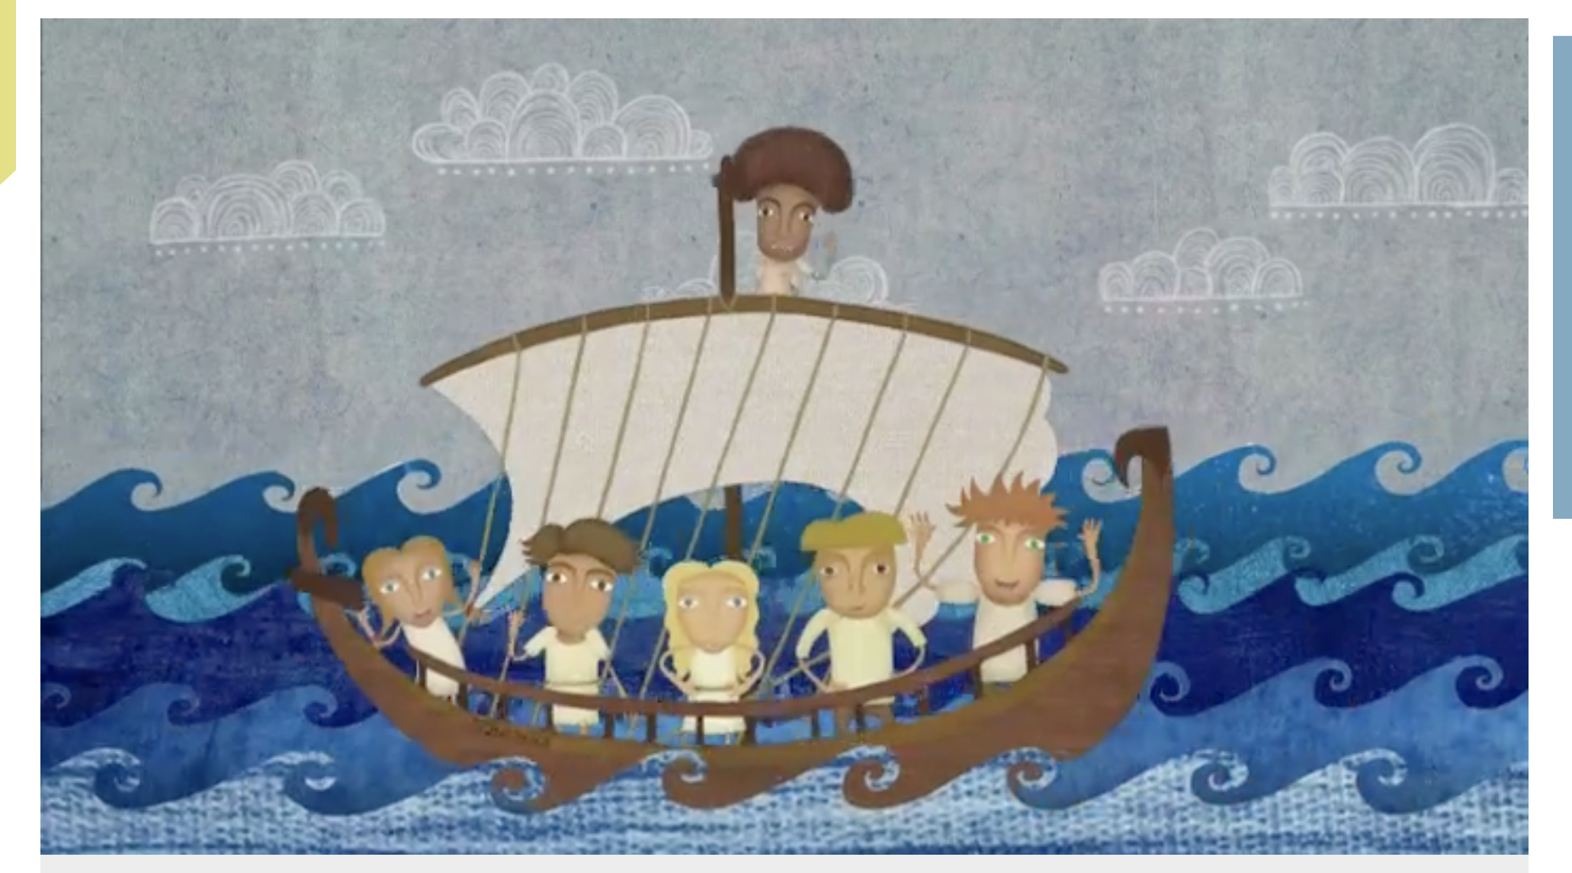
Making the right choices
https://www.bbc.co.uk/teach/class-clips-video/pshe-ks1-ks2-why-should-i-be-good/zmbrkmn

Slide 3
Hello Year 1/2! My name is Buddy, and this is my friend Tilly! We are in Year 1/2 as well! We’re here today to show you some of the choices we make every day! Watch closely and see if they are the same choices you make too!
I bet we make very similar choices in the day as KS1 do Buddy! Sometimes I think that we make the wrong choices though! Do you think you can help us decide which of our choices are right and wrong?

Slide 4

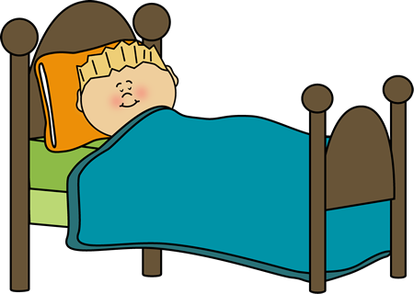
In the morning my mum comes to wake me up to get ready for school! I choose to ignore her and go back to sleep and then I argue with her when she comes to wake me up again! Is this the right choice or the wrong choice?

Slide 5


I choose to walk sensibly with my mum on the way to school! I hold her hand and stay away from the edge of the pavement and the cars.

Slide 6

When I get into school I go straight into the cloak room to put my coat and bag away. I say hello to my friends but I don’t stop to chat or be silly, I get my planner and my book and go straight into class to settle down to work.

Slide 7

When the teacher is talking to the class I sometimes choose to talk to the person next to me and fidget on the carpet. I sometimes choose to not pay attention to what the teacher is saying.

Slide 8
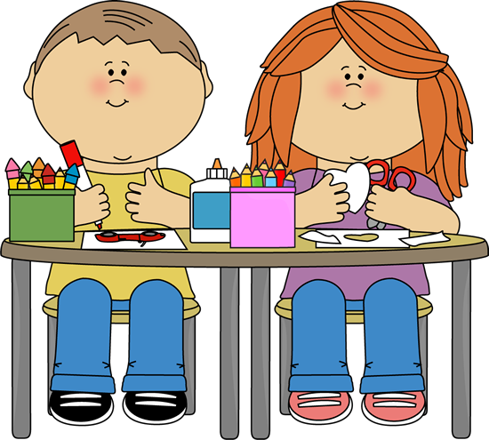
When I am working I try my best and concentrate to get my work finished on time! The teacher says it doesn’t matter if I get it wrong as long as I’ve tried my best. So I choose to work my hardest at
all times!

Slide 9
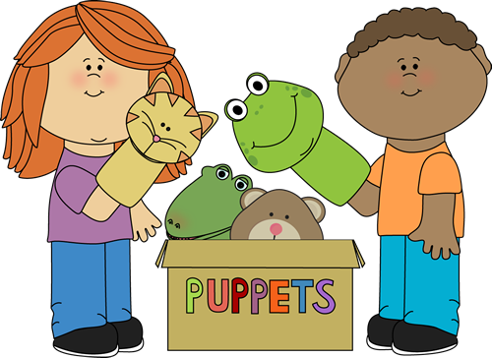
When I am playing with my friends I choose to tell other people that they can’t join in and play with us. I sometimes choose to say mean things to them which makes them upset.

Slide 10
So did YOU make the right choices? Sometimes things go wrong and we make choices that we shouldn’t, but me and Tilly are getting better at choosing the right things to do!
We all make choices every day. Sometimes a choice can be tricky but we need to learn how to make the RIGHT choices so that :
We can learn
We can have fun
Other people can learn and be
happy too.

Slide 11
Think about the choices that you make every day!

Slide 12
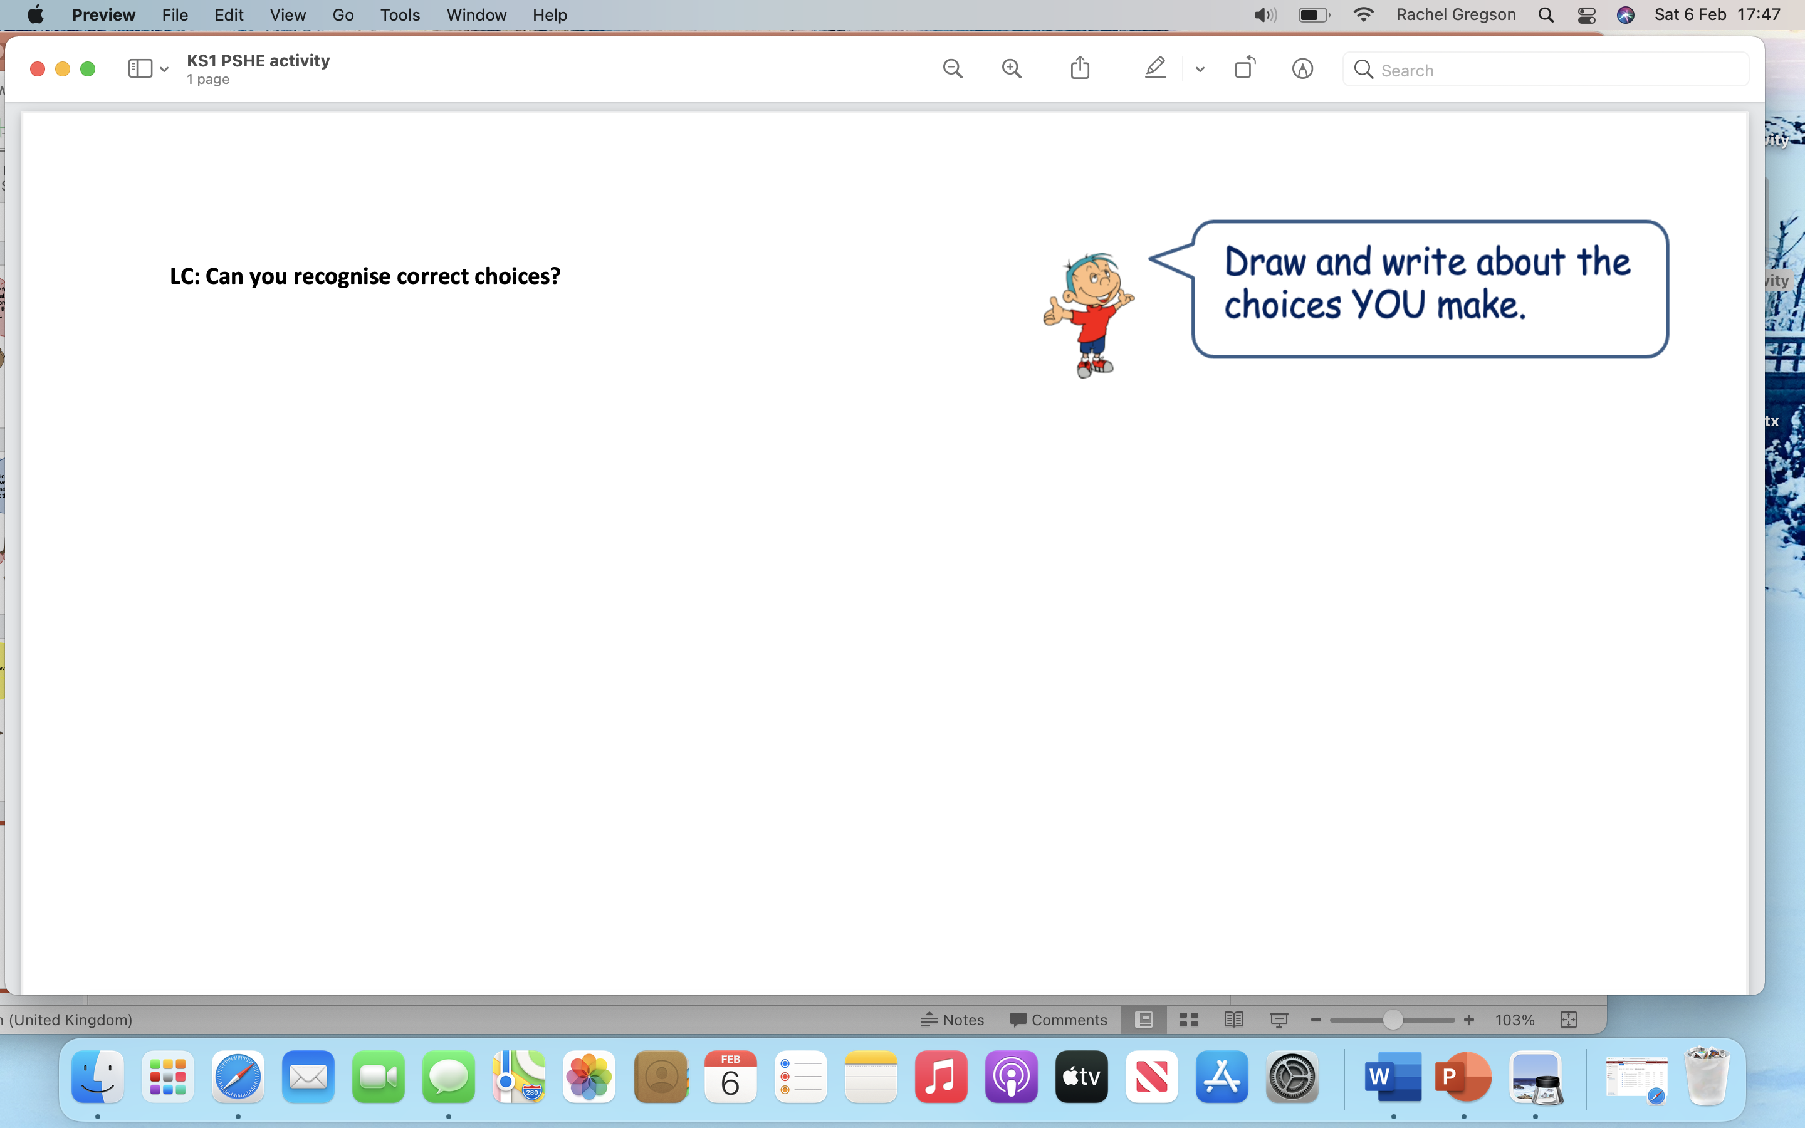
Activity:
LC: Can you recognise correct choices?
Complete the worksheet in the folder.
Draw and write about the choices you make.

