Slide 1
Silent b letters
Can you remember any of the ‘silent b’ words from yesterday’s lesson?

Slide 2
What Are Silent Letters?
Some letters in words do not make a sound, they are silent.
Silent letters are letters that you can't hear when you say the word,
but that are there when you write the word.
There are silent letters in some English words because over hundreds of years we have changed how we pronounce these words, but have kept the spelling.
The spelling tells us how the word used to be pronounced.
For example: knock. In the past, people used to say the word with the k sounded out at the beginning! That would sound very strange to us today!

Slide 3
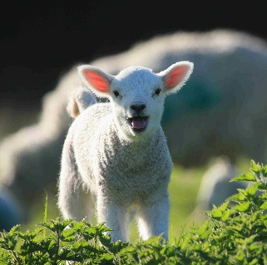


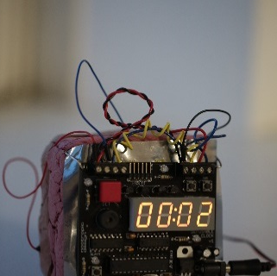
A silent b occurs after m, before t.
lamb
thumb
debt
bomb
What other words do you know with a silent b?
numb
comb
tomb
climb
lamb
dumb
doubt
debt
crumb
womb
aplomb
succumb
bomb
thumb

Slide 4
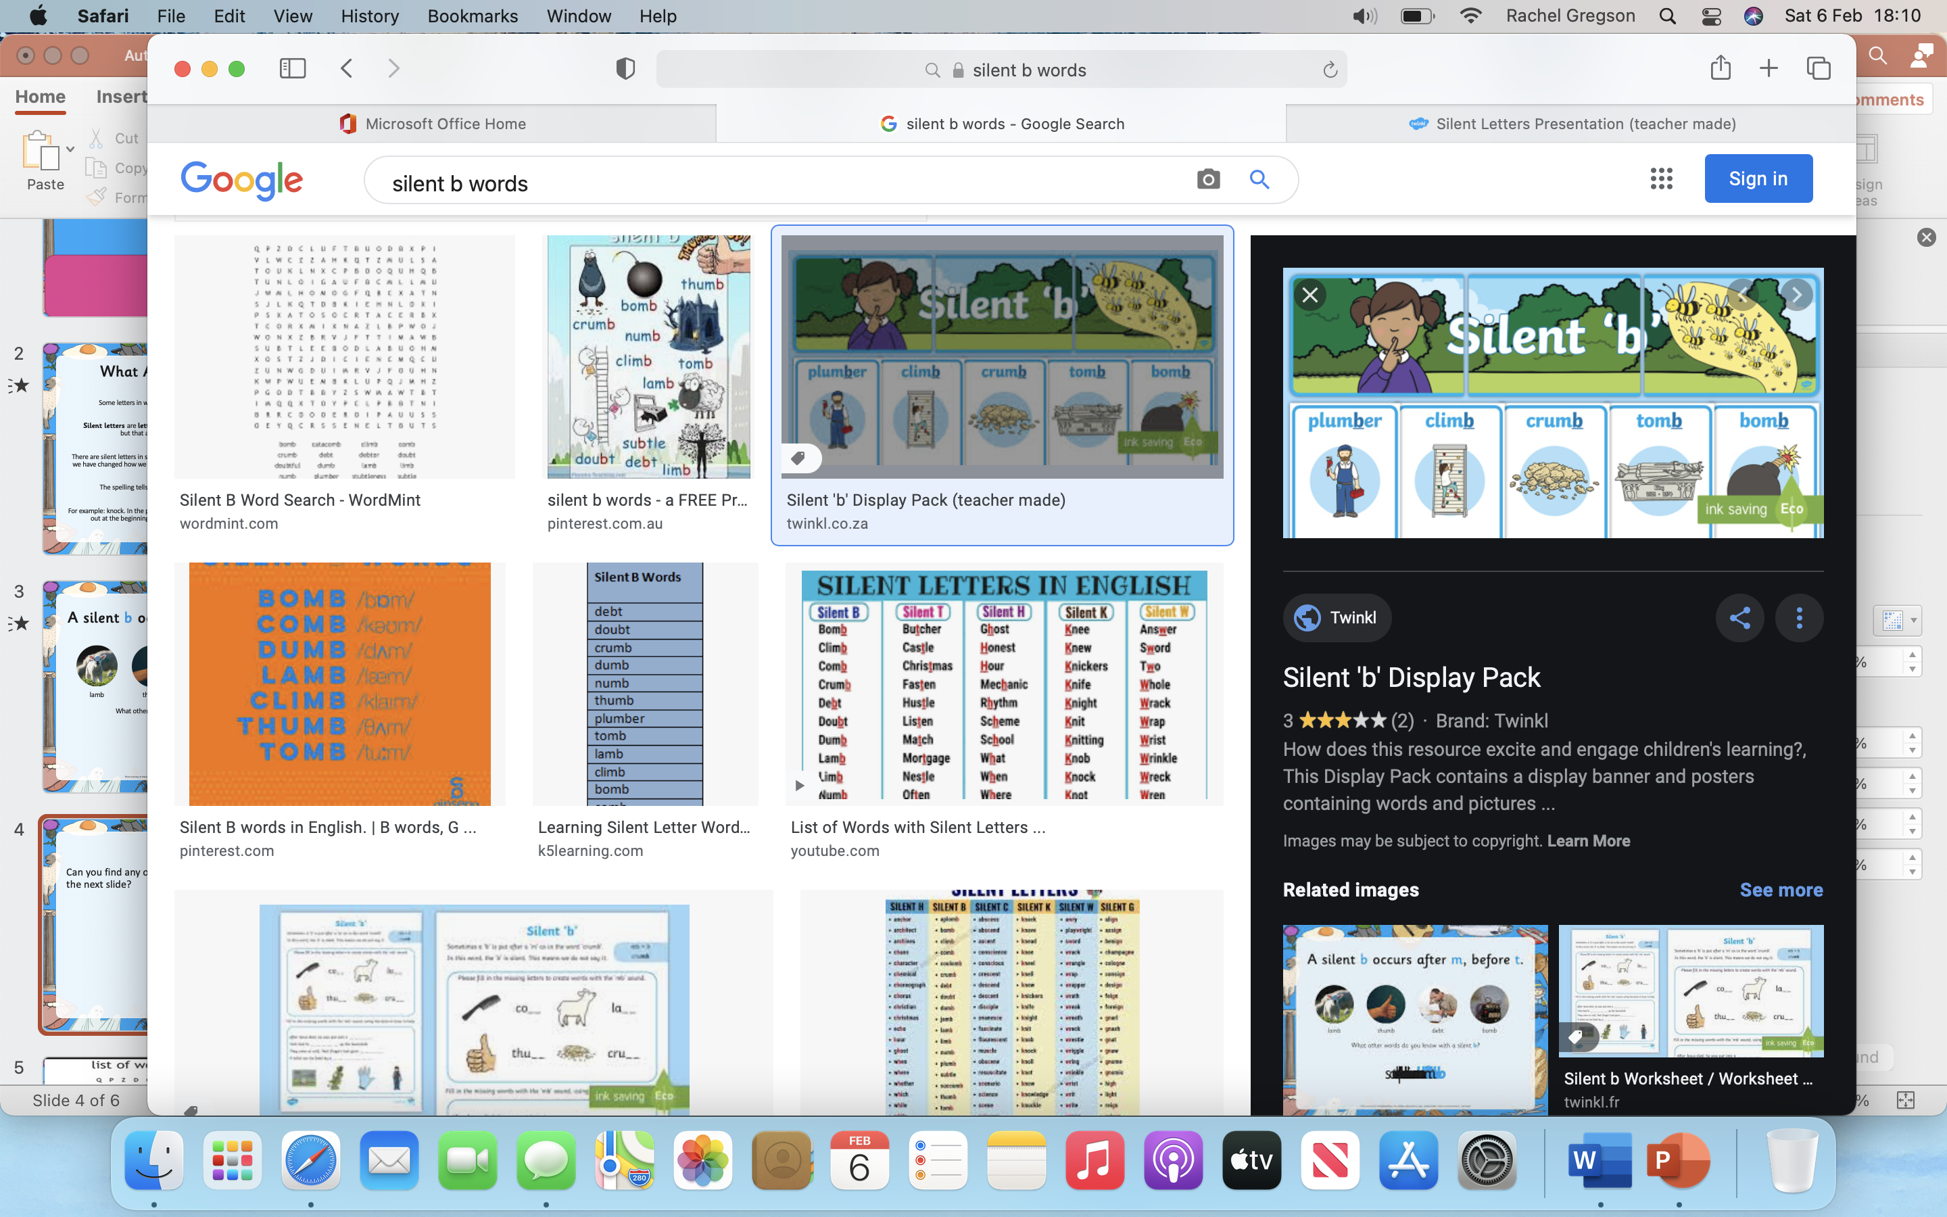
Can you find any of the ‘silent b’ words which are on the next slide?

Slide 5
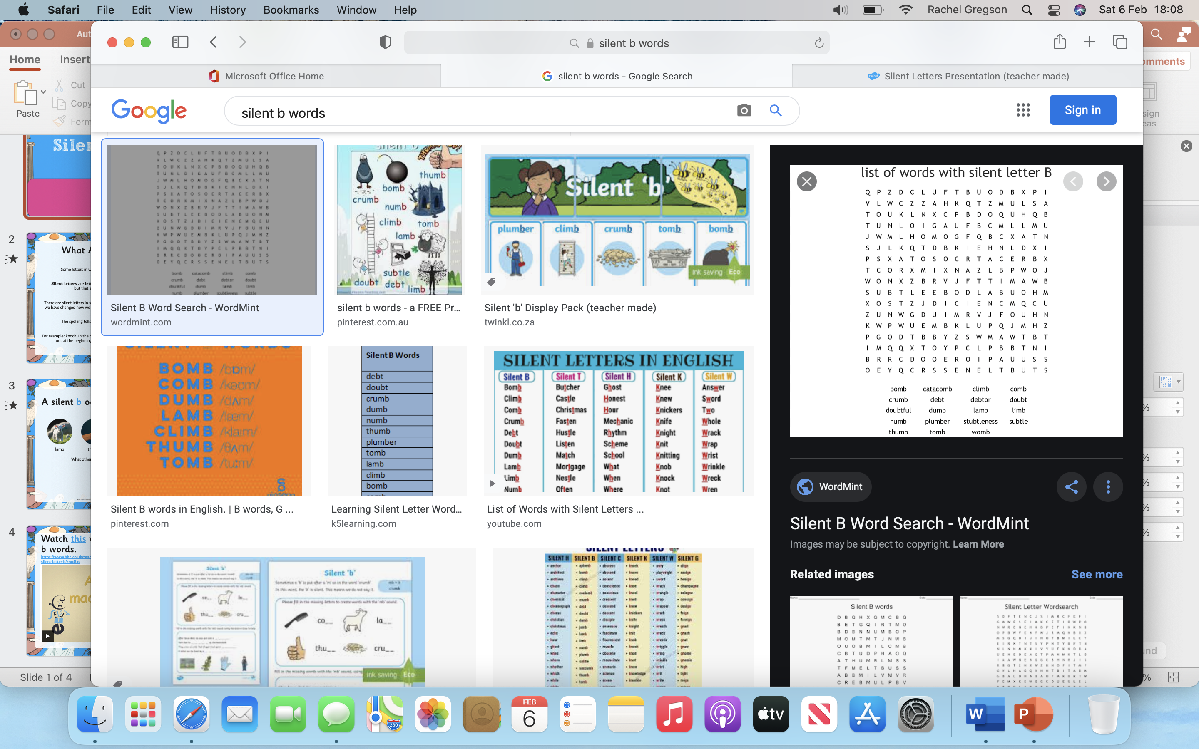

Slide 6
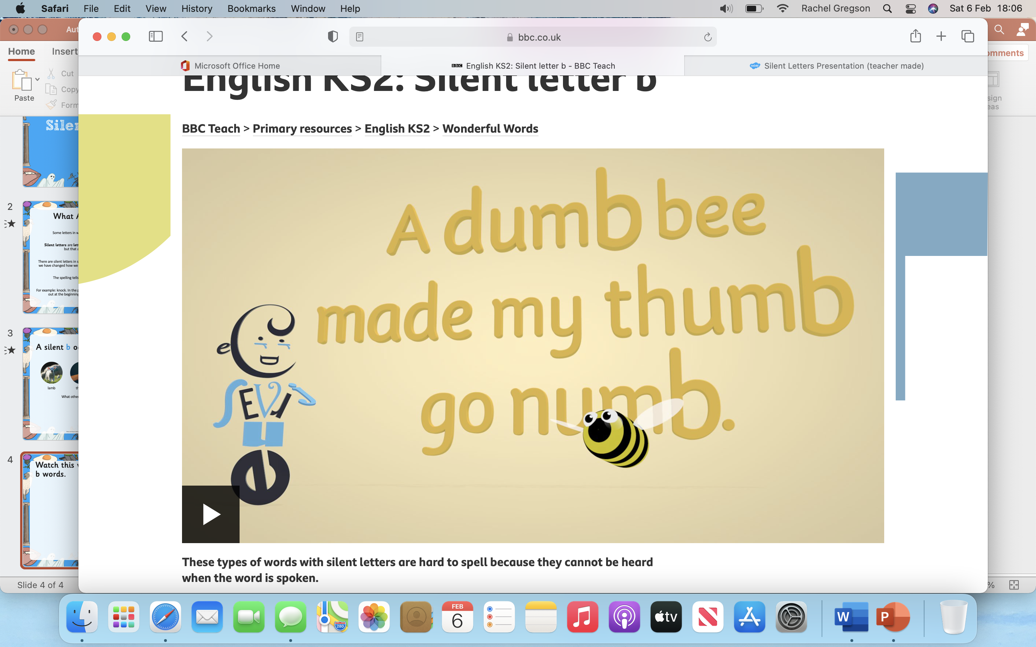
Watch this video – all about silent b words. https://www.bbc.co.uk/teach/class-clips-video/english-ks2-wonderful-words-silent-letter-b/zrxc8xs

Slide 7
Activities
Complete the worksheets in the shared folder.
Match the words to the correct picture.
Wordsearch.

