Slide 1
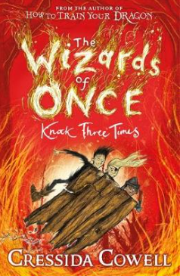
LC: Can I summarise key points in a story?

Slide 2
Vocabulary
agitation – anxious or nervous
swivelling - turn around a point
boasted – to brag about achievements, possessions, or abilities

Slide 3
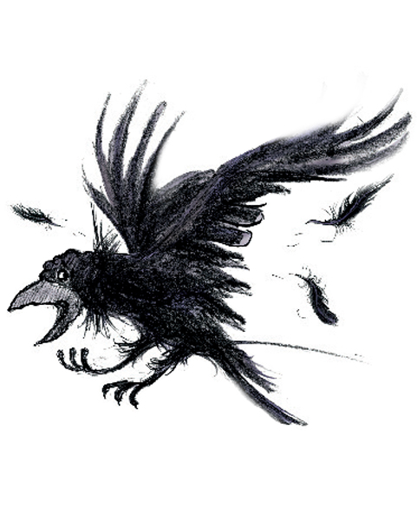
Let’s recap what has happened in the story so far.
Jot down 3 key things that have happened so far:

Slide 4
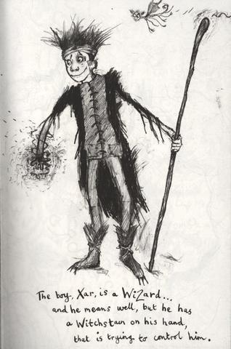
Story Summary
Wish and Xar have escaped from their parents
They are being followed by witches
They are searching for the tears of Drood

Slide 5
Today we are going to skip forward a few pages (you could
read the ones inbetween in your own time). Please read
pages 22- 24.

Slide 6
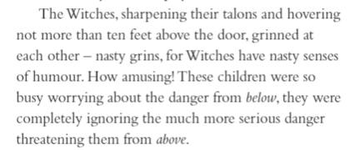
Some practice questions..
How do we know that the witches
were getting ready to close in on the
children?

Slide 7
Answer:
They were sharpening their talons
which shows that they were getting
ready to swoop and attack the children.
They were getting closer as they were
not further than 10 feet away.

Slide 8
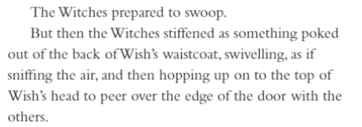
Practice questions:
Identify the two words which show the
witches were ready to attack but then
changed their minds.

Slide 9
Answer:
The witches were prepared to swoop
showing they were about to attack but
then they stiffened which suggests they
stopped what they were about to do.

Slide 10
Read pages 22-24.
Task
To summarise the key point in these few pages.
What were the key events that took place on these pages?
Can you bullet point the main events that have taken place in these pages? (Like the example we looked at earlier).

