Slide 1


Slide 2
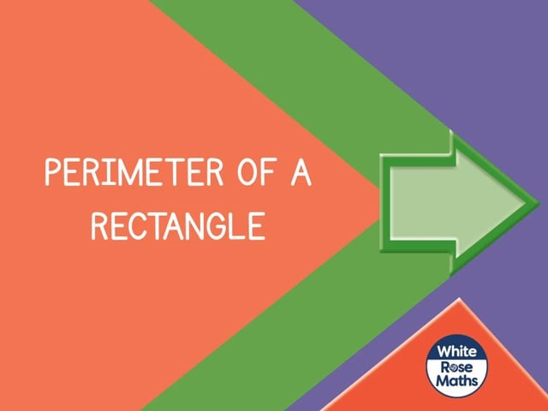

Slide 4
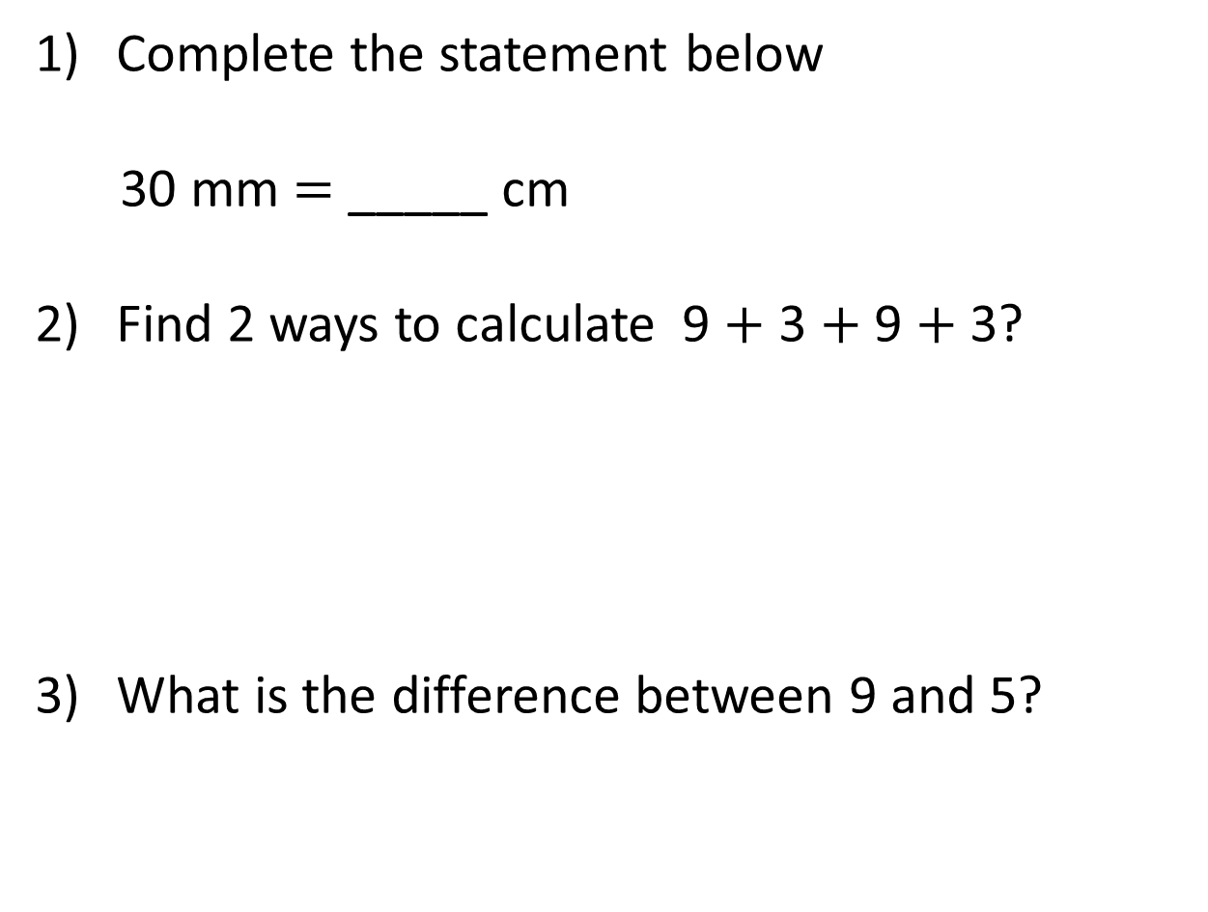
Complete the statement below
30 mm $=$ _____ cm
Find 2 ways to calculate 9 $+$ 3 $+$ 9 $+$ 3?
What is the difference between 9 and 5?

Slide 5

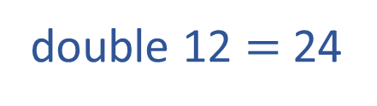
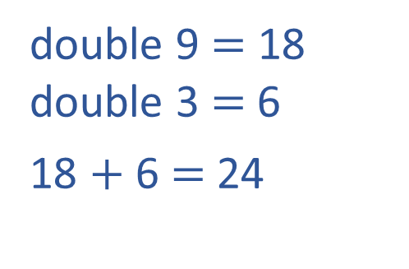

Complete the statement below
30 mm $=$ _____ cm
Find 2 ways to calculate 9 $+$ 3 $+$ 9 $+$ 3?
What is the difference between 9 and 5?
3
double 9 $=$ 18
double 3 $=$6
18 $+$ 6 $=$ 24
12
12
double 12 $=$ 24
9 $−$5 $=$ 4
5 $+$ 4 $=$ 9

Slide 7
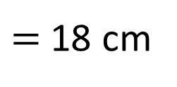
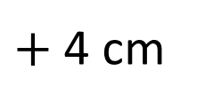
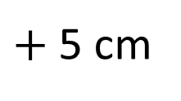
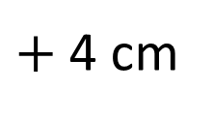
What is the perimeter of the rectangle?
1 cm
1 cm
5 cm
4 cm
4 cm
5 cm
5 cm
$+$ 4 cm
$+$ 5 cm
$+$ 4 cm
$=$ 18 cm

Slide 8
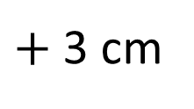
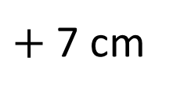
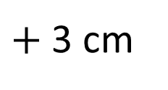
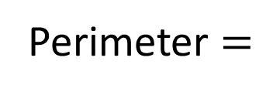
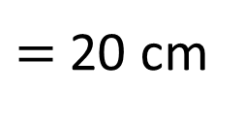
What is the perimeter of the rectangle?
7 cm
7 cm
30 mm
3 cm
3 cm
Perimeter $=$
10 cm
20 cm
Opposite sides of a rectangle are equal
7 cm
$+$ 3 cm
$+$ 7 cm
$+$ 3 cm
$=$ 20 cm

Slide 9

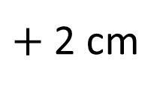
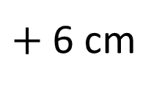
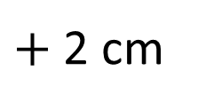
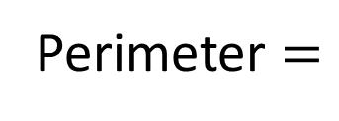
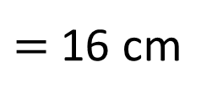
What is the perimeter of the rectangle?
2 cm
2 cm
Have a think
Opposite sides of a rectangle are equal
6 cm
6 cm
Perimeter $=$
8 cm?
16 cm
6 cm
$+$ 2 cm
$+$ 6 cm
$+$ 2 cm
$=$ 16 cm

Slide 10
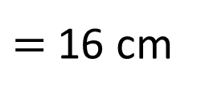

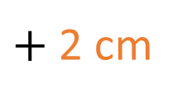
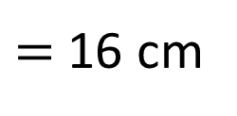
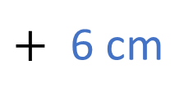
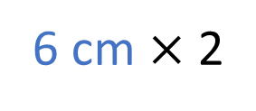
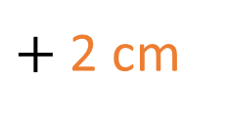
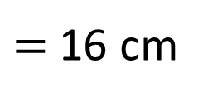

6 cm
2 cm
6 cm
$+$ 2 cm
$+$ 6 cm
$+$ 2 cm
$=$ 16 cm
$=$ 16 cm
6 cm $×$ 2
$+$
2 cm × 2
8 cm
$=$ 16 cm
$×$ 2

Slide 11

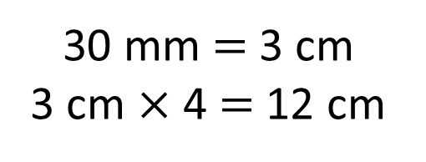
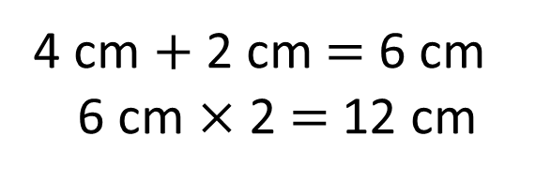
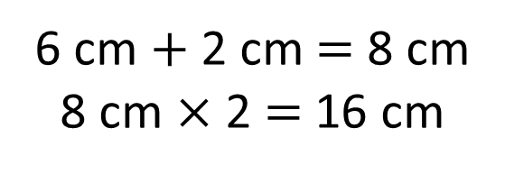
Which shapes have a perimeter of 12 cm?
2 cm
4 cm $+$ 2 cm $=$ 6 cm
6 cm $×$ 2 $=$ 12 cm
30 mm
6 cm
4 cm
2 cm
30 mm $=$ 3 cm
3 cm $×$ 4 $=$ 12 cm
6 cm $+$ 2 cm $=$ 8 cm
8 cm $×$ 2 $=$ 16 cm
Have a think

Slide 12
Have a go at questions 1 - 4 on the worksheet
Notes:
Can we simplify?
Discuss reduction structure – take away

Slide 13
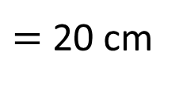
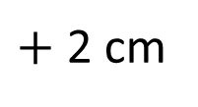
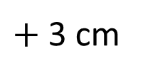
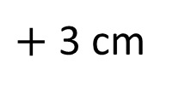
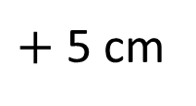
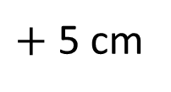
What is the perimeter of the shape?
1 cm
1 cm
2 cm
3 cm
5 cm
3 cm
2 cm
5 cm
2 cm
$+$ 3 cm
$+$ 3 cm
$+$ 2 cm
$+$ 5 cm
$+$ 5 cm
$=$ 20 cm

Slide 14

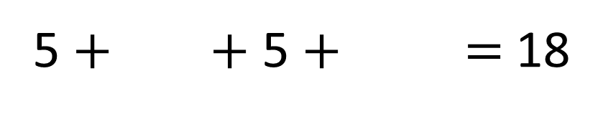
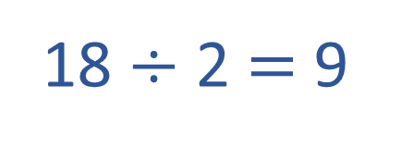

Perimeter = 18 cm
4
5 cm
5 cm
4
___ cm
___ cm
5 $+$ $+$ 5 $+$ $=$ 18
4
4
18 $÷$ 2 $=$ 9
9
9
5 $+$ $=$ 9
4

Slide 15
Have a go at the rest of the worksheet
Notes:
Can we simplify?
Discuss reduction structure – take away

