Slide 1


Slide 2
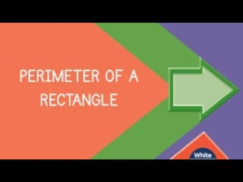

Slide 4
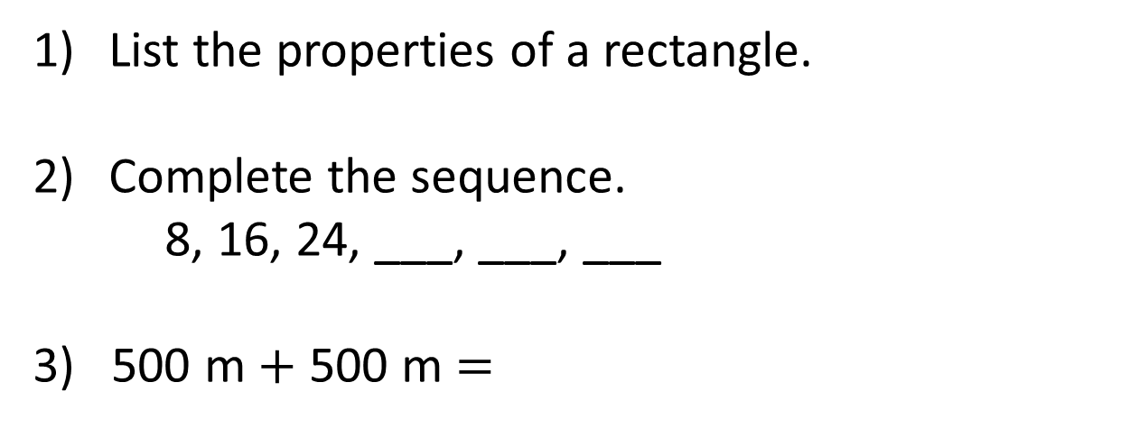
List the properties of a rectangle.
Complete the sequence.
8, 16, 24, ___, ___, ___
3) 500 m $+$ 500 m $=$

Slide 5
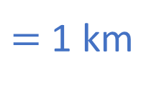
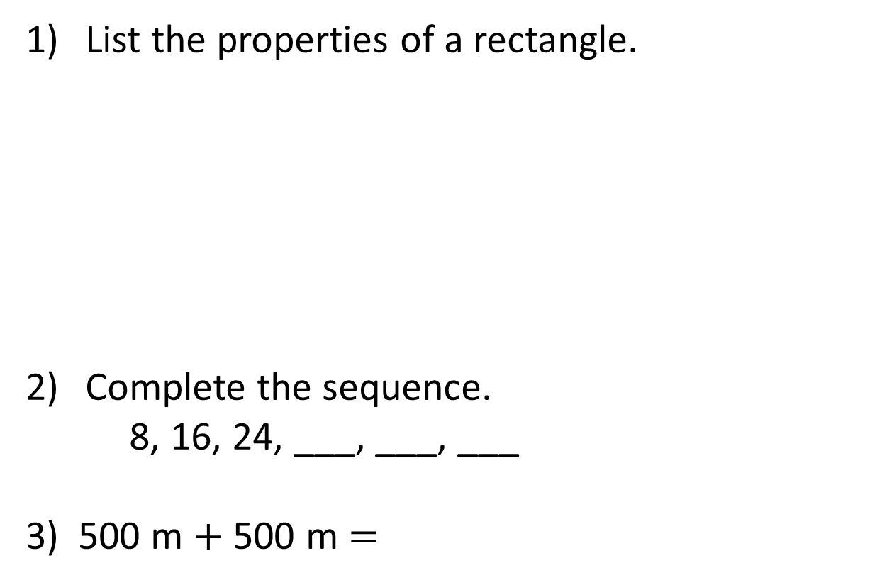
List the properties of a rectangle.
Complete the sequence.
8, 16, 24, ___, ___, ___
3) 500 m $+$ 500 m $=$
2-D shape
4 sides and 4 vertices
All sides are straight
All vertices are right angles
2 pairs of parallel sides
Opposite sides are equal
32
40
48
1,000 m
$=$ 1 km

Slide 7
Perimeter is the length around a closed 2-D shape.
1 cm
1 cm
5 cm
4 cm
4 cm
5 cm
5 cm
+ 4 cm
+ 5 cm
+ 4 cm
= 18 cm

Slide 8
2 cm
2-D shape
4 sides
All sides are straight
2 pairs of parallel sides
2 cm
6 cm
6 cm
Opposite sides are equal
16 cm
Perimeter =
8 cm ?
6 cm
+ 2 cm
+ 6 cm
+ 2 cm
= 16 cm

Slide 9
Have a go at questions 1 and 2 on the worksheet

Slide 10
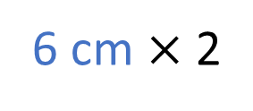
6 cm
2 cm
6 cm
+ 2 cm
+ 6 cm
+ 2 cm
= 16 cm
6 cm $×$ 2
+
2 cm × 2
= 16 cm
8 cm
× 2
= 16 cm

Slide 11

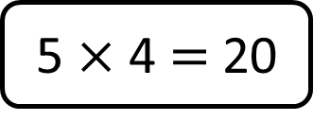
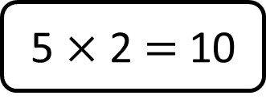
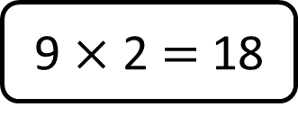
Match the rectangles with the correct calculation to find the perimeter.
Have a think
4 cm
5 cm
3 cm
2 cm
5 cm
5 $×$ 2 $=$ 10
9 $×$ 2 $=$ 18
5 $×$ 4 $=$ 20

Slide 12
Have a go at questions 3 and 4 on the worksheet

Slide 13

Perimeter = 18 cm
Have a think
5 cm
13
cm
I don’t think that looks quite right but I’m not sure how to fix it.

Slide 14


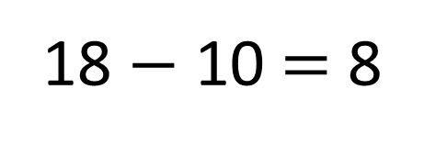
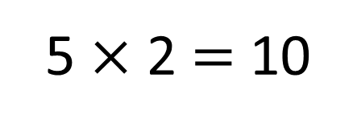
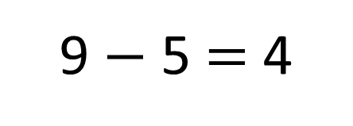
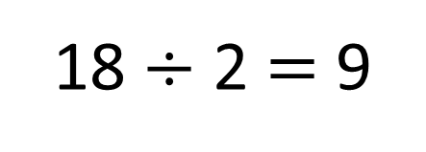
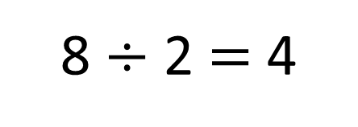
Perimeter = 18 cm
4 cm
5 cm
5 cm
4
cm
5 $×$ 2 $=$ 10
18 $÷$ 2 $=$ 9
18 $−$ 10 $=$ 8
9 $−$ 5 $=$ 4
8 $÷$ 2 $=$ 4

Slide 15
Have a go at the rest of the worksheet

