Slide 1
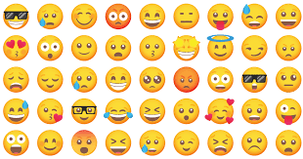
Las emociones
Emotions

Slide 2
Las emociones
Recap
Can you remember any of the feelings/emotions from last week?
I am ...happy, sad, angry, excited, tired, poorly, worried, ok?
Have another look through the slides to remind yourself and watch the videos again.
This week's activity is outlined on slide number 10.
Slide 11 will help you with the activity.

Slide 3
Las emociones
In Spanish there are 2 ways to ask:
How are you?
We can say ¿Comó estás? or we can say ¿Qué tal?
Then we can respond...
If the emotion ends in an 'o' and you are a girl saying the sentence then we change the ending to 'a'. If you are a boy then the ending stays the same.

Slide 4
Las emociones
Here are a couple of videos to watch about how we are feeling.
We've watched them before
https://www.youtube.com/watch?v=4deUxsQOGps
https://www.youtube.com/watch?v=lU8zZjBV53M

Slide 5


Las emociones
Estoy bien
I am feeling good
Estoy mal
I am not feeling good/feeling bad

Slide 6


Las emociones
Estoy contento/a
I am happy
Estoy triste
I am sad

Slide 7


Las emociones
Estoy enfadado/a
I am angry
Estoy entusiasmado/a
I am excited

Slide 8
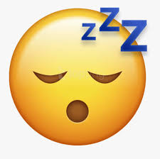
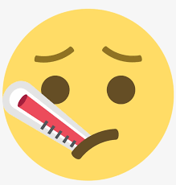
Las emociones
Estoy cansado/a
I am tired
Estoy enfermo/a
I am poorly/ill

Slide 9


Las emociones
Estoy preocupado/a
I am worried
Estoy regular
I am ok

Slide 10
Las emociones
The final sheet (number 8) in the worksheet attachment has got 7 monsters on it showing different feelings.
Label the monsters in Spanish with the emotion that you think they are feeling and then colour them in.
All the feelings are on the next slide to help you.

Slide 11
happy/contento
sad/triste
tired/cansado
worried/preocupado
angry/enfadado
excited/entusiasmado
ill/enfermo
ok/regular

