Slide 1
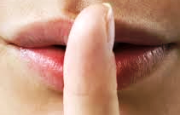
Silent b Words
b
In old English the ‘b’ used to be pronounced-
now it is silent.

Slide 2
Click the mouse on each slide to make the silent letter appear

Slide 3
b
clim

Slide 4
b
bom

Slide 5
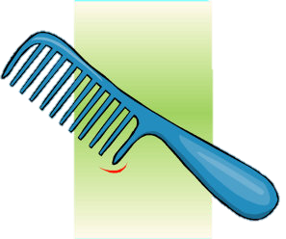
b
com

Slide 6
b
crum

Slide 7
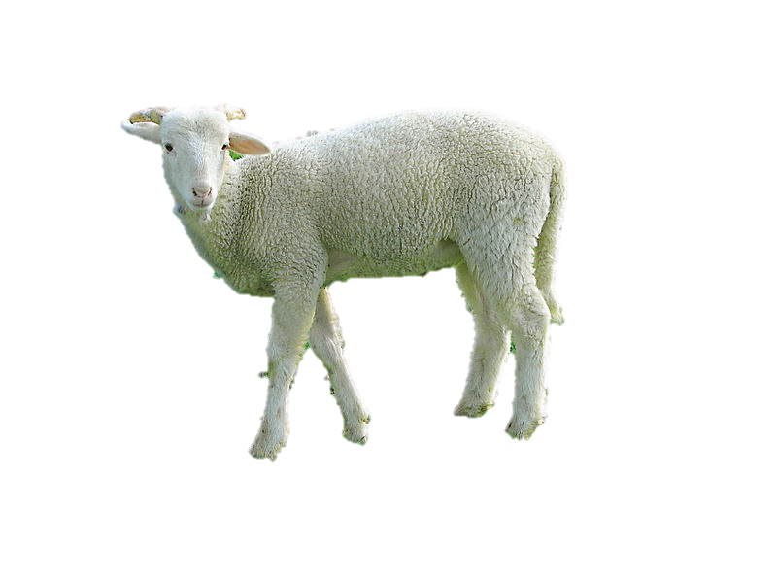
b
lam

Slide 8
b
num

Slide 9
b
thum

Slide 10
b
plum er

Slide 11
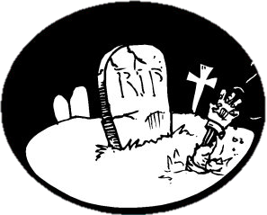
b
tom

Slide 12
b
lim

Slide 13
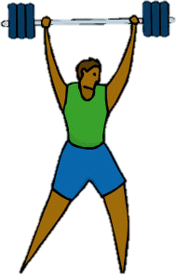
b
dum -bells

Slide 14
Now for some more unusual words

Slide 15
b
de t
an obligation owed by one party ,the debtor, to a second party

Slide 16
b
dou t
a state between belief and disbelief, involving uncertainty or distrust

Slide 17
b
succum
fail to resist pressure, temptation, or some other negative force

Slide 18
b
su tle
making use of clever and indirect methods to achieve something

Slide 19
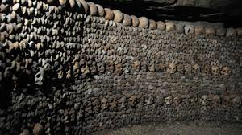
b
catacom s

Slide 20
b
aplom
self-confidence or assurance

Slide 21
Can you find anymore silent b words?
Where does silent ‘b’ more commonly appear in a word?

Slide 22
Activities
Complete the worksheets in the shared folder.
Find the ‘silent b’ words.
Complete the missing words.

