Slide 1

wh

Slide 2
Today our sound is a tricky digraph
wh
Notice how you can hear
the ‘w’ but the ‘h’ is silent.
https://www.youtube.com/watch?v=TBA-R3Sx1Pc

Slide 3
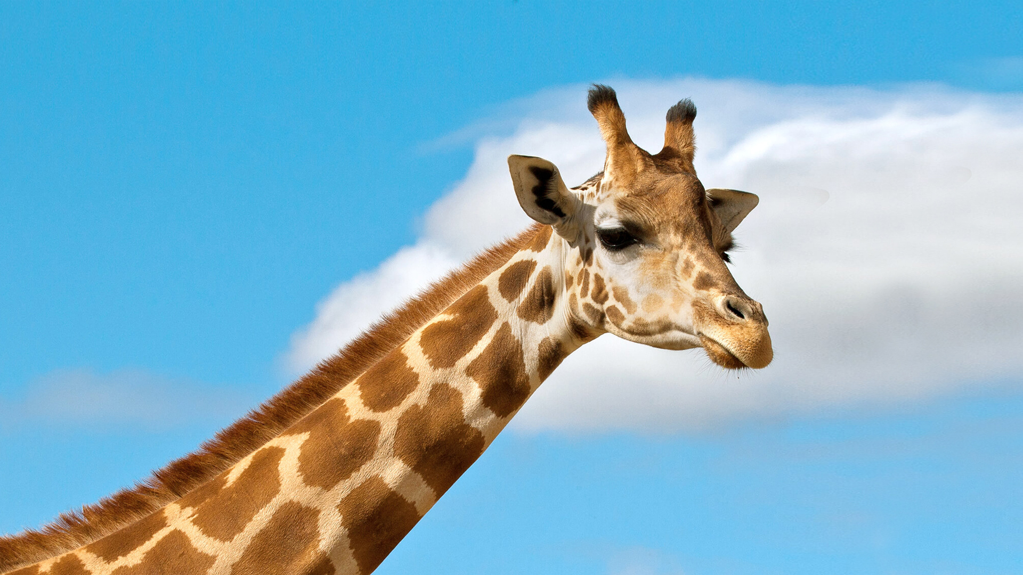
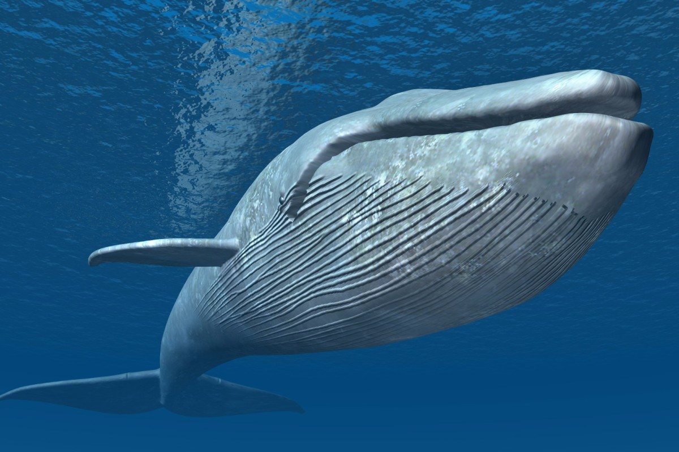
https://www.youtube.com/watch?v=vuYZVrh1iPc
Let Geraldine help you:
Let’s sing:
https://www.youtube.com/watch?v=rGOtW405L1o

Slide 4
Reading
Segment the word
2. Blend the word
3. Say the word

Slide 5
wheel

Slide 6
wheel

Slide 7
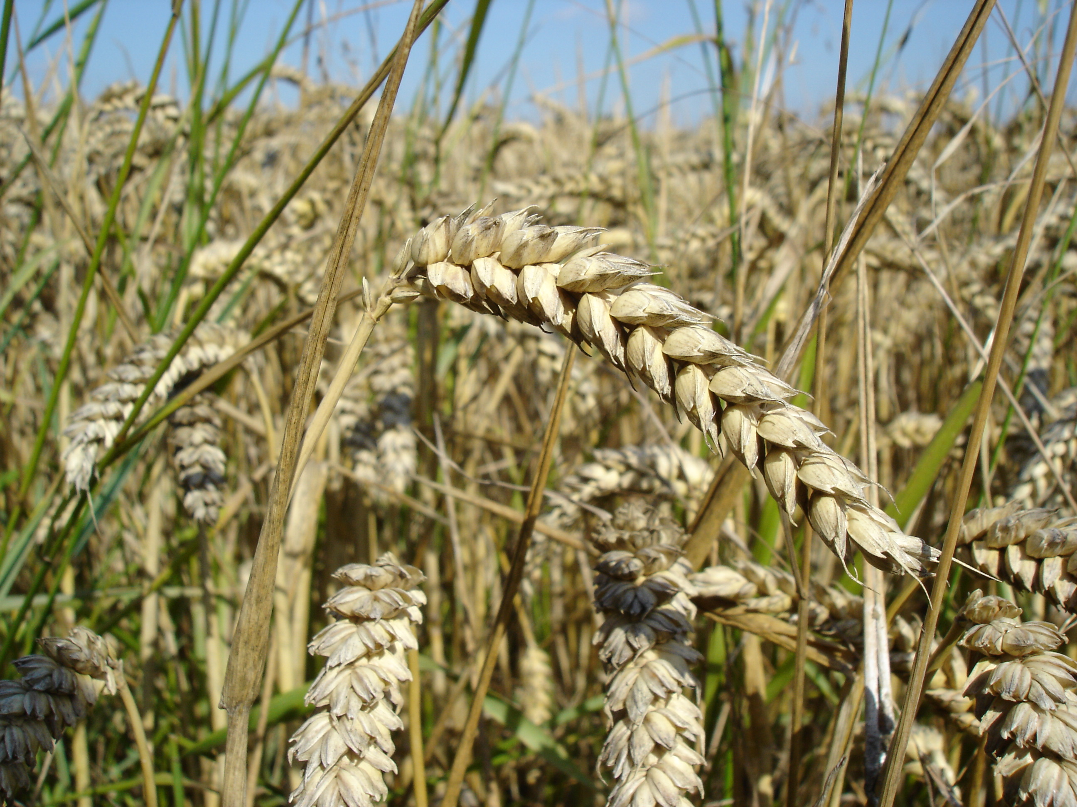
wheat

Slide 8
wheat

Slide 9

when
Notes:
Photo by Ocean Ng on Unsplash

Slide 10
when
Notes:
Photo by Ocean Ng on Unsplash

Slide 11

whemp

Slide 12
whemp

Slide 13
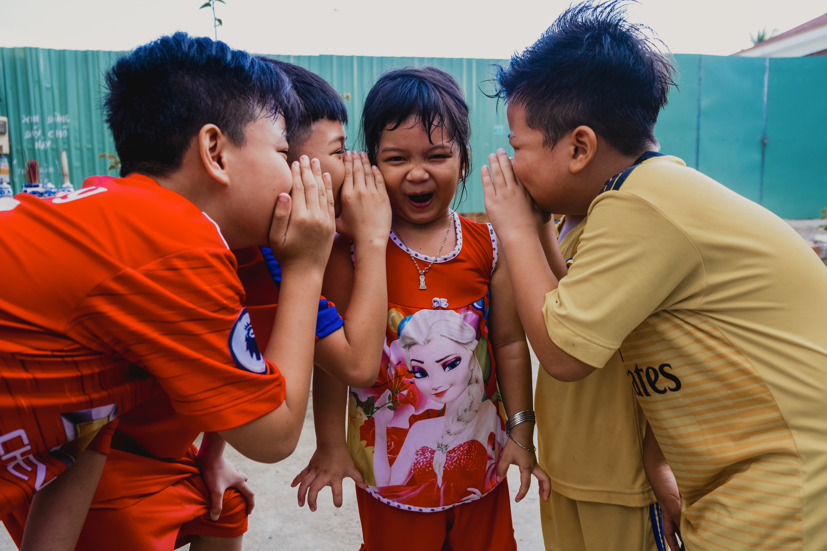
whisper
Notes:
Photo by Nguyễn Phúc on Unsplash

Slide 14
whisper
Notes:
Photo by Nguyễn Phúc on Unsplash

Slide 15

wheem

Slide 16
wheem

Slide 17
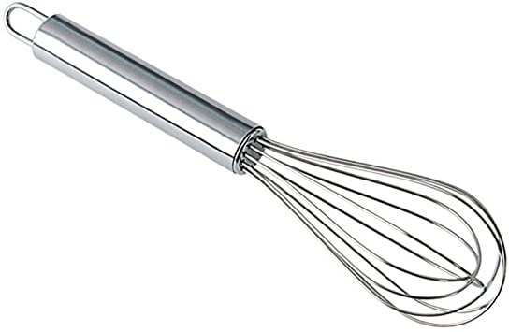
whisk

Slide 18
whisk

Slide 19

whesk

Slide 20
whesk

Slide 21
Spelling
Say the word
2. Segment the word
3. Write the word

Slide 22
Can you spell this word? Add the sound buttons.

Slide 23
wheel

Slide 24
Can you spell this word? Add the sound buttons.

Slide 25
wheat

Slide 26
Can you spell this word? Add the sound buttons.

Slide 27
whisper

Slide 28
Can you spell this word? Add the sound buttons.

Slide 29
Can you spell this word? Add the sound buttons.
whisk

Slide 30
Read this sentence
When will they whisper to me?

Slide 31
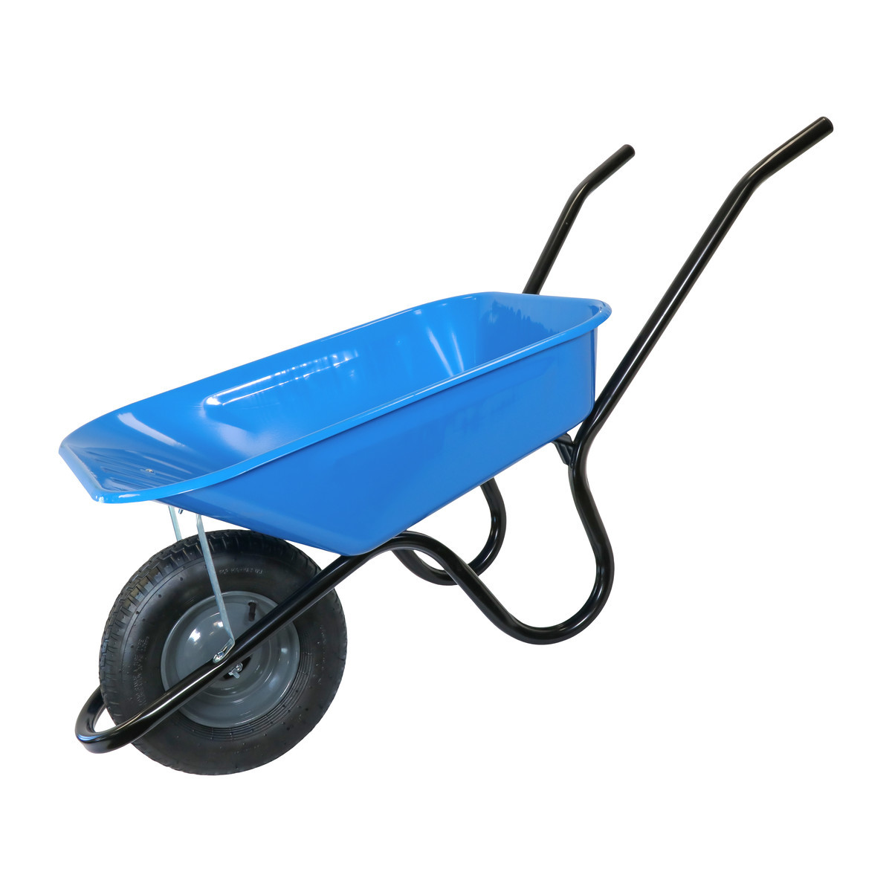
Read this sentence
What is in the wheelbarrow?

Slide 32

Write your own sentence about this picture:

Slide 33


You have learnt the digraph
Have a go at the activities in the folder.
Keep an eye out for it in any of your books, newspapers, magazines, games or signs.
/wh/

