Slide 1
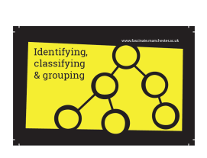
Materials
LC: What is recycling?
LC: Which materials can be recycled?

Slide 2
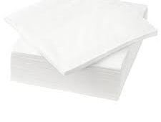
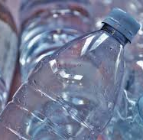
Materials: What have we learnt so far?
Today is our last lesson about materials.
We have learnt about different types of materials and their properties.
We also discovered which materials are natural and which are man-made.
Over the last two lessons we have discovered how plastic and paper are made. What can you remember?
In this lesson we are going to look more closely at recycling materials.

Slide 3
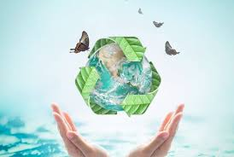
What is recycling and why do it?
Recycling is the process of taking something which is no longer needed and making it into something new.
Recycling is good for us and the environment because it reduces the use of new raw materials to make new products.
It also reduces the energy we use, improves the quality of air and water, and fights climate change.

Slide 4

Recycling our Rubbish!
What should we do with our Rubbish?
Watch this short clip to find out.
https://www.bbc.co.uk/bitesize/clips/z9p9j6f

Slide 5

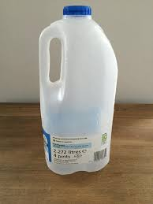
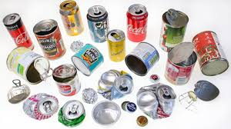
Which materials can we recycle?
Paper and Cardboard - such as newspaper and cardboard boxes.
Plastic – such as yoghurt pots and milk bottles.
Metal – such as cans.
Glass – such as bottles and jars.
Clothes – such as jumpers and trousers.
Garden Waste - such as grass cuttings.
Food – such as apple cores and leftovers.

Slide 6
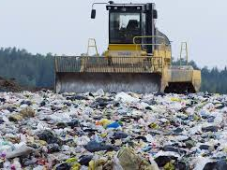
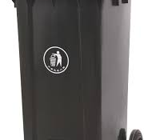
How do we recycle?
In different parts of the country, people might have different rules about where they can recycle.
Most people have a general waste bin at their homes.
This is used for waste which cannot be recycled.
This waste is taken to landfill sites.

Slide 7
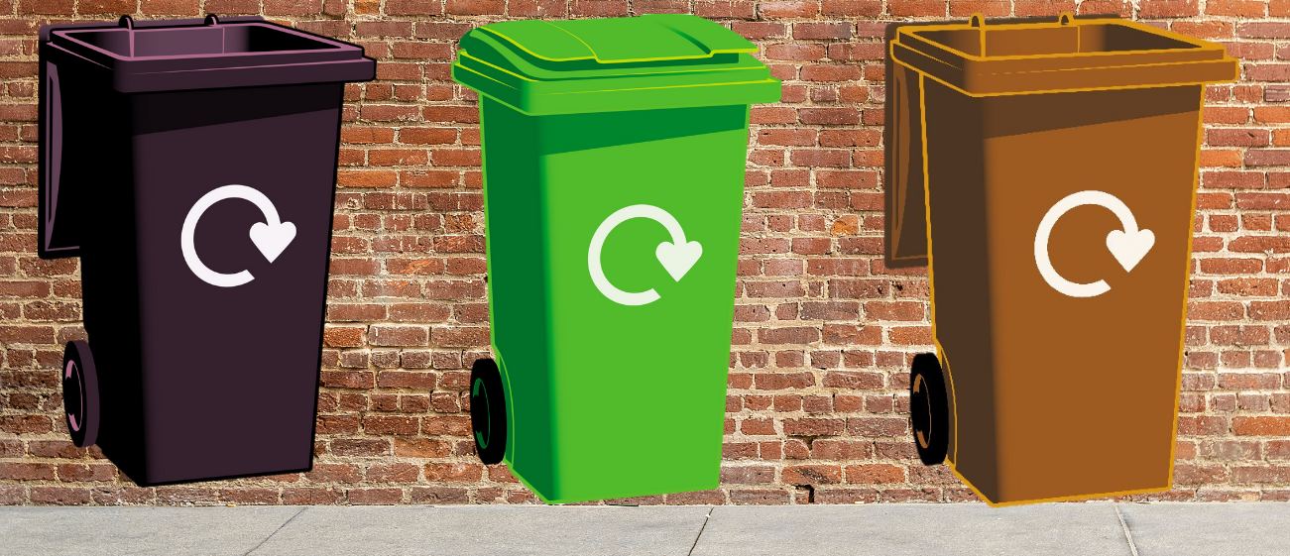
How do we recycle?
Homes are also provided with a bin / different coloured bins (this can vary in different council areas) used for recyclable waste such as plastic, paper and metal tins.
These are collected, emptied and taken by lorry to a recycling plant.

Slide 8
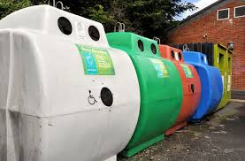
How do we recycle?
Glass bottles and jars can also be recycled.
In some parts of the country, they can be collected from homes, but in other places, like Bramhope, we can take our glass waste to a bottle bank.
People sort the glass according to its colour.

Slide 9
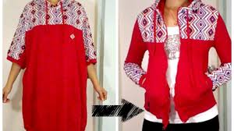
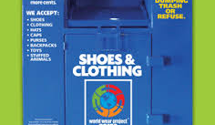
How do we recycle?
Old and unwanted clothes can be recycled.
You could use them to make new items yourself or they can be donated to charity shops.
Charities sometimes deliver bags which can be filled at home and then collected or there are clothing banks which you can take them to.

Slide 10
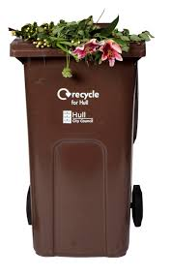
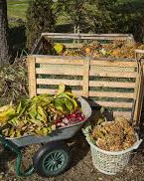
How do we recycle?
Most homes are also provided with a bin to collect garden waste.
However, some gardeners like to keep their garden waste such as grass cuttings to make compost.
The natural materials breakdown and it becomes a fertilizer (plant food) which can then be used to help new plants to grow.
Grass cuttings, leaves, flowers and vegetable scraps can all be composted, as can fruit scraps and peels, leftover table scraps and eggshells, coffee grounds and stale bread.

Slide 11
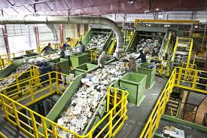
What happens at a recycling plant?
How are the materials sorted?
Watch this clip to find out.
https://www.bbc.co.uk/bitesize/clips/z7x2tfr

Slide 12
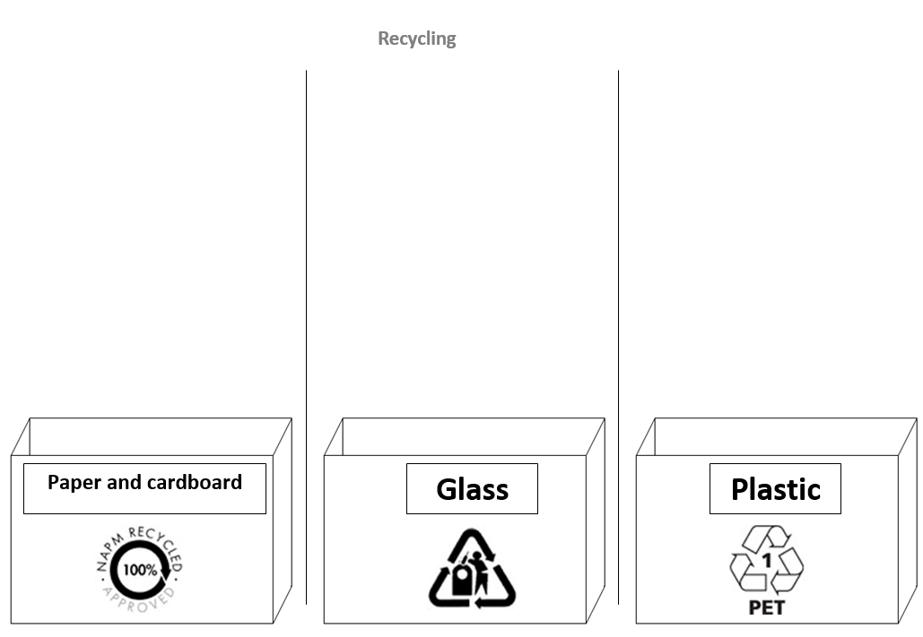
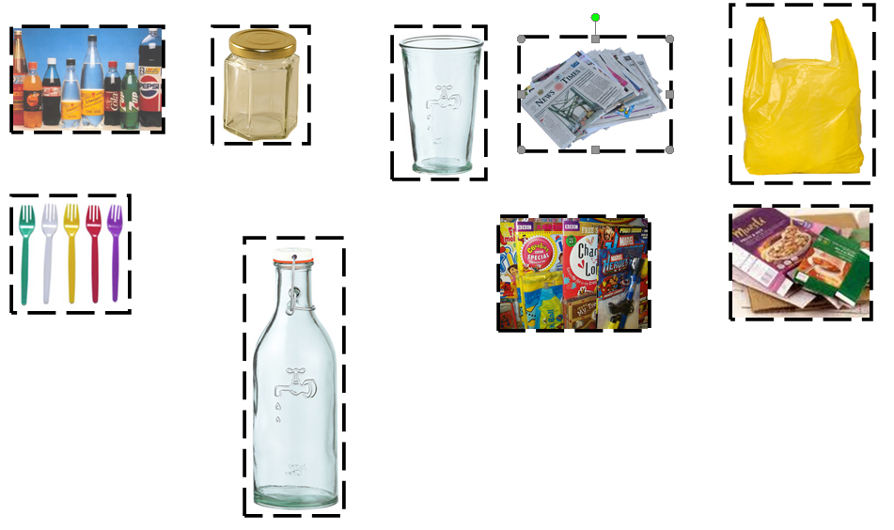
Activity: Can you sort the images for recycling?
Using the worksheet, cut out the pictures and sort them into the correct bin.
Stick them onto the sheet.
Try to add some of your own.

Slide 13
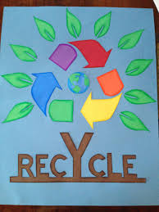
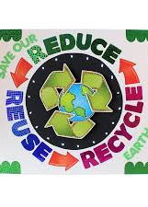
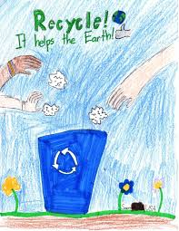
Extension activity: Can you design a poster to persuade people to recycle?

