Slide 1


Slide 3
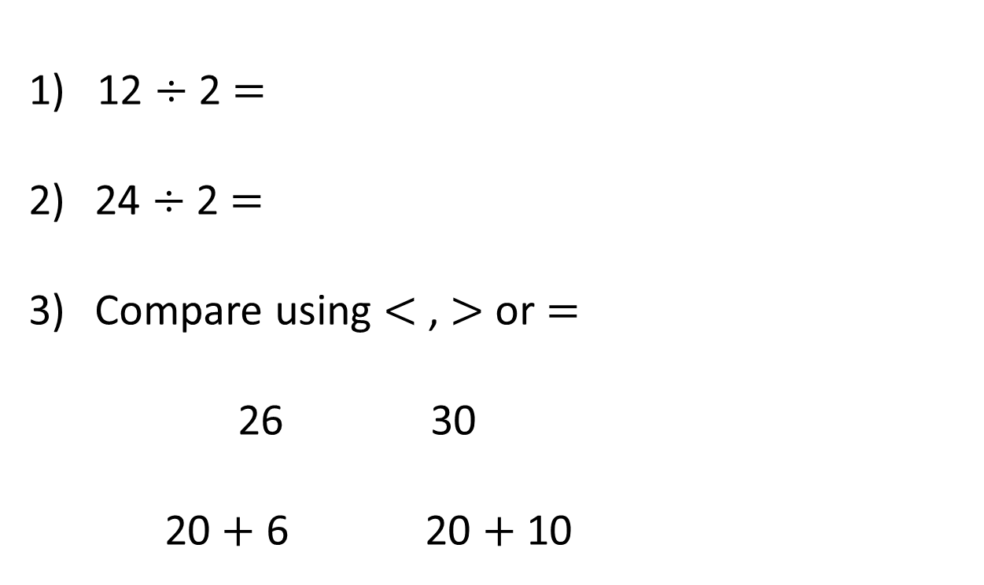
1) 12 $÷$ 2 $=$
24 $÷$ 2 $=$
Compare using $<$ , $>$ or $=$
26 30
20 $+$ 6 20 $+$ 10

Slide 4


1) 12 $÷$ 2 $=$
24 $÷$ 2 $=$
Compare using $<$ , $>$ or $=$
26 30
20 $+$ 6 20 $+$ 10
6
12
$$<$$
$$<$$

Slide 6
Calculate the perimeter of the rectangle.
1 cm
1 cm
24 cm

Slide 7
Calculate the perimeter of the rectangle.
1 cm
1 cm
9 cm
3 cm
3 cm
9 cm
9 cm + 3 cm + 9 cm + 3 cm =
24 cm

Slide 8

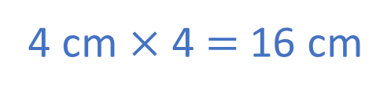
Do I need to count all the squares?
Have a think
1 cm
1 cm
1 cm
1 cm
4 cm
22 cm
4 cm $×$ 4 $=$ 16 cm

Slide 9
Have a go at questions 1 and 2 on the worksheet

Slide 10
Draw shapes with a perimeter of 12 cm.
1 cm
1 cm
width $+$ length $=$ $\frac{1}{2}$of the perimeter of a rectangle

Slide 11
Have a go at the rest of the worksheet

Slide 12
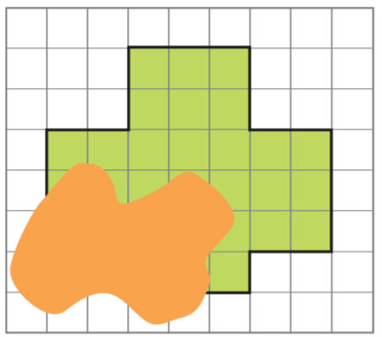
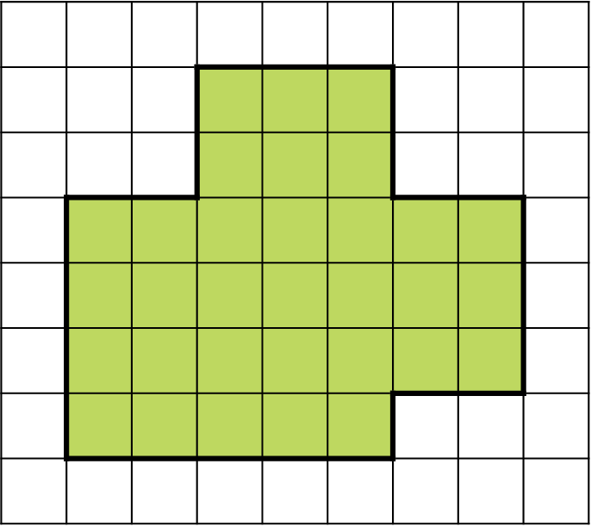
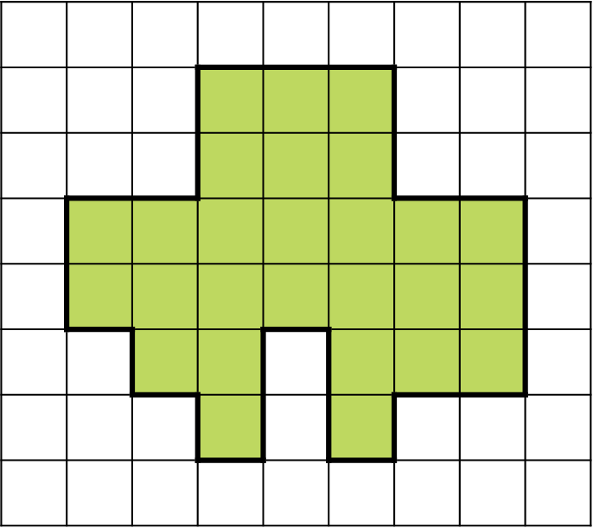


A shape is drawn on a square grid.
Part of the shape is hidden.
What could the perimeter of the shape be?
1 cm
$+$ 6 cm $=$ 26 cm
$+$ 10 cm $=$ 30 cm
20 cm
20 cm

Slide 13
Have another look at question 7

