Slide 1
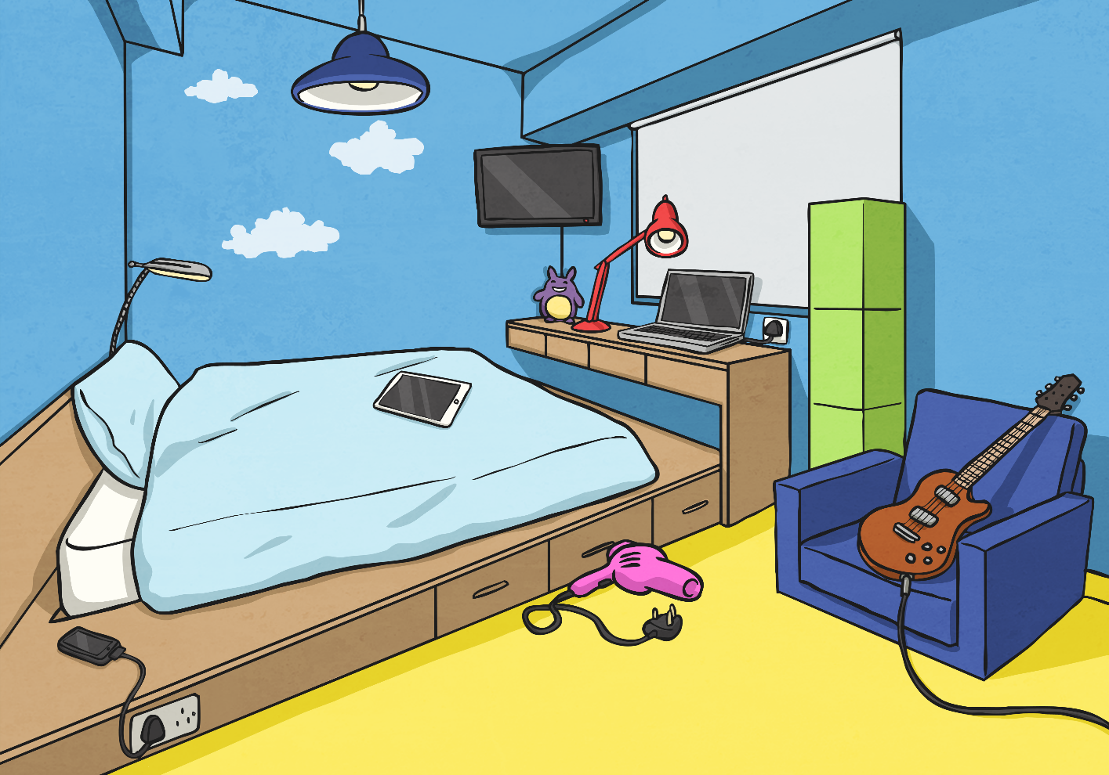
Warm up - Where Is Everything?
Look at this bedroom scene. Use a preposition to explain where things are.

Slide 2
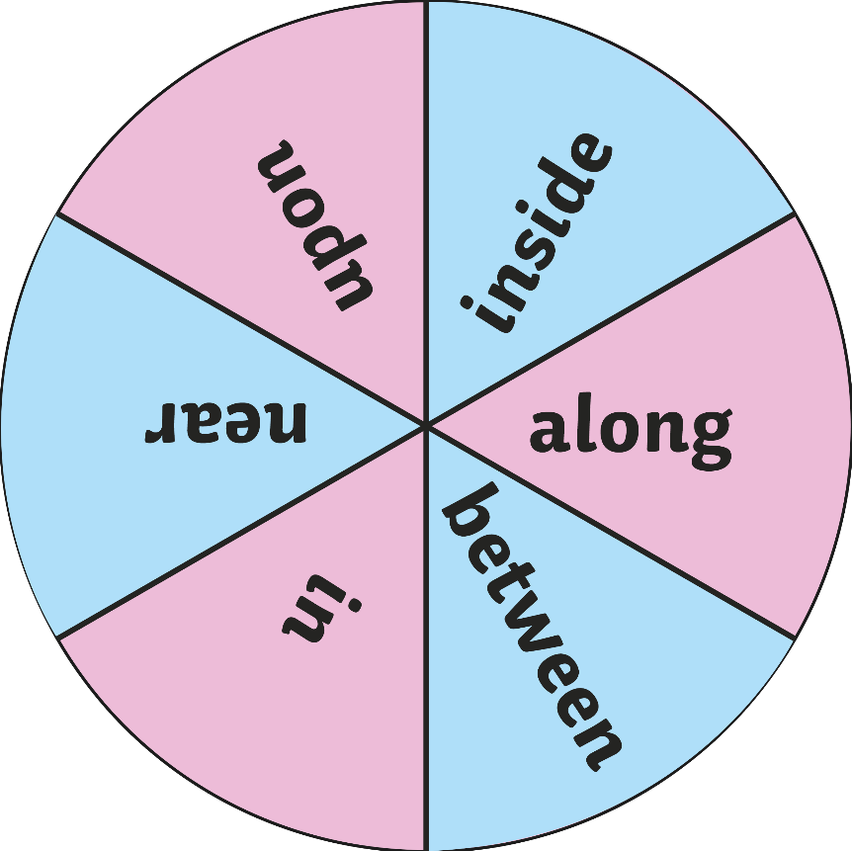

Warm up - Add a Preposition
Spin the spinner to choose a preposition.
Can you come up with a sentence using a preposition?
Spin
Photo courtesy of exmoornp (@flickr.com) - granted under creative commons licence – attribution

Slide 3
LC: Can I use apostrophes to show possession?
Today we are going to look at how we use an apostrophe.
We all know how to use them in a contraction.
E.g. do not becomes don't and should not becomes shouldn't.
Apostrophes also show who something belongs to in a sentence.
Work through the PowerPoint and have a go at the activity sheet. There are two sheets so see how you get on.

Slide 5
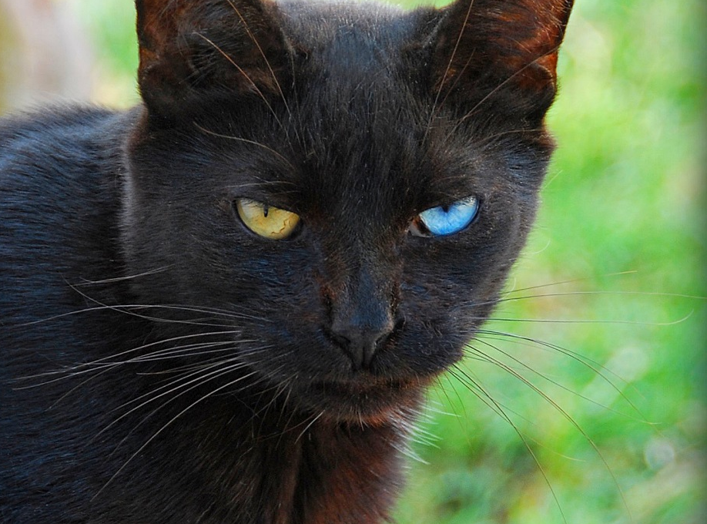
Apostrophes
An apostrophe is the same shape as a comma (,) but placed above the line (‘).
Apostrophes show two things:
That one thing belongs to another.
That some letters of a word have been left out to shorten the word.
In this Presentation, we will explore the first use of apostrophes.

Slide 6

Showing Possession
Apostrophes can be used to show that something belongs to someone or something. This is called possession.
When we are talking about one thing, we call this singular.
For example, a man or a bike.
When we need to say that something belongs to something singular, we put an apostrophe and then an ‘s’ at the end of the name it belongs to.
e.g. the man’s bike.

Slide 7

Showing Possession
We also use an apostrophe and an ‘s’ to show when something belongs to a proper noun (a name that begins with a capital letter).
e.g. India’s national flag has three horizontal stripes on it.
Photo courtesy of Sanyam Bahga (@flickr.com) - granted under creative commons licence - attribution

Slide 8
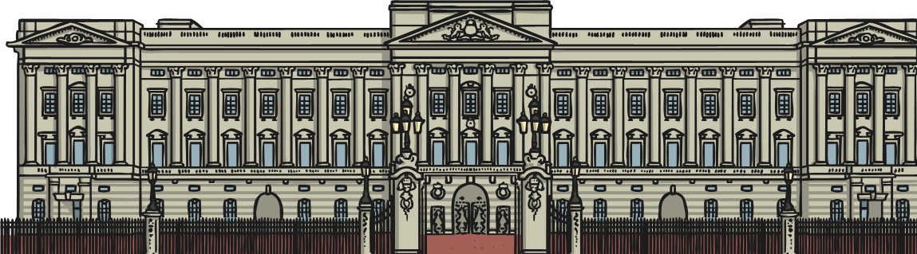
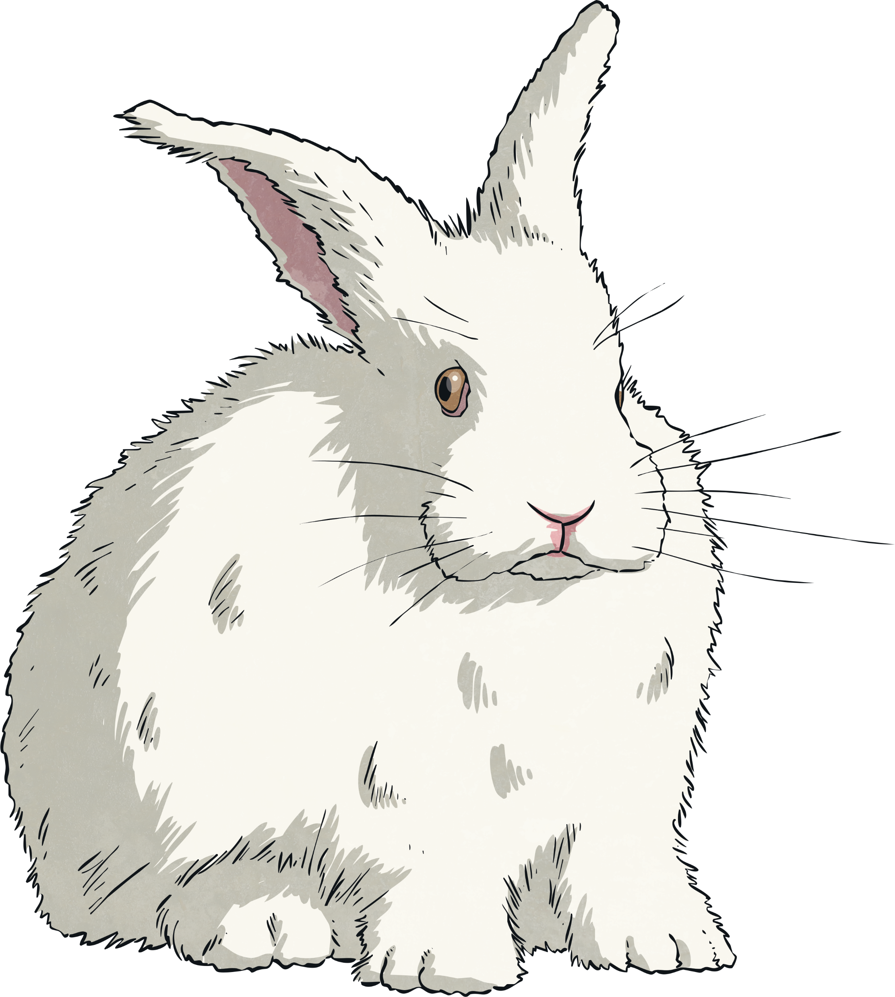
Look Out For…
When you add an apostrophe to a noun, add ‘s to the end of the last word.
e.g. Buckingham Palace’s gates are painted gold and black.
Never use an apostrophe if you have already used a possessive pronoun (his, her, its).
e.g. Dave had a rabbit and its fur was white.
The only time that it’s has an apostrophe is when it is a contraction for ‘it is’ or ‘it has’.

Slide 9

Apostrophes of Possession
The next few slides show examples of how to use apostrophes of possession with singular and proper nouns.

Slide 10
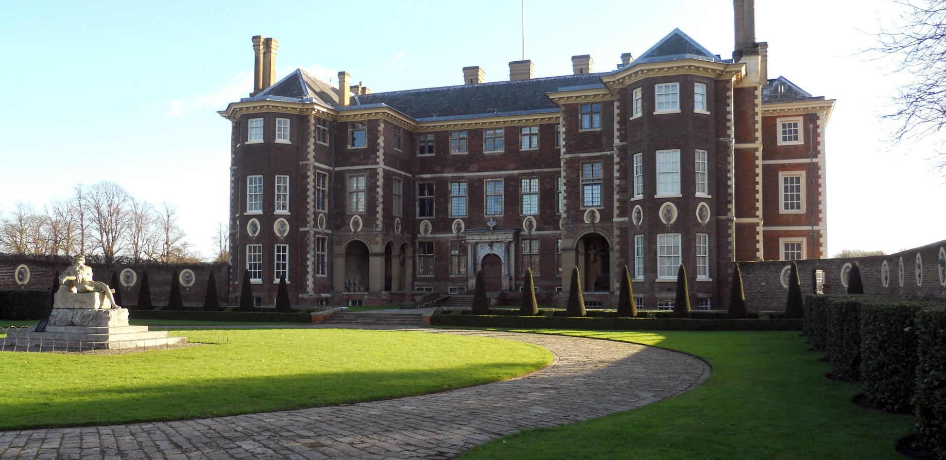
Apostrophes of Possession
Catherine’s house is old and large.

Slide 11

Apostrophes of Possession
The cat’s eyes are different colours.
Photo courtesy of Chris Yarzab (@flickr.com) - granted under creative commons licence - attribution

Slide 12
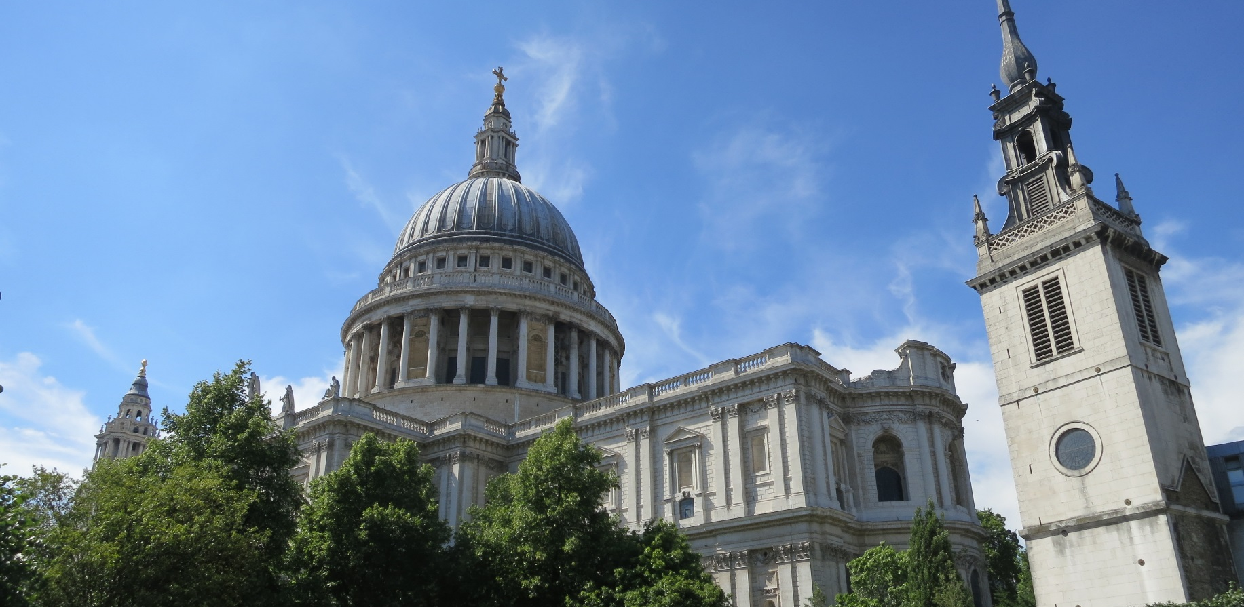
Apostrophes of Possession
St Paul’s Cathedral is in central London.
Photo courtesy of Eric Titcombe (@flickr.com) - granted under creative commons licence - attribution

Slide 13

Apostrophes of Possession
Rachel’s favourite sport is running.
Photo courtesy of Richard Liblanc (@flickr.com) - granted under creative commons licence - attribution

Slide 14
Apostrophes of Possession
The forest’s light is always changing.

Slide 15

Apostrophes of Possession
The Statue of Liberty is probably one of America’s most famous landmarks.

