Slide 1

Survivors
Extraordinary tales from the wild and beyond
Day Twenty-five

Slide 2
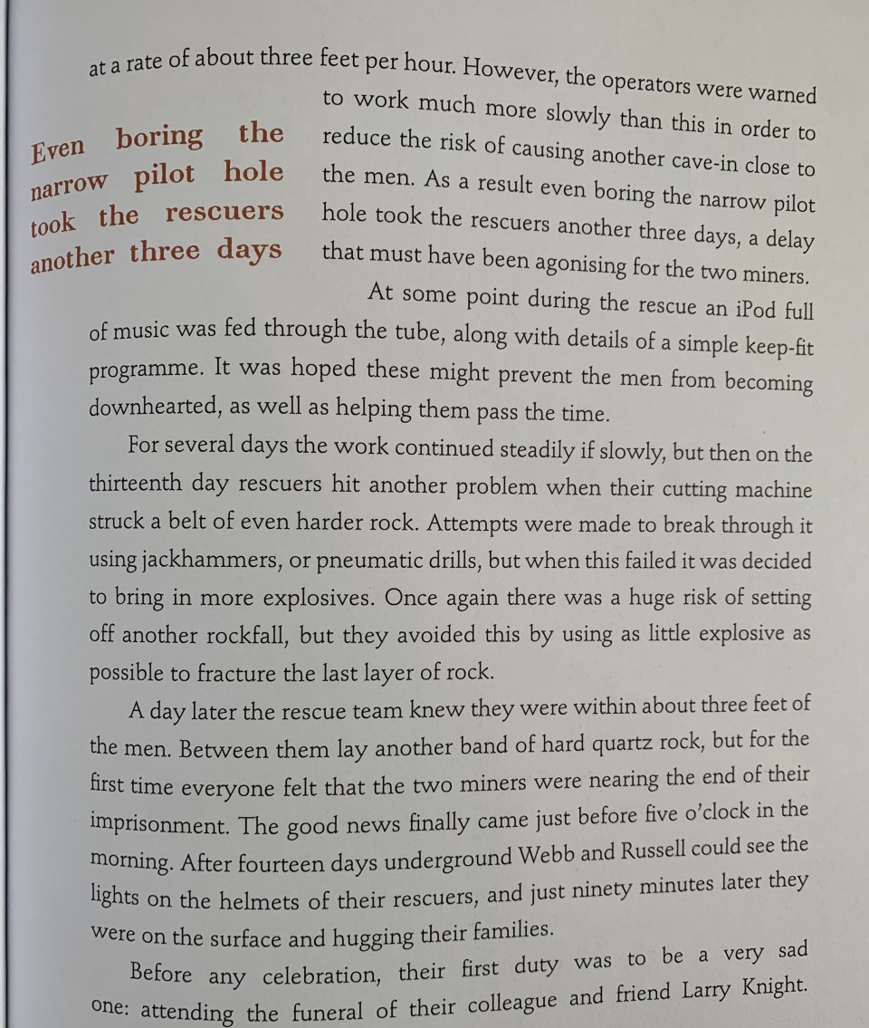
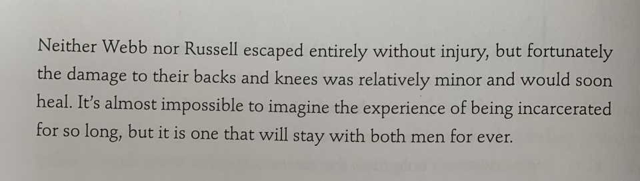

Slide 3
LC: Can I write a news article?
Toolkit
Modal verbs

Slide 4
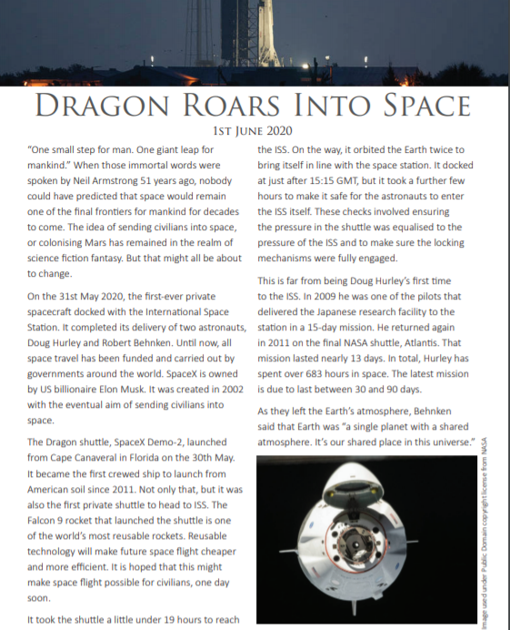
Take note of the final paragraph
It’s called a reorientation.

Slide 5
A reorientation brings the reader up to date with the story and may directly address the reader.
It discusses what is happening now or what might happen next.
It therefore uses present and sometimes future tense. What do you imagine might be included in the reorientation of your own articles?
Think about what is different about the way a reorientation is written in comparison to the rest of the newspaper

Slide 6
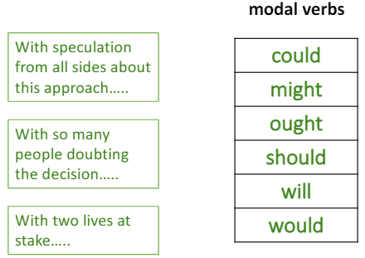
Despite the risk of further rockfall, Frederik Pine and his team are convinced that the use of explosive devices is now the only possible way of reaching Webb and Russell.
This is the first sentence of a reorientation for the Tasmanian mine disaster report. Challenge yourself to write three alternative follow-up sentences using the sentence stems with a modal verb you feel is most appropriate to each.

Slide 7
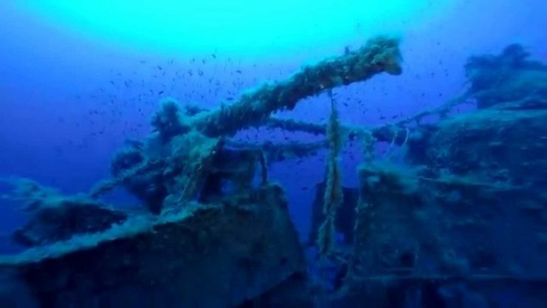
|Task
Your task today will be to write a complete news article for the BBC Newsround website.
It must include
1 Headline.
2 Subhead.
3 Byline.
4 Lead/ Orientation
5 Body or running text.
6 Reorientation.

Slide 8
FAQs
Can I add my own research? Absolutely
Can I type my work? Yes, but you may need an adult to show you how to add brackets.
Can I add photographs to enhance my work? Yes, one or two carefully placed photographs can add to your writing.
Can I do a PowerPoint? No.
Do I need to upload this piece of work? Yes.

