Slide 1
L.C. Can I answer RIC questions about Malamander?

Slide 2
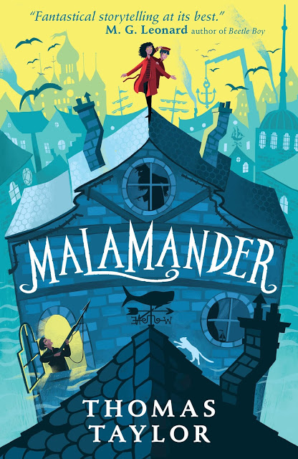
What do you think the book is about?

Slide 3
“SO, DO YOU REALLY THINK you’ve been attacked by the malamander, Mrs F?” I say, settling down on an upturned fishing crate beside her. “Oh, Herbie, I really don’t know,” says Mrs Fossil, wincing as she tries to move her bandaged arm. “I always said I believed in the old stories, but honestly, I was just saying that to amuse people. You know, the tourists we get in the summer? This is our Loch Ness Monster, after all. They come in the shop and ask if I’ve seen anything. So of course I tell them yes – glimpses in the sea mist, that sort of thing. It makes them more inclined to buy something. I never actually took the legend that seriously. But now…”

Slide 4
“What is the malamander legend, exactly?” says Vi. “I mean, the one everyone knows. The one the tourists ask you about.” “Oh, there are lots of different stories about it, going way back,” says Mrs F. “It’s a monstrous creature – half man, half fish, half goodness-knows-what – that has haunted these misty shores since before ever a town was built on Eerie Rock. They say it can sometimes be glimpsed as midwinter approaches, as it searches for somewhere to lay its magical egg.” “Magical egg?” Vi says. “What kind of magical egg?” “Oh, the grants-you-your-dearest-wish kind.” Mrs F chuckles, with a return to her usual cheerful ness. “The whole makes-your-dreams-come-true shebang! But of course, you only get that if you can take the egg. And to take the egg, you have to defeat the malamander.”

Slide 5
“Which no one can do,” I throw in, remembering the first time I heard the tales too. “On account of its hideous spikes and steely scales and it being, you know, a monster.” “So what happens to it then? The egg?” “The creature devours it,” says Mrs Fossil. “As the sun rises the next day, when its mate never comes, it eats up that egg and slinks back into the deep for another year.” “But have people tried to take it?” says Vi, after a thoughtful pause. “I mean, in the stories. Have people tried to steal this amazing wishing egg?” “Oh, endlessly!” Mrs Fossil chuckles again. “Heroes galore in the legends. Every single one of them –” she rolls her eyes and waggles the fingers of her good hand in a way she probably thinks is spooky – “gobbled up by the beastie!”

Slide 6
Violet doesn’t smile. “Anyway,” Mrs Fossil continues, “the tourists love it. Gives them something to look out for when the mists come in and they try a bit of beachcombing for themselves. Everyone loves a good story.” “But you’d never actually seen anything yourself?” Vi asks. “Before yesterday?” “Oh, I wouldn’t go that far. You don’t spend hours on the foreshore in all weathers without having strange experiences. Or hearing strange sounds. Those mists in particular can addle your senses, make close things seem far away and faraway things seem…” “Close enough to nearly bite your hand off?” I say, finishing the sentence for her. Mrs F grimaces, and begins to look exhausted. “I really don’t know what I saw, my dears. And that’s the truth of it.”

Slide 7
Retrieval questions
1. Why does Eerie-on-Sea get a lot of tourists in the summer, according to Mrs Fossil?
2. What is the Loch Ness Monster? How is the legend of the ‘malamander’ similar to that of the Loch Ness Monster?
3. How old is the story of the malamander?
4. What happened to all of the ‘heroes’ in the legends, according to Mrs F?

Slide 8
Inference questions
What can you infer about Mrs Fossil from her name? What kind of character do you think she is? What might she be interested in?
How does Mrs Fossil describe the malamander?
Do you think she is frightened of it? Why or why not?

Slide 9
Choice questions
How does the author, Thomas Taylor, create a dream-like quality in his writing? Why do you think he does this?

